Slide 1
exeter.ac.uk/peersupport

Slide 2
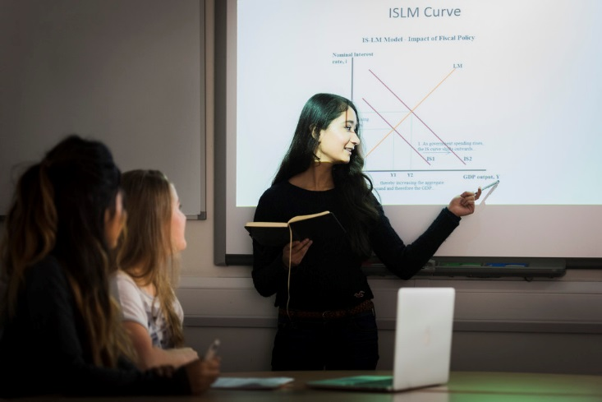
Understand the role of a Peer Mentor and the responsibilities and boundaries
Demonstrate how to handle various scenarios you may encounter when engaging with students
Recognise ways to keep your mentees engaged

Slide 3
What to Expect in the Future
Resources and additional training videos/material on digital platforms
Help on facilitating digital Peer Mentoring
Regular emails from the team with updates and support
Notes:
TA

Slide 4
Training Support Text
The peer mentor training indicates pages of the Student's Guide to Peer Mentoring text for mentors to read through in support of their activities as a mentor.
There will also be parts of the workflow that will require reference to this text.
Text details: Frith, L. , May, G., Pocklington, A. (2017) The Student's Guide to Peer Mentoring: Get More From Your University Experience. London, Palgrave, Macmillan Education
There will be copies of this text available shortly
Notes:
AP

Slide 5
As Peer Mentor, your role is to:
Support new students with the transition into Higher Education
Help them to settle in and become pro-active, independent members of the university community
What could you do to achieve this?
Text pages 7-17

Slide 6
Regularly scheduling Peer Support sessions
Being prepared for these sessions
Creating a safe and positive atmosphere where your mentees feel comfortable to ask questions and explore different issues
Guiding the discussion of some key issues
Informing mentees of support services they can use
Maintaining confidentiality
Uploading registers at the end of each term
Text pages 7-17

Slide 7
You are not expected to:
Teach your mentees
Give specific advice on assignments
Know all of the answers
Act as a counsellor to your mentees
Text pages 7-17

Slide 8
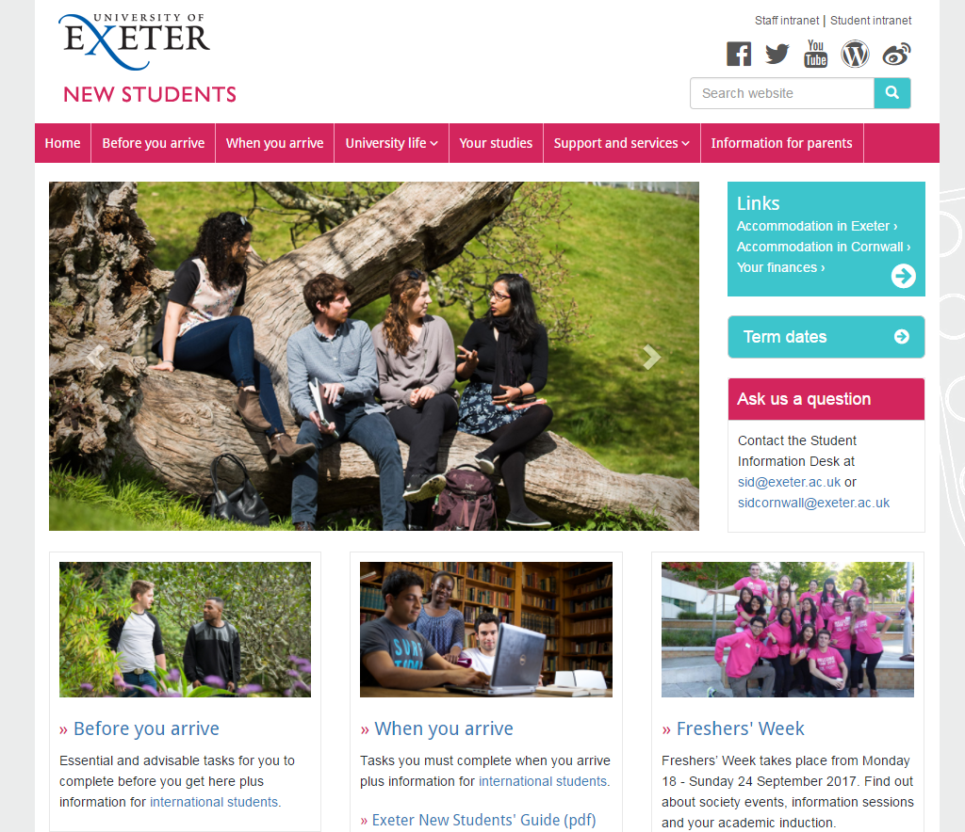
http://www.exeter.ac.uk/newstudents/
Student Services Directory
Student’s Guild Advice Unit
Text pages 60-61
https://www.exeterguild.org/advice/
Notes:
TA
Guild Advice Unit

Slide 9
Building a trusted relationship
Data Protection: You need explicit and informed written consent of the student before you pass on information about them to a third party.
Exceptional Circumstances:
You have good reason to believe that the Mentee (or others) may be at risk of serious harm.
You believe that the mentee has committed (or intends to commit) a serious crime, or you are required to provide information to the police as part of an investigation.
If in doubt, contact your Programme Organiser
Text pages 17, 38-39
Notes:
AP
What if scenario – potential new slide

Slide 10
In your groups:
Discuss each scenario and agree on 3 things you could do
Use Zoom Breakouts
Write down on post its
Notes:
TA

Slide 11
Notes:
TA

Slide 12
Intended Learning Outcomes (ILOs)
At the end of this session you will…
…be able to understand a certain topic on your course
…know where to go at the University for support
…have developed social connections with peers on your course
Text pages 11-15
Notes:
AP

Slide 13
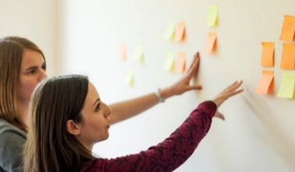
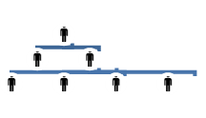
Brainstorming
Think-Pair-Share
Games
Snowballing
Notes:
TA

Slide 14
Allocate time to each part of the session
Anticipate running over
Being flexible & thinking on your feet
Readjust activities / discussion
Prioritise activities / discussion
Notes:
TA

Slide 15
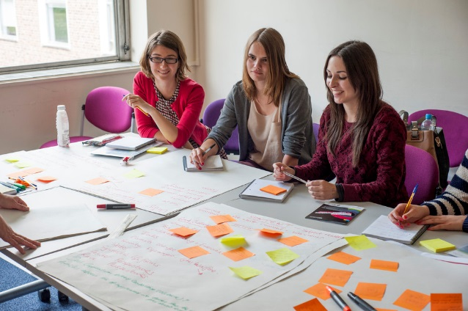
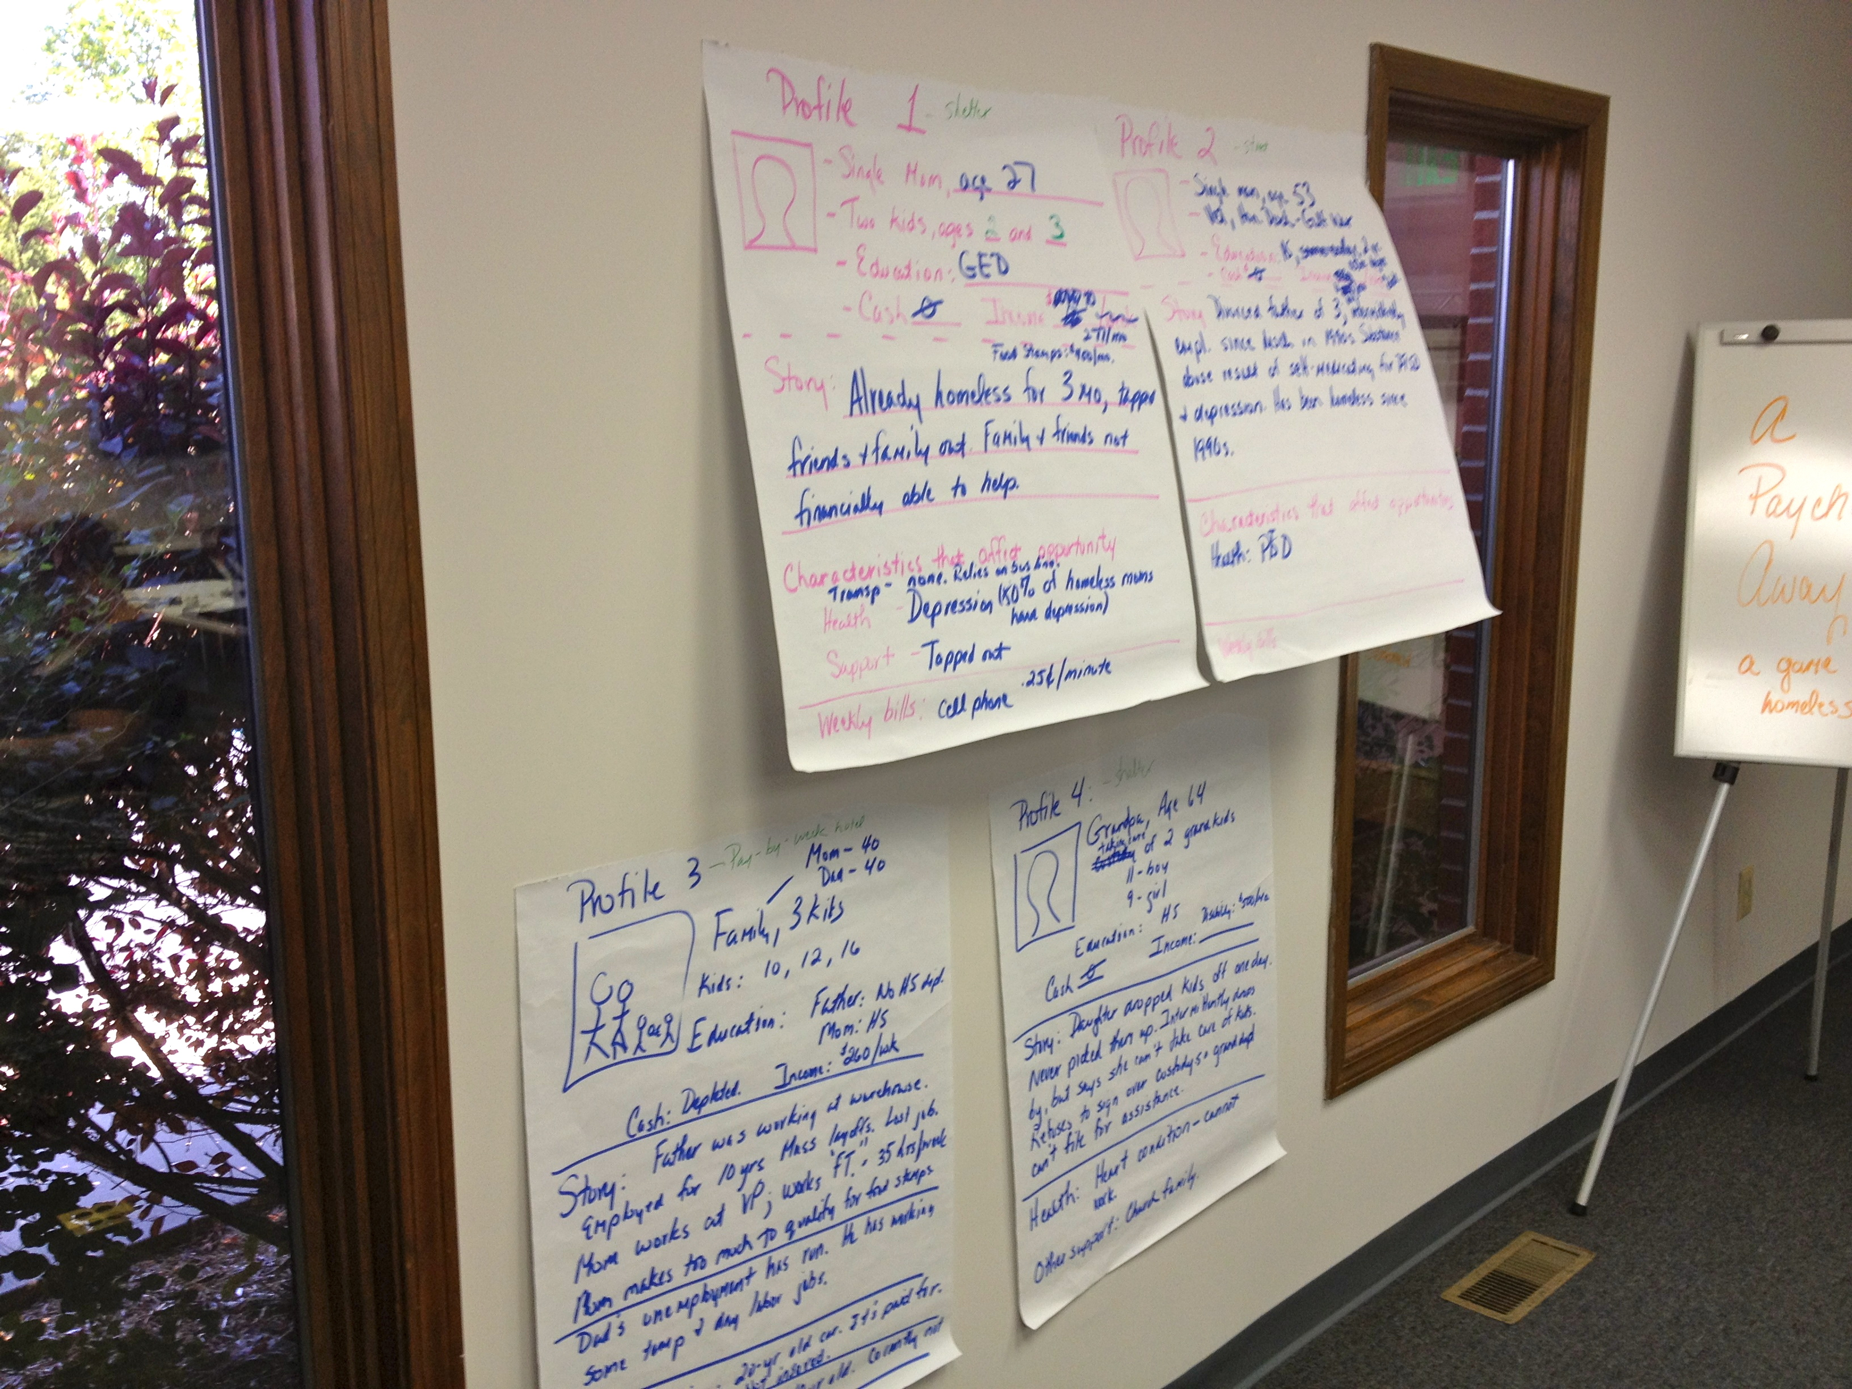
Text page 15
Notes:
TA

Slide 16
“What if I don’t know the answer to a question?!?”
Strategies for responding to questions:
Redirect questions to the group
Turn it into an activity
Direct them to a resource
Strategies for silence:
“What if the room goes silent when I ask a question?!?”
Embrace it – some quiet thinking time is necessary!
Rephrase the question
Turn it into an activity
Text pages 32-34
Notes:
AP

Slide 17
Knowledge transfer
Deepening of understanding is emergent through peer to peer interaction
Enabling knowledge transfer through guided discussion and facilitated activities
Notes:
AP

Slide 18
After the break, you will be:
Planning a future 1 hour Peer Support session
Sharing your plan to the rest of the group
Notes:
TA

Slide 19
Notes:
TA

Slide 20
You choose
What do you want mentees to come away with / be able to do?
Be less worried about settling into Exeter? Identify support services in Exeter?
What activities would help mentees meet your ILO?
Keep it simple: Think-Pair-Share / Brainstorming / Game
Use activities as a base for further guided discussion
Remember the aim of Peer Learning: To get your Mentees communicating with each other to reach an answer for themselves. You facilitate this.
Notes:
AP
Make yellow bigger

Slide 21
Plan your session;
Planning a future 1 hour Peer Support session
Sharing your plan to the rest of the group
45 minutes
PText pages 11-15
Notes:
AP/TA

Slide 22
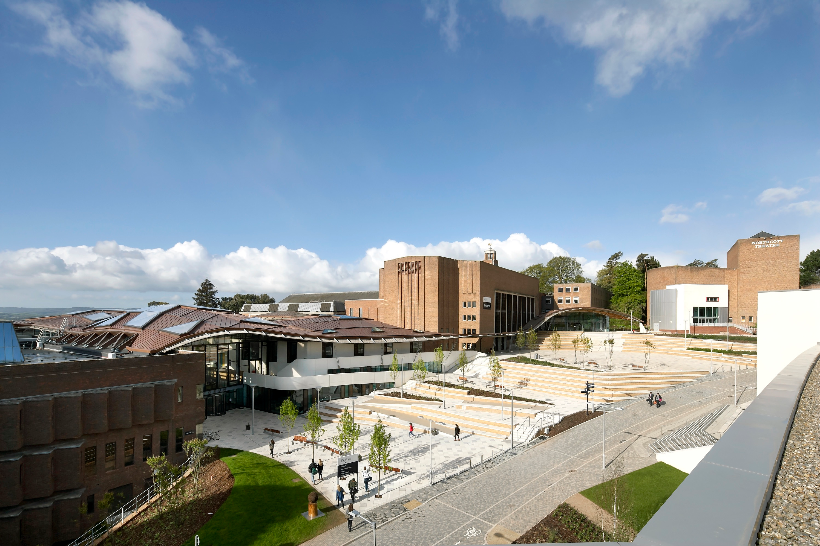
Be pro-active in your communication
=
Better engagement!
Foresee issues that mentees might have throughout term and structure sessions around this
One email at the start of term: “get in touch if you have any issues”
Inviting them to a tour of the library/campus
VS

Slide 23
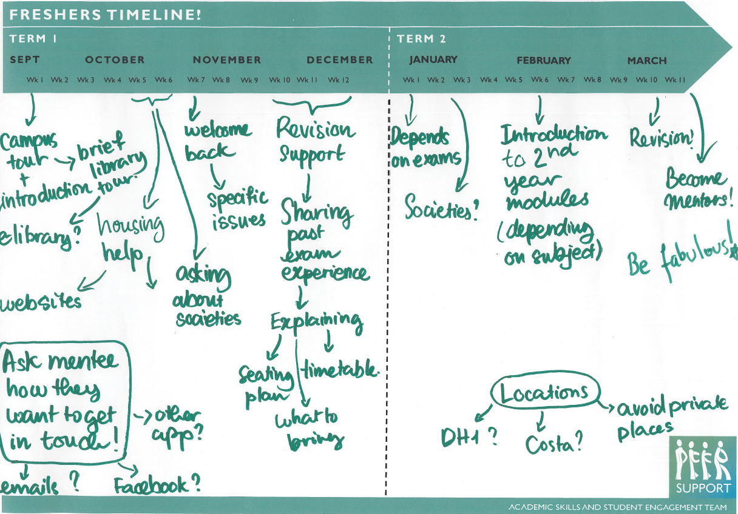
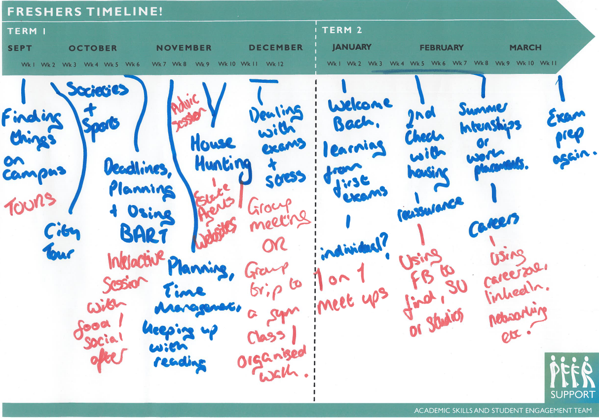
Reflect on your first year at University
At particular times throughout the year…
What were you worried about?
What questions did you have?
What did you need clarity on?
Use this to inform what support and guidance you can proactively give at the most pertinent times

Slide 24
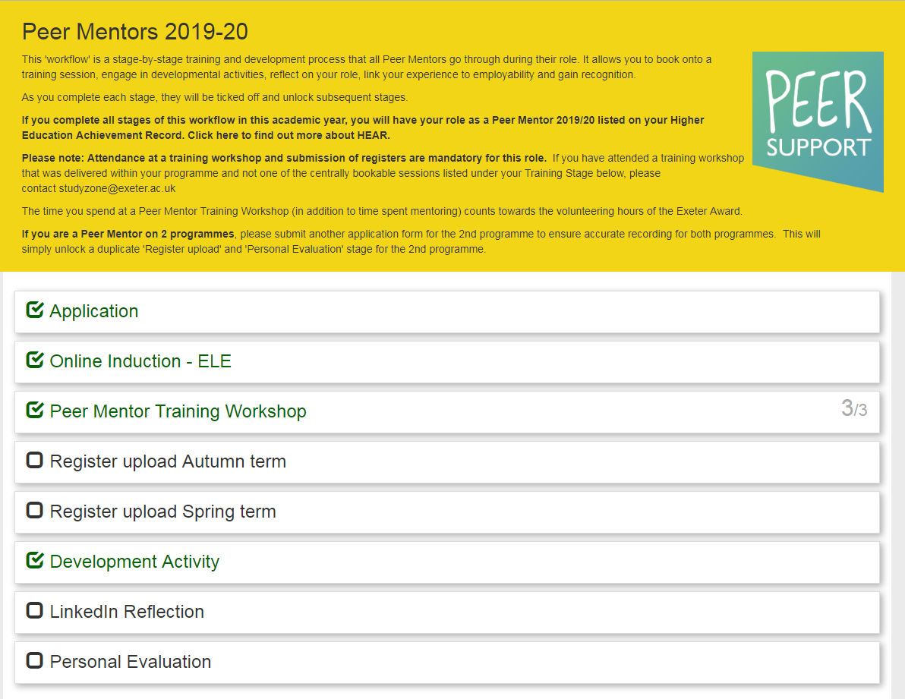

Slide 25
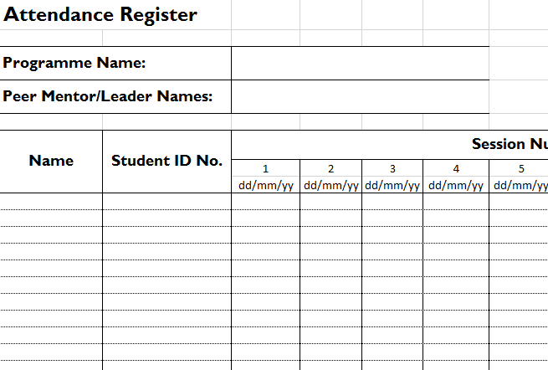

Slide 26
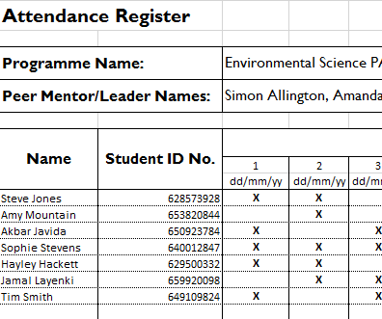

Slide 27
Registers
Evaluation form
exeter.ac.uk/peersupport

