Slide 1



Degree Apprenticeships

Slide 2

What are Degree Apprenticeships?
Degree Apprenticeships offer a cost-effective way of obtaining a bachelor’s or master’s degree whilst gaining valuable work experience.
Combine working with study at university.
You gain a University of Exeter degree
You are a full-time, salaried employee
No tuition fees! You can enjoy a fully-funded university experience, at a Russell Group university.

Slide 3






What programmes are available?
Digital and Technology Solutions (BSc):
Partners include IBM, Renishaw, BT, Rolls Royce, the Met Office and more…
Specialisms including Software Engineering, Cyber Security and Data Analysis
Syllabus is accredited by Tech Partnership Degrees
Civil Engineering (BEng):
Two pathways: consultancy or contracting
Developed in partnership with industry (Laing O’Rourke, EDF Energy)
Working on major infrastructure projects such as Hinkley Point C

Slide 4
What programmes are available?
Financial Services Professional (BSc Applied Finance):
Gain the skills to become a highly competent professional ready to excel in the finance industry
Membership of CISI from the start of the course.
Four qualifications from one programme:
  BSc Applied finance degree
  Chartered Institute of Securities and Investment Diploma in Investment Operations
  Level 6 Apprenticeship
  Level 4 Apprenticeship
Diagnostic Radiographer (BSc):
Extensive workplace learning and practice within your imaging department
Full access to our state-of-the-art, purpose-built facilities including X-ray room, MRI scanner and lab space
Programme approved by the Health and Care Professions Council (HCPC)

Slide 5

How does it work?
You will be a full-time employee, studying towards a University of Exeter degree
Apprentices on degree and masters level apprenticeships can earn up to £22,000 a year.
Delivery models vary between programmes – blended learning, block release, online interaction
Work done as part of your day-to-day role contributes to your degree. Apprentices are required to spend 20% of their total time on ‘off-the-job training. How this is structured will depend on your programme.
Mentors support you throughout the programme – University and employer mentors
Access to the same support as any other University of Exeter student, including the Students’ Guild, library, societies, facilities.

Slide 6
Course Structure
Residentials
Held at the University’s Streatham Campus in Exeter
Brings all apprentices together from across the country.
Residential structure varies by programme:
  Civil engineering: Two weeks block residentials four times a year
  Digital and Technology Solutions: One week residential blocks three times a year, weekly online learning activities
  Applied Finance: One day masterclasses once a month, weekly webinars and online learning activities
  Diagnostic Radiographer: Three to five day block learning, three times per year
During residentials you will meet with fellow apprentices, and spend time with your academic mentor.
E-learning
Include lectures, seminars and online collaborative work
Undertaken through the University’s electronic learning environment.
E-learning supplements and furthers the learning begun during residential and provides academic support for ongoing projects in the workplace.

Slide 7
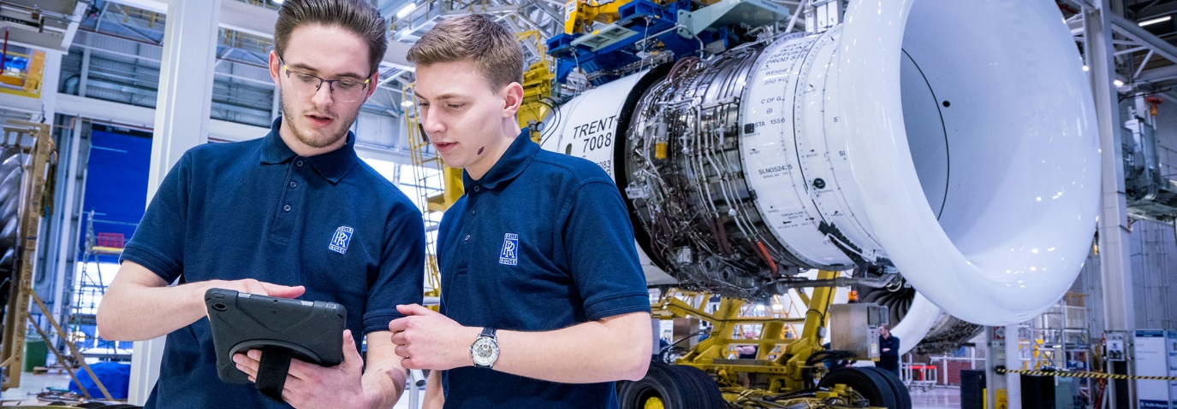
What do Apprentices do?
As an Apprentice you will undertake a wide variety of tasks.
Some employers may rotate your role between departments.
You’ll be working as part of a team
You will have real responsibility giving you hands-on, vocational training every day.
At work you will be supported by your line manager and mentor.
Current apprentices are working on exciting projects such as:
Helping to build Hinkley Point Nuclear Power Station
Supporting international investment portfolios at JPMorgan
Supporting the UK’s weather predication systems at the Met Office
“I've always had a keen interest in technology but also business, and the programme allows me to develop my skills and learn more about how the two fields closely rely on each other. I'm confident that the range of topics covered in the teaching, as well as my placements at work, will set me up for a strong career.”
Harley, Digital and Technology Solutions Degree Apprentice working at Rolls Royce

Slide 8

Student Experience
Degree Apprenticeships are easier programmes for people that cannot get through the ‘usual’ degree.
Regular students get better support.
Lack of a proper University student experience.
You will not have academic mentor support as other students do.
I am not going to learn enough.
It is a tough program! You will have to develop time management skills very quickly. We look for the best students.
Same support as a regular students.
Residential periods on campus and access to the Students Guild.
Academic and employer mentors follow each students from day one.
Earning, learning, experience, no debt!

Slide 9

Student experience
https://youtu.be/DBfCSMfdzDY

Slide 10
Future prospects
As an apprentice you are already a valued member of an organisation.
Businesses invest in developing their apprentices and will likely want to keep their investment once their apprentices complete their studies.
Four to five years of industry experience gained - which is extremely valuable for moving around the sector or developing your own company.

Slide 11
How do I apply?
NOT routed through UCAS – a sixth choice
Applications are led by employers: We signpost to opportunities. Employers recruit at different times throughout the year.
Entry requirements are equivalent to other Exeter programmes (AAA-ABB)
See also:
  Current University of Exeter Degree Apprenticeship vacancies: exeter.ac.uk/degreeapprenticeships/vacancies/
  Find an Apprenticeship service: gov.uk/apply-apprenticeship
  UCAS: careerfinder.ucas.com/jobs/apprenticeship/

Slide 12
Any questions?
exeter.ac.uk/degreeapprenticeships/apprentices/

