Slide 1
A place in the country - the contribution of second homes to North Devon communities Jenny Barnett
Centre for Sport, Leisure and Tourism Research - University of Exeter
Research Showcase Event - June 8th 2011

Slide 2
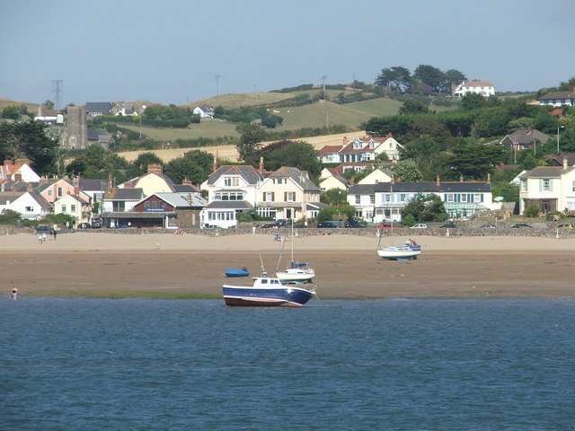
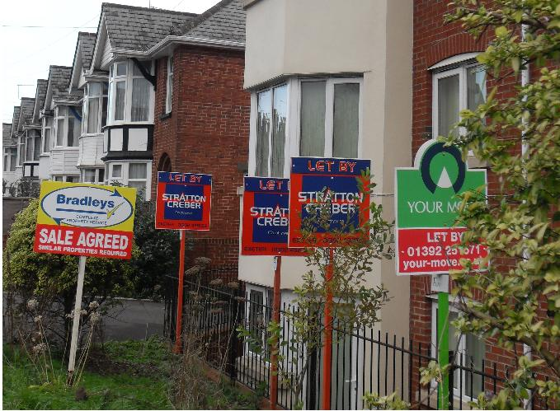
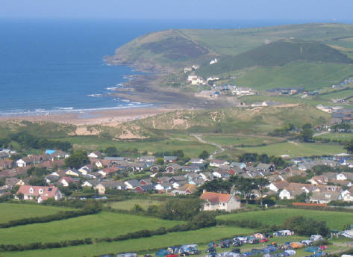
Project Outline and Aim
To examine the value and contribution of second home ownership to communities, framed within UK planning’s statutory sustainable communities agenda.
In collaboration with:
Dr. Mike Kelly, Planning Manager and Andrew Austen, Planning Officer at North Devon Council

Slide 3
Research Objectives
To undertake a secondary review of the relationships between second home ownership, house prices and affordability;
To explore the socio-economic and cultural impact of second home ownership in North Devon communities from community and planning policy perspectives;
To explore community participation: the challenges for communities with high proportions of second homes and for planners efforts to use community participation strategies in delivering the sustainability agenda;
To develop best practice for developing sustainable community strategies in areas where there is a high proportion of second homes.

Slide 4
Percentage of Second Homes

Slide 5
Methodology
Brendon & Countisbury
Initial Questionnaire
Follow Up Questionnaire
Interviews
Georgeham
Instow
Policy Maker Interviews

Slide 6
“Second Homes: Curse or Blessing” (Coppock, 1977)
“Oddly enough I don’t think second homes are the problem. They’re a small part of the problem but the fundamental problem is the lack of affordable supply of housing in a low wage area”
“Properties lost to second homes will have a knock on effect in terms of a) house prices and b) availability”
“A subsidiary problem in amongst this”
“I wonder if North Devon would be better off without tourism at all”
“The area is such a beautiful place to live and to holiday that any available house is being snapped up now by second homes...and because of that they’re over inflating the price of the property and taking it out of the reach of the finances of...the indigenous population”
“They use local pubs, local labour...sometimes more than the locals”
“My feeling is it’s probably not a good thing”
“I have got nothing against responsible second home owners”
Notes:
While a significant correlation has been found between the average house prices of parish’s where over 10 houses were sold in 2010 and the percentage of second homes – based on those registered with the 10% council tax reduction this should read with a warning attached as it is not a strong correlation and is based on a small sample and also fails to take into account other factors that may influence house prices in these areas. However the correlation is still present.
It’s a very emotive subject strongly connected with housing availability and affordability. Statistics provided from the last few years have shown that for every 4 houses added to the housing stock in North Devon one becomes a second home – increasing demand.
Interviews with policy makers so far have provided an entirely mixed reaction from those accepting it as a part of social change, those unable to direct opinion as each household is so different
Oddly enough I don’t think second homes are the problem. They’re a small part of the problem but the fundamental problem is the lack of affordable supply of housing in a low wage area. Second homes don’t help, particularly in some communities particularly when we’re into parish’ like Brendon and Countisbury on Exmoor where you’ve got 30% houses are second homes, Croyde and Georgeham are not as high as that but it’s a high percentage so some communities are on the edge of being unsustainable because of second home ownership. But across North Devon as a whole it’s an element of the problem but probably not a big contributor to the problem therefore on second homes the solution is to be rather more targeted at those communities where it is making communities socially unviable.
About keeping a balance – not everyone’s comfortable with suggesting a threshold but 20% has been put forward and a study in the Lake District suggested 25% marked the point where negative effects were felt in communities
Need to ring fence money locally, a possible tourist tax but also the difficulties in policing such policy.

Slide 7
Thank you – any questions?
Research presented here was conducted during an ESRC Studentship under its Capacity Building Clusters Award (RES-187-24-0002) in partnership with North Devon Council (Mike Kelly and Andrew Austen)
For more information about this project and the work of the Centre for Sport, Leisure and Tourism research, see www.ex.ac.uk/slt/ourresearch/tourismcommunityandsustainabilitysecondhomeownership/
Jenny Barnett jeb228@exeter.ac.uk

