Slide 1
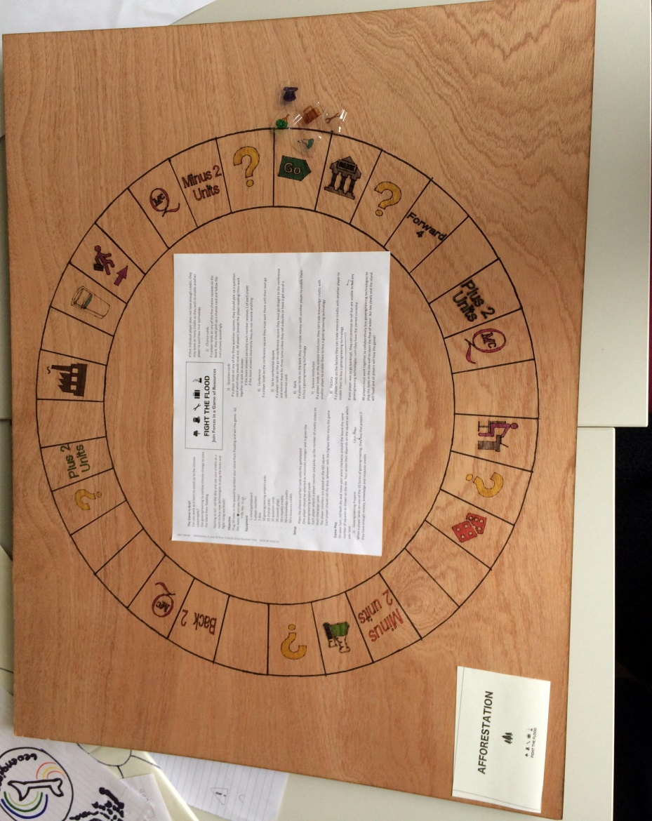

Slide 2
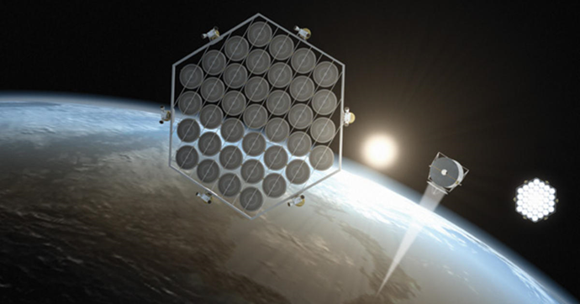
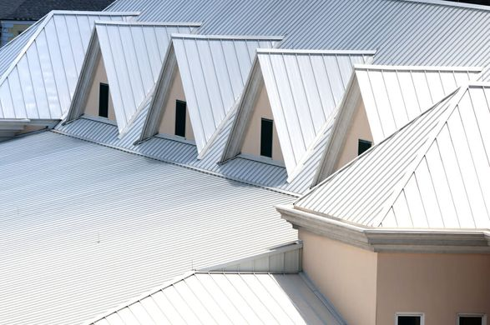
Initial observations
Went in with a vague understanding of geoengineering
Controversial subject
Create something to increase knowledge of geoengineering potential
Notes:
Went in with a vague understanding of geoengineering
Researched
Discovered how controversial it is, despite the fact that people don’t know much about it
Decided to create something to increase people’s knowledge about the potential of geoengineering

Slide 3
Aims of board game
Game set on an island surrounded by slowly melting ice
Players must work together to collaboratively buy geoengineering technologies to plug the holes in the sea wall
Highlight the importance of cooperation between different groups to prevent further temperature increase

Slide 4
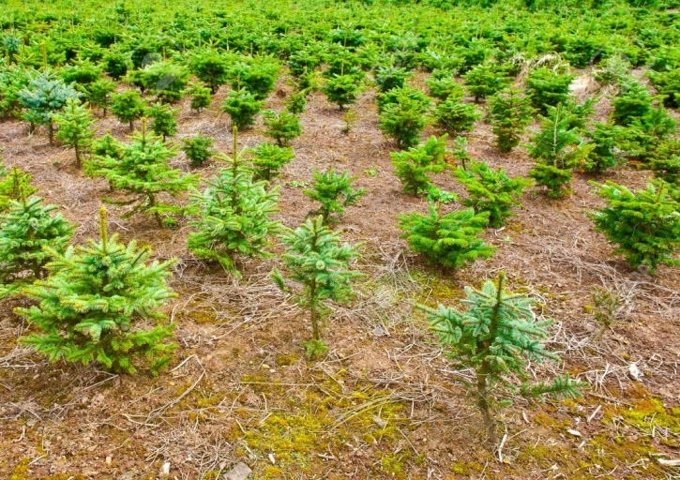
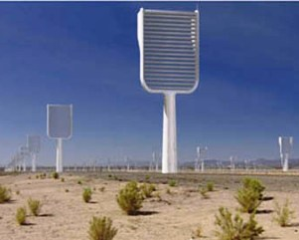
What does it teach?
Space mirrors
Cloud seeding
Artificial trees
Ocean fertiliser
Aerosols
Roof whitening
Carbonate addition
Biochar
Afforesting
Reflective crops
Roof whitening

Slide 5
Importance of cooperation
Need for cooperation to form solutions
Players have different resources that together can utilise geoengineering
Notes:
Need for cooperation to form solutions
Politicians, scientists, activists, corporations and engineers have different resources that together can utilise geoengineering

Slide 6
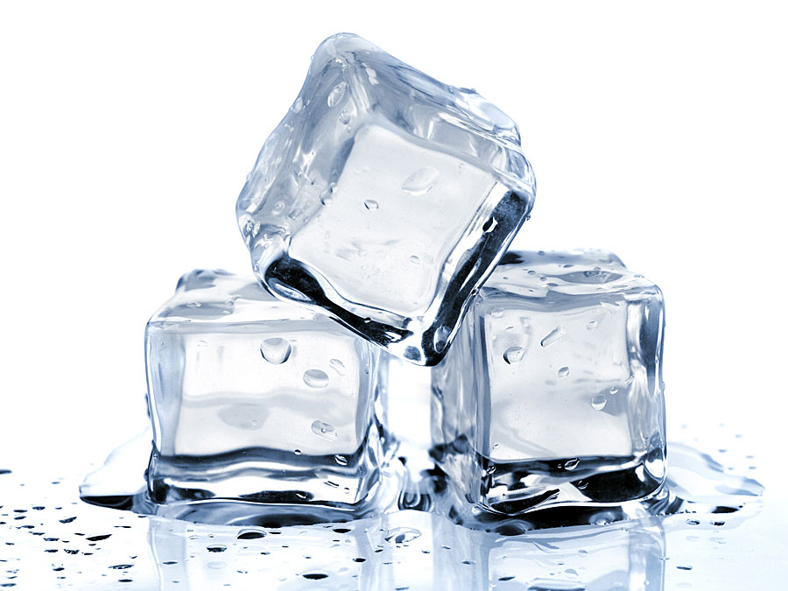
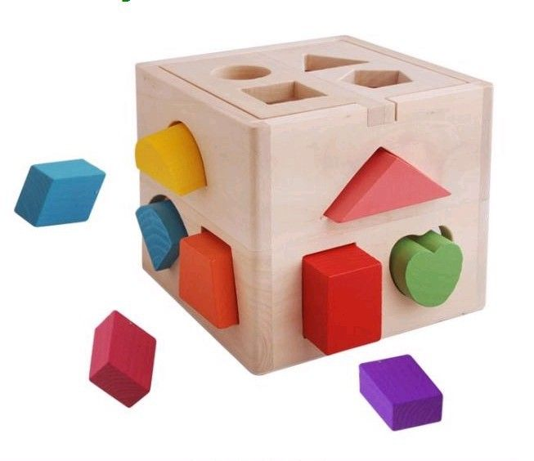
Symbolism of island and melting ice
Climate change is a pressing issue, and we need to find ways to cool the planet quickly

Slide 7
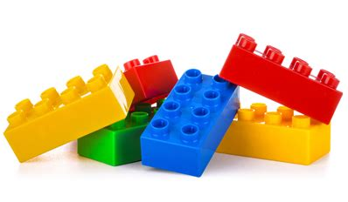
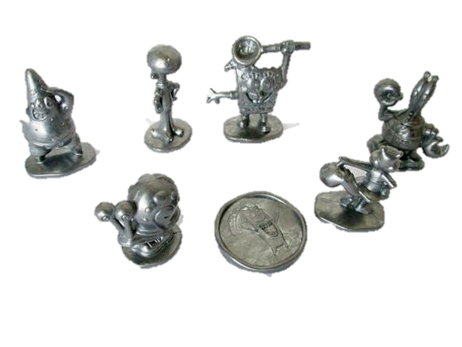
The logistics
Reused ABS plastic – waterproof and tough, so can survive the repeated expansion of the ice
Ice
Metal counters
Cards for game characters, chance cards, question cards, and technologies
Money, resources and knowledge tokens

Slide 8
What did we learn?
A pressing twenty first century problem
Increased understanding of geoengineering whilst producing a product to educate others
Product development
Dynamics of a group project

Slide 9
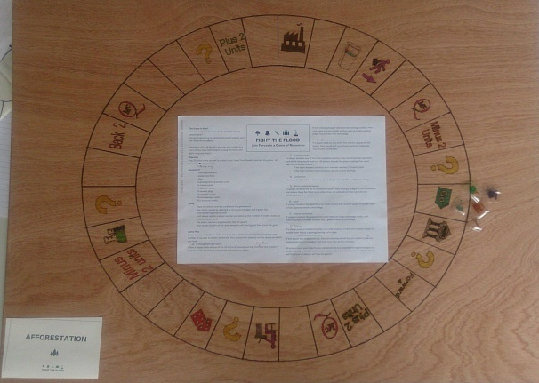
Drawing board
Debate on geoengineering: Solution or Problem?
Problems: unengaging, time constraint
Board game idea
Difficulty in making a simple but informative game
Vote: debate or board game? BOARD GAME
Fun prioritised over depth
problems with using water and ice
BUT cost and efficiency of products proportionally correct
Difficulty fact-checking

