Slide 1
ACT: Debunking Climate Myths
Notes:
Hey guys, we are ACT and this is our presentation to address the challenge of debunking climate myths.:-)

Slide 2
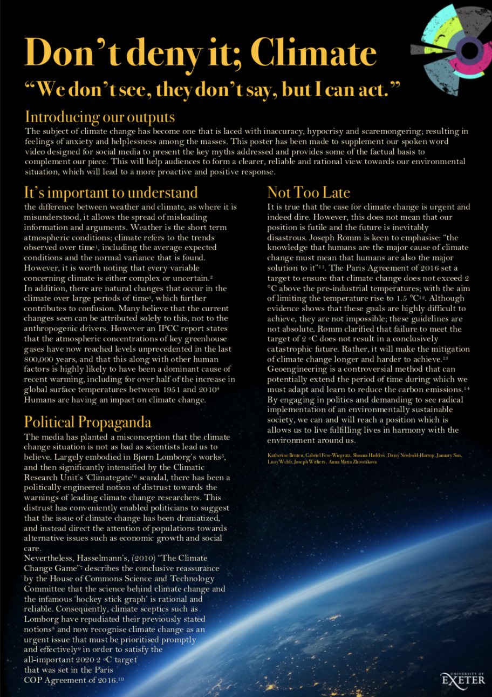
Outputs – WHAT we did
Video for social media;
Complementary informative poster;
PLEASE, STOP.
Notes:
We created a video designed for social media. We chose for the video to be in the format of a spoken word piece, as it has previously been extremely successful across social media platforms and appeal to our target audience.
An additional output we made is an informative poster to which you could refer for certain references that provide background to the video's content and message.

Slide 3
Target Audience
Open-minded, but confused
Potentially apathetic
Notes:
We are aiming to target those who are aware that climate change is an issue, however they may be confused by the media portrayal, which is often lacking in scientific basis, allowing myths to spread. This may lead them to be apathetic, as they do not know how significant an issue it is and the way that it can relate to them, or they may not believe that they have any power to make a difference. We believe that our campaign will be most effective for the 15 to 25 age bracket, as they are most involved in the viral culture on social media.

Slide 4
Aims
Engage
Dispel
Inspire
Notes:
Our motivation for this task was to engage our target audience in the magnitude of the climate change situation, and offering them a more scientific backing for their understanding. It is our hope that the outputs that we have created will leave our audience feeling informed and inspired as to how they can participate in resolving the problems we face and preventing the issues from becoming irreversible.
The poster and video are both designed to act as a starting point that will, we hope, encourage further research into climate change. We want to trigger a dialogue between scientists, politicians and individuals who previously would have been disengaged with the need for action.

Slide 5
VIDEO→

Slide 6
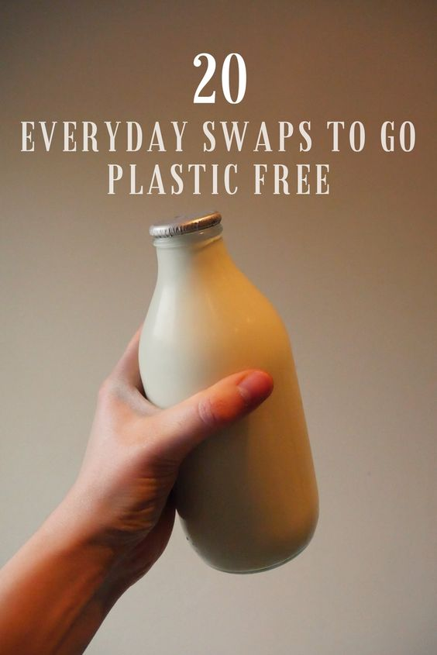
SO...
WHAT NEXT?
&
Educate yourself
Adapt your lifestyle

Slide 7
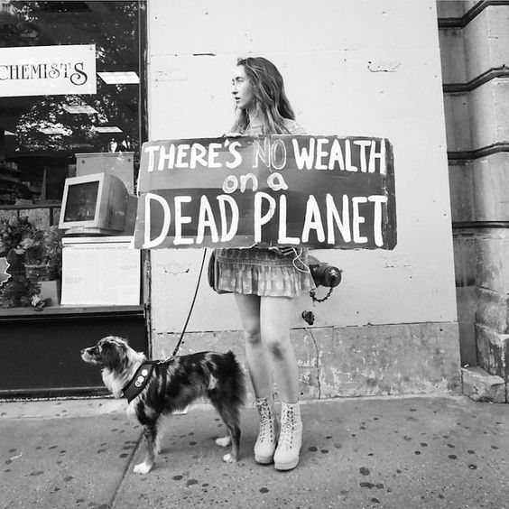
Plastic free, Walk
Shop ethically
Go vegan
Adjust your thermostat
Save energy
Save water
3 R’s
Participate politically
Notes:
Our video aimed to inspire you to take action. As well as reading our poster for some more scientific background, we have come up with some inspirations for ways in which we can all adapt our behavior on a personal and political level to really engage with this campaign. These ideas include:
Going plastic free, especially on single use plastics;
Walking instead of driving;
Shopping ethically;
Adapting our diets to vegan or more plant-based;
Adjusting your thermostat in your home
And to summarise all of this, to
Save energy
Save water
Reduce, reuse, recycle
Participate politically and use your voice

Slide 8
THANK YOU FOR YOUR TIME

