Slide 1
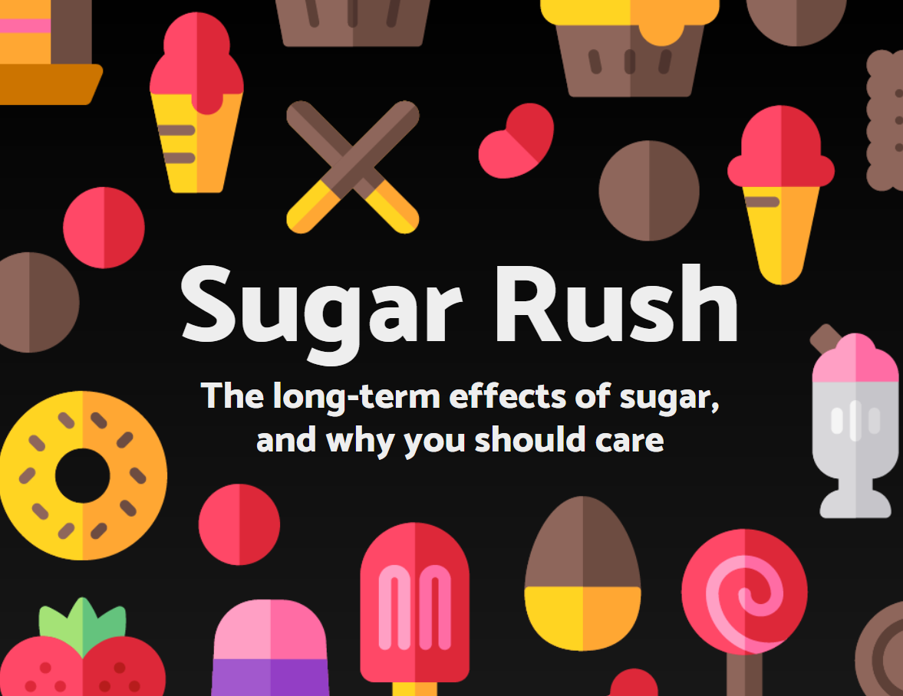

Slide 2
Our Campaign
Do we know how much sugar we’re eating?
How much sugar is there in a Costa blueberry muffin?
The average American eats around 80g of sugar a day (20 teaspoons), which has serious long-term implications. (Daily allowance 30g.)
Blueberry Muffin: 40.8g
Our solution

Slide 4
