Slide 1
The difference between male and female eating behaviour INFLUENCES

Slide 2
The main eating behaviour INFLUENCES are:
Emotions and mood
Social pressure
Body image
Impulses

Slide 3
Previous Research:
Examined sex differences relating to eating habits and nutrient intake.
Findings:
Male students engage in less healthful eating habits when compared with females.
Males are more likely to eat fast-food, but less likely to read food labels, have breakfast and prepare their own food.
Examined roles of gender in students determinants of food choices on a college campus (405 students took part)
Findings:
Gender played a significant role in determinants of students food dislikes. Males were significantly more likely to chose cost, taste, and poor quality over poor nutrition as determinants.
Study 1: Kiefer, Rathmanner, & Kunze (2005)
Study 2: Li, K., Conception, R. Y (2012)
Notes:
These are the two studies that we examined
The first identified the sex differences relating to eating habits and nutrient intake
The second looked at the gender role determinants of food choices

Slide 4
Our Grand Challenge Project:
Based on previous research we focussed on the following 5 eating behaviour influences
Emotions and Mood
Social pressure
Body image
Impulses
Exercise
We wanted to see whether men and women were affected differently by these eating behaviours influences
Objective: To produce a poster that identifies the main eating behaviour influences for both males and females.

Slide 5
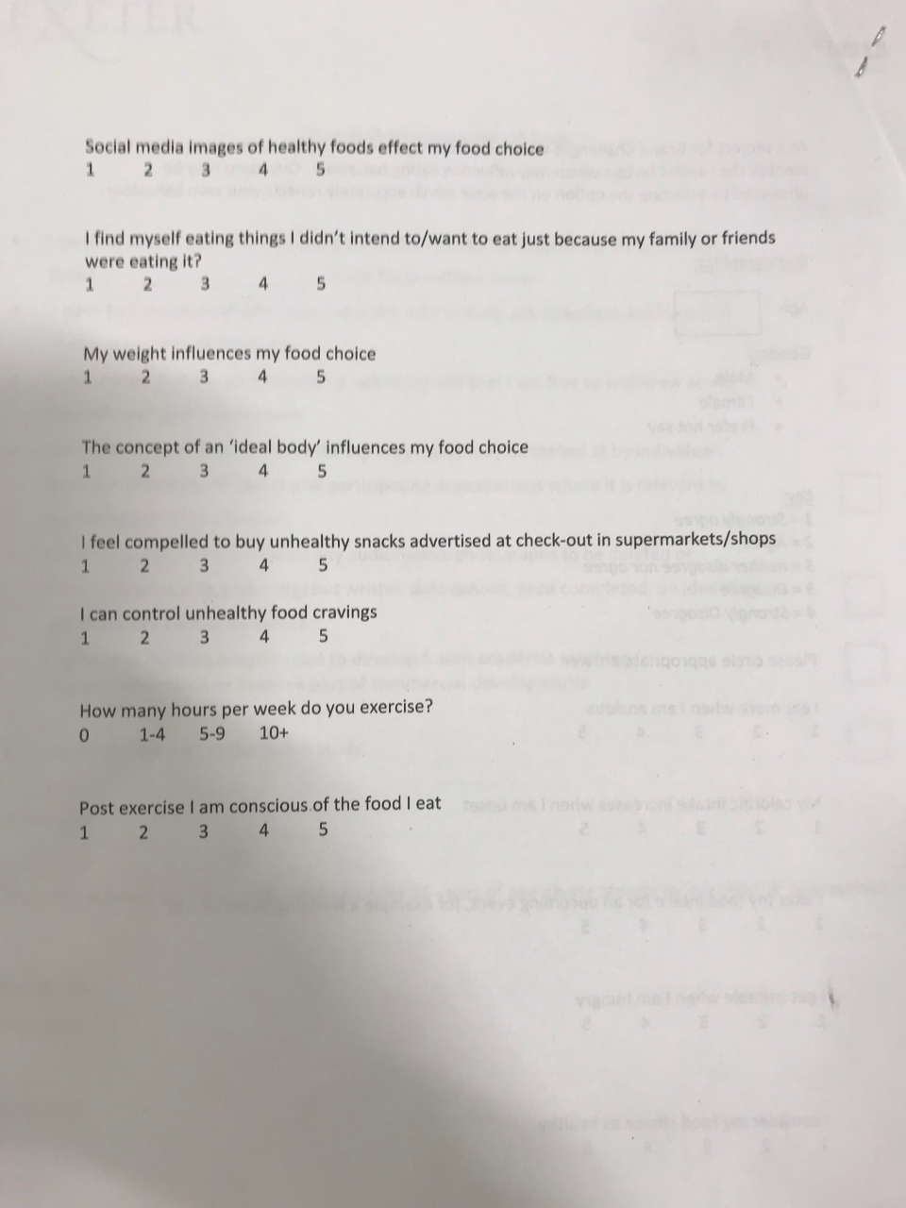
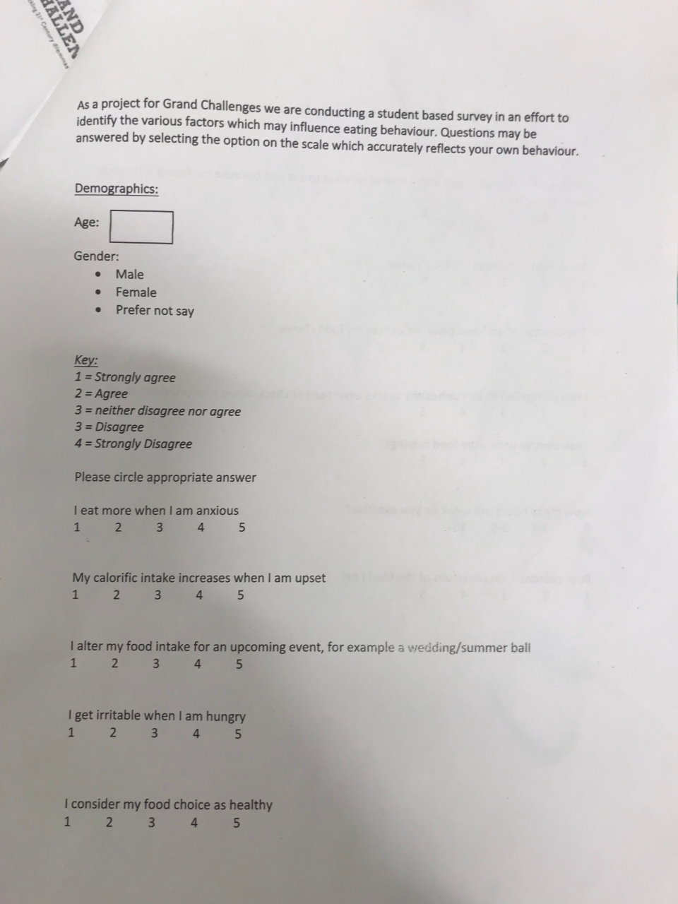
Data Collection:
Survey
Online
Paper based
67 students
Female 35
Male 32
Likert scale:
1-5
Key for Survey:
1 Strongly Agree
2 Agree
3 Neither Agree Nor Disagree
4 Disagree
5 Strongly Disagree
Notes:
*Lower score means food behaviour is more likely to be affected by that environmental pressure*

Slide 6
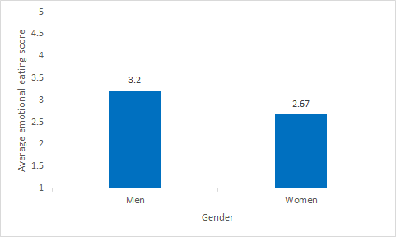
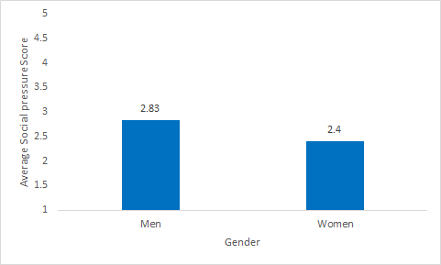
Emotions and Mood
Social Pressure
*Lower score means more likely to be affected*
Notes:
Here are the 5 common influences on eating behaviour that we looked at
Within these here are the gender differences that we found
*Lower score means more likely to be affected*
These two graphs were significant

Slide 7
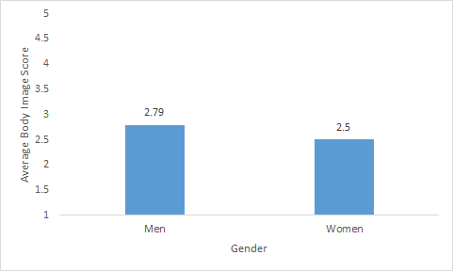
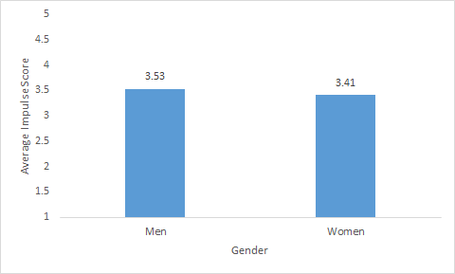
Body Image
Impulses
*Lower score means more likely to be affected*
Notes:
These 3 graphs were not significant
Explanations: Power = too low
True trend?

Slide 8
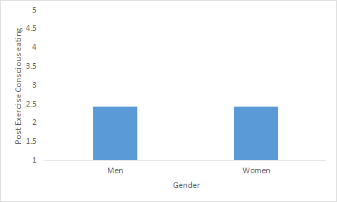
Exercise
*Lower score means more likely to be affected*

Slide 9
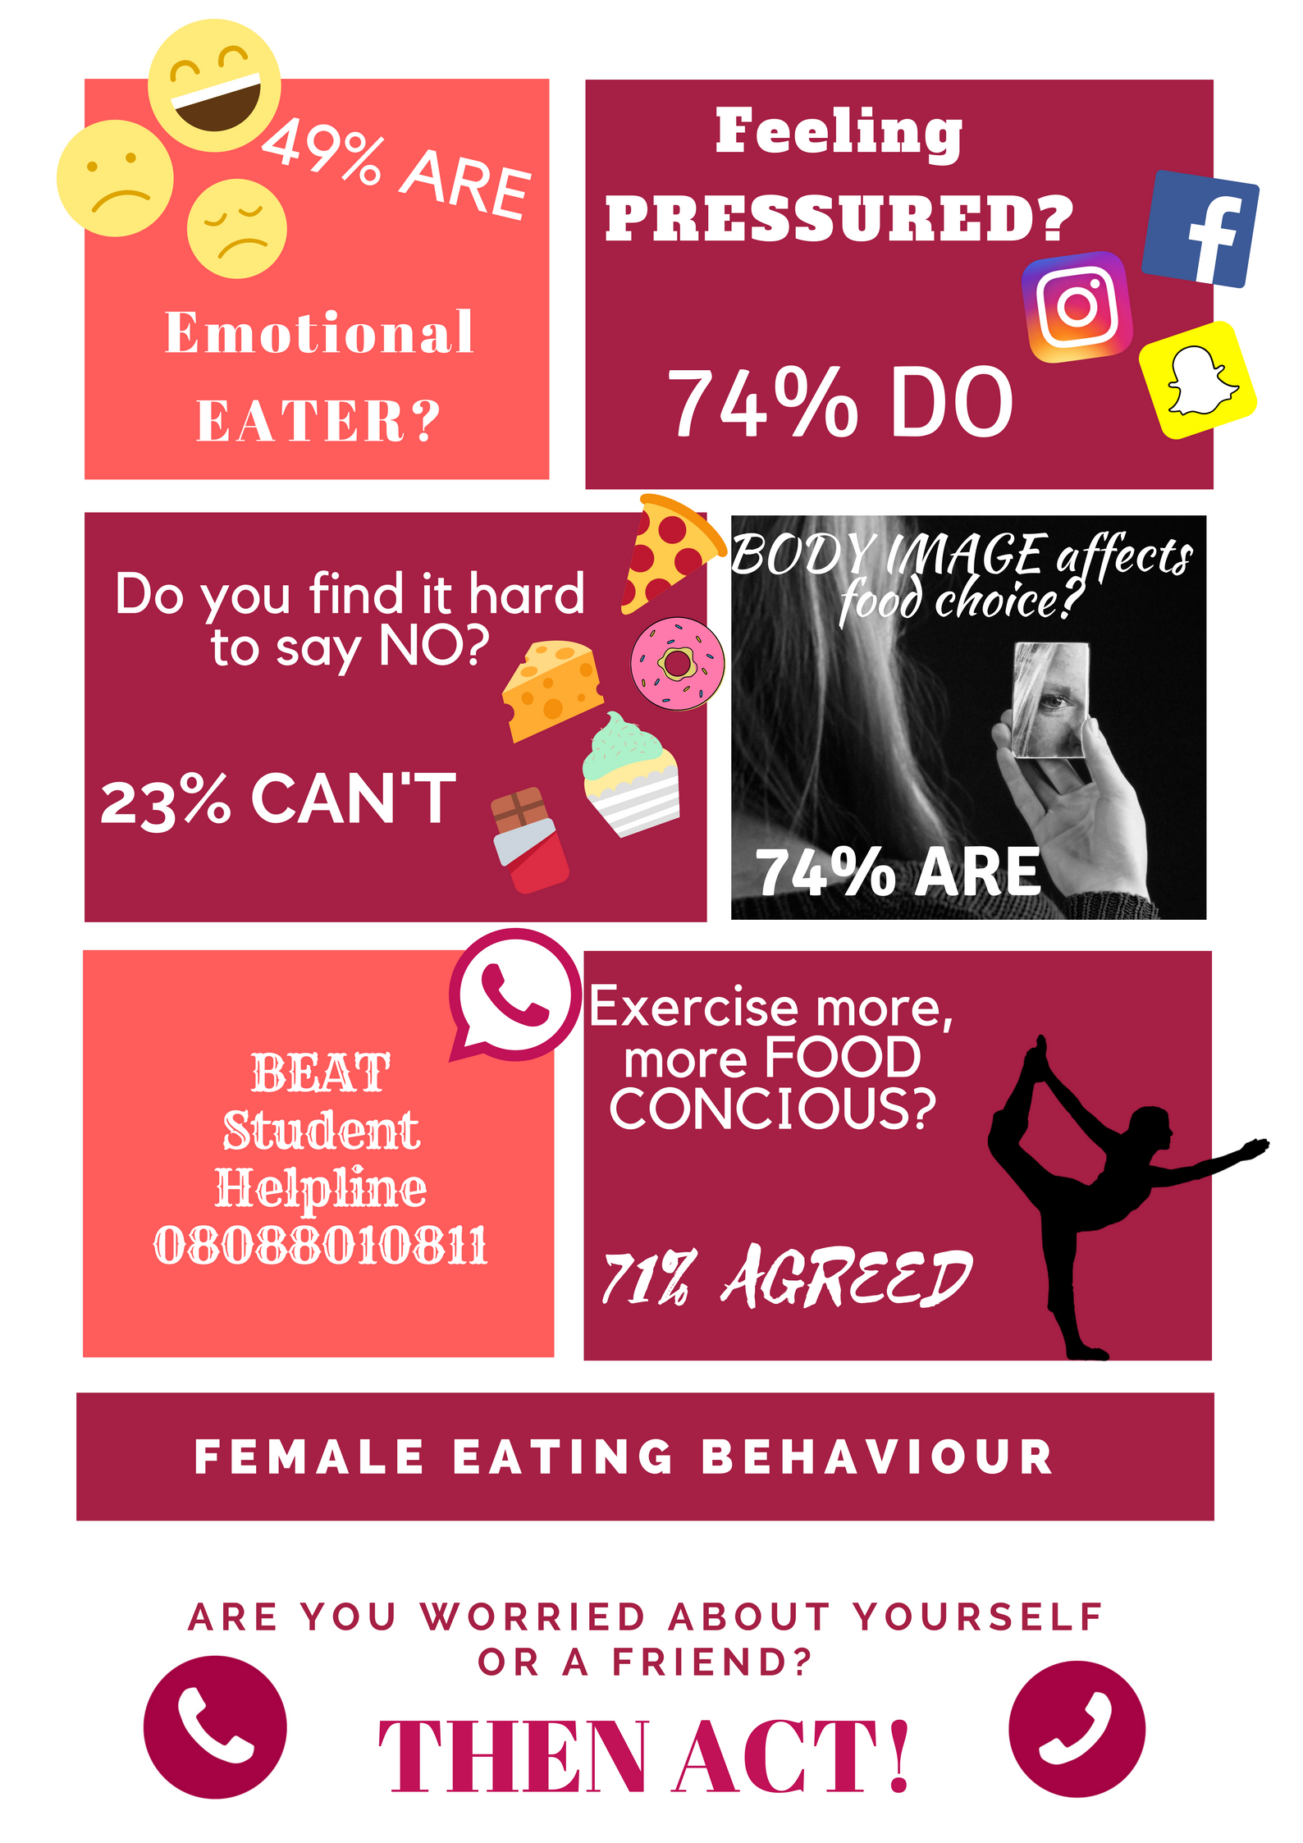
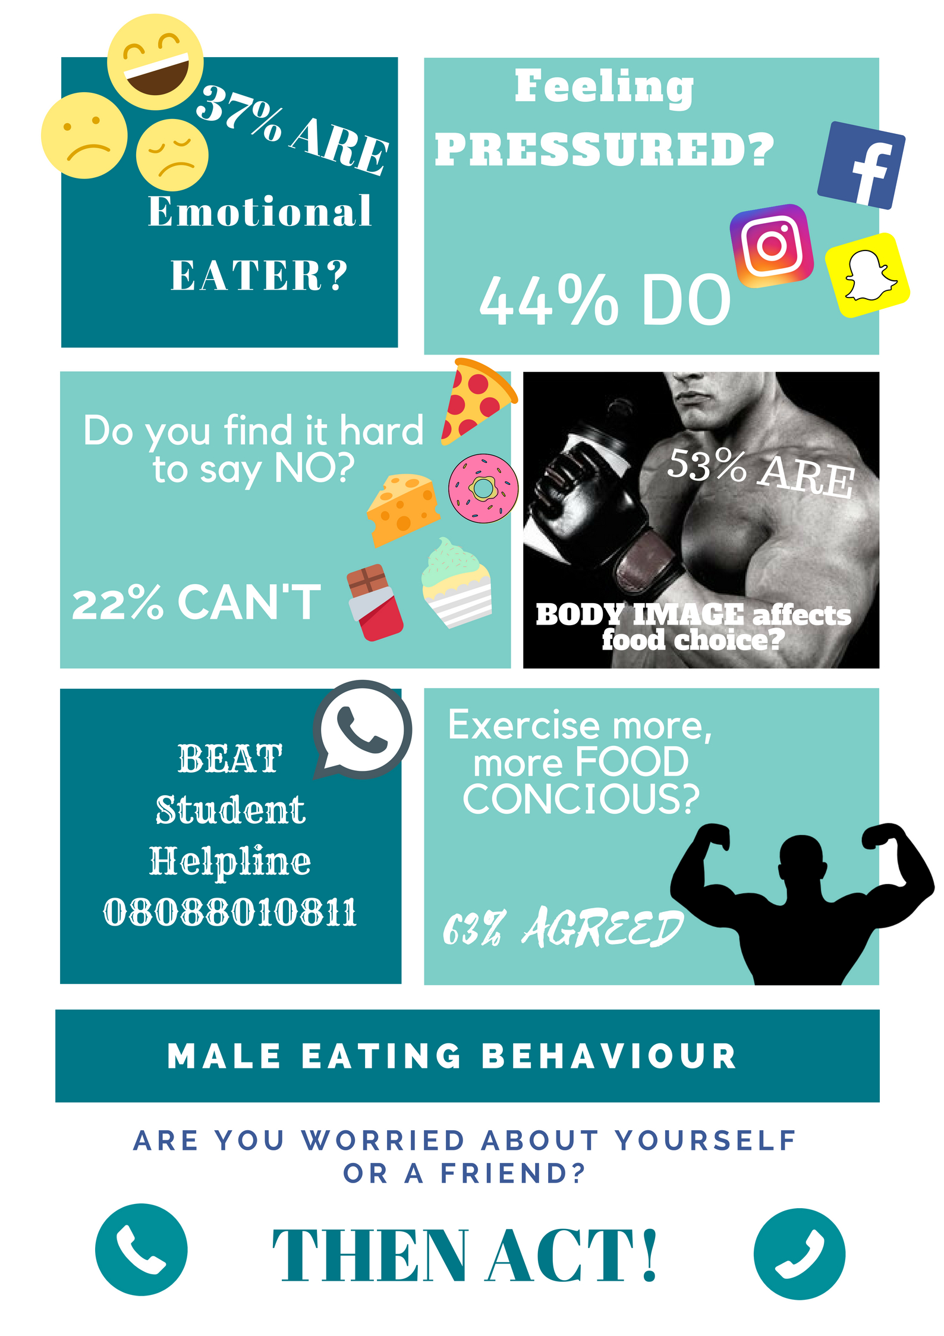
Awareness Campaign Poster:

Slide 10
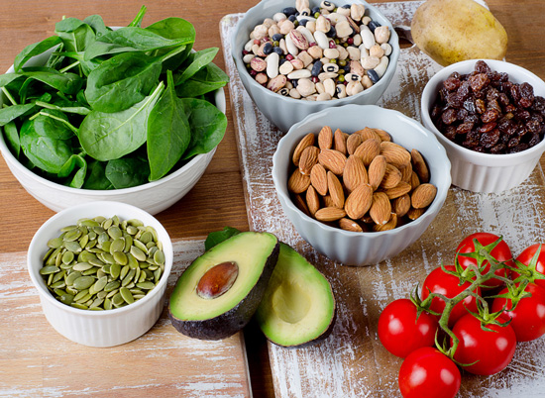
Conclusion
Implications:
Women and men both feel pressured to eat in certain ways
Some pressures affect women more than men
Future campaigns and awareness interventions must target men and women appropriately so that everyone is eating healthy regardless of their gender

Slide 11
References
Li, K., Conception, R. Y., Lee, H., Cardinal, B. J., Ebbeck, V., Woekel, E., Readdy, T. (2012). An examination of sex differences in relation to the eating habits and nutrient intakes of university students. Journal of Nutrition Education and Behaviour, 44, 246-250. doi:10.1016/j.jneb.2010.10.002
Kiefer, I., Rathmanner, T., Kunze, M. (2005). Eating and dieting differences in men and women. The Journal of Men’s Health & Gender, 2, 194-201. doi:10.1016/j.jhmg.2005.04.010

