Slide 1
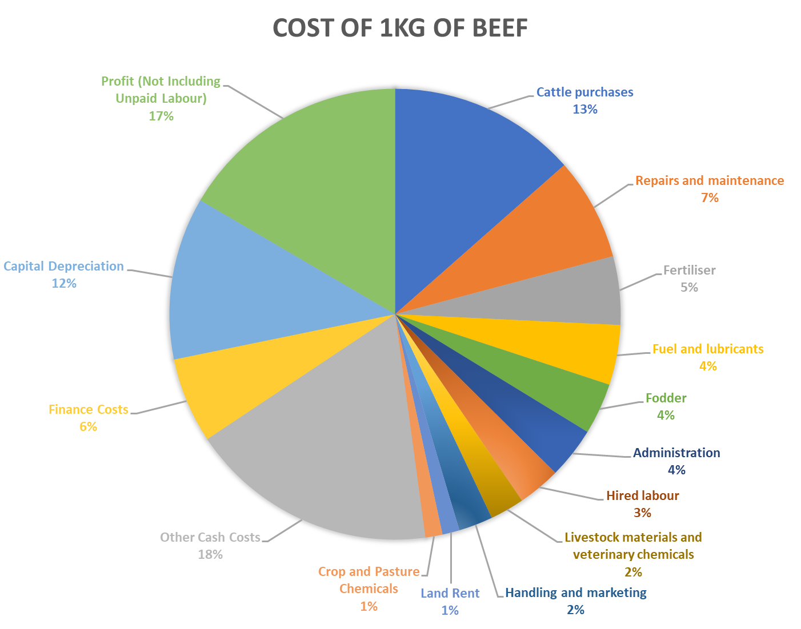
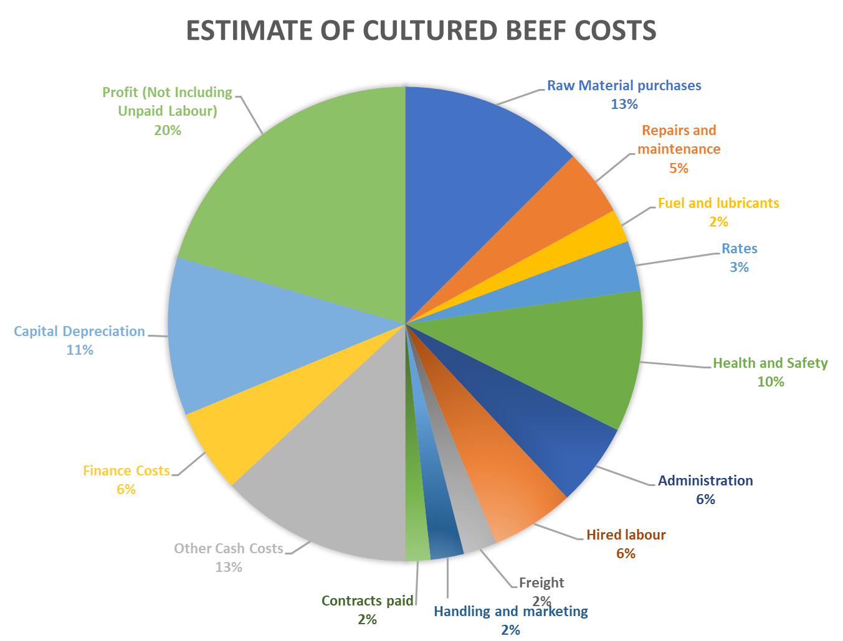
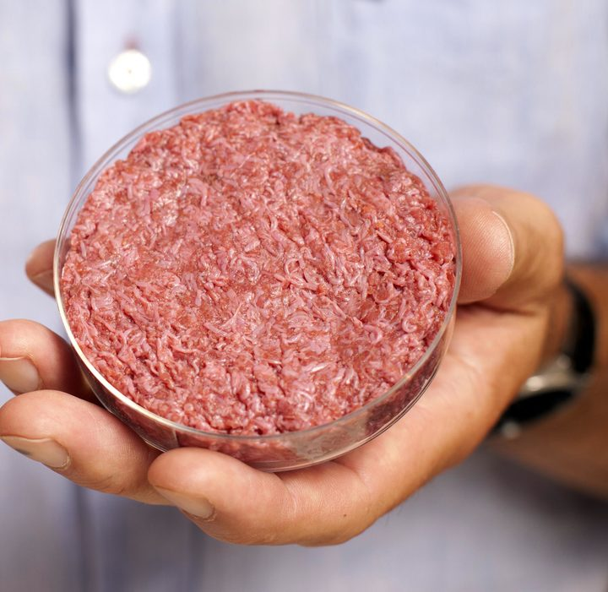
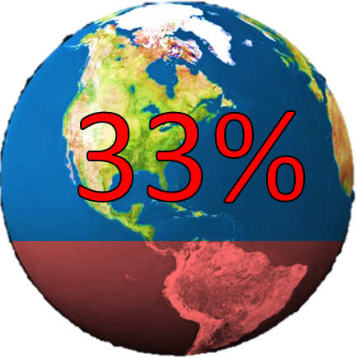
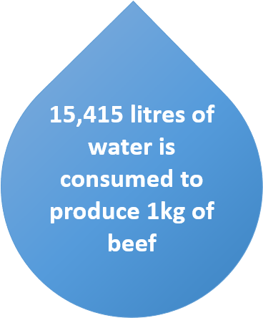
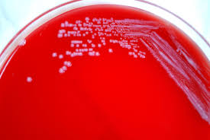
ENVIRONMENTAL IMPACTS
Lab-Made Meat: The Facts
ECONOMIC VIABILITTY
March 2015- Prices in US Dollars per Pound of Beef
Beef US import $3.60^{[1]} | Lab Meat Estimated at $36.00^{[2]}
Beef Costs (Pasture Raised) ^{[3]} | Cultured Meat Costs
Cattle purchases | Cultured meat is only the meat, therefore no bones or other waste produced. Almost all serum used to create muscle, no vet bills or fodder needed.
Livestock materials and veterinary
Fodder
Fuel and lubricants | Cultured meat is not bound to soil or place- No land rent, fertiliser or crop chemicals. This also reduced costs of vehicles and fuel as needs much less transport and machinery to produce.
Repairs and maintenance
Land Rent
Fertiliser for fields
Crop and Pasture Chemicals
Other Cash Costs- Taxes, Economic factors, etc. | It takes weeks instead of years to produce the cultured meat. Therefore the amount of feed and labour required per kg is much lower.
Finance Costs
Administration
Handling and marketing
Hired labour
 | Increased Hygiene, Health and Safety Costs. Increased costs for computer management. Increase labour cost per person.
[1] Wholesale Price Update, 2018, Cattlemen's Beef Board & National Cattlemen's Beef Association, http://www.beefretail.org/wholesalepriceupdate.aspx (accessed 07/06/2018)
[2] Lab-Grown Meat Is Getting Cheap Enough For Anyone To Buy, Fast Company & Inc © 2018 Mansueto Ventures, LLC, https://www.fastcompany.com/40565582/lab-grown-meat-is-getting-cheap-enough-for-anyone-to-buy (accessed 07/06/2018)
[3] Cost of production Australian beef cattle and sheep producers 2012–13 to 2014–15, Research by the Australian Bureau of Agricultural and Resource Economics and Sciences, https://www.mla.com.au/globalassets/mla-corporate/prices--markets/documents/trends--analysis/abares-farm-survey/costofprod_austbeefandsheep_2016_v1.0.0.pdf (accessed 07/06/2018)
WHAT IS IT?
First myosatellite cells (cells with potential to become muscle cells) are extracted from a live specimen. A protein is then applied which stimulates tissue growth, and the cells are put in a culture medium in a bioreactor. This supplies the cells with energy required to grow, and the cells are grown on a scaffold to simulate an animal’s body to give structure to the meat. The meat is then harvested and made into meat products ready for consumption.
1. In Vitro Bistro, 2017. How to make an in vitro burger. [online] Available at: <https://bistro-invitro.com/en/how-to-make-an-in-vitro-burger/> [Accessed 7 June 2018]
HEALTH PROSPECTS and CONCERNS
Disease Prevention
Comparison with Traditional Methods
Customised Meat
Cultured meat does not require growth hormones (still allowed for use in Canada and the U.S.), which according to the EU’s Scientific Committee for Veterinary Measures, can have “developmental, neurobiological, and carcinogenic effects.” Lab grown meat would not contain residues of pesticides (applied to the animals to control insects), tranquillizers, or de-wormers [1].
Eating conventional meat can lead to food-borne pathogens such listeria, E. coli or Campylobacter infections (among others). These contribute to millions of episodes of illness each year [2]. These diseases have been associated with the intensity of livestock farming and other anthropogenic developments in the bio-industry.
Lab-grown meat could not be said to be 100 percent safe, just much safer. Implementing strict quality controls, such as Good Manufacturing Practice, can significantly reduce the incidence of food-borne disease and would be impossible to introduce to modern slaughterhouses [3].
Cardiovascular disease, diabetes and cancer have been associated with red meat consumption.
120g red meat per day significantly raises the relative risk of colorectal cancer [4].
The nutrients causing these issues are still not defined, therefore it would be difficult to avoid specific health issues being prevalent even in modified lab meat [1].
The first burger in consumed in London in, 2013, was composed only of muscle fibres – no connective tissue, fat or blood vessels. If in vitro meats were produced using current technology, they could lack nutrients that are essential for good health. However, a lack of saturated fats can also be an advantage.
My manipulating the culture medium, poly-unsaturated fatty acid composition could be increased, while the fat content can be adjusted further with supplementations after production. [5]
Editing the biochemical composition of the meat can tailor to specific dietary requirements or simply create a healthier source of protein.
For example, replacing saturated fatty acids with omega-3 fatty acids could lead to a meat that lowers the risk of heart disease, rather than raise it.
These techniques are not inherent to the production of cultured meat however. Although currently motivated by social/environmental factors there is no guarantee future producers will share these priorities [6].
1 Post, M. (2012). Cultured meat from stem cells: Challenges and prospects. Meat Science, [online] 92(3), pp.297-301.
2 CDC (2016). Estimates of Foodborne Illness | CDC. [online] Available at: https://www.cdc.gov/foodborneburden/2011-foodborne-estimates.html [Accessed 7 Jun. 2018].
3 Bhat, Z. and Fayaz, H. (2010). Prospectus of cultured meat—advancing meat alternatives. Journal of Food Science and Technology, [online] 48(2), pp.125-140.
4 Larsson, S. and Wolk, A. (2006). Meat consumption and risk of colorectal cancer: A meta-analysis of prospective studies. International Journal of Cancer, [online] 119(11), pp.2657-2664.
5 Arshad, M., Javed, M., Sohaib, M., Saeed, F., Imran, A. and Amjad, Z. (2017). Tissue engineering approaches to develop cultured meat from cells: A mini review. Cogent Food & Agriculture
6 Stephens, D., Dunsford, I., Lucy Di Silvio, Ellis, D., Glencross, A. and Sexton, D. (2018). Bringing cultured meat to market: Technical, socio-political, and regulatory challenges in Cellular Agriculture. Trends in Food Science & Technology.
How does it stack up?
Getting warmer
A cradle-to-plate study was conducted to compare cultured meat with other meat alternatives such as mycoprotein (Quorn) and plant-based substitutes. The study found that overall cultured meat has the greatest environmental impact. Exceptions to this were the impacts on freshwater toxicity and land use.
Energy use was found to be a major factor in cultured meat’s poor performance, but it was noted that the technology can be innovated to reduce energy requirements, making it less environmentally damaging. [6]
Jean-Francois Hocquette of the French National Institute for Agricultural Research stated that he expects the environmental impact of waste culture disposal to be comparable to that of today’s chemical industry. [7]
The only way is up?
According to the Food and Agriculture Organization (FAO), the livestock sector is responsible for 18% of all greenhouse gas emissions, a higher share than all forms of transport together. [4] This is worrying, as increased greenhouse gas emissions could bring increased rates of global warming and other environmental impacts.
A study investigated the potential environmental impacts of cultured meat and found that its production involves 78-98% less greenhouse gas emissions and 7-45% less energy use (depending on which meat it was compared to). Poultry meat production required less energy than cultured meat, but the greenhouse gas statistics suggest the 18% figure could be reduced to just 4%.
Currently, 33% of all arable land is used for growing
crops for feeding livestock.
26% of the Earth’s ice-free terrestrial land is used for grazing livestock. [1]
This results in deforestation and destruction of biologically diverse habitats and ecosystems to make way for meat production, thus having a great impact on the environment.
With cultured meat, it is estimated that 99% less land will be required to produce meat, and biology professor Dickson Despommier suggested vertical farming –building farms upwards to reduce land use- could be implemented, as cultures can be stacked on top of one another. [2]
Water problems
In 2013, The Guardian’s data blog found that in the production of 1kg of beef, 15,415 litres of water is consumed. [5]
The production of meat via the culture process reduces water consumption by 82-96%, meaning that the water consumption for 1kg of beef could be reduced to around 2,775 litres, a vast improvement on the previous figure.
One potential issue which remains, however, is that blood is a key ingredient in many growth serums used so far. There is research being done into identifying and synthesising the necessary chemicals within the blood but until this is done, there are questions over whether livestock are still required for the process. [3]
VERDICT:
If the issues of high energy requirements and blood substitutes for growth serums can be solved or at least reduced in scale, the environmental impacts of cultured meat production would be very favourable compared to those of the traditional meat production industry. Land use, water consumption and greenhouse gas emissions would be greatly reduced, meaning cultured meat provides a realistically viable option for replacing meat in terms of environmental impact.
1. Tuomisto, H et al., 2011. Environmental Impacts of Cultured Meat Production. Environmental Science & Technology, [e-journal] 45{14). https://doi.org/10.1021/es200130u.
2. Despommier, D., 2009. The Rise of Vertical Farms, [e-journal] 301(5). https://pdfs.semanticscholar.org/de82/2ee4587919e63ca04b4985260d4cbeb7cd21.pdf.
3. Science Focus, 2017. The artificial meat factory – the science of your synthetic supper. [online] Available at: <http://www.sciencefocus.com/article/future/artificial-meat-factory> [Accessed 7 June 2018]
4. EcoWatch (2016) Which is Worse for the Planet: Beef or Cars? [online] Available at: <https://www.ecowatch.com/which-is-worse-for-the-planet-beef-or-cars-1919932136.html> [Accessed 7 June 2018]
5. The Guardian (2013) How much water is needed to produce food and how much do we waste? [online] Available at: <https://www.theguardian.com/news/datablog/2013/jan/10/how-much-water-food-production-waste> [Accessed 7 June 2018]
6. Stephens, N., 2018. Bringing cultured meat to market: Technical, socio-political, and regulatory challenges in Cellular Agriculture [e-journal] Available at: <https://www.sciencedirect.com/science/article/pii/S0924224417303400> [Accessed 7 June 2018]
7. Hocquette, J., 2016. Is in vitro meat the solution for the future?. Meat Science, [e-journal] 120, pp. 167 – 176. https://www.sciencedirect.com/science/article/pii/S0309174016301358

