Slide 1
Ocean Plastic – Group 7
Jacob Evans Lana Shaw Alycia Garland Jordan Daines Katerina Kavourides Rachael Jeffries and Sophie Davies

Slide 2
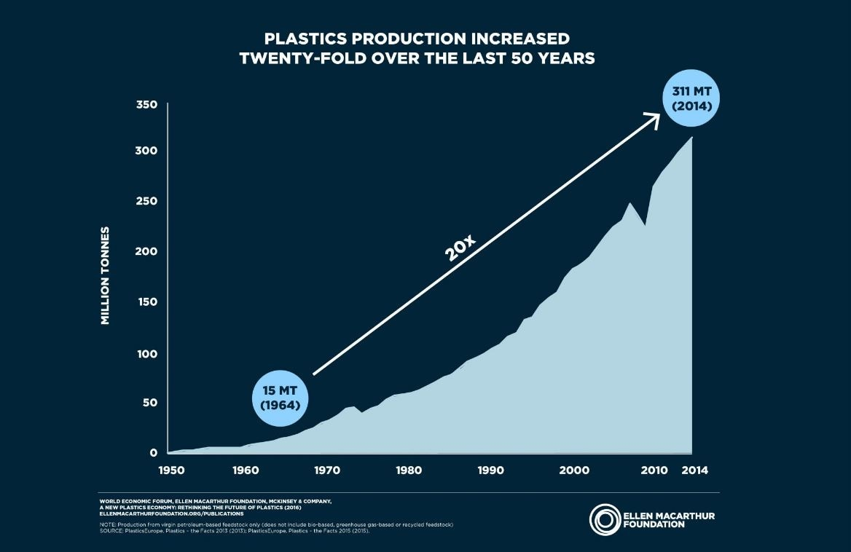
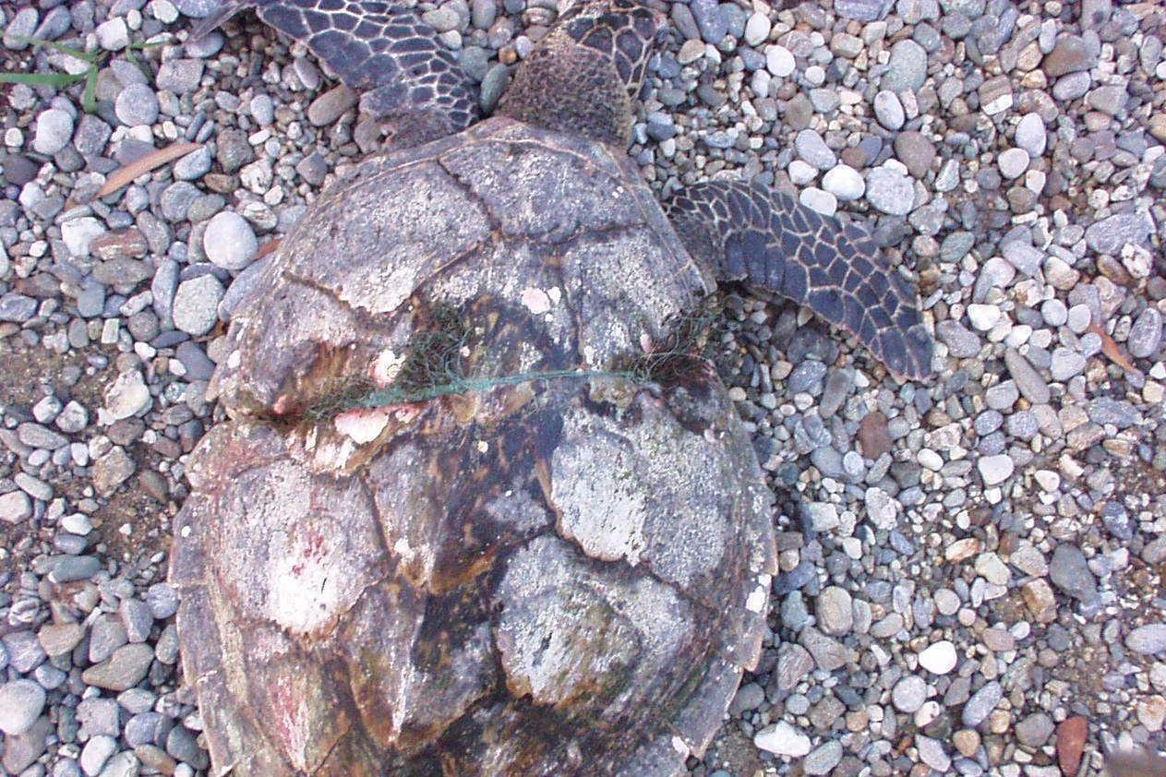
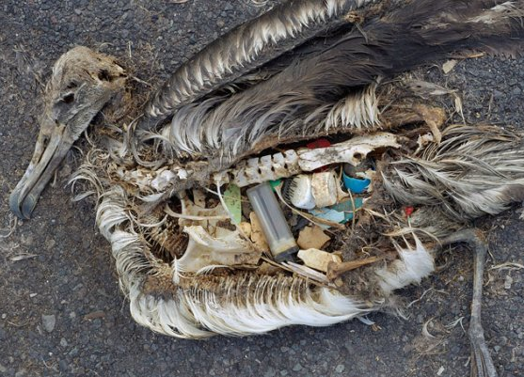
The Ocean Plastic issue
Notes:
Plastic Oceans reports how over 8 million tonnes of plastic are dumped into our oceans every year. This has caused serious consequences to marine life and systems. It is estimated that there is 100 million metric tonnes of debris in the ocean. This has led to the terrible images we can see here. More than 1000 turtles die every year due to plastic debris. A report by the University of Exeter found that 91% of turtles that get tangled in fishing net, nylon, plastic string and beer holders die. Other pieces of plastic lead to maiming, amputation and strangling with survivors having to carry and drag debris along with them. Birds are also seriously affected with plastic bags and other pieces of plastic being mistaken for food. A plastic bag can remain in the ocean for over 15 years and subsequently lead to the death of many birds like Albatrosses and Guillemots.

Slide 3
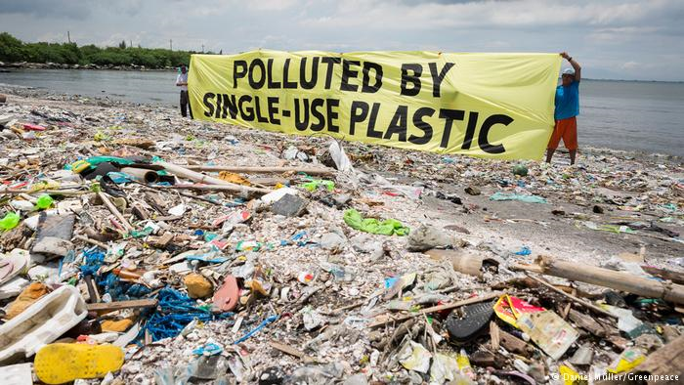
Recycling
Recycling 1 plastic bottle saves enough energy to power a lightbulb for 3 hours.
If every can was recycled then the UK would need 14 million less bins.
1 recycled tin can would save enough energy to power a television for 3 hours.
(Recycle-more, 2018)
Notes:
The UK produces 20 x more plastic than it did 50 years ago, combatting this issue through a recycling initiative is what our ethos was from the start.

Slide 4
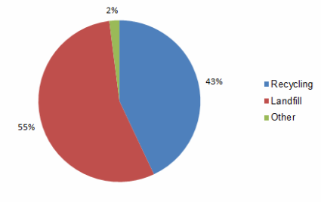
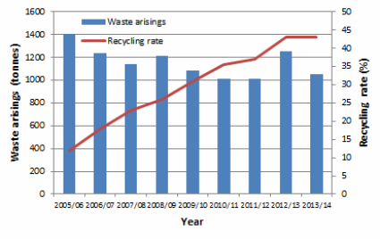
Recycling at Exeter
Greenmatch.com green rating 2017:
16th greenest University
37.15% plastic recycling rate
Nottingham Trent University
1st with 95.65% plastic recycling rate.
Recycling Statistics at Exeter, Exeter University (2017)
Notes:
On the local scale we can see that Exeter University is underperforming. We may rank 16th and recycle 44% of total waste but these statistics are relative and a huge scope for improvement is visible. We utilised this data to frame our brainstorm of ideas, to tackle this issue explicitly.

Slide 5
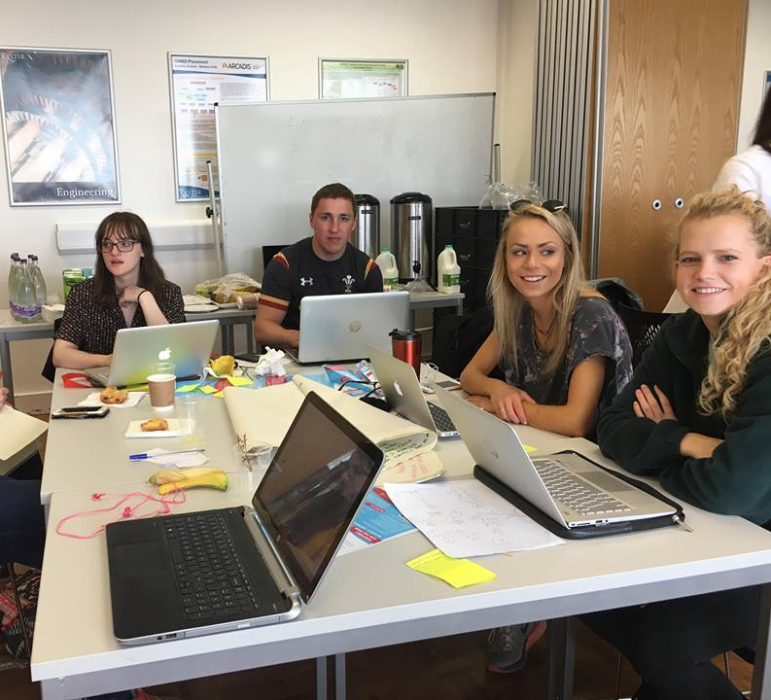
Initialising ideas
Ocean plastic game for children
Plastic Kills packaging
Remoulding into furniture
Locational App to encourage recycling
Notes:
To begin with we wrote our ideas on post it notes. From this we read them out and shortlisted our favourites. The four we left were……. The ocean plastic game was similar to Dumb Ways to die but it was a bit morbid. The packaging idea was too simple and too complicated as there are so many plastic products. The idea of billboards and adverts was far too expensive and perhaps not really affective. Remoulding into furniture was far too complicated and expensive also, as seen by the kayak remoulding. As a result we were left with the locational app, something we quickly became excited with and soon started to elaborate on.

Slide 6
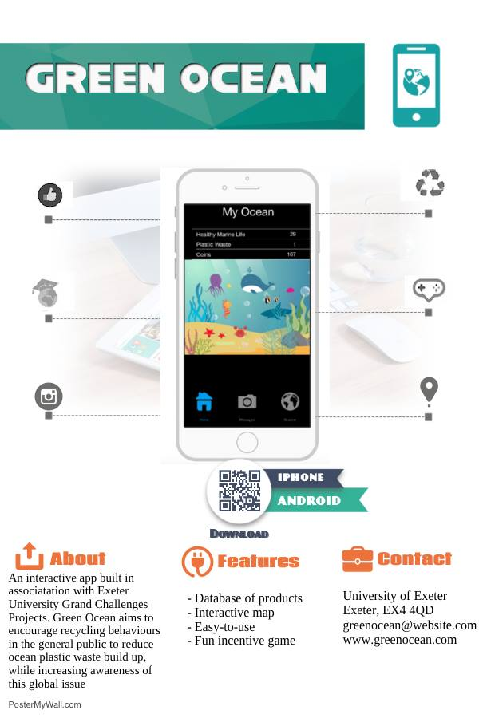
Notes:
Here is our idea. Our idea is called Green Ocean. This app would be available on the iExeter app as one of the panel sections. The aim is to increase student recycling by informing whether an item is recyclable, where it can be recycled and provide competition through means of a game. To begin with the idea was initially purely to provide an app with a barcode reader to tell you if the item is recyclable; this is similar to what Marks and Spencer have introduced. However we soon decided to elaborate on the idea as we deemed this too simple. This may not target recycling directly however so we decided that allowing location to be identified; like on snapchat. This would inform students of the nearest recycling facility, bin or bank. To encourage students t

Slide 7
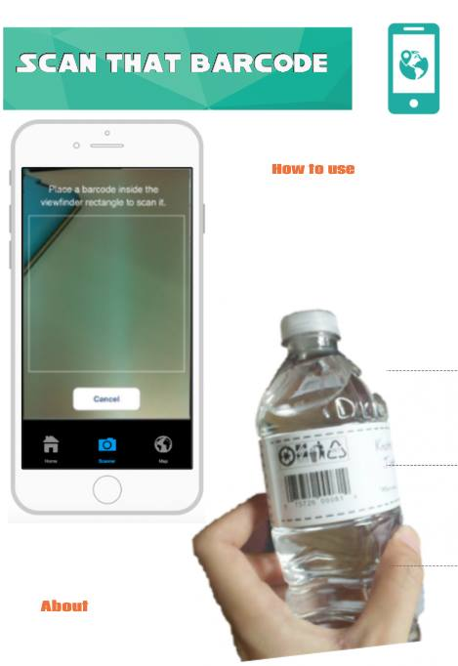
Our idea
Notes:
The main part of the app is to identify whether an item is recyclable or not or if parts of it are recyclable. This will help remove uncertainty and contamination. This may not target recycling directly however so we decided that allowing location to be identified; like on snapchat would be a great addition. This would inform students of the nearest recycling facility, bin or bank. This would prevent students from throwing items in the bin and instead realise a recycling bin is closer.

Slide 8
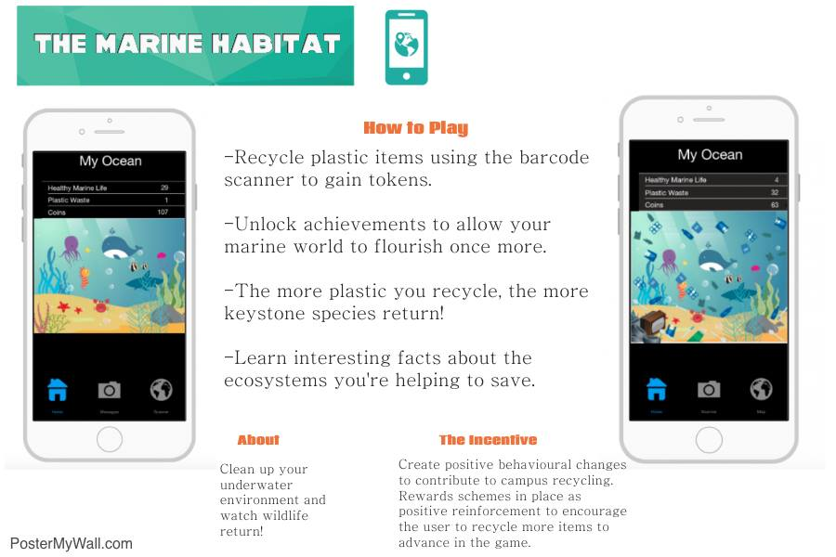
Our idea
Notes:
The second part of the app is much more interactive. In a similar fashion to that of pokemon go! From scanning a barcode, identifying a bin and then being within a 2 meter radius of that bin, the app will assume that you have recycled that item. This will generate a score and points that can be used on the interactive version of the app. You have your own ocean, with plastic pollution in it. Pop up facts on ocean plastic and its detrimental effects will also be there. You begin with an avatar, the plankton, and the more you recycle; the cleaner the ocean becomes and the further up the food chain you rise. Culminating with the whale. These hand drawn characters, are the avatars that would be available.

Slide 9
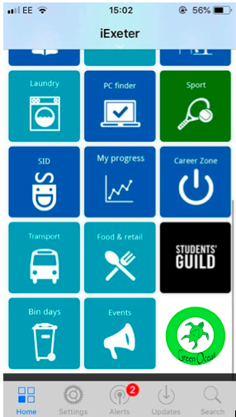
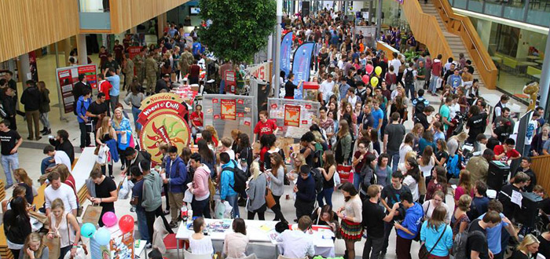
Implementation
The app will be featured on iExeter
Green Ocean will be advertised at the freshers fair, giving students the opportunity to explore the app as well as highlighting the main recycling points on campus.
Notes:
Emails would be sent to all students advertising the launch of the new Green Ocean App on campus, it would provide information on how to use the feature and what it hopes to achieve. It will be featured on the iExeter app, making it easily accessible for all students and encouraging engagement with the app. Notifications will appear on phones screens as gentle nudges and reminders to look after ‘your ocean world’. In freshers week a stall with people operating and informing students about the importance of the addition and how to operate the app will be there. Hopefully, further stalls in the forum would be available to help increase the word of the panel.

Slide 10
Expansion
Penryn and St Luke’s Campus
Trials at other universities and colleges
130 UK Universities
Approximately 90 Sixth Form Colleges in England and Wales
Varying the degree of scale
Operable on all campuses- similar to eduroam

Slide 11
Conclusion
Interactive App to encourage recycling
Huge scope for improvement at all higher education institutions
Huge scope for expansion
Any Questions?

