Slide 1
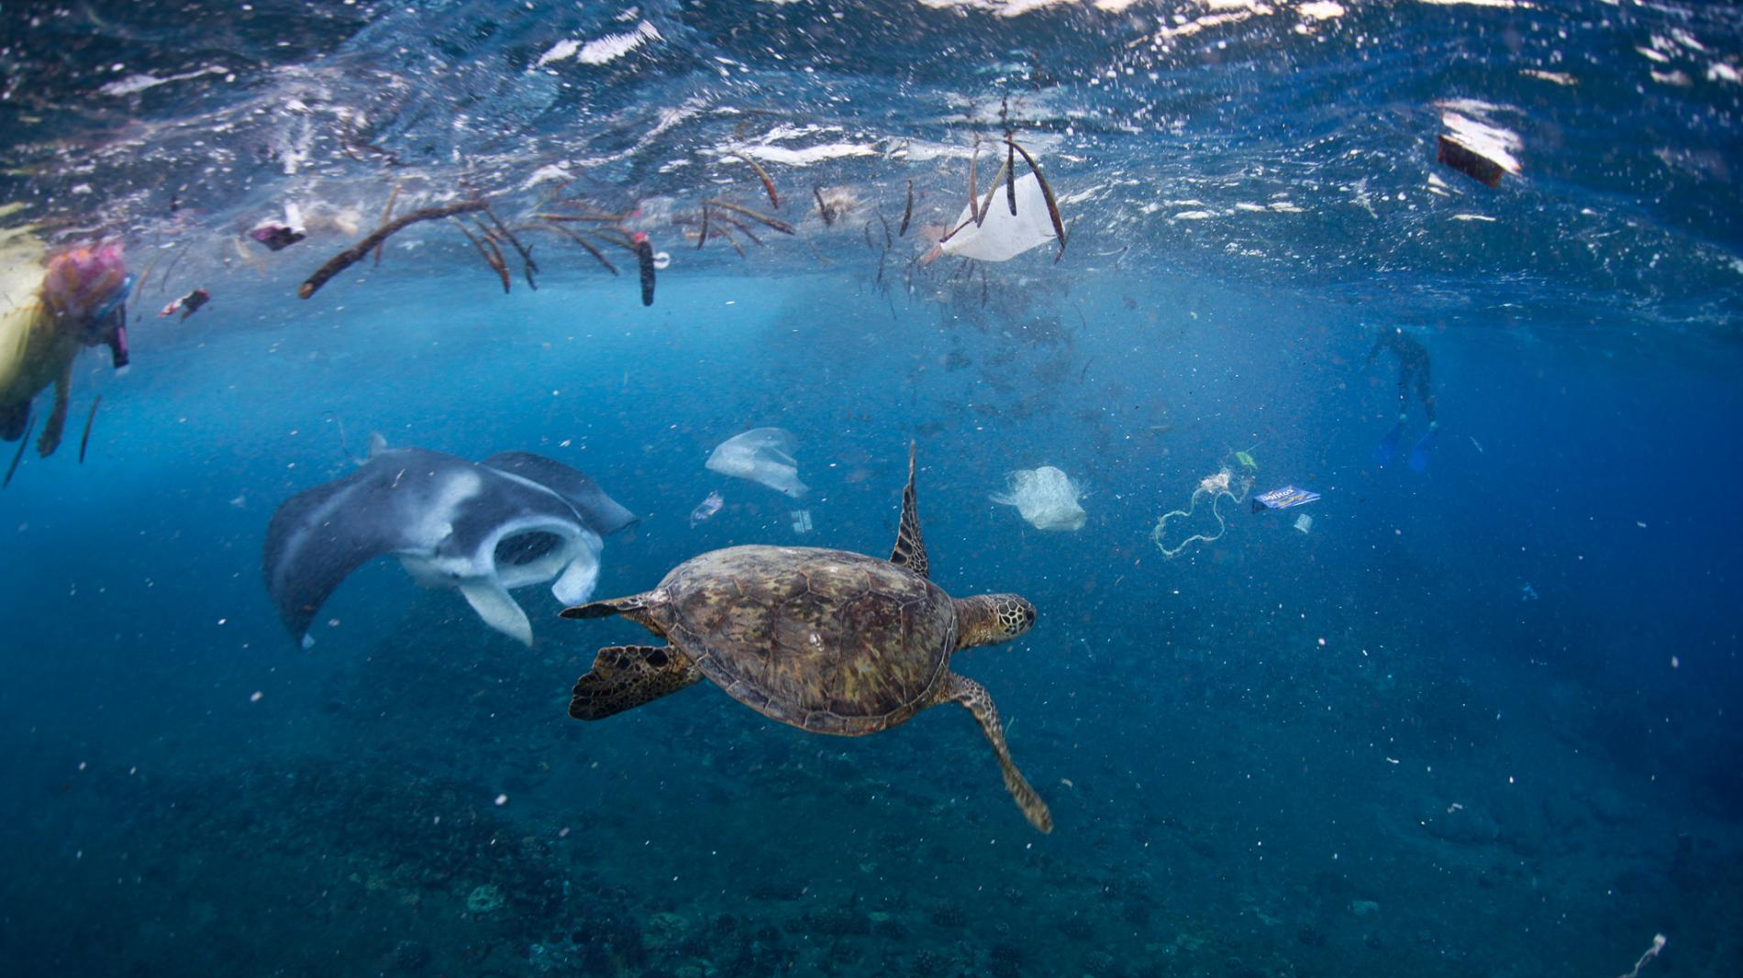
Ocean Plastics
Innovating solutions influenced by Circular Economy
Peter Atanasov, Daniel Femi- Alemede, Stefan Loubry, Lara Mayhew, Sophie Mowbray, Kate Reddaway, Jonathan Teasdale, Phoebe Warren and Leo Wu
Notes:
https://www.youtube.com/watch?v=6zrn4-FfbXw

Slide 2
Notes:
https://www.youtube.com/watch?v=6zrn4-FfbXw
50 seconds- end

Slide 3
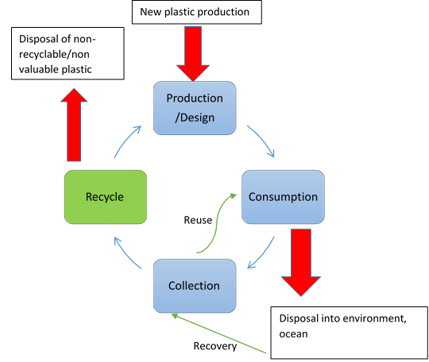
Circular Economy
Enablers and favorable system conditions.
Collaboration
Rethinking incentives
Providing sustainable set of international environment rules
Access to financing

Slide 4
Our traffic light coding system

Slide 5
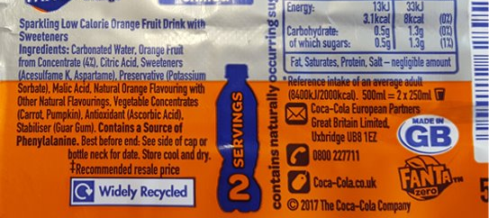
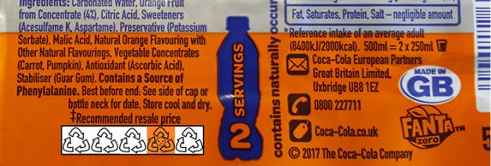
Where did it come from; where should it go?
Please recycle

Slide 6
The survey
91 University of Exeter students and members of staff participate:
55 female; 29 male; 7 did not provide information about their gender;
52 British; 30 International; 9 did not provide information about their Nationality;
Mean age=21.67 years; St. Deviation=3.8years;
MCQs on knowledge and opinions about plastic waste, recycling and our idea
Open questions allowing for further comments on how the participants reused plastic:
The survey
81% of participants approved of colour-coding for plastic recyclability; 3% disapproved while the rest were undecided.
80% of the participants approved of our proposal for colour-coding range from green to red; 3% disapproved while the rest were undecided.

Slide 7
Who should implement the system?
Government Agency | Private Third-party
Pros: Unified, simplistic system. Could lead to internationally recognized standards | Pros: More opportunity for specialization and innovation More competition would lead to a higher quality system, services, and more modern standards
Cons: Might be slower than private agencies to keep up with public opinion and consumer’s views on plastics Funded by the tax-payer | Cons: May lead to confusion for consumers due to potential for a non-universal scale. Needs to be profit-driven, so business would have to pay out-of-pocket for their plastics to be rated
Notes:
An ideal middle-ground:
An ideal system would be a Non-ministerial Government Department (NMGD), similar to the Food Standards Agency. This would be an independent body, free of political oversight that would serve the public interest. Its actions wouldn’t need ministerial approval and could be advised by different committees. It would have its own government website and only one rating system, making it easier to understand than multiple private rating systems. Some of the work could be subcontracted out to individuals or private businesses in order to carry out auditing/rating of plastic producers. This system would be cost-effective as there would be no need for advertising after initially starting up, and the tax-payer would only fund the research, while plastic producers would pay for the labelling.

Slide 8
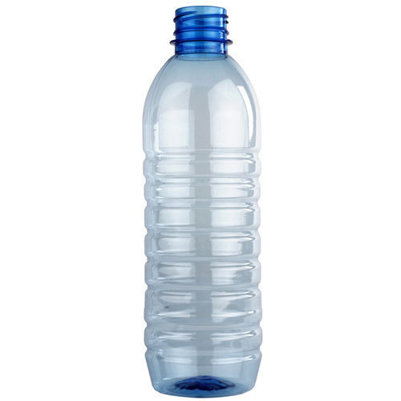
Considerations
How can we take the idea further?
Non single-use plastic?
Certification of plastics?
Recovery of plastic?
Different locations have different recycling systems
The code may not be able to replace information on the bottle about recycling, as it considers the overall environmental impact with regards to plastic, and so may not reflect the recyclability
Our system only focuses on single-use, consumer primary packaging, not secondary or tertiary

Slide 9
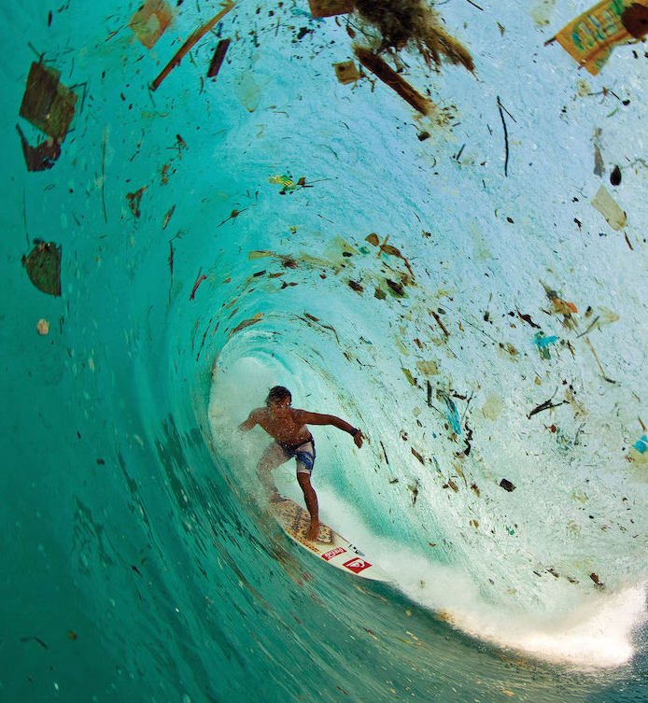
Are you ready to turn the tide on plastic?

