Slide 1
REDCapCloud
CLINICAL TRIALS UNIT
What it can do for you

Slide 2
REDCap Cloud Background
Based on the well known and used REDCap system build by Vanderbilt.
nPhase tasked with validating this free version and making it cloud-ready for business and regulated trial work.
Launched 2016 in the US, now available in Europe. Hosted in the EU, complies with GDPR.

Slide 3
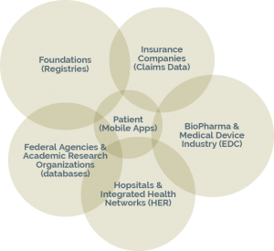
Benefits over Coalition version
Comes with eLearning system.
UI Improvements.
Form library (negotiable.)
Pre-configured ePRO (not yet mobile.)
Fully validated for regulated use (audit ready.)
As such, already in use in industry:

Slide 4
Our Setup
Free license if an investigator instigated trial, with soft limits: 3 sites, 100 users, no fixed limits on subjects.
Regulated or larger trials require license agreement following negotiation with nPhase.

Slide 5
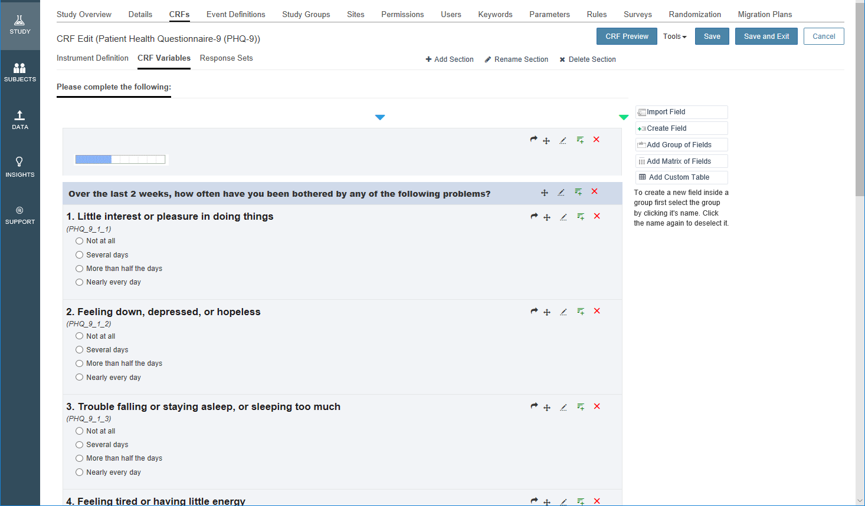
Typical setup steps – Setup CRFs
Drag and drop interface.
Questions can be moved between sections.
Branching logic available.
Library of forms can be built up, library available from nPhase upon negotiation.

Slide 6
Typical setup steps – Add fields to CRFs
Create Field Types | Field Options
 | Min/Max Values | Other Options
Text Box | Yes | Medical Coding if enabled in Parameters with option to select from dictionaries enabled
Notes Box | No
Phone | No
E-mail | No
Number Box (integer) | Yes
Number Box (decimal) | Yes | Max Decimal Size
Date Box | Yes | Partial Date
Date Time Box | Yes
Time | Yes | 12-24 Hour Clock; Default Current Time
Calculated Field | No | Calc. Equation: Measurement Units
Drop-down | No | Response Sets
Radio Buttons | No | Response Sets
Checkboxes | No | Response Sets
Yes – No | No
True – False | No
Signature | No
File Upload | No
Folder Upload | No
Slider | No | Labels (LMR) & Display Number Min / Max Value
Descriptive Text | No | Add Image/Link
New Section | No
RegEx | No | Regular expressions
IFrame | No | HTML insert load options
Media Object | No | Insert MP3 Audio/MP4 Video
Rich Text | No | Add images and/or video to a field
Fields can be added to sections, or pages.
Any field can be repeated a fixed or variable number of times, with optional limits.
Rules can be set against any field using a logic engine. These can hide/show other fields, CRFs, trigger emails (good for safety reporting.) These can be global across all timepoints or locked down in scope.

Slide 7
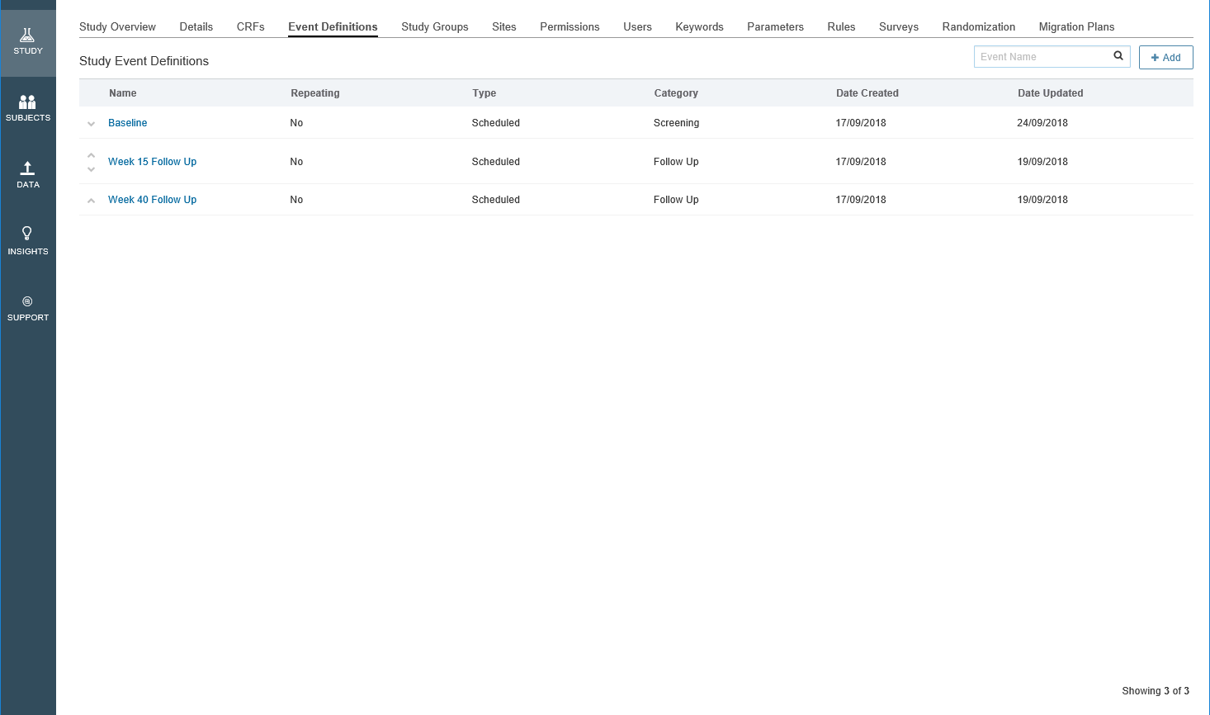
Typical setup steps – Add CRFs to events
Events can happen once (e.g. Baseline) or repeat a set number of times.
They can be scheduled (time delay) or calendared (booked in.)
In ePRO, these are used to email invites to participants.

Slide 8
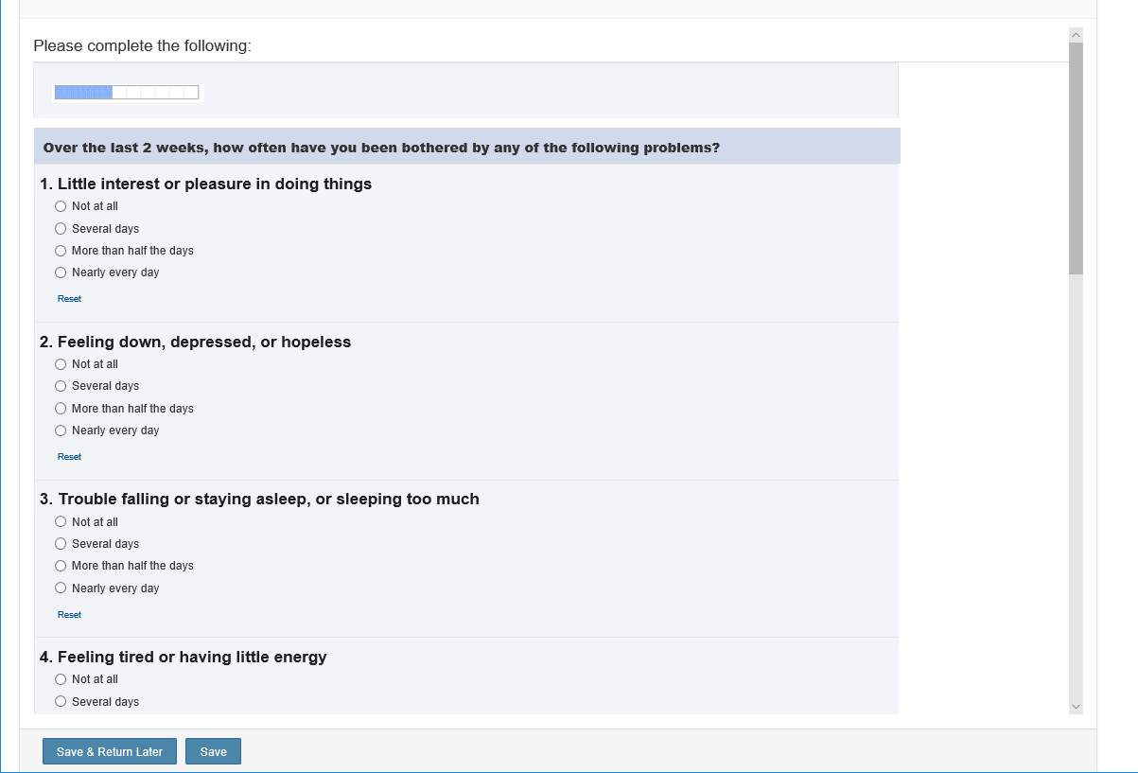
Typical setup steps – ePRO
Any CRF can be turned into an ePRO version, in the form of a survey.
These can be lightly themed, still quite locked down at the moment.
nPhase intend for these to be fully mobile accessible, still working on validating this.
Surveys are emailed to the participant to complete based on events.

Slide 9
Still to come…
Simple to Complex Randomisation – Not yet validated.
API integration – We can integrate with our randomisation system while the above work is completed.
Full mobile ePRO – we will be involved in testing.

Slide 10
Other benefits
A REDCap Cloud (RCC) UK User Group has just been set up Exeter, Plymouth, Manchester, Hull/York.
Full Software Development Lifecycle (SDLC) compliant environment – Build, Test & Live servers (best practice and helps with validation for regulated trials.)
Built-in file transfer system – like DropBox/OneDrive but on secure environment
Compliance – now (10/2018) ISO27001 compliant!

Slide 11
Any Questions?
The system is extremely flexible out of the box, happy to set up demos.
Slides will be available after, more info also at:
https://www.redcapcloud.com

