Slide 1
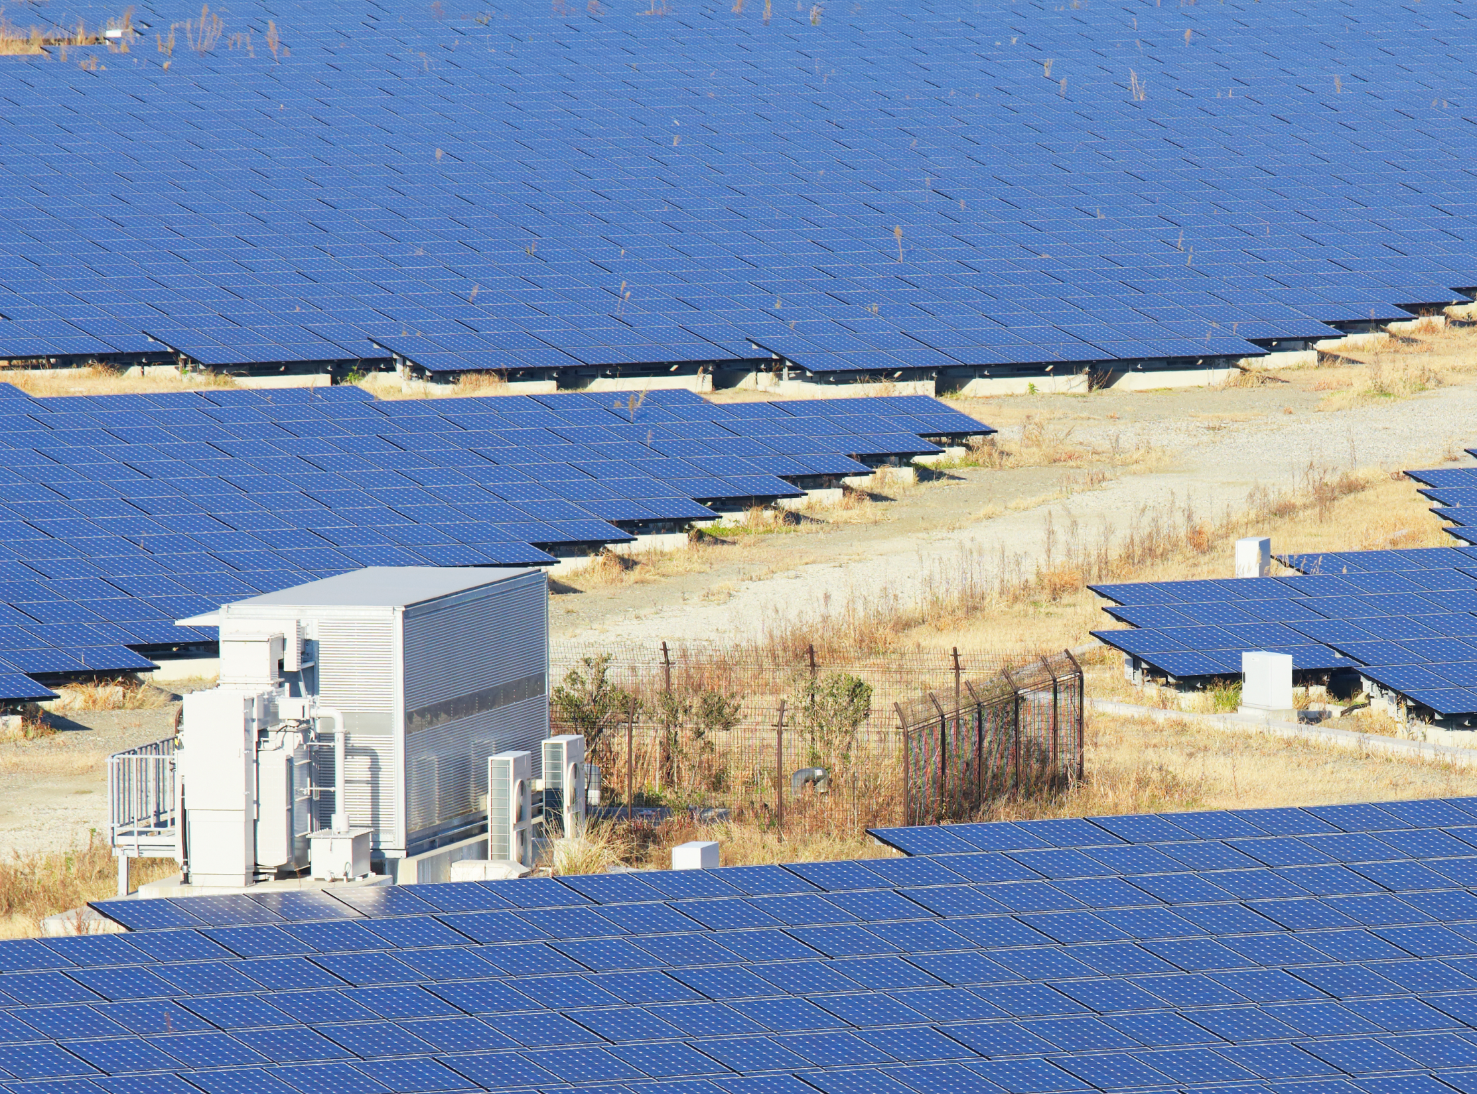
Working Group III
The challenge of mitigation
#climate2014

Slide 2

Working Group III: the challenge of mitigation
Chair: Professor Jim Skea
Research Councils UK Energy Strategy Fellow,
Imperial College London
Keynote: Professor Ottmar Edenhofer
Co-chair of Working Group III
Commentators: Professor Simon Caney
Professor in Political Theory and Director of the
Centre for the Study of Social Justice,
University of Oxford
Professor John Barrett
Professor of Sustainability Research;
Deputy Director of Research (Excellence),
University of Leeds
Professor Catherine Mitchell
Professor of Energy Policy,
University of Exeter

Slide 3

The challenge of mitigation
Professor Jim Skea
Research Councils UK Energy Strategy Fellow, Imperial College London

Slide 4
The challenge of mitigation
Professor Ottmar Edenhofer
Co-Chair of Working Group III

Slide 5
Climate Change Adaptation and Mitigation: Key messages from IPCC's AR5
16 May 2014, University of Exeter, Great Britain
Prof. Dr. Ottmar Edenhofer
Co-Chair, IPCC Working Group III
Notes:
Welcome everybody
The main task of the IPCC Working Group III ‚Mitigation of Climate Change‘ can be described as making a map. Like cartographers, the authors explore the solution space, drawing the map of all possible pathways IPCC: scientists as mapmakers, governments as navigators.

Slide 6

Exploring the solution space
Notes:
In Working Group III, we often use the image of a mapmaker and a navigator to illustrate the division of labour between the authors, scientists and practitioners, experts in their fields, and the primary audience: policymakers. The authors explore different paths to certain goals and they characterize these paths in the assessment. This is what we refer to as the ‘exploration of the solution space’. But IPCC reports are written to be policy-relevant, not policy prescriptive. To serve policymakers as a map and for them to act as the navigator. They decide which path to follow.
The first part of the WGIII contribution to the AR5 helps to clarify this division of labour. In the chapters 1 to 4, our authors assess the many different perspectives used in the literature to analyse mitigation. By showing these different perspectives and how and why they differ, these opening chapters increase transparency over the many theories, concepts, and methods that are used to measure the landscape of climate change mitigation. This is very important for navigators to know because different methods of measurement lead to different maps.
As a first application of our measurement tools, the following chapters look into the past to draw and understand the paths the world has evolved along and why it did so. Here again, many alternative perspectives are used to display humankind’s traces in the atmosphere, including cumulative emissions and emissions per geographic and economic regions and per economic sectors and gases.
We then explore and characterize pathways far into the future, focusing on the cost, co-benefits, and risks, of mitigation pathways that lead to stabilization of the atmospheric concentration of greenhouse gases at various levels. We show that low stabilization levels require mitigation throughout the economy. Our report greatly increases the sectoral resolution of mitigation maps. They show in detail the landscape along these pathways and highlight the very diverse aspects of mitigation in energy systems, transport, buildings, industry, land-use, and human settlements.
The report concludes with insights into policies and institutions that navigators could use to steer economies along pathways at all levels of governance.

Slide 7
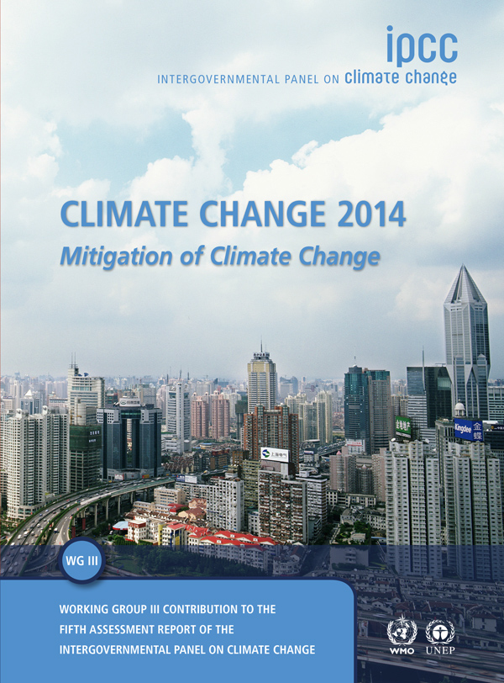
IPCC reports are the result of extensive work of many scientists from around the world.
1 Summary for Policymakers
1 Technical Summary
16 Chapters
235 Authors
900 Reviewers
More than 2000 pages
Close to 10,000 references
More than 38,000 comments
Notes:
Work of many distinguished scholars over 4 years
Climate change mtigation is an area of intense research, assessment refers to 10.000 scientific articles
Extensive Review to which some of the present people will have contributed as reviewers

Slide 8
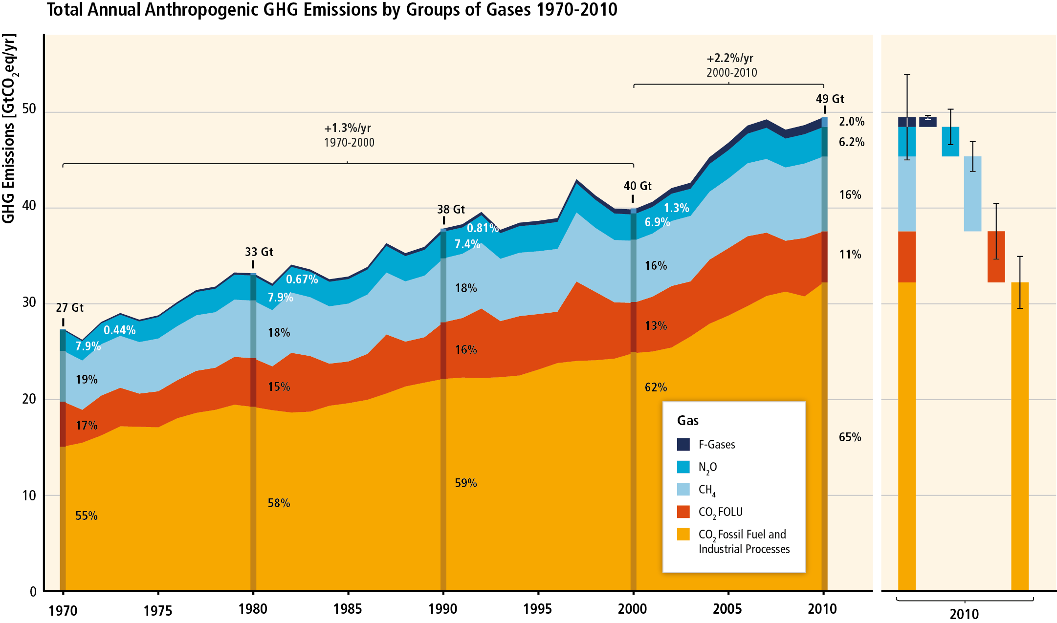
GHG emissions accelerate despite reduction efforts. Most emission growth is CO₂ from fossil fuel combustion.
Figure SPM.1
Notes:
Energy supply and industry are responsible for three quarters of the increase of emissions.
With an increasing role in the last decade.
Steep rise of CO2 from fossil, cement, flaring.
Global CO2 emissions from fossil fuel combustion are known within ±8% uncertainty.
CO2 emissions from FOLU have large uncertainties attached in the order of ±50%.

Slide 9
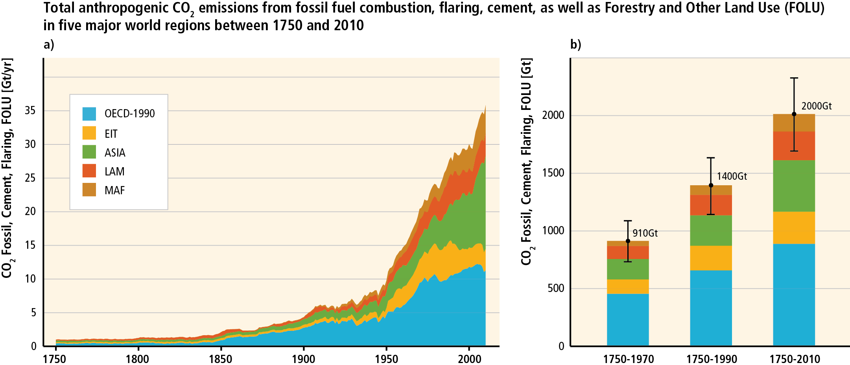
Cumulative CO₂ emissions have more than doubled since 1970.
After 1970:
1100 GtCO₂
Before 1970:
910 GtCO₂
Figure TS.2

Slide 10
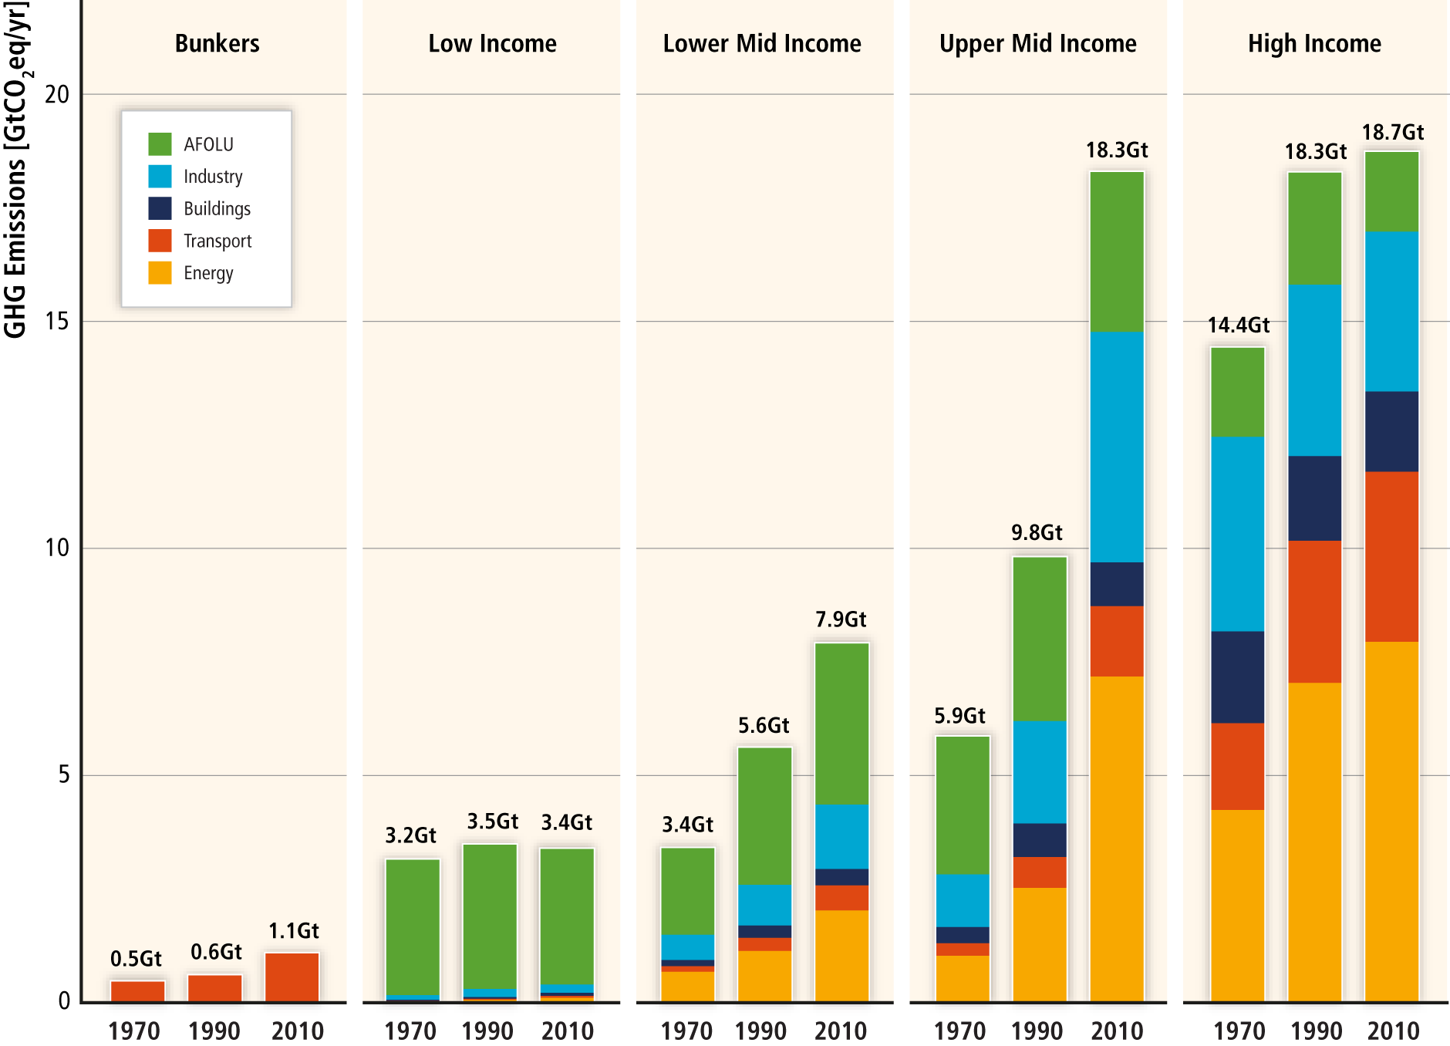
Regional patterns of GHG emissions are shifting along with changes in the world economy.
Figure TS.3
Notes:
Since 2000, GHG emissions have been growing in all sectors, except AFOLU.
For most low-income countries, the largest source of emissions is from AFOLU.
The shares of the energy and industry sectors increase for lower middle income countries, and these are the largest sectors for upper middle income countries.
Transport becomes a large sector for high income countries.
Most of the emission growth before 1970 has taken place when currently industrialized countries underwent rapid economic development.
Most of the recent emission growth has concentrated in the centers of economic growth in developing countries.

Slide 11
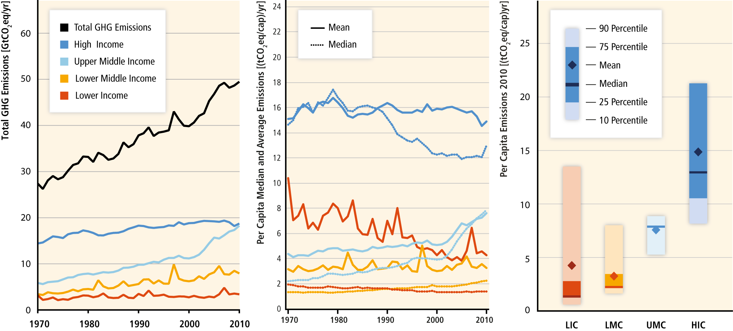
National per‐capita GHG emissions are highly variable within and between income groups.
Figure TS.4
Notes:
In 2010, median per capita GHG emissions for the high income country group were around 9 times higher than for the low income country group.
Within these income groups, there are substantial variations in per capita GHG emissions and GHG emissions per economic output, with
both varying by a factor of around two and more.
High income countries have often lower levels of GHG emissions per unit economic output than low and middle income countries.

Slide 12
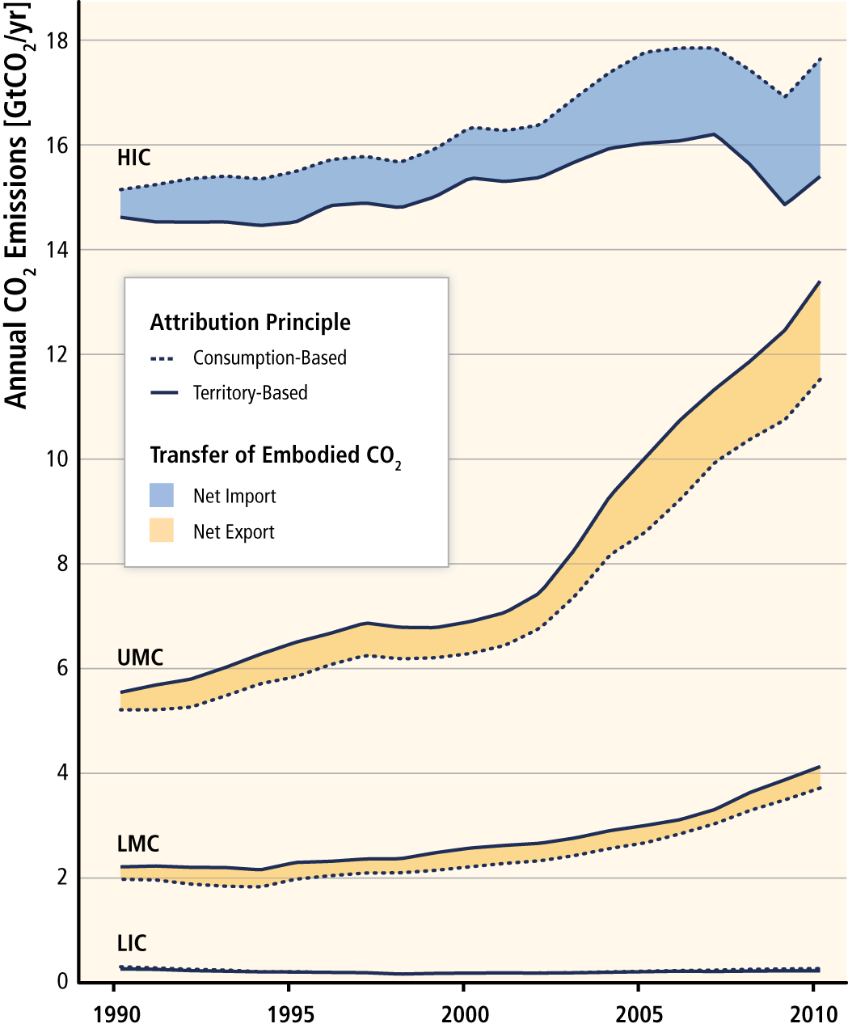
A growing share of CO₂ emissions from fossil fuel combustion and industrial processes in low and middle income countries has been released in the production of goods and services exported, notably from upper‐middle income countries to high income countries.
Figure TS.5

Slide 13
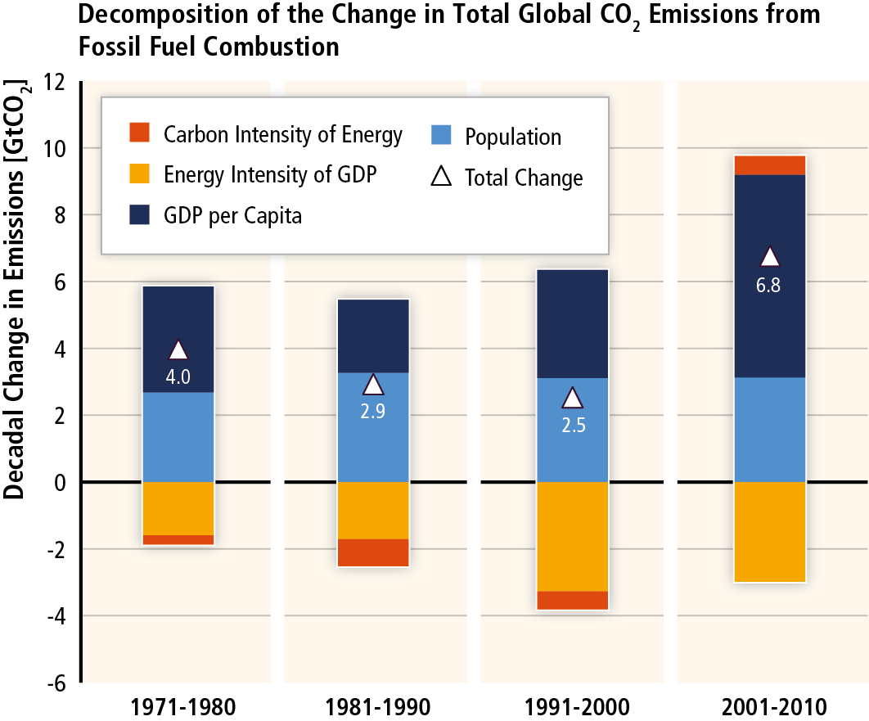
GHG emissions rise with growth in GDP and population; long-standing trend of decarbonisation of energy reversed.
Figure SPM.3
Notes:
Economic and population growth continue to be the two main drivers for increases in global fossil fuel CO2.
Outpacing emission reductions from improvements in energy intensity.
Population control? → Appropriate intervention points for climate policy cannot be identified by historical analysis.

Slide 14
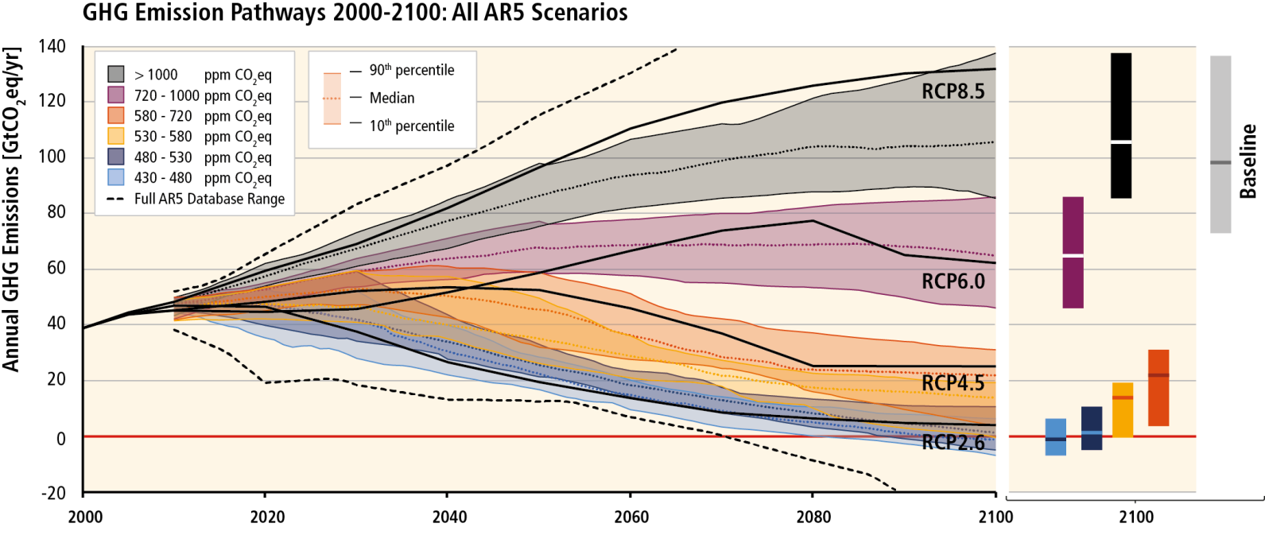
Without more mitigation, global mean surface temperature might increase by 3.7° to 4.8°C over the 21st century.
Figure SPM.4
Notes:
‚Mitigation maps‘ for navigators.
Temperature increase compared to 1850-1870.
Baseline scenarios exceed 450 ppm CO2eq by 2030 and reach CO2eq concentration levels between 750 to more than 1300 ppm CO2eq by 2100.
Even 3°C scenarios show substantial changes. What is done over the next 20 or so years does not change if one relaxes the temperature target from 2°C to say 3°C.
No multi-model comparison study and only a limited number of individual studies have explored pathways to atmospheric concentrations of below 430 ppm CO2eq by 2100.

Slide 15
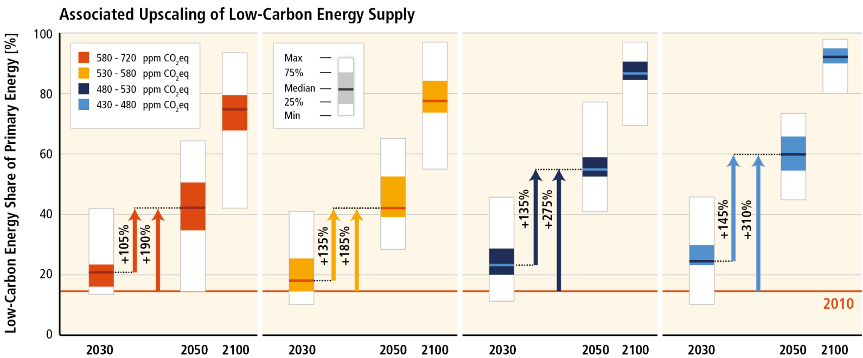
Mitigation requires major technological and institutional changes including the upscaling of low- and zero carbon energy.
Figure SPM.4
Notes:
Scenarios that limit warming to less than 2°C with a probability of >50% never exceed atmospheric GHG concentration levels of 530ppm CO2eq by 2100.
These scenarios assume immediate introduction of climate policies as well as the rapid upscaling of the full portfolio of mitigation technologies in all sectors and strongly depend on the ability to remove large amounts of carbon dioxide from the atmosphere in order to bring concentration levels well below 430 ppm CO2eq in 2100

Slide 16
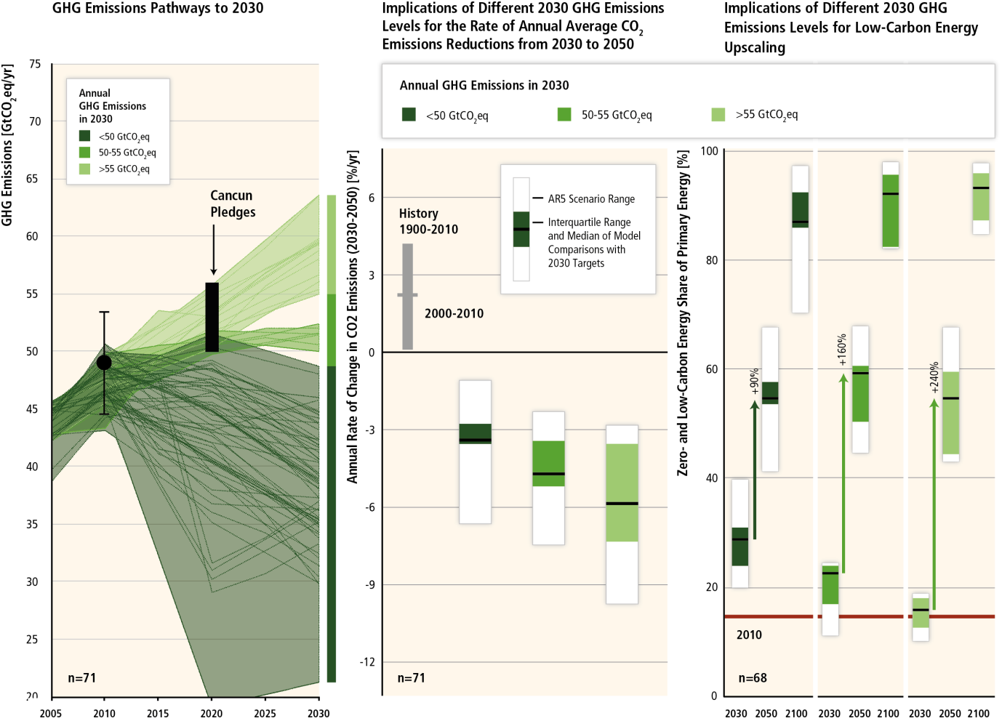
In cost-effective 2°C mitigation strategies, emissions have peaked and emission levels in 2030 tend to be lower than today
Delayed mitigation
50 GtCO₂e
Cost-effective mitigation
Figure SPM.5

Slide 17
Delayed mitigation significantly increases the challenge to reach low concentration targets
Sweden and
Figure SPM.5

Slide 18
Current Cancun Pledges imply increased mitigation challenges for reaching 2°C
Delayed mitigation significantly increases the challenge to reach low concentration targets
Figure SPM.5

Slide 19
Estimates for mitigation costs vary widely.
Reaching 450ppm CO₂eq entails consumption losses of 1.7% (1%-4%) by 2030, 3.4% (2% to 6%) by 2050 and 4.8% (3%-11%) by 2100 relative to baseline (which grows between 300% to 900% over the course of the century).
This is equivalent to a reduction in consumption growth over the 21st century by about 0.06 (0.04-0.14) percentage points a year (relative to annualized consumption growth that is between 1.6% and 3% per year).
Cost estimates exlude benefits of mitigation (reduced impacts from climate change). They also exclude other benefits (e.g. improvements for local air quality).
Cost estimates are based on a series of assumptions.
Notes:
Estimates rely on three important institutional requirements:
all countries begin to mitigate immediately
they all introduce a globally uniform price on all GHG emissions
they all allow the use of all key technologies

Slide 20
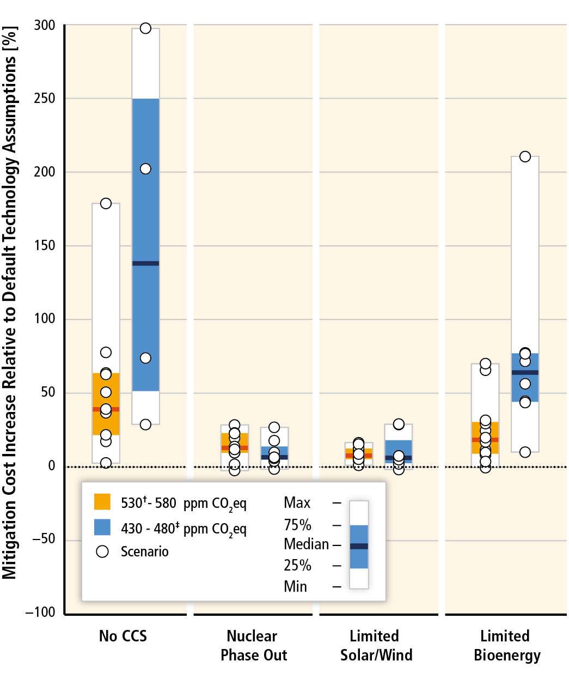
Limited availability of technologies increases costs.
Figure TS.13
Notes:
Relative increase of NPV mitigation costs (period 2015-2100, 5% discount rate) from technology portfolio variations compared to a scenario with default technology availability.
Low Energy Intensity = higher energy intensity improvements leading to energy demand reductions of 20-30% by 2050 and 35-45% by 2100 relative to the default baseline
Nuclear phase out = No addition of nuclear power plants beyond those under construction; existing plants operated until the end of their lifetime;
Limited Solar/Wind = 20% limit on solar and wind electricity generation
Limited Bioenergy = maximum of 100 EJ/yr bioenergy supply
Conventional energy future = combining pessimistic assumptions for renewable energy (Limited Solar/Wind + Limited Bioenergy)
Energy efficiency and renewable energy future = combining low energy intensity with non-availability of CCS and nuclear phase-out
Limited Technology Future = all supply side options constrained and energy intensity developing in line with historical records in the baseline.

Slide 21
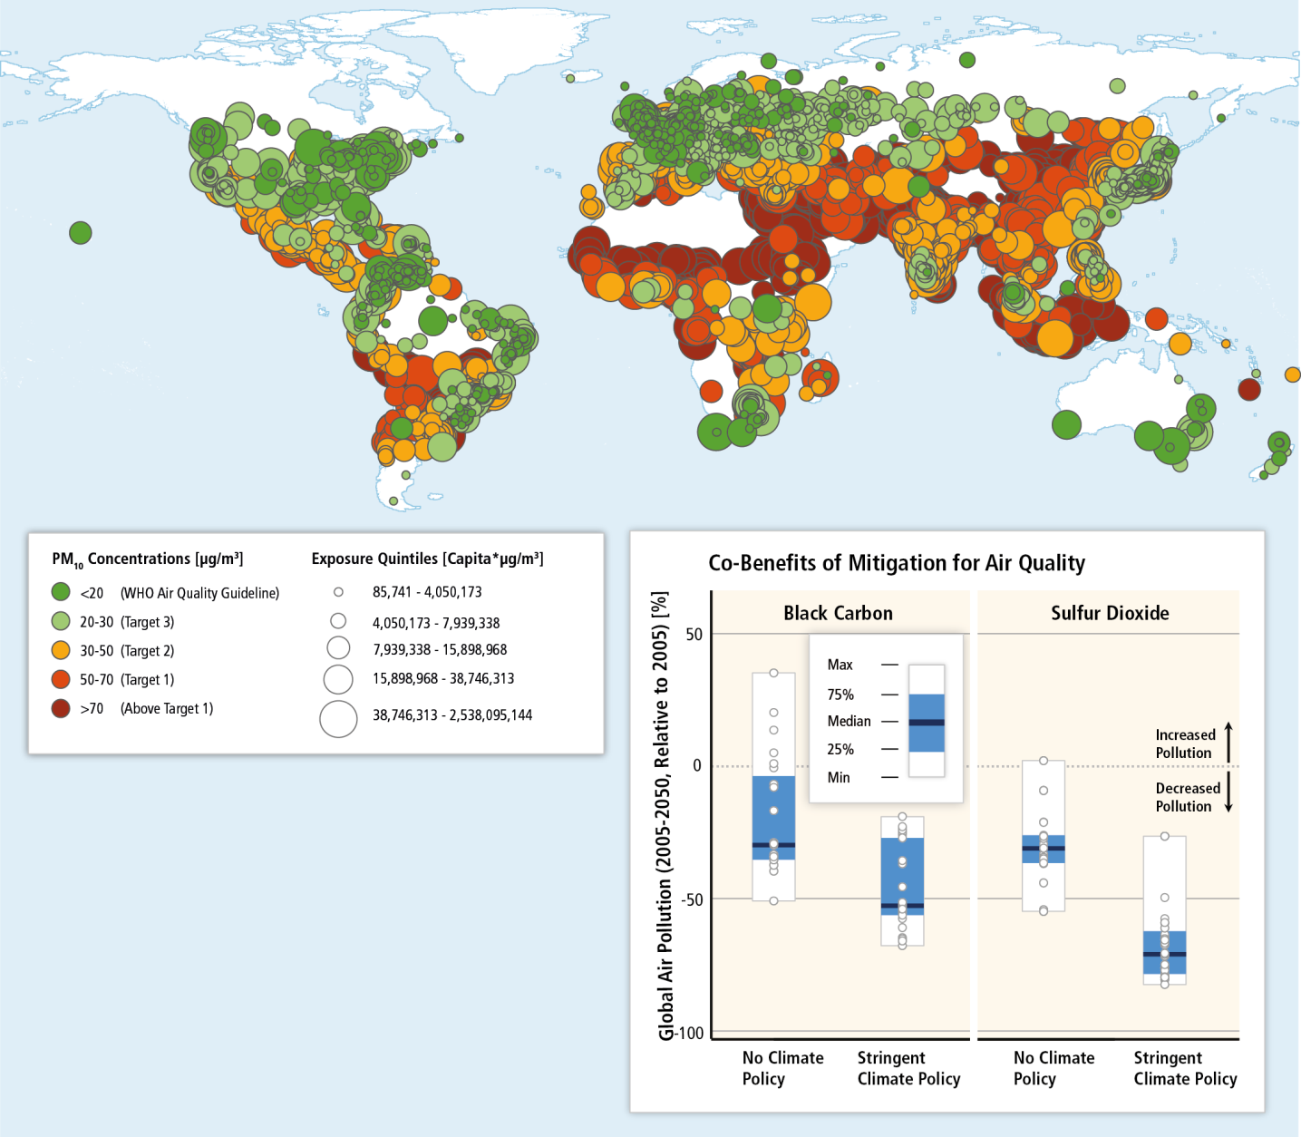
Mitigation can result in large co-benefits for human health and other societal goals.
Figure TS.14
Figure 12.23

Slide 22
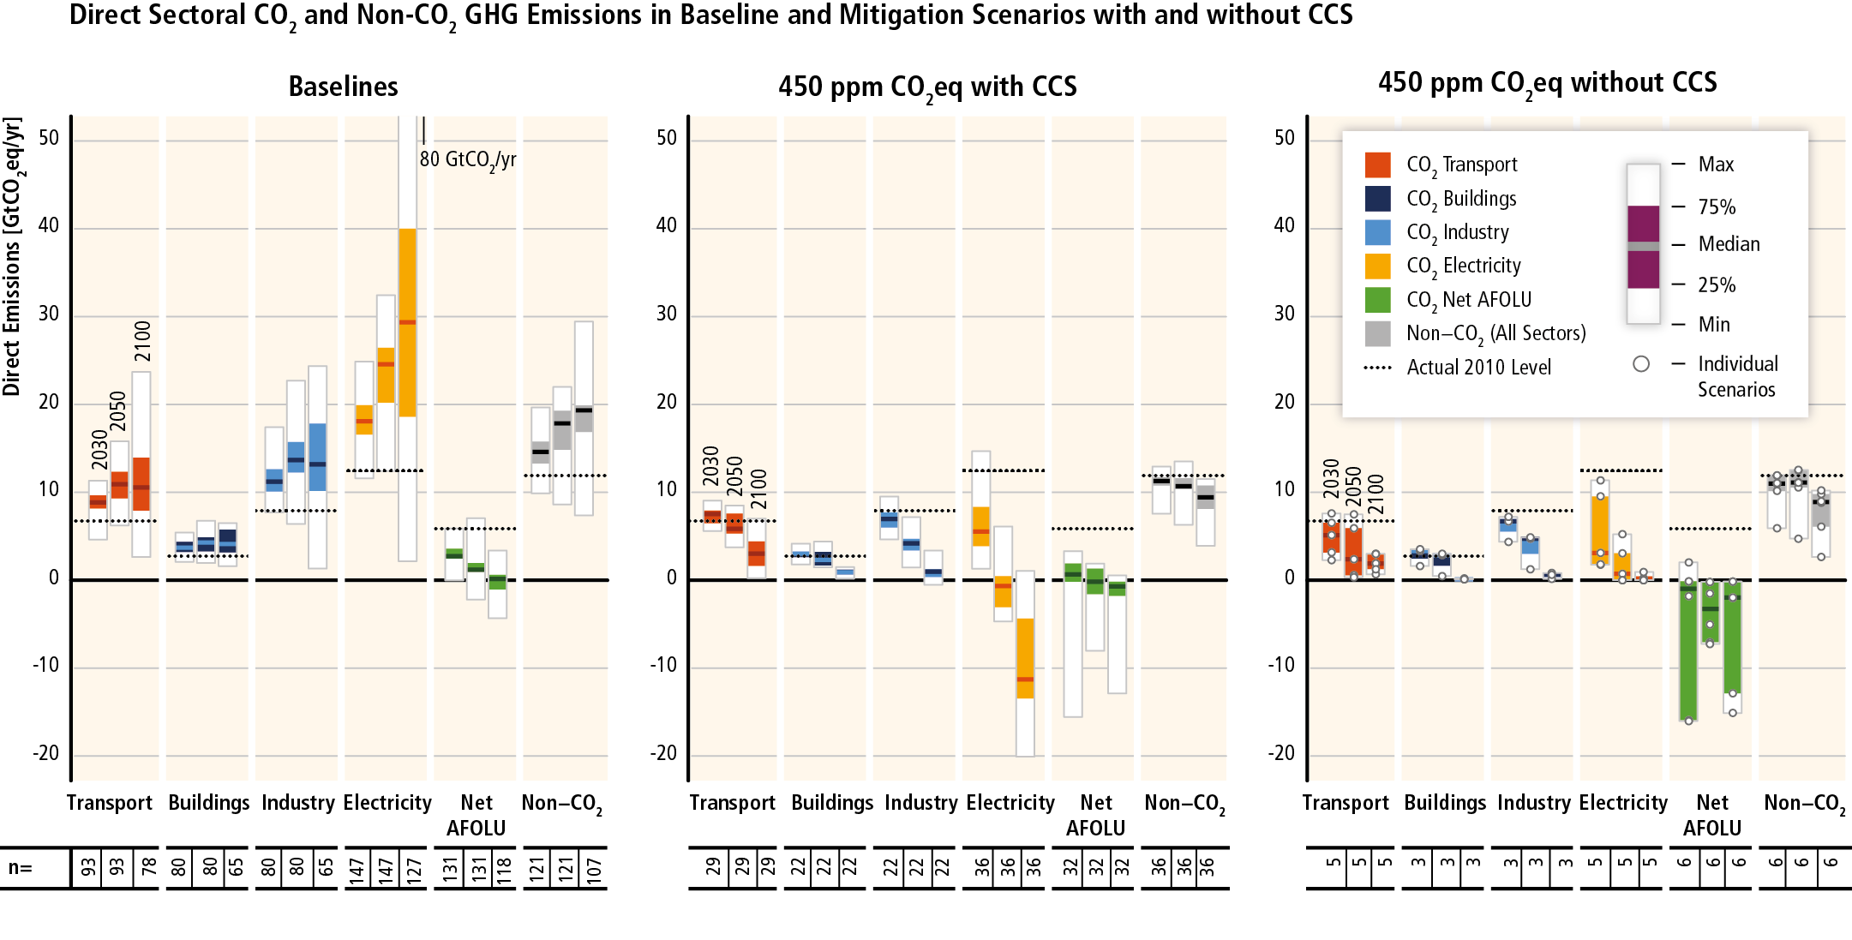
Mitigation requires changes throughout the economy. Efforts in one sector determine mitigation efforts in others.
Figure SPM.7
Notes:
Fast emission reductions in one sector, allow more flexibility for the required emission reductions in other sectors.
The availability and performance of BECCS and large scale afforestation has a strong influence on how mitigation efforts are distributed across sectors.
Because the “Agriculture, Forestry, and Other Land Use” sector provides options to remove carbon dioxide from the atmosphere, it has a unique and key role in low stabilization scenarios.
However, with the AFOLU sector also having a central role for food security and sustainable development, comprehensive policy frameworks are required to manage the possible competition for land.

Slide 23
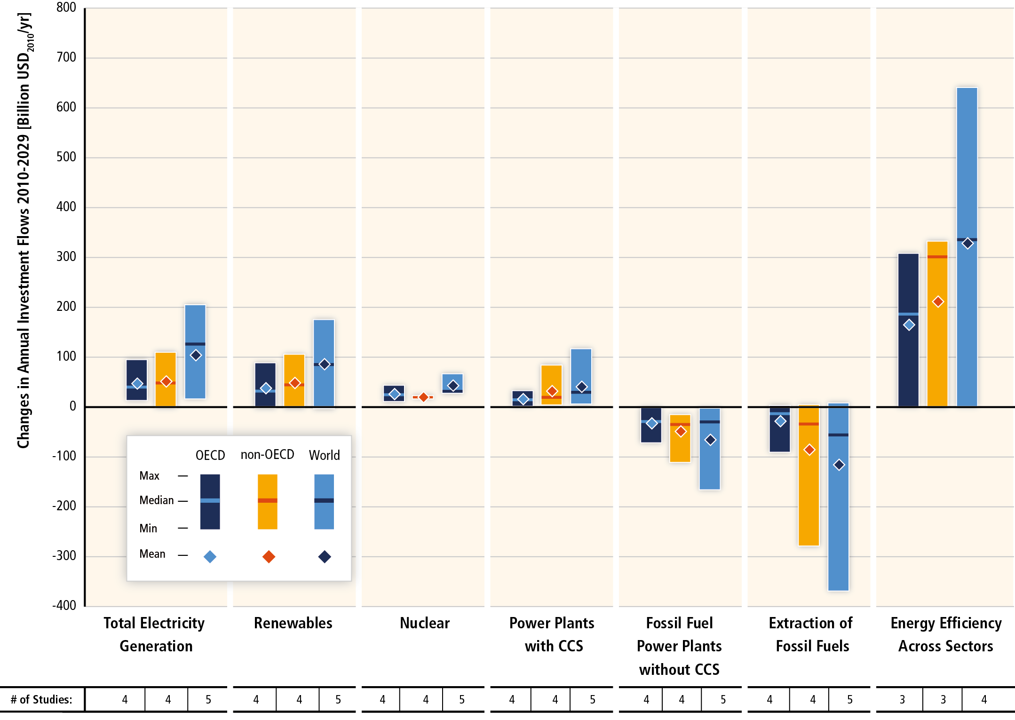
Substantial reductions in emissions would require large changes in investment patterns.
Figure SPM.9
Notes:
Estimates for mitigation scenarios that bring concentrations to 430-530 ppm by 2100.
Comparison to baseline investments in the period 2010-2029.
Annual investments in fossil fuel technologies would decline by 20%.
Annual investments in low-carbon technologies would rise by 100%.
Most investments would occur in non-OECD countries.

Slide 24
Since AR4, there has been an increased focus on policies designed to integrate multiple objectives, increase co-benefits and reduce adverse side-effects.
Sector-specific policies have been more widely used than economy-wide policies.
Regulatory approaches and information measures are widely used, and are often environmentally effective.
Since AR4, cap and trade systems for GHGs have been established in a number of countries and regions.
In some countries, tax-based policies specifically aimed at reducing GHG emissions–alongside technology and other policies–have helped to weaken the link between GHG emissions and GDP.
The reduction of subsidies for GHG-related activities in various sectors can achieve emission reductions, depending on the social and economic context.

Slide 25
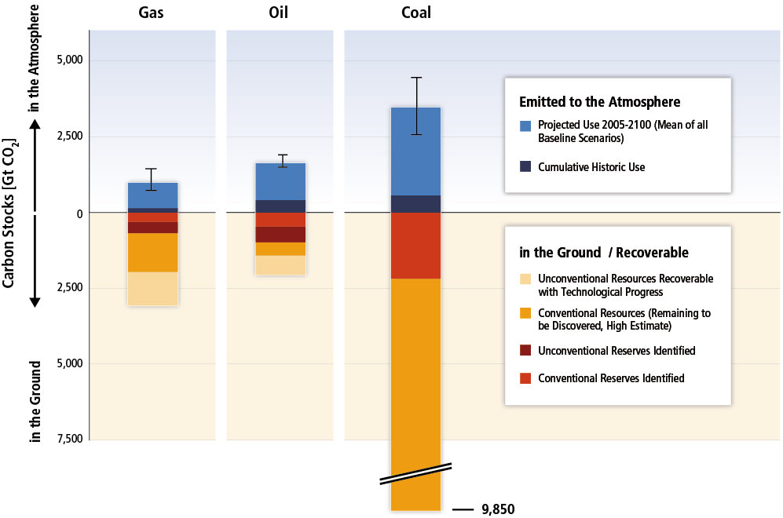
Climate change is a global commons problem that implies the need for international cooperation.
SRREN, Figure 1.7

Slide 26
Effective mitigation will not be achieved if individual agents advance their own interests independently.
Existing and proposed international climate change cooperation arrangements vary in their focus and degree of centralization and coordination.
Issues of equity, justice, and fairness arise with respect to mitigation and adaptation.
Climate policy may be informed by a consideration of a diverse array of risks and uncertainties, some of which are difficult to measure, notably events that are of low probability but which would have a significant impact if they occur.

Slide 27
www.mitigation2014.org

Slide 28
The challenge of mitigation
Professor Simon Caney
Professor in Political Theory,
University of Oxford

Slide 29
Ethics, The Challenge of Mitigation, and the Future of Climate Research
16th May 2014
Professor Simon Caney
Department of Politics and International Relations
University of Oxford

Slide 30
The Structure
I: Ethics and Climate Change
II: Ethics in AR5
III: Future Directions

Slide 31
I: Ethics and Climate Change
The role of ethics … to guide
(1) What is “dangerous anthropogenic interference with the climate system” (UNFCCC, Article 2)
(2) What is a just response to risk and uncertainty? [“Where there are threats of serious or irreversible damage, lack of full scientific certainty should not be used as a reason for postponing such measures … .” (UNFCCC, Article 3.3)]

Slide 32
(3) What is a just distribution of the burdens of mitigation and adaptation? “The Parties should protect the climate system … on the basis of equity and in accordance with their common but differentiated responsibilities and respective capabilities.” (UNFCCC, Article 3.1)
(4) What is a just distribution of rights to emit greenhouse gases? Equal per capita view/contraction and convergence; greenhouse development rights; grandfathering.
(5) The ethical relevance of past emissions to (a) equitable burden sharing and (b) the just distribution of emission rights.

Slide 33
(6) What obligations does the current generation have to future generations both (a) in terms of preventing dangerous climate change and (b) distributing costs of mitigation and adaptation (“The Parties should protect the climate system for the benefit of present and future generations of humankind, on the basis of equity” (UNFCCC Article 3.1)
(7) What moral constraints are there on mitigation policies (biofuels, nuclear, hydroelectric, hydraulic fracturing) or geoengineering (SRM or CDR)?
(8) Procedural Justice: Who has the right to be included in the decision making process (mitigation, adaptation …. )?

Slide 34
II: Ethics in AR5
Major Innovation
Ethics plays a key role in a IPCC Assessment Report for first time and moral and political philosophers included
Aim:
to outline some core concepts, justice, value, good (conceptual analysis)
to represent debates about nature of justice, equity and well-being (normative analysis)

Slide 35
Content of Chapter III
Justice, equity and responsibility
Responsibility for burden sharing
Intergenerational justice
Historical responsibility and distributive justice
Intra‐generational distributive justice:
compensatory justice and historical responsibility
ethics of geoengineering
nature of well-being
nonhuman values

Slide 36
Findings (chapter 3)
Executive Summary
“Duties to pay for some climate damages can be grounded in compensatory justice and distributive justice” (p.5)
“principles of compensatory justice will apply to only some of the harmful emissions [3.3.5]” (p.5)
“Duties to pay for climate damages can, however, also be grounded in distributive justice [3.3.4, 3.3.5]”. (p.6)

Slide 37
Comments: Relation to SPM
Summary for Policy Makers:
“Issues of equity, justice, and fairness arise with respect to mitigation and adaptation.” (p.4)
“Sustainable development and equity provide a basis for assessing climate policies and highlight the need for addressing the risks of climate change.” (p.4)
“Many areas of climate policy‐making involve value judgements and ethical considerations. “ (p.4)

Slide 38
III: Future Directions
#1. More systematic integration of ethical principles into analysis of mitigation; more on distributive impacts of mitigation policies; more on comprehensive normative framework for comparing mitigation options that goes beyond monetary impacts and enables comparisons and trade-offs.
#2. Developing accounts of energy justice that does not focus simply on rights to emit, but focuses instead on serving persons’ capabilities (Sen)

Slide 39
#3. more on non-Western ethical perspectives for analysing climate change (Given it is a global problem, should not ethical analysis be informed by analysis of all ethical traditions?)
#4. Institutional design and the politics of climate change
(a) combining effectiveness with procedural justice
(b) incentivising longterm policymaking (courts, ombudsman, committee for the future, longterm performance indicators, UN High Commissioner for Future Generations)

Slide 40

Thank you!
Professor Simon Caney
Co-Director of Human Rights for Future Generations, Oxford Martin School, University of Oxford.
Director of Centre for the Study of Social Justice, University of Oxford.

Slide 41
The challenge of mitigation
Professor John Barrett
Professor of Sustainability Research, University of Leeds

Slide 42

Driver of emissions
Notes:
Demand reductions in the energy end-use sectors are a key mitigation strategy and determine the
41 scale of the mitigation challenge for the energy supply side (high confidence). Limiting energy
42 demand 1) increases policy choices by maintaining flexibility in the technology portfolio, 2) reduces
43 the required pace for up-scaling low-carbon energy supply and hedges against related supply side
44 risks, 3) avoids lock-in to new, or a potentially premature retirement of, carbon-intensive
45 infrastructures, 4) maximizes co-benefits for other policy objectives and 5) increases the cost
46 effectiveness of the transformation

Slide 43
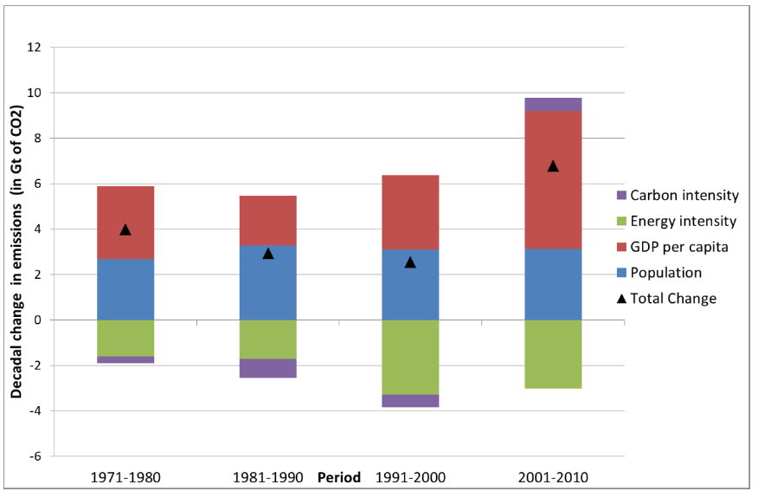
Final Demand as a driver of emissions
Notes:
Over the last four decades total cumulative CO2 emissions have increased by 1 a factor of 2 from
2 about 900 GtCO2 for the period 1750 - 1970 to 2000 GtCO2 for 1750 – 2010
More than 75% of the 10 Gt increase in annual GHG emissions between 2000 and 2010
3 was emitted in the energy supply (47%) and industry (30%) sectors.
Without explicit efforts to reduce GHG emissions, the fundamental drivers of emissions growth
18 are expected to persist despite major improvements in energy supply and end-use technologies
We still have a broadly technological focus with demand seen as a issue of household energy use and not the economy-wide. Problems of rebounds and also an over extraration of decoupling
Current pledges made in Cancun are simply not enough

Slide 44
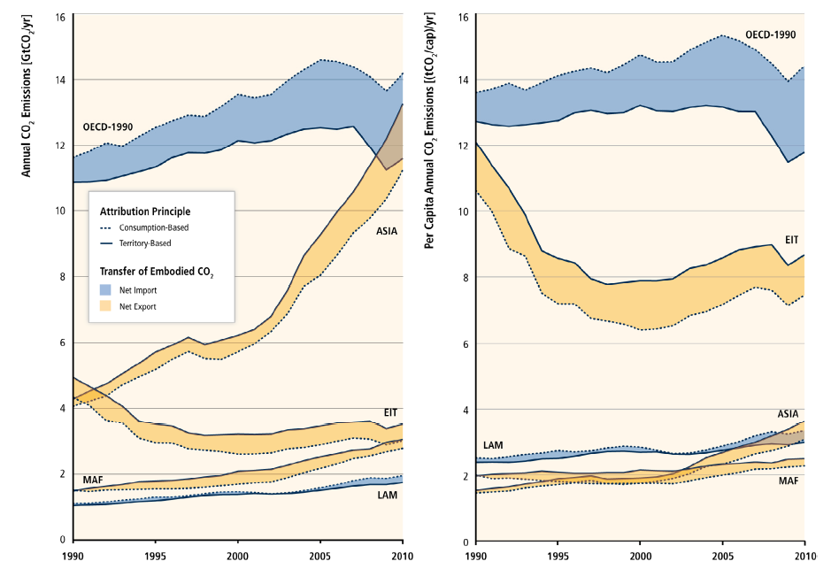
Rate of decoupling

Slide 45
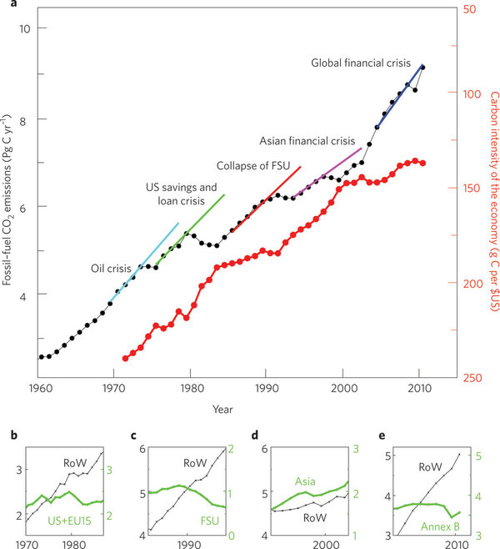
Effects of past economic crises
Source: Peters et al (2011)

Slide 46
Carbon budgets for the UK
Notes:
Demand reductions in the energy end-use sectors are a key mitigation strategy and determine the
41 scale of the mitigation challenge for the energy supply side (high confidence). Limiting energy
42 demand 1) increases policy choices by maintaining flexibility in the technology portfolio, 2) reduces
43 the required pace for up-scaling low-carbon energy supply and hedges against related supply side
44 risks, 3) avoids lock-in to new, or a potentially premature retirement of, carbon-intensive
45 infrastructures, 4) maximizes co-benefits for other policy objectives and 5) increases the cost
46 effectiveness of the transformation

Slide 47
Revisit UK Carbon Budgets for RCP 2.6
Figure 1: UK Emissions 2012 – 2100 to achieve equitable 2 degree benchmark with 67% probability
95% reduction by 2050
Figure 2: Comparison of 2 degree equitable reduction with CCC budgets
80% reduction by 2032
Source: Own Calculations

Slide 48
Climate is a short-term issue under RCP 2.6
Figure 1: UK Consumption Emissions with 3.2% per year efficiency improvements
Figure 2: UK Consumption Emissions with necessary annual reduction achieved to 2027
Source: Own Calculations

Slide 49
Demand reduction strategies for the UK
Notes:
Demand reductions in the energy end-use sectors are a key mitigation strategy and determine the
41 scale of the mitigation challenge for the energy supply side (high confidence). Limiting energy
42 demand 1) increases policy choices by maintaining flexibility in the technology portfolio, 2) reduces
43 the required pace for up-scaling low-carbon energy supply and hedges against related supply side
44 risks, 3) avoids lock-in to new, or a potentially premature retirement of, carbon-intensive
45 infrastructures, 4) maximizes co-benefits for other policy objectives and 5) increases the cost
46 effectiveness of the transformation

Slide 50
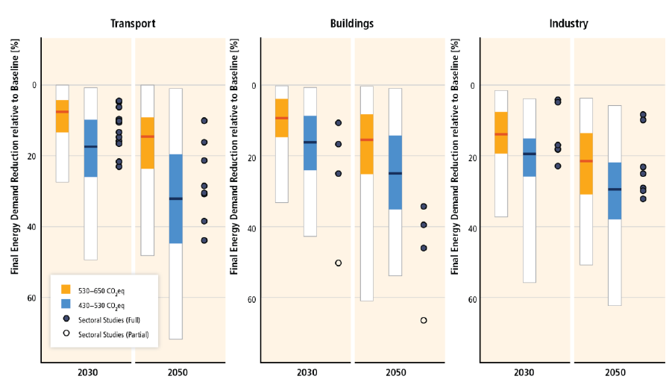
Demand responses
Source: IPCC SPM WG3
Notes:
Demand reductions in the energy end-use sectors are a key mitigation strategy and determine the
41 scale of the mitigation challenge for the energy supply side (high confidence). Limiting energy
42 demand 1) increases policy choices by maintaining flexibility in the technology portfolio, 2) reduces
43 the required pace for up-scaling low-carbon energy supply and hedges against related supply side
44 risks, 3) avoids lock-in to new, or a potentially premature retirement of, carbon-intensive
45 infrastructures, 4) maximizes co-benefits for other policy objectives and 5) increases the cost
46 effectiveness of the transformation

Slide 51
Groups affected by mitigation
Source: Own Calculations, analysis available on request

Slide 52
Conclusions
Difficult and under explored relationship between consumption and emissions
Distribution of responsibility remains a crucial question
Increased reduction by 2030 changes the policy landscape
Notes:
Demand reductions in the energy end-use sectors are a key mitigation strategy and determine the
41 scale of the mitigation challenge for the energy supply side (high confidence). Limiting energy
42 demand 1) increases policy choices by maintaining flexibility in the technology portfolio, 2) reduces
43 the required pace for up-scaling low-carbon energy supply and hedges against related supply side
44 risks, 3) avoids lock-in to new, or a potentially premature retirement of, carbon-intensive
45 infrastructures, 4) maximizes co-benefits for other policy objectives and 5) increases the cost
46 effectiveness of the transformation

Slide 53
The challenge of mitigation
Professor Catherine Mitchell
Professor of Energy Policy,
University of Exeter

Slide 54
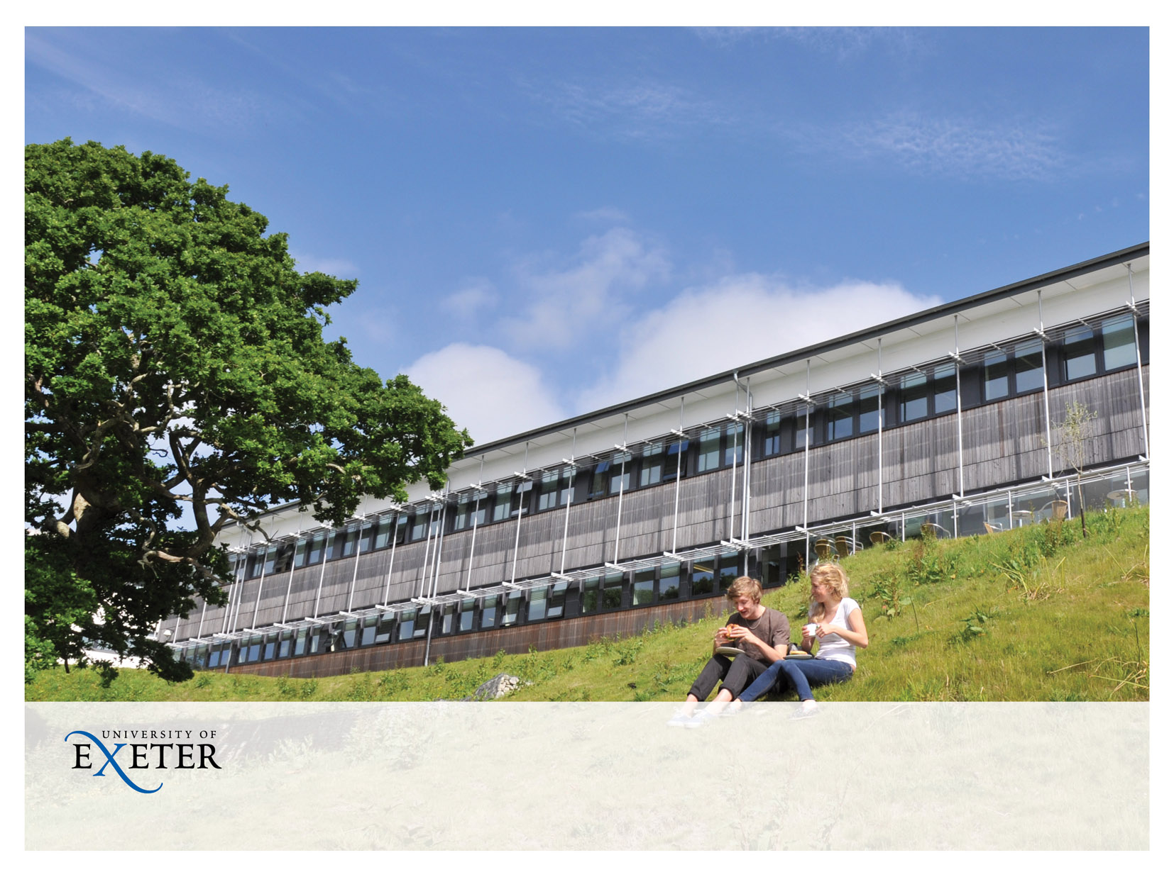
WG3 and policy for climate change
Catherine.mitchell@exeter.ac.uk, Energy Policy Group

Slide 55

Discussion of mitigation policies runs through the WG3 Report
The sector-specific chapters include policies specific to their sector, for example transport or buildings
The policy chapters provide more general overviews of policy instruments
  Chapter 13 International Cooperation
  Chapter 14 Regional Development and Cooperation
  Chapter 15 National and Sub-national Policies and Institutions
  Chapter 16 Cross-cutting Investment and Finance issues
Notes:
I am in Chapter 15 and I specialise in energy
I strongly recommend you read these chapters

Slide 56
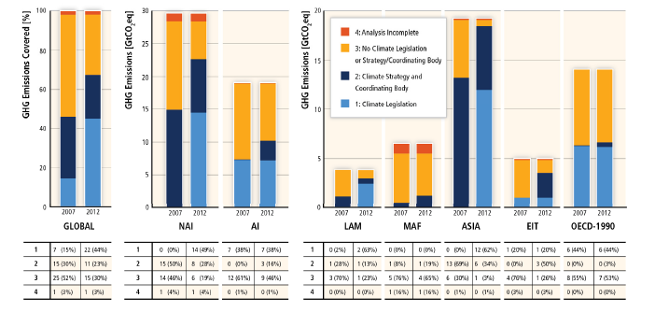
More countries have climate policies now than they did in AR4

Slide 57
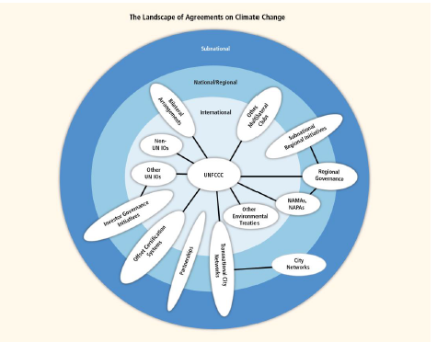
Notes:
Taken from Chapter 13
There are lots of agreements on climate change which are either situated in the international space; or span international, regional, national and subs-national
There is international cooperation that has produced political agreement regarding a long term goal to limit temperature change to 2⁰C above pre-industrial levels
There is a great deal of interesting smaller scale initiatives going on as well as interesting developments from various business sectors which are working outside of Governments.
However overall level of mitigation is inadequate for stopping rise in GHG emissions

Slide 58
There are lots of policies that work
There is an increasing focus on policies designed to integrate multiple objectives and increase co-benefits
  For example, combined development and GHG reduction targets; combined energy security and energy reduction policies
Economy –wide policies, for example carbon taxes, have been implemented in some countries, and long with technology policies, have contributed to decoupling of emissions from GDP
Sector-specific policies have been more widely used that economy wide policies, for example policies to increase the stringency of building regulation; policies to encourage change of modalities in transport
Regulatory approaches (eg only allowing installation of efficient boilers) and information measures are widely used, and often environmentally effective
There is a distinct role for technology and innovation policy to complement other climate mitigation policies
  Technology push (eg R&D) and demand pull (eg support mechanisms) can complement each other in a virtuous cycle
Notes:
Please look at the chapters – I do not want this presentation to be a long list of policies

Slide 59
Policies have to take account of other factors if they are to be successfully implemented
Delayed mitigation significantly increases the challenge to reach low concentration targets
A lot of inertia in the system and successful policies require an enabling environment
Infrastructure developments, spatial planning and long lived products can lock societies into pathways which are difficult to change
  On the other hand, if undertaken as part of early action they can act as a facilitator for mitigation
The regions with the greatest potential and flexibility to leapfrog to low carbon development trajectories are the poorer development regions where there are few lock-in effects but they also have the lowest financial, technological and human capacities
Notes:
1. Delayed mitigation significantly increases the challenge to reach low concentration targets
2. A lot of inertia in the system and successful policies require an enabling environment
No policy mechanism exists in a vacuum
The policy mechanism has to ‘fit’ with its surrounding environment and that surrounding environment also has to fits with the needs of the policy objective, for example
Institutions (including regulations, markets and laws)
Information, knowledge, skills and capacity have to exist
3. Infrastructure developments, spatial planning and long lived products can lock societies into pathways which are difficult to change
On the other hand, if undertaken as part of early action they can act as a facilitator for mitigation
4. The regions with the greatest potential and flexibility to leapfrog to low carbon development trajectories are the poorer development regions where there are few lock-in effects but they also have the lowest financial, technological and human capacities

Slide 60
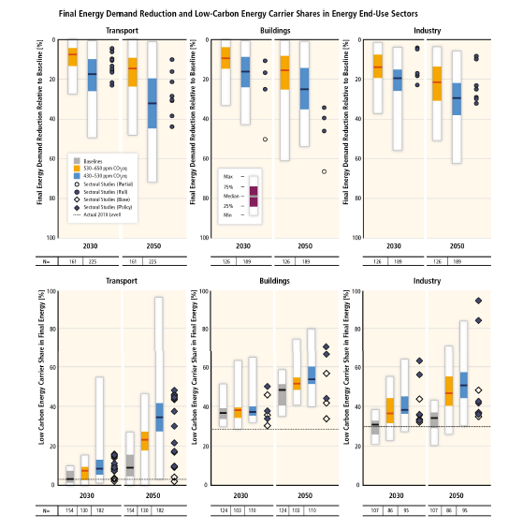
Policies that reduce substantially emissions will have major technological, institutional, business and social/ experiential/ attitudinal/ behavioural impacts
Notes:
SPM 8 -
If policies seriously reduce emissions then there will be impacts - positive and negative; we do not know what they will be.
My point is that we have to expect this and be ready for it.
This figure is showing the required amount of energy demand reduction and low carbon provision in the end-use sectors of transport, buildings and industry, for 2030 and 2050 to meet the 2 degree temperature change in 2100.
To achieve these levels of demand reduction and low carbon provision will require institutional and technological change as well as attitudinal and behavioural changes
Managing the social and business opportunities and challenges of this may require innovations in policy and institutional design – certainly openness to new entreprises and ways of doings things
Behaviour, lifestyle and culture have considerable influence on emissions, and can be substantially altered through changes in consumption patterns

Slide 61
Substantial reductions in emissions would require large changes in investment patterns and will have distributional impacts
Figure SPM.9
Notes:
Again there are going to be major impacts – we can expect stranded assets of fossil fuels, job losses and gains. This is not going to happen unless Governments and society hold firm in the face of the changes.
Estimates for mitigation scenarios that bring concentrations to 430-530 ppm by 2100.
Comparison to baseline investments in the period 2010-2029.
Annual investments in fossil fuel technologies would decline by 20%.
Annual investments in low-carbon technologies would rise by 100%.
Most investments would occur in non-OECD countries.

Slide 62
Conclusion
There are now more climate policies in place than there was at AR4.
GHG are still rising, and the rate is getting faster – in this sense, there is insufficient policy stringency.
There is a lot of evidence about successful policies for emission reduction.
There is a lot of examples of new actors and new ways of doing things which reduce emissions
Achieving substantial emission reductions requires change and will have distributional etc impacts
The role of government in policy is multifaceted:
signing up to international agreements
putting in place the enabling environment for climate change policies; but also
helping to break the inertia in the system
managing change and distributional impacts (both positive and negative) on business and society
enabling inclusion and innovation
Notes:
Will be impacts, will be lobbies against change and governments and society have to be ready for it

Slide 63

Transformational Climate Science
The future of climate change research
following the IPCC Fifth Assessment Report
#climate2014

Slide 64

Panel session II
Frontiers of climate change research
#climate2014

Slide 65
Frontiers of climate change research
Chair: Professor Dame Julia Slingo
Chief Scientist, Met Office
Panellists: Professor Stephen Belcher
Head of the Met Office Hadley Centre
Professor Sam Fankhauser
Co-Director of the Grantham Research Institute,
London School of Economics
Professor Sir Andy Haines
Professor of Public Health and Primary Care,
London School of Hygiene and Tropical Medicine
Professor Pierre Friedlingstein
Chair, Mathematical Modelling of Climate Systems,
University of Exeter
Professor Tim Lenton
Chair in Climate Change/Earth Systems Science, University of Exeter
Professor David Stephenson
Chair in the Statistical Modelling of Weather and Climate,
University of Exeter

Slide 66
Frontiers of climate change research
Professor Dame Julia Slingo
Chief Scientist, Met Office

Slide 67
Frontiers of climate change research
Professor Stephen Belcher
Head of the Met Office Hadley Centre

Slide 68
Frontiers of climate change research
Professor Sam Fankhauser
Co-Director of the Grantham Research Institute,
London School of Economics

Slide 69
Frontiers of climate change research
Professor Sir Andy Haines
Professor of Public Health and Primary Care,
London School of Hygiene and Tropical Medicine

Slide 70
Frontiers of climate change research
Professor Pierre Friedlingstein
Chair, Mathematical Modelling of Climate Systems, University of Exeter

Slide 71
Frontiers of climate change research
Professor Tim Lenton
Chair in Climate Change/Earth Systems Science, University of Exeter

Slide 72
Frontiers of climate change research
Professor David Stephenson
Chair in the Statistical Modelling
of Weather and Climate,
University of Exeter

Slide 73
Transformational Climate Science
The future of climate change research
following the IPCC Fifth Assessment Report
#climate2014

