Slide 1
v
Exeter Scholars Year 9 Pathway: Next Steps
Notes:
So over today, hopefully you will have had the chance to experience a little bit about what a university campus is like, and gained a bit of an understanding of how the programme works and some of its aims.
Over the next 15 minutes or so, we’re going to be having a look at actually what the programme involves, how the sessions work, and what’s expect of you, and you’ll have the opportunity to ask any questions or queries that you may still have about the programme, before completing an evaluation form for the day.

Slide 2
Year 9 South West Pathway: Programme Overview
Year Group | Session | Name of Session
Year 9 | Event | Year 9 Welcome Event
Year 9 | 1 | Getting to Know You
Year 9 | 2 | HE: To Go or Not to Go?
Year 10 | 3 | Cracking Careers
Year 10 | 4 | Demystifying HE
Year 10 | 5 | Exploring Courses
Year 10 | 6 | Round Up
Year 11 | 7 | Money Matters
Year 11 | 8 | Next Steps
Year 11 | Event | Year 11 Celebration Event
Notes:
This programme is designed to support and help young people who have the potential to progress on to university, but doesn’t mean that they have to go on to university, it’s very much about looking at what the options are and being able to help make the informed decision.
At the minute you are all at the very start of the programme. Over the next couple of years, through to this time in year 11, you will be taking part in 8 tutoring sessions which explore a variety of different things to do with your future, and to help to dispel myths about university. In the spring term, you’ll be taking part in those first two sessions which introduce you to the programme and start to get you thinking about what you might want to do after you finish school or college.
Next year, in year 10, you will complete the main bulk of the scholars tutoring sessions, 4 sessions ranging from starting to think about whether or not you might want to go to university, through to exploring the variety of courses which you could study as part of higher education.
In year 11, you will take part in the final sessions of the programme, which will culminate in a Celebration event, like the year 11s that are here today for, where you can find out a bit about where the Exeter Scholars programme could take you next.

Slide 3
What do the sessions entail?
1 hour sessions
Student ambassador led tutoring
Exploring options for after finishing school
Providing advice and guidance
Answering questions and concerns
Notes:
The actual sessions themselves take place in your school, with the other members of your year group which are taking part in the programme. Each session is designed to last for an hour, however in some schools, if there are different lesson lengths, they may vary to fit in with the lesson times.
Today you’ve already had the chance to meet some of the ambassadors who have been out and about delivering these Exeter Scholars Tutoring sessions in school. For a session you will usually have two ambassadors delivering the session; if possible we try and get the same ambassadors to come out to you over the sessions that you are doing throughout the programme so that you get a chance to know who these students are and find out a bit more about their journey to university.
Your teacher in school has set the session times for the sessions taking place for the rest of this year; session 1 usually takes place in March, and session 2 in May. Your teacher should let you know in school what date and time the sessions are taking place. When you first start the programme in school, you will be given a workbook with resources for the whole of the programme over your three years. Your teacher should have a safe place for these to be stored in school between the sessions as you’ll need the resources throughout the programme.
This opportunity really is designed to enable you, as students with the potential to progress onto university (if you choose to do so), to have the confidence and understanding of what university involves, and exploring whether or not it is a pathway for you. It’s your chance to talk to university students to find out more, to ask questions and to build up your knowledge about higher education to ensure that you can make an informed decision about your future and where it may take you.

Slide 4
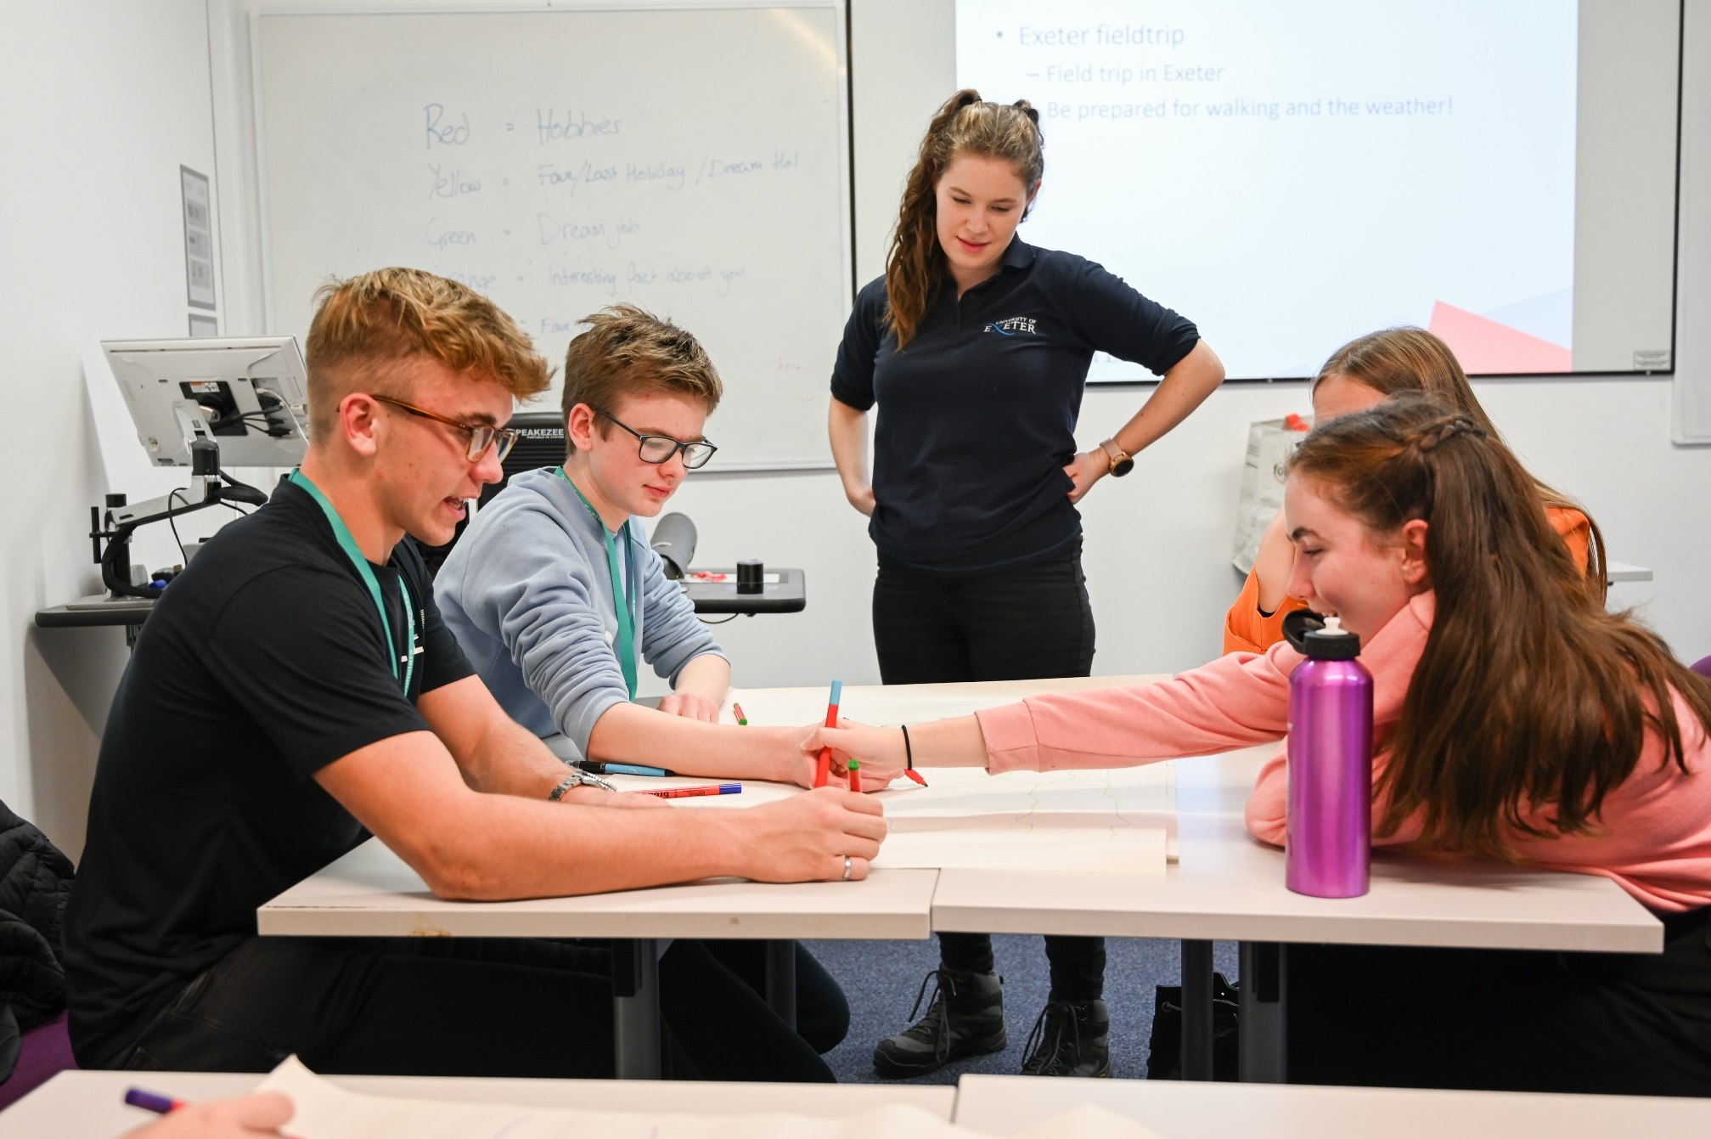
From here…
Notes:
Throughout this programme you’ll be working with student ambassadors to help you to explore what university is like, what some of the myths around university is, and whether university may be for you during the 10 sessions…

Slide 5

To here…
Notes:
And ultimately, you may decide that university is the right option for you. This short video gives you a little bit of a taster about what university life is like from when you start as a ‘Fresher’ through to graduating and gaining your degree in your subject.
Play video
I’m sure there’s also more studying that takes place as well as all of the fun!

Slide 6
Any programme questions?
Notes:
So that gives you an idea of what is happening next in terms of logistics for the programme. Does anyone have any questions relating to the programme before we move on to final bits of information.
If time do 5 min Q&A with throwing catch box

Slide 7
Finally…
Campus challenge winners announced
Feedback and evaluation form
Travel expenses
Email us: exeterscholars@exeter.ac.uk
Notes:
Announce Campus Challenge Winners
Please see our website for all the info you need about the programme
Final reminder to please hand in all evaluation forms – these are in your pack and they are double sided. There are a couple of questions for guests to complete at the end too! We take your feedback very seriously and want to make sure we receive this from you!
Travel expenses for your journey here today can be claimed back/reimbursed. You can complete a form online on the Exeter Scholars website and send back to us at the email address on the slide.

Slide 8

Exeter Scholars Travel Expenses Claim Form

Slide 9
Thank you and goodbye!
Notes:
Thank you for coming and have a safe journey home!
Any questions, please come and ask me.

