Slide 1
Pandemic and Progressivity
December 2, 2021
Alexander Klemm and Paolo Mauro
“The views expressed in this presentation are of the authors and do not necessarily represent the views of the IMF, its Executive Board, or IMF management.”

Slide 2
Motivation
Policy Relevance:
Case for progressive tax reforms
High direct and indirect cost of pandemic on public finances
Likely increase in inequality
Gauge attitudes toward
Temporary levies
Permanent/structural reforms
Different terms (including “solidarity tax”)
Contribution to literature on how experiences shape attitudes

Slide 3
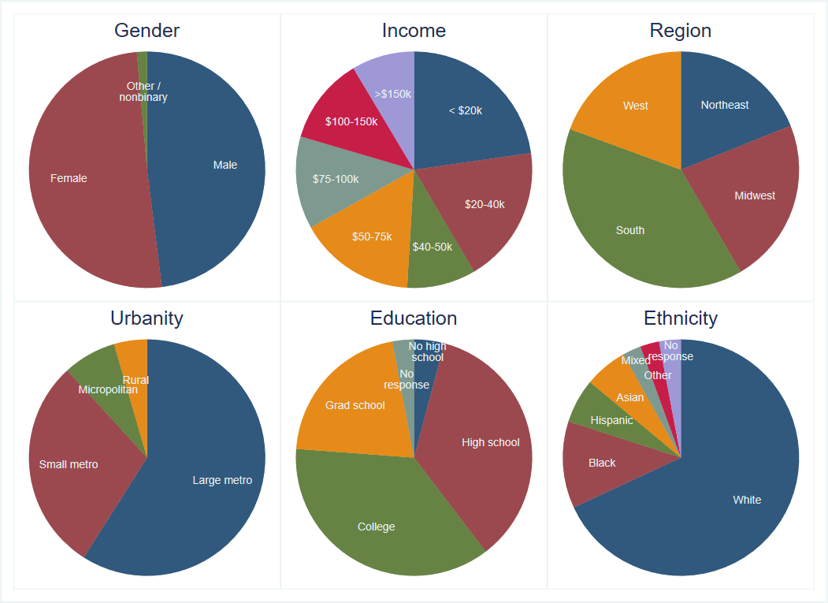
Data
Survey of 2,519 US residents (October 9-23)
 | Min | Median | Max
Age | 18.0 | 43.0 | 99.0
Number of children | 0.0 | 1.0 | 9.0
Number of adults in household | 1.0 | 2.0 | 19.0
Number of children in household | 0.0 | 0.0 | 19.0

Slide 4
Introductory Paragraph
The COVID-19 pandemic has caused the government to spend more to cover health costs and help people and businesses. Meanwhile, tax revenues have fallen because of the decline in incomes.
After the pandemic, a combination of spending cuts and tax increases is to be expected. We would like to get your input on how the government should approach making these changes.

Slide 5
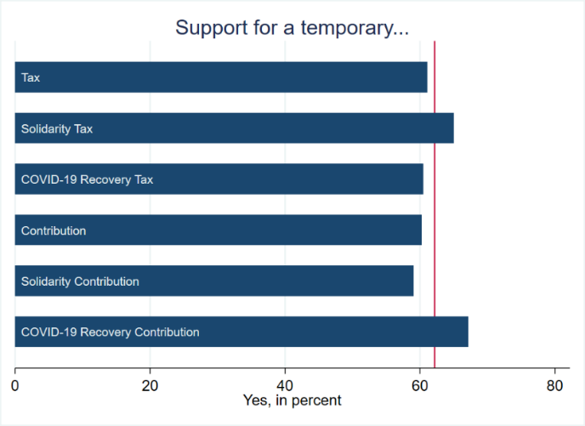
Would you support the introduction of a temporary [tax/solidarity tax/COVID-19 recovery tax/contribution/solidarity contribution/COVID-19 recovery contribution] charged on those who are well off, to cover the costs of fighting the COVID-19 pandemic and its economic impact?

Slide 6
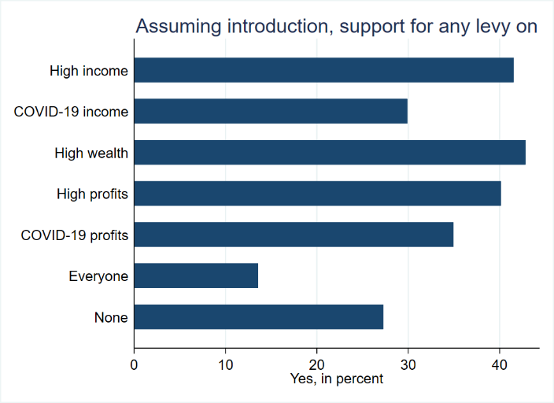
Assuming such a temporary [tax/solidarity tax/COVID-19 recovery tax/contribution/solidarity contribution/COVID-19 recovery contribution] were introduced, which of the following would you support?

Slide 7
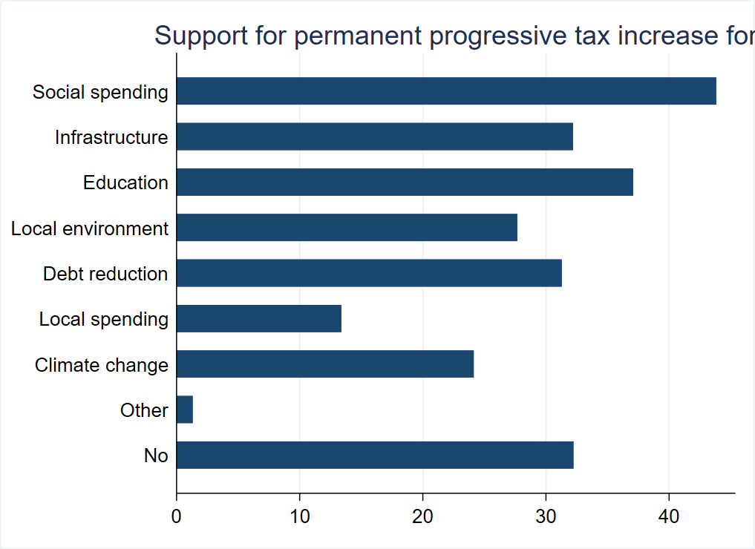
Would you support a permanent increase in taxes raised only on those who are well off?

Slide 8
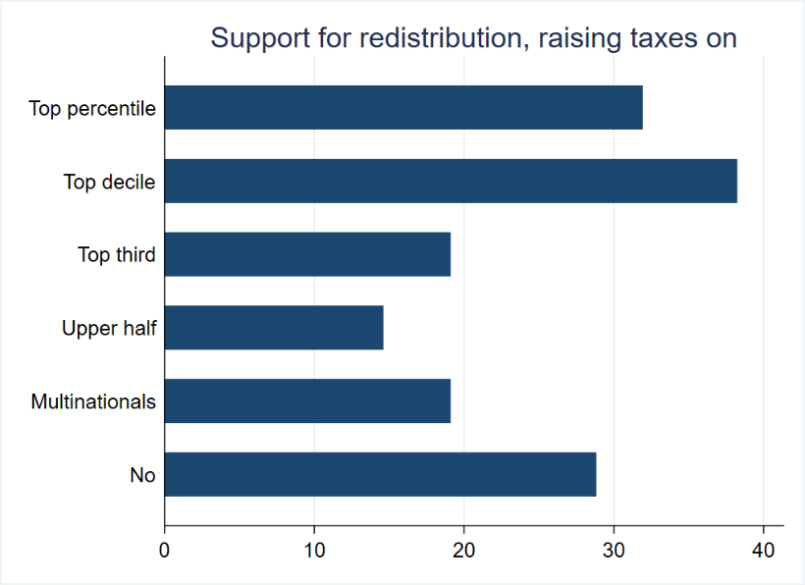
Would you support a tax law change that raises taxes on the rich, reducing them for everybody else so that the government receives the same total revenue?

Slide 9
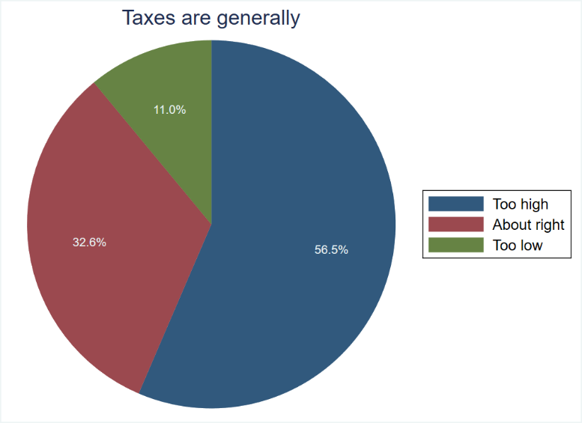
Which of the following statements do you agree with?

Slide 10
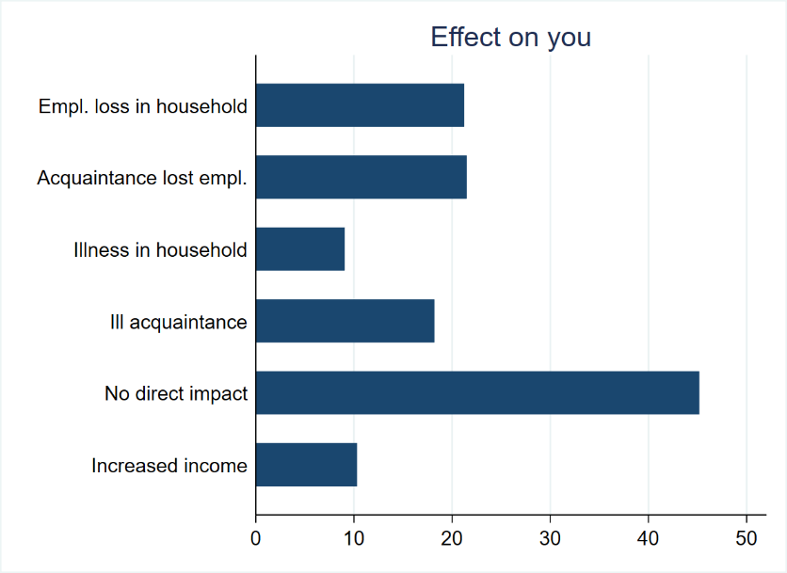
How has the COVID-19 pandemic directly affected your life?

Slide 11
Logit (marginal effects): Support for a Temporary Levy
 | (1)
Female | 0.01
 | (0.02)
Older half | -0.05***
 | (0.02)
Has children | 0.06***
 | (0.02)
Household size | 0.02**
 | (0.01)
Education | 0.03**
 | (0.01)
Income > $20k | 0.08***
 | (0.03)
Income > $50k | -0.03
 | (0.02)
Income > $150k | -0.07**
 | (0.03)
Black/African American | 0.07**
 | (0.03)
Ethnicity withheld | -0.48***
 | (0.08)
Suffered | 0.11***
 | (0.02)
Observations | 2,519
Robust standard errors in parentheses; *** p<0.01, ** p<0.05, * p<0.1.

Slide 12
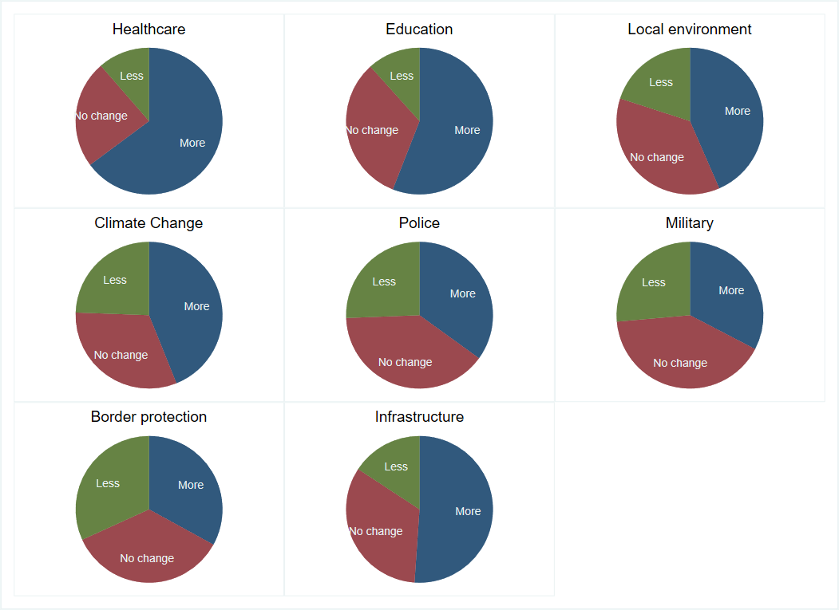
Political Views from Spending Decisions
“Universalist:” a respondent who (i) supported at least one of higher health, education or climate spending, and (ii) did not ask for cuts in any of these three areas, and (iii) wanted to reduce at least one of police, military, or border protection spending.
“Communitarian:” a respondent who (i) supported at least one of higher police, military, or border protection spending, (ii) did not ask for cuts in any of these three areas, and (iii) wanted to reduce at least one of health, education, or climate spending.
“Moderate:” anyone who does not meet the conditions for the other two labels.

Slide 13
Logit (marginal effects): Support for a Temporary Levy
 | (1) | (2) | (3)
Female | 0.01 | 0.01 | 0.01
 | (0.02) | (0.02) | (0.02)
Older half | -0.05*** | -0.06*** | -0.04**
 | (0.02) | (0.02) | (0.02)
Has children | 0.06*** | 0.08*** | 0.07***
 | (0.02) | (0.02) | (0.02)
Household size | 0.02** | 0.02*** | 0.02***
 | (0.01) | (0.01) | (0.01)
Education | 0.03** | 0.02* | 0.02
 | (0.01) | (0.01) | (0.01)
Income > $20k | 0.08*** | 0.07*** | 0.07***
 | (0.03) | (0.03) | (0.03)
Income > $50k | -0.03 | -0.03 | -0.03
 | (0.02) | (0.02) | (0.02)
Income > $150k | -0.07** | -0.08** | -0.07**
 | (0.03) | (0.03) | (0.03)
Black/African American | 0.07** | 0.04 | 0.03
 | (0.03) | (0.03) | (0.03)
Ethnicity withheld | -0.48*** | -0.46*** | -0.45***
 | (0.08) | (0.07) | (0.07)
Suffered | 0.11***
 | (0.02)
Universalist |  | 0.26*** | 0.28***
 |  | (0.02) | (0.02)
Communitarian |  | -0.01 | -0.04
 |  | (0.02) | (0.03)
Communitarian and suffered |  |  | 0.20***
 |  |  | (0.04)
Universalist and suffered |  |  | 0.01
 |  |  | (0.03)
Moderate and suffered |  |  | 0.12***
 |  |  | (0.03)
Observations | 2,519 | 2,519 | 2,519
Robust standard errors in parentheses; *** p<0.01, ** p<0.05, * p<0.1.

Slide 14
Logit (marginal effects): Support for Structural Reform
 | (6) | (7)
Dependent variable | Structural reform
Dependent variable | Tax increase | Revenue neutral
Female | -0.03* | 0.00
 | (0.02) | (0.02)
Older half | -0.08*** | -0.05***
 | (0.02) | (0.02)
Has children | 0.06*** | 0.05***
 | (0.02) | (0.02)
Household size | 0.00 | 0.00
 | (0.01) | (0.01)
Education | 0.03** | 0.03***
 | (0.01) | (0.01)
Income > $20k | 0.05** | 0.10***
 | (0.02) | (0.02)
Income > $50k | -0.01 | -0.05**
 | (0.02) | (0.02)
Income > $150k | -0.04 | -0.05
 | (0.03) | (0.03)
Black/African American | 0.05* | 0.02
 | (0.03) | (0.03)
Ethnicity withheld | -0.42*** | -0.40***
 | (0.06) | (0.05)
Universalist | 0.32*** | 0.24***
 | (0.02) | (0.02)
Communitarian | -0.01 | -0.00
 | (0.02) | (0.02)
Communitarian and suffered | 0.19*** | 0.17***
 | (0.04) | (0.04)
Universalist and suffered | 0.05 | 0.09**
 | (0.04) | (0.04)
Moderate and suffered | 0.18*** | 0.14***
 | (0.03) | (0.03)
Observations | 2,519 | 2,519
Robust standard errors in parentheses; *** p<0.01, ** p<0.05, * p<0.1.

Slide 15
Political Views from Principal Component Analysis
 | (5)
Female | 0.00
 | (0.02)
Older half | -0.03*
 | (0.02)
Has children | 0.08***
 | (0.02)
Household size | 0.02***
 | (0.01)
Education | 0.02
 | (0.01)
Income > $20k | 0.07***
 | (0.03)
Income > $50k | -0.02
 | (0.02)
Income > $150k | -0.09***
 | (0.03)
Black/African American | 0.02
 | (0.03)
Ethnicity withheld | -0.44***
 | (0.07)
Suffered | 0.09***
 | (0.02)
Communitarian (PCA) | -0.11***
 | (0.01)
Communitarian (PCA) and suffered | 0.05***
 | (0.01)
Observations | 2,519
Robust standard errors in parentheses; *** p<0.01, ** p<0.05, * p<0.1.
Principal components (eigenvectors)
-------------------------------------------------------------------
Variable | Comp1 Comp2 Comp3 | Unexplained
-----------------------+------------------------------+------------
Health Cuts | 0.3620 0.3444 -0.2829 | .421
Education Cuts | 0.3844 0.3726 -0.1582 | .395
Local environment cuts | 0.4495 0.0991 -0.0367 | .4976
Climate change cuts | 0.4709 0.0323 -0.0851 | .4597
Police cuts | -0.2648 0.4809 -0.2259 | .4068
Military cuts | -0.2856 0.4918 -0.1984 | .3719
Border protection cuts | -0.3411 0.3575 0.1406 | .4931
Infrastructure cuts | 0.1717 0.3617 0.8810 | .04268

Slide 16
Robustness Checks
Leave out health spending preferences in detecting moral perspectives
Calculations to show that result not driven by simply fewer universalists available to change their mind
Use actual COVID-19 incidence data instead of self-reported sickness
Also used this to check whether there are systematic differences in reporting sickness across moral perspectives
Checked assigned moral perspectives by comparing them to answers on questions regarding attitudes toward social policy (e.g., taxes generally too high, benefits discourage poor,…)

Slide 17
Conclusions
Strong support for temporary and permanent progressive tax increases
Despite general perception that taxes too high
Views differ as expected across moral perspectives
But change as a result of personal exposure
Term used not particularly important
But: “COVID-19 Recovery Contribution” wins
Open questions for future research:
How long do changes in attitudes last?
Are results transferable to other countries?

