Slide 1


Tax Administration and Digitalization:
The Estonian Experience
Rivo Reitmann
Deputy Director General

Slide 2
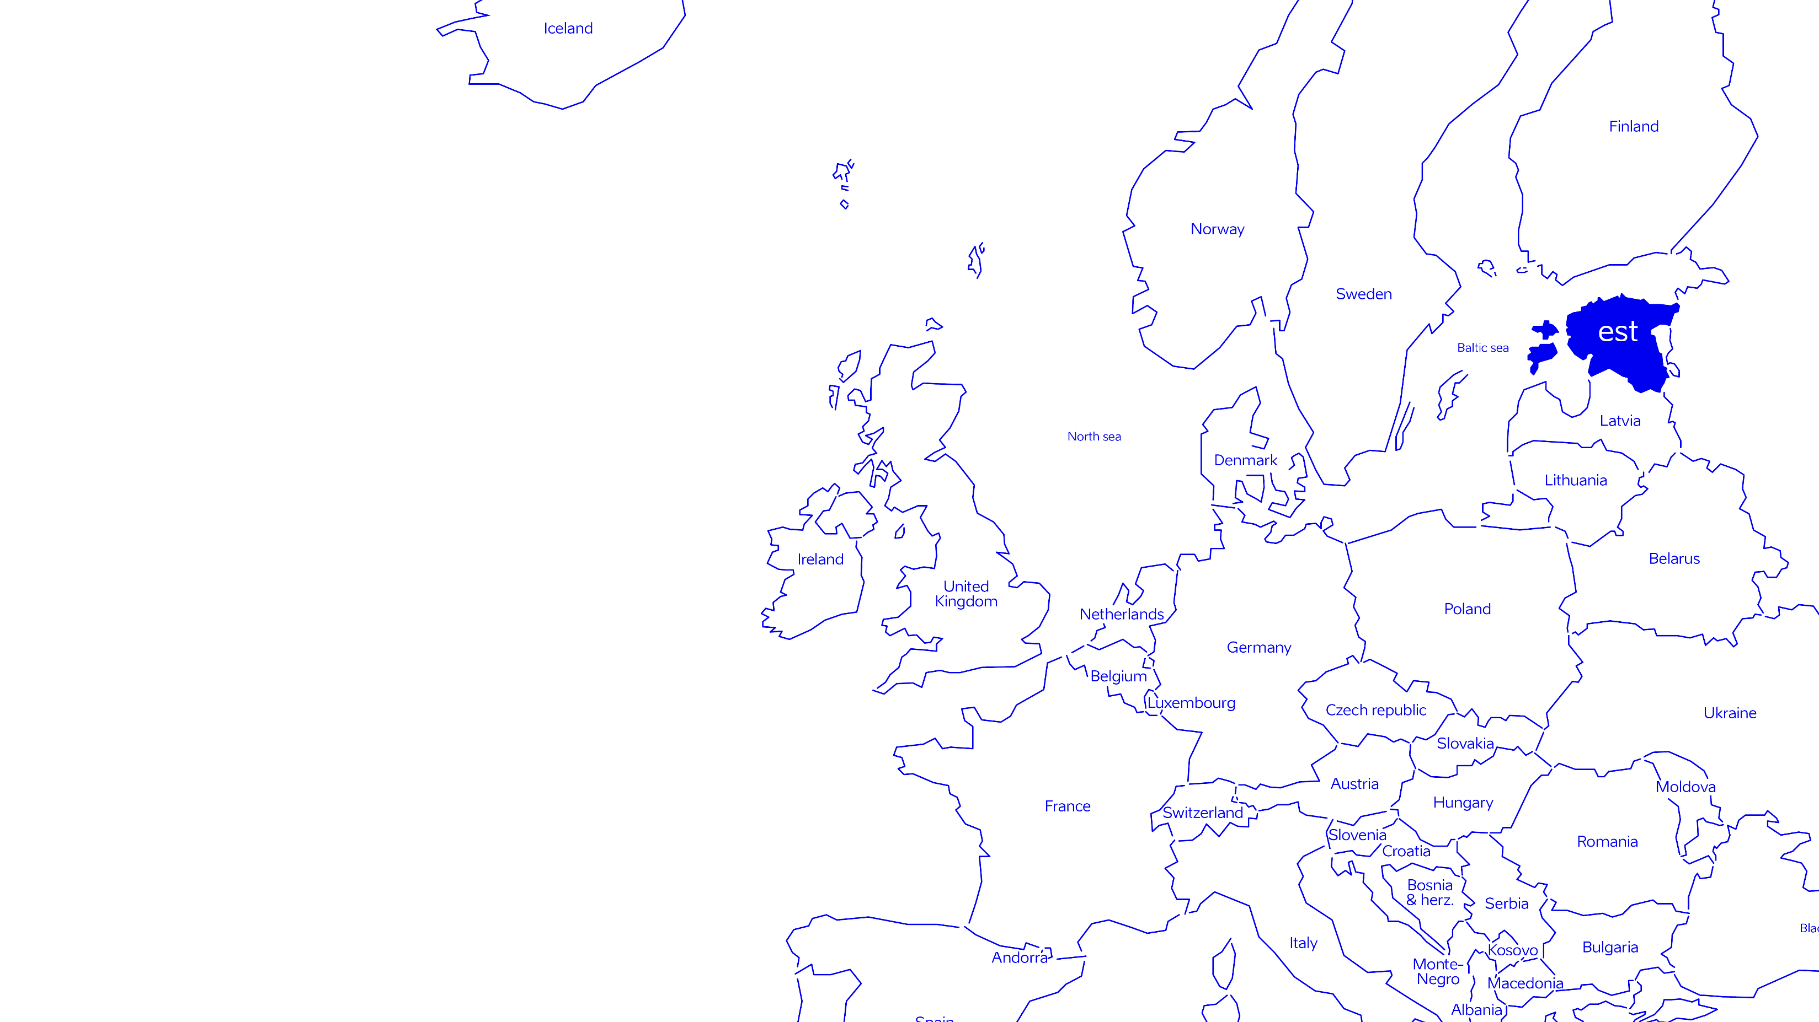
a modest country that extends beyond its borders
population: 1.3 million
area: 45,339 km2
currency: Euro
member of: EU, NATO, WTO, WCO, OECD, DIGITAL 7, …
ICT sector: 7% of GDP
Notes:
2. Introducing Estonia and e-Estonia - where we came from and where we are today
e-Estonia is an incredible success story that grew out of a partnership between a forward-thinking government, pro-active IT sector and a switched-on, tech-savvy population. Becoming a pathfinder in public sector e-services meant that nothing was prepared for us – we had to create our own path to discover how to provide services in a form that did not exist yet and which should be available to everyone 24/7. Today, Estonia is:
a great information society
a member of D7 (i.e. 5 Leading Digital Governments)
highlighted by the experts as an excellent example for other countries striving to establish an e-society.
How did we get here?
Estonia has never had much in the way of resources or a huge internal market as we are a small country. Yet, we do have a lot of eager and enterprising people. (In fact, according to the World Economic Forum, we are the most enterprising country in Europe.) We realized in Estonia that our size is actually a huge advantage that can help us create effective solutions for the country and build up an information society with high quality services.
When Estonia started building our information society about two decades ago, there was no digital data being collected about our citizens. The general population did not have the internet or even devices with which to use it. It took great courage to invest in IT solutions and take the information technology route.
Both, the public and private sector understood the need to build up our country as an information society and integrate e-state solutions as they are created.
Connection to the host country: e.g. Estonia is 10 times smaller than X country, but has the same problems as X and has resolved them this way. Or - Estonia is a similar post-soviet country, like X, and faced the same problems as X, but resolved them this way.
If necessary, highlight the fact that even though Estonia is today still associated more with other post-soviet countries, today it is definitely more influenced by Scandinavian countries and export markets that are similarly open and innovative in terms of technology.

Slide 3
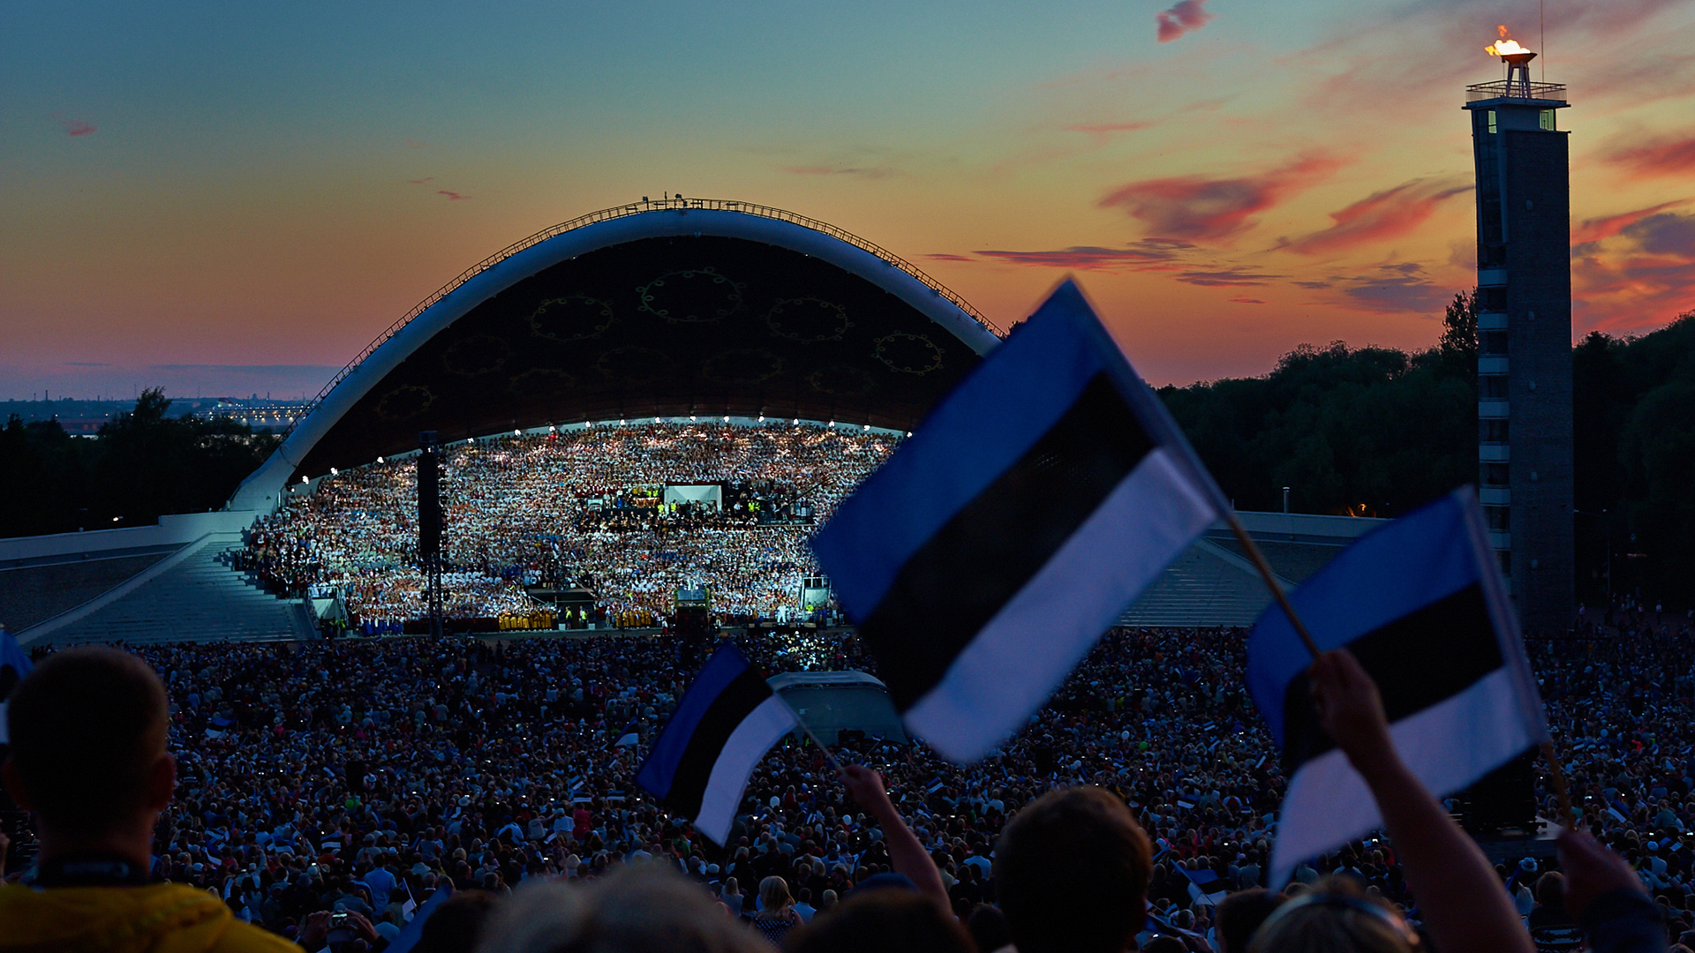
essential
Best secret weapons.
© Taaniel Malleus
internet is a social right
every Estonian resident has an electronic ID
99% of services are online
Estonians trust e-solutions
Notes:
4. Our secret weapons (instead of metal) stand in the information society
Internet is a social right today in Estonia
88% broadband coverage in Estonian households
3G and 4G coverage over almost the entire country
Estonia, together with Sweden, will already be the first countries in Europe with 5G mobile internet in 2018
Every Estonian resident has an electronic ID
personal data can be accessed, signed and managed from banking to digital prescriptions with an ID-card, Mobile-ID or Smart-ID
electronic ID is also issued to Estonian e-Residents (today more than 20,000)
At least 2% of GDP-worthy time is saved due to digital signatures
99% of Estonian public services are online
accessible 24/7
most public services work via the X-Road data exchange platform that saves over 800 years of working time annually for the Estonian population together.
People trust and use e-solutions, since they are fast, safe (privacy) and convenient
Blockchain-backed integrity throughout the government infrastructure and registries since 2012
almost all public e-solutions in Estonia are created by Estonia
in companies and state institutions
Examples of trust:
More than 350 million digital signatures have been provided in Estonia which is more than in the entire European Union.
Over 30% of Estonian voters from 116 countries used i-Voting in Estonian Parliamentary elections
99% of banking transactions are done online

Slide 4
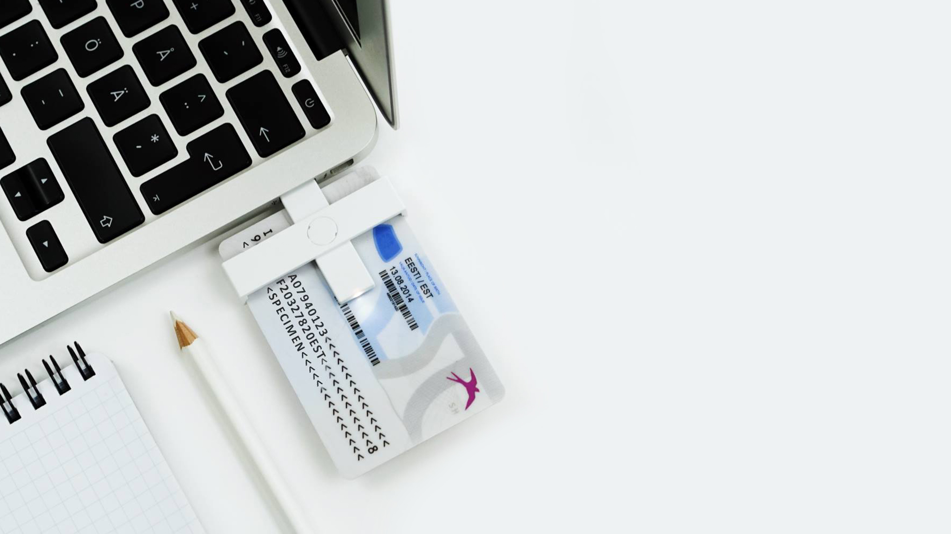
electronic ID
The strongest identity.
© estoniandesignhouse.ee
98% of e-ID – celebrating 15 years!
eIDAS assurance level „high“
13% of mobile-ID
16% of smart-ID
e-Residency
Notes:
10. Electronic ID
Intro: Electronic ID was the first cornerstone of e-Estonia and enables Estonian citizens to benefit from convenient, safe and fast hassle-free e-services.
98% have e-ID, celebrating 15 years – Nearly every one of Estonia's 1.3 million citizens has an ID card, which is a mandatory national card with a chip that carries embedded files and can function as definitive proof of ID in an electronic environment. The ID card applies to the highest EU standards and provides citizens with digital access to all of Estonia’s secure e-services, releasing them from bureaucracy and making daily tasks faster and more comfortable, whether we are talking about banking or business operations, signing documents or obtaining a digital medical prescription.
eIDAS assurance level „high“
What is eIDAS? In 2014 the European Union adopted the so-called eIDAS regulation, which redesigned cross-border identification and trust services in the EU. Digital identification carries enormous potential both socially and economically. However, being able to to digitally identify your person has until now been a typical cross-border problem due to several issues, such as technical incompability and security concerns. Keeping that in mind, we are delighted and excited about the fact that in 2018, the Estonian national e-ID has been granted the highest assurance level under the eIDAS regulation.
What does that mean? This means nothing less than the fact that whenever a member state allows their own citizens to access a public service using digital identification, Estonian cardholders will be able to access the very same public services across the European Union with their own Estonian ID or even with an e-residency ID-card in just a few years, after the regulation’s implementation period has expired. This will save time and costs for anyone who plans to live, study, work or become an entrepreneur in one or more EU member states.
13% have mobile-ID – Mobile-ID allows people to use a mobile phone as a form of secure digital ID. Like the ID-card, it can be used to access secure e-services and digitally sign documents, but has the added advantage of not requiring a card reader, since it works via a mobile phone’s SIM card.
16% have smart-ID – One of Estonia’s latest ID-solutions is Smart-ID, which is a convenient mobile application that works as an identification solution for anyone that does not have a SIM card in their smart device but needs to securely prove their online identity. As a simple, easy to use and convenient alternative to bank code cards, with Smart-ID you can log in to financial sector e-services and confirm transactions and agreements. You can use Smart-ID on smartphones and tablets. When using Smart-ID, you only need a Wi-Fi network or mobile internet connection, no data roaming is necessary.
e-Residency – Estonian e-Residents also receive a digital ID card that provides everything necessary for managing company in Estonia: a government-issued digital identity, secure access to e-services, and the ability to sign and authenticate documents digitally. However, the digital ID is not a physical identification or travel document, nor visa or citizenship and does not display a photo.

Slide 5

elaborated
Clear and honest principles.
© Aron Urb
once-only
digital by default
Transparency by design
open platform
Notes:
6. Principles of Estonian e-governance
Once-only – The data are only collected once by one specific institution, eliminating duplicate data and bureaucracy (e.g. the need to file the same data for different public institutions several times).
Digital-by-default – It is always a priority to fill and file documents digitally and work continuously on automating public services. Even terminology in our legislation today refers to digital information (not only information on “paper”). Meanwhile, the digital society has no legacy, meaning that there is a continuous legal change and organic improvement of the technology and law.
Transparency-by-design – All the data exchanges, M2M communications, data at rest, and log files are independently and fully accountable thanks to KSI Blockchain technology. With KSI Blockchain deployed in Estonian government networks, history cannot be rewritten by anybody and the authenticity of the electronic data can be mathematically proven. It means that no-one – not hackers, not system administrators, and not even the government itself – can manipulate the data and get away with it.
Open internet (or platform) – Any institution can use the infrastructure and it works as an open source. There’s no central database and every stakeholder, whether it is a government department, a ministry or a business, gets to choose its own system in its own time. However, all the elements in the system are able to exchange data securely and work smoothly together.

Slide 6
exchange
The busiest highway of e-Estonia –
X-Road from 2001.
saving 800 years annually
over 900 connected organizations, databases
over 500 million transactions per year
exported to Finland, Azerbaijan, Kyrgyzstan, Namibia, Faroe Islands and other countries
Notes:
11.Data exchange
Intro: Another cornerstone of e-Estonia is the X-Road data exchange system, which works like an open source highway for data traffic. X-Road interconnects public and private databases, which are held in a distributed manner. While every institution manages it’s own processes, government institutions can decide independently which platforms and technologies they use over X-Road.
Saving 800 years annually – While working as the open-source backbone of e-Estonia, X-Road is an invisible yet crucial environment that allows the nation’s various e-service databases, both in the public and private sectors, to link up and operate in harmony, and saves more than 800 years of working time for the state and citizens annually. Bear in mind the unique aspect of e-Estonia is that it lacks a centralized or master database – all information is held in a distributed data system and can be exchanged instantly upon request, providing access 24/7.
Over 900 connected organizations, databases – Over 900 organizations and enterprises in Estonia use X-Road daily.
For example, while using eID and logging into the Tax and Customs Board portal, one can give permission to the system to take necessary data automatically from the Population Register and create a connection with a person’s bank account in order to pay the necessary taxes in the required amounts. In this way a pre-filled tax declaration is prepared that can be submitted with a click. All this together takes about 3 minutes while data from different portals can be viewed or accessed only by the relevant citizen (e.g. TCB cannot see your account balance in the bank etc.).
Over 500 million transactions per year – this is all done without the need to print out any papers or drive anywhere. All you need is a suitable ID for your device and an internet connection.
Today, Estonia has shared its e-governance journey with 60 governments and exported its solutions to over 130 countries around the world. For example, it has exported its digital knowledge to Finland, Oman, Ukraine, the Faroe Islands, Macedonia, Albania, Moldova, Palestine, Montenegro, Namibia, Tunisia, Georgia, Armenia, Kyrgyzstan, India, Cyprus and Azerbaijan among the others. Besides exporting its knowledge, Estonia is the 1st in the world to interconnect decentralized components of the state and public sector databases on an international level. A public sector data exchange facility between Finland and Estonia was created in 2017. This means that in the future health or education data on Estonian citizens can also be accessed by the Finnish government or private sector, regardless of whether the person is living in Estonia or Finland. Hopefully cross-border data exchange will soon become possible between all European countries.

Slide 7




First cross boder e-Signature
Estonia and Finland
₪
Company
e- establishing
Zero
bureaucracy
Country as
a service
e- Taxation
₪
e-prescription
e - Recidency
%
+
e®
„0“B
CAAS
ID Card
ID
e-Signature
1996
1999
2001
2002
2005
2007
2008
2013
2014
2015
2016
2017 +
!?
m ID
R 3.0
↔
√
e- Banking
e- School
Mobile ID
x- Road
e- voting
Services
Owners
Conception
Reporting 3.0
Data
ownership

Slide 8
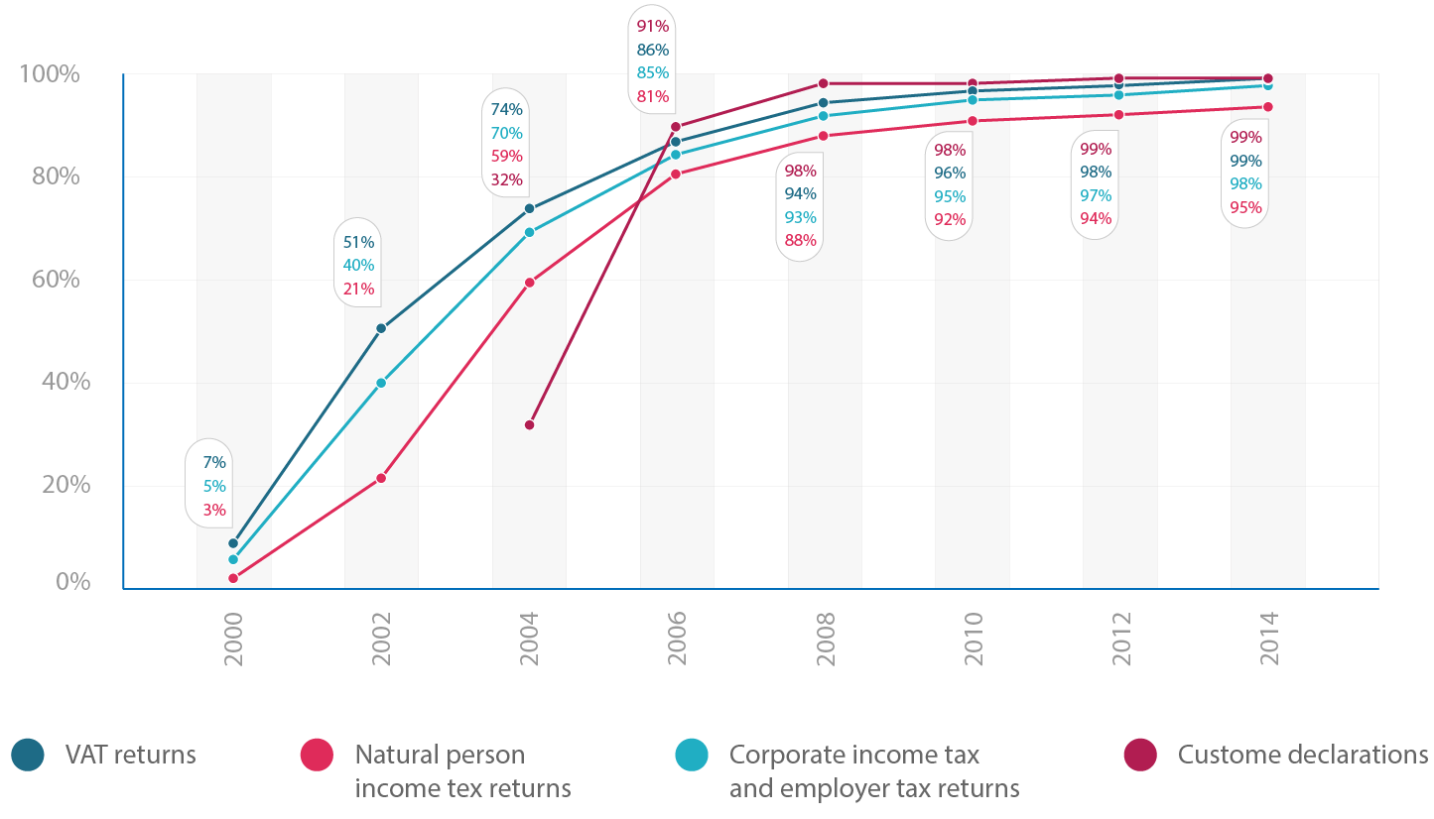
Statistics of e-tax returns

Slide 9

Everything can be done electronically
All types of tax and customs declarations
Paying taxes, tax arrears in instalments
Registration of employees
Certificates, inquiries
Administration of power of attorneys, contact details
Sending and receiving messages, notifications, administrative acts

Slide 10




Replacing tax returns with machine-to-machine data collection
How to reduce administrative
burden?
DATA
COLLECTION
CALCULATION
OF TAXES
PAYING
TAXES
E-INVOICE
We need data, not tax returns
ETCB gets data from accounting softwares or from third parties
ETCB calculates taxes based on the received data
ETCB sends e-invoice
to the bank
Money is transferred to ETCB
Data automatically from the systems companies already use
Notes:
LHV
Aruandlus 3.0

Slide 11
Filing Tax Return vs Data Exchange Process
Tax Declaration as a Background Process
Employer logs in to e-bank and pays salaries
Employer logs in to the e-taxboard, fills in tax return and confirms it
Employer logs in to e-bank and pays taxes
Next month
Filing
Tax Return
Employer logs in to e-bank and pays salaries
Simultanious background process:
Taxes are calculated;
Tax return prefilled;
Taxes paid with the same transaction (or saved as future payment in bank).
Background process:
ETCB automatically confirms the tax return;
Tax Return
with
Data Exchange
Next month

Slide 12
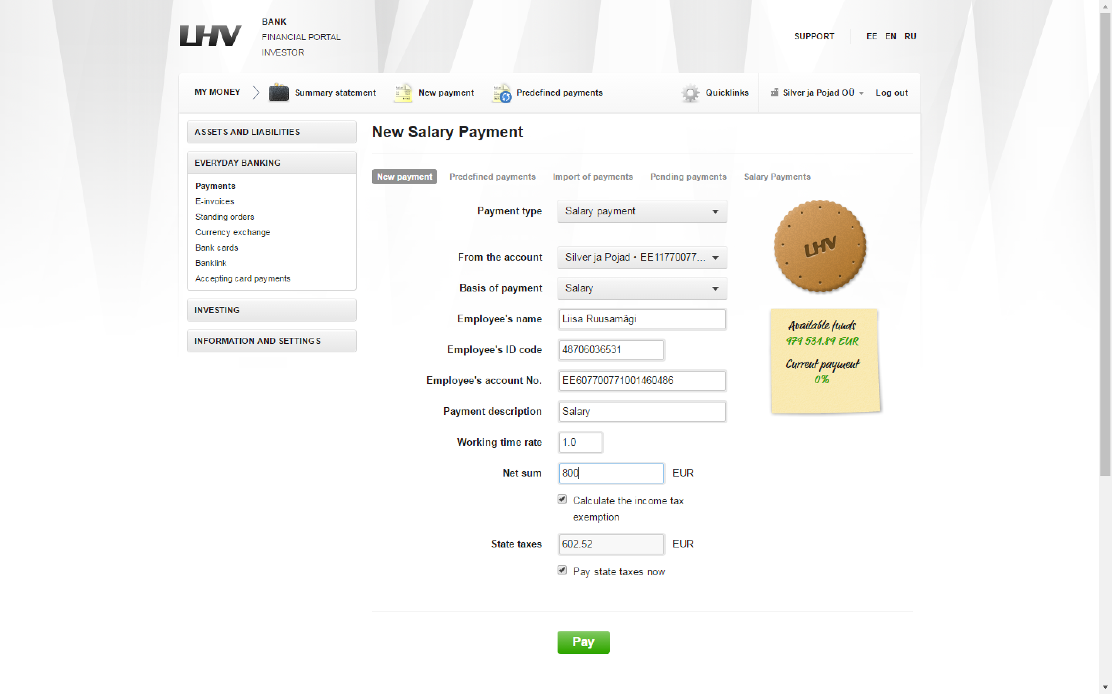

Slide 13
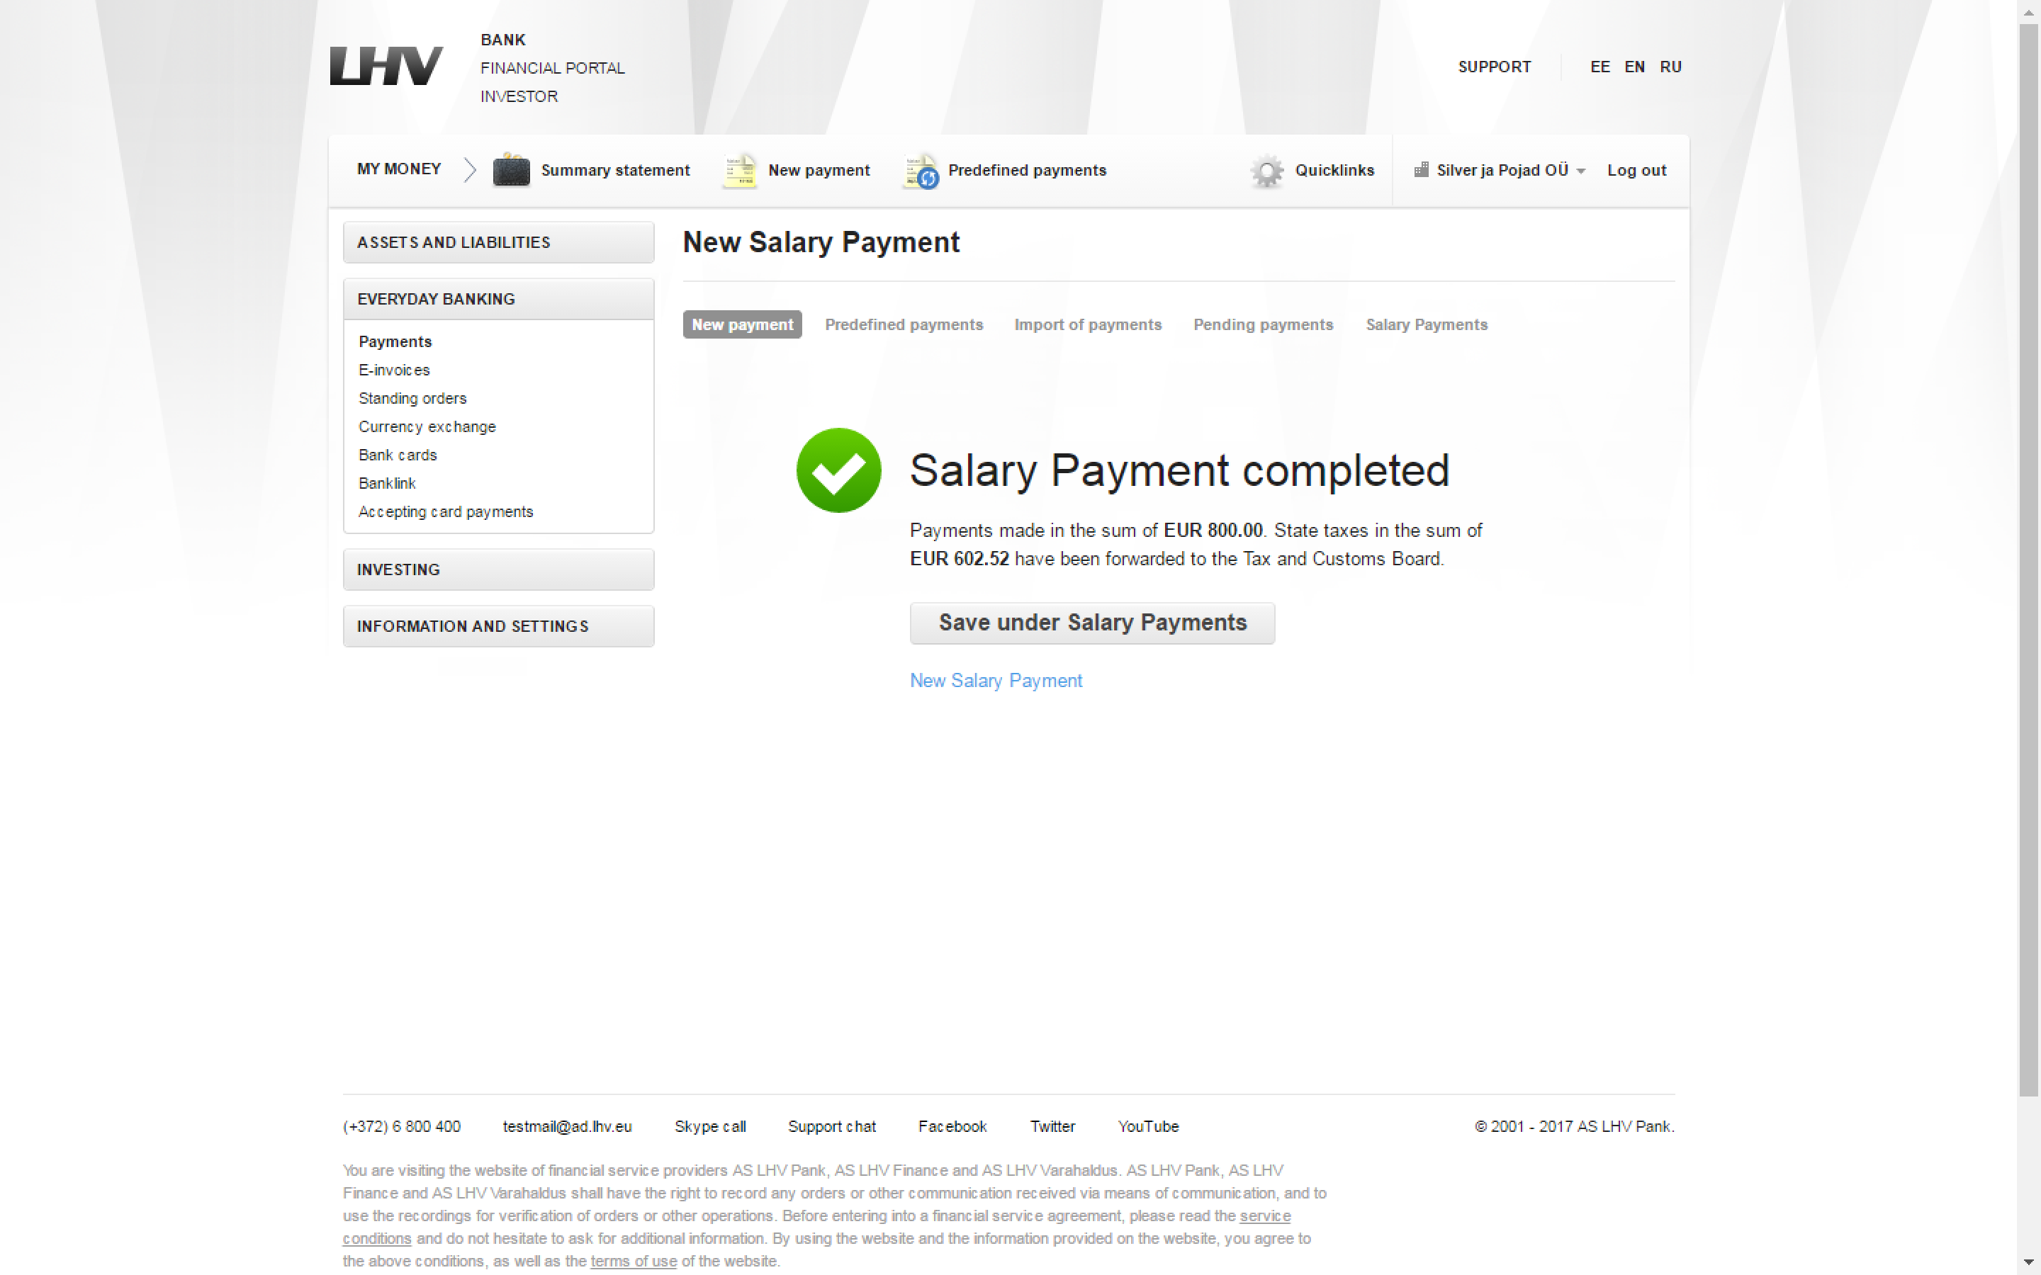

Slide 14




Ministries
Rights and Obligations
Sub authorities
Events
Services
Life
Cycle
Silo Based Services Provider
People

Slide 15
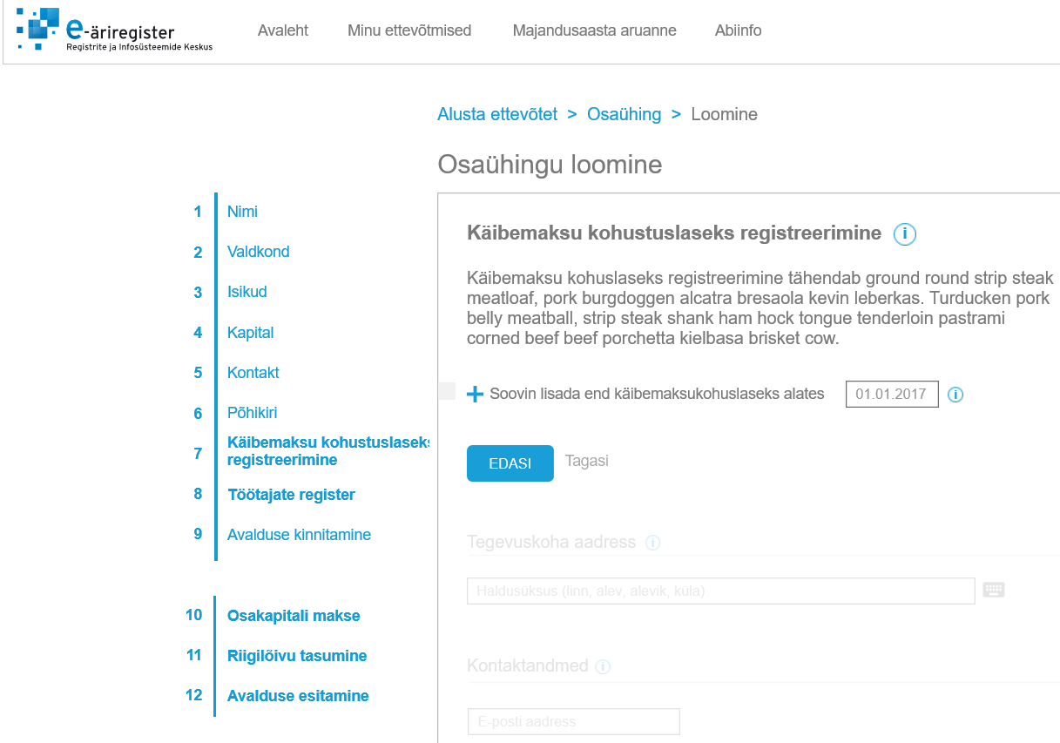

create
Creation of private limited company
Events
Name
VAT registration
Domain
Persons
The Tax and Customs Board issues a decision on registration within five working days after receiving the application. If additional documents are required for registration, we will contact you within five working days
Capital
Contacts
Life
Cycle
Statute
I would like to be registered since
VAT registration
Next
backд
Staff registration
Confirmation of the application
Payment of share capital
Payment of the state fee
People
Submitting of the aplication
Notes:
VAT process and staff registration (services owner is Tax and Customs Board) integrated in to the Business registration service (service owner Commercial register)

Slide 16

„Seamless services“
Services that are offered without a customer applying automatically and proactively.
Services that are offered with notification, if a customer does nothing, services will be offered automatically and proactively offered.
Services that are offered with notification but only after a customer applies.
© Johann Kööp
Notes:
We have to make an agreement how we will divide services in to the different groups.
For example we already provide automatically “Child health insurance service”, “Family doctor of the child” , “Digital name or personal code”

Slide 17






Automated tax collection
Data collection
Paying taxes
Calculation of taxes
Data/Risk analysis
Data/Risk reflecting

Slide 18


Slide 19

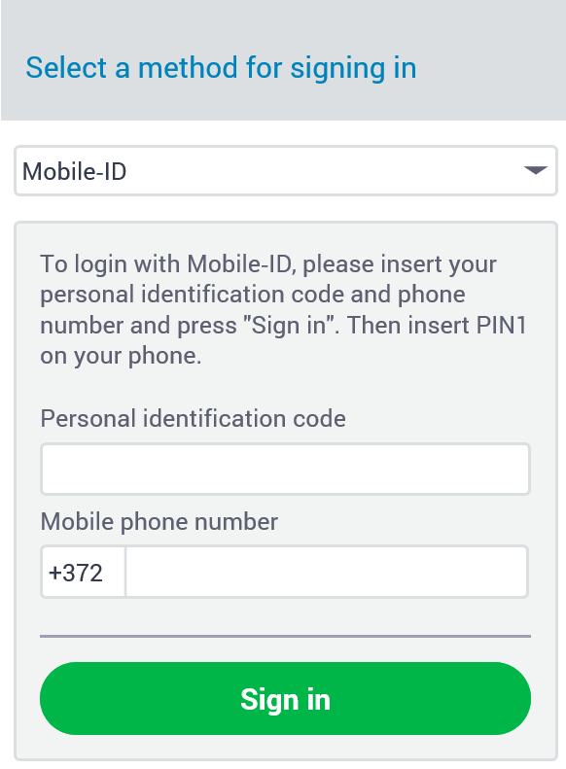
COVID-19 and the organisation
Since our tools are web-based, it doesn't matter from which location they are used.
We ensured secure channels and provided the necessary equipment.
We work from home and will continue to do so after COVID.
Real estate optimization

Slide 20
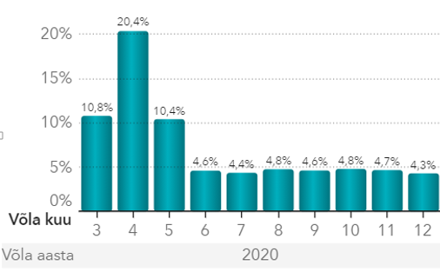
COVID-19 and our services
We quickly lowered the interest rate on tax arrears to 0 % to help economic operators rescue their businesses.
We provided the state with data and analysis for the introduction of various support measures and helped avoid benefit fraud.
We were flexible and supportive in finding solutions to problems.
As all our services are digital, nothing changed in the availability of the services for customers.
More video calls and e-mails instead of face-to-face meetings, including in control activities.
Tax tebt

Slide 21
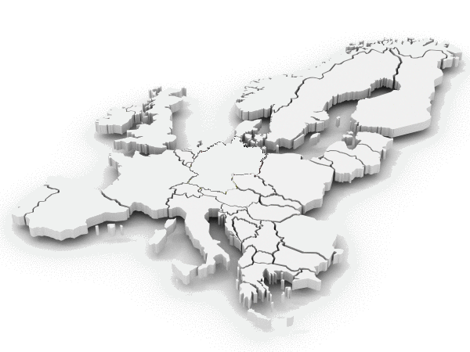


ETCB
Thank you for your attention!
Rivo Reitmann
Deputy Director General
Estonian Tax and Customs Board
Rivo.Reitmann@emta.ee

