Slide 1
Changes to courses from 2024 – 2025 Intensive Training & Practice (ITAP)

Slide 2
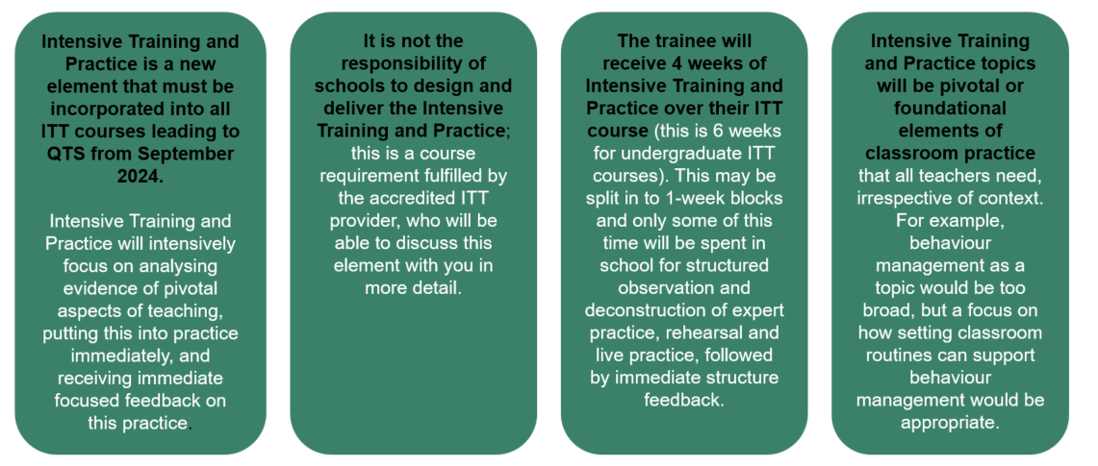
What is Intensive Training and Practice? Guidance from the DfE
“Another way that schools can get involved in ITT is through supporting Intensive Training and Practice.
Intensive Training and Practice is not part of the ITT placement, although placement schools may wish to support Intensive Training and Practice too. Other schools can also be involved in supporting Intensive Training and Practice”.

Slide 3
How can schools support Intensive Training and Practice? DfE Guidance
Intensive Training and Practice is not part of the school placement but an additional element of the provider's ITT curriculum.
A typical Intensive Training and Practice block will include expert input, observation, opportunities to practice in both a controlled and live environment, and expert feedback throughout this process. Some elements of Intensive Training and Practice will take place in the ITT institution, or virtually, and some will need to take place in a school environment, such as the live classroom practice.
Many schools will be well placed to welcome individual or groups of trainees, to allow them to observe strong practice in the area being examined and give them the opportunity of live classroom practice.
Intensive Training and Practice will be supported by an appropriate range of experts, which can include lead mentors from the ITT provider and other experts within the school.

Slide 4
University of Exeter Intensive Training and Practice plans
Primary trainees
Each five day ITAP will consist of four taught days and one day of school experience
Primary trainees
ITAP 1 Early Reading
ITAP 2 Formative Assessment (maths lens)
ITAP 3 Effective questioning (science lens)
ITAP 4 Adaptive Teaching
ITAP 1 and ITAP 2 happen before placements begin so they will have one day of school experience in specific ITAP schools for one day.
ITAP 3 and ITAP 4 will have their school experience days in their placement schools with activities to complete, led by the trainee.
We are looking for specific ITAP schools for ITAP 1 and 2 near our three ITE Hub locations

Slide 5
Primary Course structure including ITAP
Blue days are placement days
Yellow blocks are ITAP blocks, this is explained later
Orange days are the taught course days

Slide 6
University of Exeter Intensive Training and Practice plans
Secondary trainees
Each five day ITAP will consist of four taught days and one days worth of school tasks to complete during their normal placements.
The tasks will be led by the trainee using Exeter Model training tools such as demonstrations, agendas and framework tasks. The trainee will have a subject specific ITAP handbook containing all their instructions that they can share with their Mentor.
ITAP 1 Setting up the learning environment
ITAP 2 Assessment
ITAP 3 Adaptive Teaching
ITAP 4 Literacy and Numeracy across the curriculum

Slide 7
Secondary Course structure including ITAP
Blue days are placement days.
Yellow blocks are counted as ITAP days.
Any yellow days that happen within the placement window are to highlight that the ITT Criteria has been met but the tasks can happen at any point before the next ITAP day.
ITAP days on Fridays during school based work are seminar days on campus.
Orange days are the taught course days

