Slide 1
Changes in 2024 – 2025

Slide 2
Reaccreditation
All ITE providers have been through a reaccreditation process with the DfE. Information for prospective students can be found on our recruitment website:
https://www.exeter.ac.uk/study/teachertraining/
We have updated our Partnership website to show what benefits we can offer schools and mentors choosing to work with us:
https://education.exeter.ac.uk/partnership/joiningthepartnership/

Slide 3
Key course changes for 24/25
DfE requirements
School Direct no longer exists after 23/24
Courses must be consistent and designed by reaccredited ITT provider
All courses must have 4 weeks of Intensive Training and Practice (ITAP) in addition to 120 days in school
New Mentoring requirements
Exeter PGCE changes
Placement fee increased to £700 per placement
Current Lead Mentor renamed to Mentor
Removal of need for separate Reflective Mentor role
Removal of school responsibility for professional studies programme
New primary ITE Hubs model, three hubs for 24/25 - Exeter, North/Mid Devon, Somerset/Dorset
Primary 3-7 and Primary 5-11 only option at application
Primary trainees will select a Leadership Development Module after application
Secondary trainees apply to regional placement locations

Slide 4
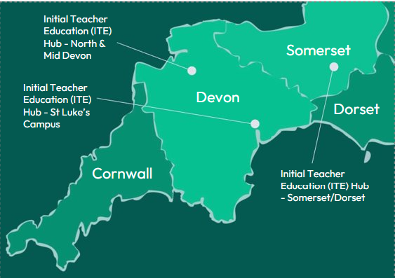
University of Exeter Primary Initial Teacher Education (ITE) Hubs
Notes:
New ITE Hubs for Primary PGCE.
3 options to attend for taught course – exactly the same Outstanding curriculum no matter which location.
Developed in partnership with Lead Partner schools in the areas.
Ensuring high quality ITE reaches more rural locations and supports trainees and schools.

Slide 5
Primary Course structure including ITAP
Blue days are placement days
Yellow blocks are ITAP blocks, this is explained later
Orange days are the taught course days

Slide 6
Secondary DfE Apply areas for secondary
University of Exeter taught course with Mid/North Devon preferred placements
Somerset
All course delivery in term 1 takes place in St Luke’s – maximum of 2 days per week on campus to reduce travel costs and time
University of Exeter Campus taught course with Exeter, East & South Devon preferred placements
Devon
Dorset
Cornwall
University of Exeter taught course with Dorset/Somerset preferred placements
University of Exeter taught course with West Devon & Cornwall preferred placements
Notes:
We hope that this approach

Slide 7
Secondary Course structure including ITAP
Blue days are placement days
Yellow blocks are classed as ITAP days, this is explained later but 1 day per ITAP is allocated to complete specific tasks in their placement schools, this will be trainee led.
Orange days are the taught course days

Slide 8
Leadership Development Modules
We currently have primary pathways (30 Masters credits) and these have changed to non-credit bearing Leadership Development Modules.
Trainees will select which module to select after application
Our Primary programmes also enable you to select a particular curriculum area to focus on during the year to support your development as a future curriculum leader. You will attend 7 sessions across the autumn term and curriculum areas vary year on year depending on demand but are likely to include Art, English, Humanities, Maths, Modern Languages, Science, EAL, SEND, SEND in special schools, Primary 3-7.
QUESTION FOR DISCUSSION
What is most useful for schools for our trainees to have additional input on / to become 'future curriculum leaders' in? Both primary and secondary
Notes:
Thank you for your input into this question which will help with our future course design. See notes for more details.

Slide 9
Opportunities for Partnership schools
Course design and delivery
Subject Curriculum Lead role
Lead Mentor role
Course development and consultations groups
Initial Teacher Education Coordinator Meetings
University PGCE Partnership Committee
Advantages of being linked to local HEI for wider opportunities
Internationally renowned research in the education field
Opportunities for pupils
Wider university support and infrastructure
Notes:
We advertised for Subject Curriculum Leads (School-based) to support with course design and delivery (particularly for our primary ITE Hubs). We will advertise when we next need to recruit.
We are currently writing the job description for the new Lead Mentor roles so will contact schools to recruit as needed.
Thank you for coming to our ITEC Meeting and contributing to our courses.

