Slide 1
contractual and legal responsibilities
With thanks to Great Torrington School

Slide 2
What are Teachers’ Contractual Obligations?
With thanks to Great Torrington School
The School Teachers’ Pay and Conditions Document (STPCD) applies to teachers in England and Wales who are employed by a local authority or by the governing body of a foundation or voluntary aided school.
It may apply to teachers in academies in England and in independent schools which use the STPCD working time provisions in teachers’ contracts, and will do so where teachers have transferred when a school in England has adopted academy status.
However, academies can set their own terms and conditions and may not follow the obligations on the slides which follow.

Slide 3
How many days per year does a full-time teacher have to work?
A full-time teacher must be available for work on 195 days. The teacher may be required to teach pupils on 190 of these days.
The number of hours for which teachers can be directed to teach or undertake other professional duties is subject to a limit of 1,265. On top of this teachers are expected to work ‘reasonable additional hours’ to fulfil their professional responsibilities. All teachers are also subject to the provisions of the Working Time Regulations which seek to place a 48-hour limit on the average working week.

Slide 4
What is directed time?
Directed time is when teachers are directed by their head teacher to be at work and available for work. This is a maximum of 1,265 hours per academic year, spread over 195 days.
Teachers can be required to teach on 190 days, the maximum length of the pupil year. They can also be required to work a further five non-teaching (usually inset) days, the hours for which count towards the 1,265 hour limit.
The following must be part of directed time for full and part time teachers: Teaching time, PPA time, break times (but not lunchtimes, when teachers can’t be required to work), cover, parents’ evenings, after school meetings, INSET/CPD and anything else which teachers are “directed” to do, and which requires their professional skills.

Slide 5
Directed Time Calendar
All schools should have a calendar of the activities which make up teachers’ directed time – published in the summer term for the next academic year and consulted on with staff via trade unions. They should also give each teacher their own personal directed time calendar showing their individual commitments.

Slide 6
Are all teachers entitled to planning, preparation and assessment (PPA) time and, if so, how is the entitlement calculated?
All teachers are entitled to PPA time, set as a minimum of ten per cent of their timetabled teaching time.
It must take place within the times that normal teaching takes place.
It should not be used for cover.
Time lost, for example going on a school trip, should be paid back to ensure that minimum PPA entitlements are met.

Slide 7
Do teachers have to cover for absent colleagues?
Teachers can only be required to cover ‘rarely’. This means in circumstances which were not foreseeable. A certain level of sickness absence, perhaps dependent on the time of year, is entirely foreseeable so a colleague’s absence on sick leave is not a good enough reason for requiring a teacher to provide cover.

Slide 8
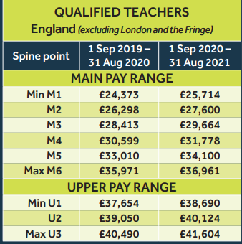
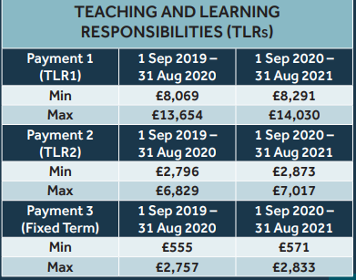
Pay Scales.

Slide 9
Your responsibilities

Slide 10
What do you need to know about safeguarding?
Who is the school Safeguarding lead?
Procedures for reporting concerns
Knowledge of child protection policies
How to identify potential signs of child abuse
Safe working practices
Keep training up to date, regular updates

Slide 11
What do you need to know about health and safety?
Who is/are the Health and Safety officer/s?
What is the procedure for reporting concerns?
What is the procedure for risk assessment for unusual or off-site activities?
What safe-teaching practices do you need to follow (e.g. in relation to use of equipment, PE)?
How do you access trained first-aiders, and what are the requirements for this for school trips or events?
https://neu.org.uk/advice/who-responsible-health-and-safety

Slide 12
What do you need to know about e-safety AND DIGITAL LITERACY?
School policies and procedures relating to digital literacy, including safeguarding
School policies for use of the internet in lessons and onsite generally
School social media policy
School policies for professional use of email / telephone numbers
How attention to digital literacy and e-safety is built into the curriculum
What online platforms are used by the school

Slide 13
What do you need to know about equality?
School policies for equality and diversity.
How to recognise a discriminatory incident, including racist or sexist incidents or microaggressions.
What you should do if you witness an incident, including your responsibility to report to the relevant person (who may need to report to governors, the local authority or other stakeholders).
How to promote diversity and equality in a positive way.

Slide 14
What do you need to know about safe working practices generally?
Staff-Pupil ratios
Safe practices for practical subjects and use of equipment – e.g. D&T, PE, Science
Safe practices for extra-curricular activities, when permissions are needed for clubs, visits and so on
Absence policies and procedures
Safe practices for working with volunteers, work experience, parent helpers
How to deal with student accidents (e.g. vomiting, wetting, injuries)
Procedures for pupils leaving the school site
Procedures for visitors / access to the school site

Slide 15
A teacher is expected to demonstrate consistently high standards of personal and professional conduct. The following statements define the behaviour and attitudes which set the required standard for conduct throughout a teacher’s career.
Teachers uphold public trust in the profession and maintain high standards of ethics and behaviour, within and outside school, by:
o treating pupils with dignity, building relationships rooted in mutual respect, and at all times observing proper boundaries appropriate to a teacher’s professional position
o having regard for the need to safeguard pupils’ well-being, in accordance with statutory provisions
o showing tolerance of and respect for the rights of others
o not undermining fundamental British values, including democracy, the rule of law, individual liberty and mutual respect, and tolerance of those with different faiths and beliefs
o ensuring that personal beliefs are not expressed in ways which exploit pupils’ vulnerability or might lead them to break the law.
Teachers must have proper and professional regard for the ethos, policies and practices of the school in which they teach, and maintain high standards in their own attendance and punctuality.
Teachers must have an understanding of, and always act within, the statutory frameworks which set out their professional duties and responsibilities.

