Slide 1
ITE Coordinator Meetings- November 2023

Slide 2
Agenda
Welcome and introductions
Mentor Training information
Placement 1 information
Expectations for the 2 weeks in November
Changes to the IDP for 23/24
Reaccreditation of ITE programmes
Placement 2 reminders
AOB/ questions from ITECs

Slide 3
Welcome and introductions
Introductions
Partnership Relations Managers:
Gini Williams – g.williams6@exeter.ac.uk
Heidi Long – h.long@exeter.ac.uk
Fiona Bosley- f.bosley@exeter.ac.uk
Purpose and format of ITEC meetings in autumn and spring

Slide 4
Mentor Training
All new mentors should have attended induction training. If you have any untrained mentors then there is another session 5th December in the afternoon at St Luke’s Campus- please contact exeterpartner@Exeter.ac.uk to book a place.
There will be further sessions in February for mentors working with trainees in Placement 2. These are online on 28th and 29th February. Placement 2 mentors will be invited by the Partnership Office as required.
Lead Mentors should also attend Lead Mentor Training Development and Consultation sessions. These are online, Lead Mentors will be sent invitations and links. Dates can be found on the printable 23/24 calendar: https://education.exeter.ac.uk/partnership/mentor_zone/coursehandbooksanddocuments/ These also list all key deadlines for the Exeter PGCE programmes
All mentors should have received a log in to the IDP and should log on. There is an introduction video about how to use the IDP https://education.exeter.ac.uk/partnership/mentor_zone/induction_training_and_feedback/ in the IDP User Guides and Training Videos section (username and password: exeterpartner)

Slide 5
Placement 1
6th- 17th November and 2nd Jan- 15th March
Trainees should be completing an Induction Template in their IDP where they confirm the induction checklist has been completed, they upload their Trainee Information form, and they upload their timetable.
The induction checklist for ITECs can be found in the course handbooks in section 5.2 https://education.exeter.ac.uk/partnership/mentor_zone/coursehandbooksanddocuments/
Trainees also have a Safeguarding Template to complete. They should already have uploaded their NSPCC safeguarding certificate and Prevent Certificates. They need to add the name of the school safeguarding office and be shown where to find KCSIE and any school procedures.

Slide 6
Induction Template

Slide 7
Safeguarding Template

Slide 8
General Expectations for the initial two weeks in school
Meeting with the ITEC and completing the induction checklist (section 5.2 in the handbook)
Being given a timetable (optional for primary)
Seeing how the school operates/ being introduced to the school expectations and ethos/ behaviour policies
Getting to know classes/ pupils
Completing Challenging the Gap Framework Task
Any programme specific tasks as detailed in the handbooks

Slide 9
Expectations for the initial two weeks in school- Exeter Model Tools and Assessment
One weekly development meeting with the Lead Mentor each week
In the first week 1 x demonstration and agenda cycle, 1 x observation
In the second week 2 x demonstration and agenda cycle, 2 x observation
Beginning Practice FRAP- Lead Mentors need to complete the feedback from by the 17th November

Slide 10
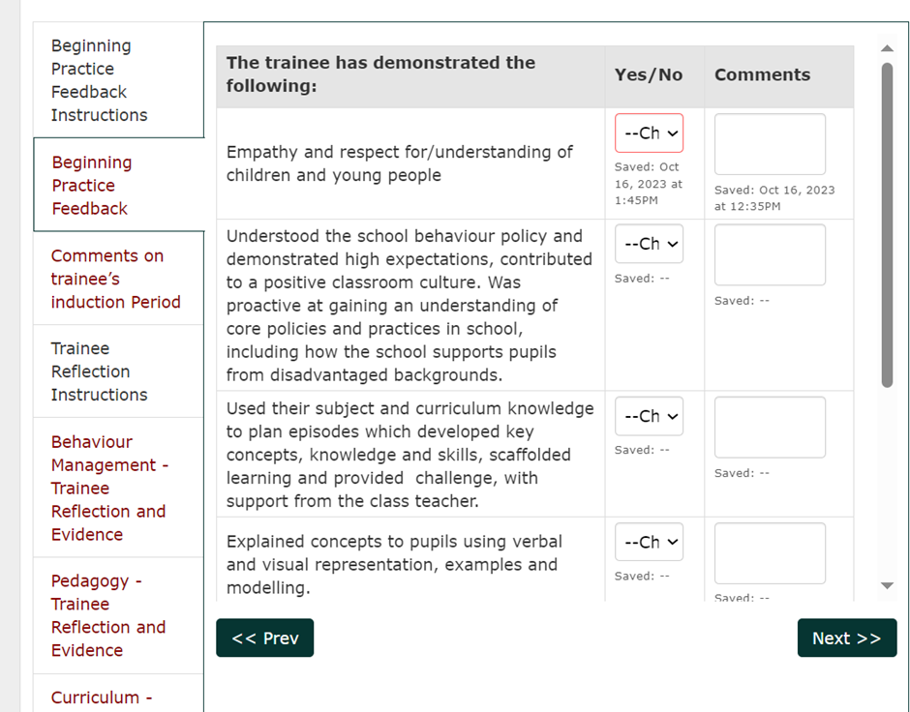
Beginning Practice FRAP- Lead Mentor Feedback
There is a video explaining the BP FRAP process on the Mentor Zone: https://education.exeter.ac.uk/partnership/mentor_zone/induction_training_and_feedback/ in the IDP User Guides and Training Videos section

Slide 11
ITAP
ITAP (Intensive Training and Practice) is being delivered on the Primary Programme and with the Secondary Science cohort
This is to prepare for the changes 24/25
Primary completed their ITAP on assessment (with a maths focus) before half term
Secondary science have some specific tasks to do when in school for their ITAP. Science Lead Mentors have been sent resources about this

Slide 12
Changes to the Exeter Model/ IDP 23-24
Given the changes that we are making to programmes next year we have tried to change very little this year, but have tried to clarify how systems work and provide more support for users.

Slide 13
Changes to FRAPs
Moving between phases has been simplified by the removal of the Continuing in the Phase Action Plan and Continuing in the Phase FRAP. This is to reduce administration work for schools and UVTs but will not reduce the support or monitoring of the trainees who have not met the phase
Trainees who have not met a phase should be issued with a Trainee Support Plan or Cause for Concern. This must state where the trainee will upload the additional evidence to their IDP and who will check and verify this. If you are issuing a TSP/CFC for someone who has not met a phase please contact UVT/Partnership Relations Managers for advice

Slide 14
FRAPs continued….
Consolidating Practice FRAP will have a Lead Mentor comment box to support the move from school 1 to school 2 (not relevant for some School Direct distance trainees)
Each FRAP template clearly explains what should happen, and there will be videos for each FRAP on ELE (for trainees and tutors) and the Partnership website (for school mentors)
Tutors will be asked to confirm that trainees have completed their Safeguarding templates on the Beginning Practice FRAP. This includes checking any uploaded certificates

Slide 15
Changes to other Templates
Framework tasks- These are now grouped per phase rather than per term. They are specific to the programme the trainee is on (i.e. primary/secondary/SDD primary/SDD secondary)
Demonstrations and Agendas- are now grouped as one agenda per template with the option of one or two demonstrations
The focuses for Agendas and Focused Reflections are now grouped according to the profile descriptor headings
We have added a comment box for Lead Mentor on WDM record as requested by schools and UVTs
We have made it more explicit on observation template that lesson plan should be uploaded to the template

Slide 16
New training videos:
Introduction to the IDP (5 minutes 30 seconds)
Adding and renaming templates (9 minutes 30 seconds)
Linking Evidence (6 minutes 30 seconds)
Anticipating Practice FRAP (5 minutes)
Weekly Development Meeting (4 minutes)
Reflective Conversations (5 minutes)
Beginning Practice FRAP
Videos to follow:
CP and DI FRAPs
WDM in DI phase/ Focused Reflections
FSR
PGCE- ECT Transition
https://education.exeter.ac.uk/partnership/mentor_zone/induction_training_and_feedback/ in IDP User Guides and Training Videos section (username and password: exeterpartner)

Slide 17
Communications from Partnership- Bulletins:
Again this year Exeter Partner will send out bulletins at the start of each phase. There are bulletins for Trainees, Schools, Lead Schools and Tutors. They all contain the same information but tweaked as appropriate to each role. Bulletins are also added to the Mentor Zone https://education.exeter.ac.uk/partnership/mentor_zone/coursehandbooksanddocuments/

Slide 18
Reaccreditation
All ITE providers are being reaccredited by the DfE. We are currently working with schools and academics on our new programmes. Information for prospective students can be found on our recruitment website:
https://www.exeter.ac.uk/study/teachertraining/
We have updated our Partnership website to show what benefits we can offer schools and mentors choosing to work with us: https://education.exeter.ac.uk/partnership/joiningthepartnership/
We are asking Partner schools to indicate that they wish to continue working with us on our new programmes. If you haven’t already done so please do complete the form on the above link

Slide 19
Placement 2
We will be sending out provisional placement reminders to schools this month. Please do contact us if there are any changes or you can offer additional placements
Trainee names and details will follow in the new year
Placement 2 dates are: 18th March- 26th June (primary) 27th June (secondary)

Slide 20
Any questions?

