Slide 1
Exeter Model and IDP Induction 2nd school placement

Slide 2
Plan for the session Introduction and welcome The Exeter Model Curriculum Exeter Model Tools Learning Conversations Supporting trainees Introduction to the IDP Mentoring Questions and close

Slide 3
Who's Who? Partnership Relations Managers: Fiona Bosley, Gini Williams, Heidi Long There are three mentoring roles within the Exeter Model Initial Teacher Education Co-ordinator (ITEC) Lead Mentor Reflective Mentor

Slide 4
The Exeter Model Curriculum – a phased approach

Slide 5
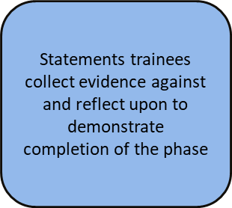
Phase Instructions and Profile Descriptors

Slide 6
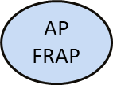
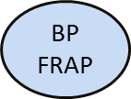
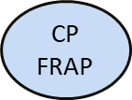
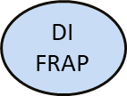
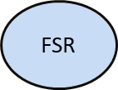
Assessment Points
Formative Reflection on Achievement & Progress

Slide 7
Consolidating Practice FRAP

Slide 8
Developing Independence FRAP

Slide 9
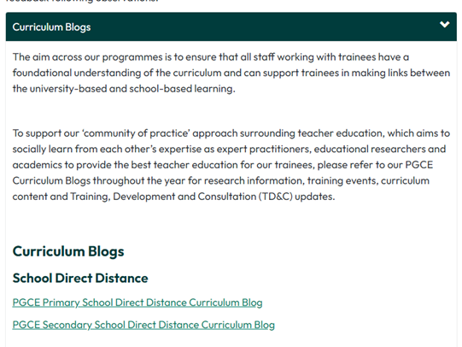
Mentor Zone, bulletins Curriculum blogs
Keep an eye on the bulletins and blogs!
https://education.exeter.ac.uk/partnership/mentor_zone/welcome/

Slide 10
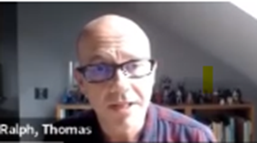
The Exeter Model Curriculum
Ruth Flanagan – Director of Primary Education
Tom Ralph – Head of ITE
Induction, Training and Feedback | Partnership with Schools | University of Exeter

Slide 11
The Core Content Framework
The Ofsted Framework for ITT changed in September 2020, and, like the Education Inspection Framework for schools, is very much focused around the ‘Curriculum as the progression model’, built on the core idea that a well-planned curriculum, appropriately taught and assessed, will secure the training of excellent teachers.
“The approach is built around the connectedness of curriculum, teaching and assessment within the ‘quality of education and training’ judgement” (ITE Framework Inspection Handbook 2020, p. 9)

Slide 12
Timetabling in each phase
Beginning Practice & Consolidating Practice Primary and Secondary including School Direct @ exeter | Developing Independence Primary and Secondary including School Direct @ exeter
12 Hours contact time in the classroom per week. | 12-15 hours contact time in the classroom per week.
Two Demonstrations & Agendas and Observations per week | Focused Reflections supported by Exeter Model Training Tools
Team teaching, episodes or whole lessons

Slide 13
Timetabling requirements
Primary:
Trainees are based with the Lead Mentor (LM) but should also have the opportunity to experience all year groups across the key stage. LM should assist with arranging demonstrations in other year groups.
Trainees should have the opportunity to teach all national curriculum subjects.
Secondary:
Trainees should be timetabled to teach their subject across Key Stage 3 and 4, with post 16 experience in schools with 6th Forms. Trainees do not need to be given independence with year 11 or 6th Form groups, but they do need to experience them. They should also be timetabled with a tutor group.
Trainees should be based in lessons with their LM for at least 50% of their timetable minimum

Slide 14
The Exeter Model Tools
Framework Reflection
Exeter Model Framework
Episode
Agenda
Demonstration

Slide 15
Episode and Lesson Planning

Slide 16
Episode and lesson observations
Observations can be conducted by teachers in the department as well as the Lead Mentor
Focus is on the impact of teaching and pupil learning
2 formal lesson observations a week in BP & CP Phase
More flexible in DI/EE Phase
Trainee to upload lesson plan in lesson observation template
The observer references the profile descriptors against the practice observed. See Phase Instructions and Profile Descriptors
Teacher notes the Areas of Strength and Areas for Development and completes a summary

Slide 17
Demonstrations and Agendas – 2 a week

Slide 18
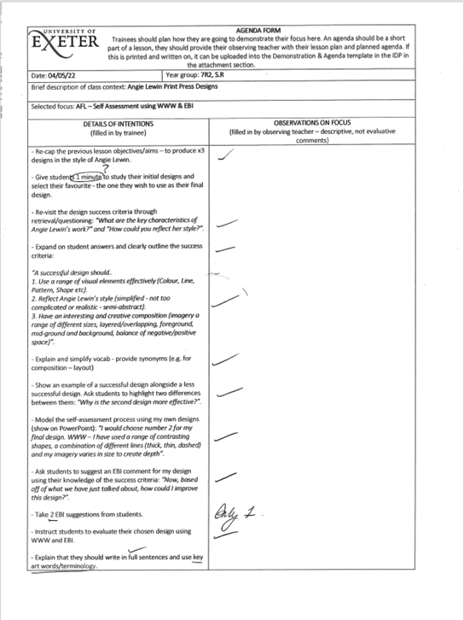
Agendas
The Agenda focuses on an aspect of the trainee’s classroom practice that they want (or need) to develop.
It acts as a ‘microscope’ on a single aspect of their teaching.
The trainee then analyses their teaching and writes a critical reflection, working out what effect they had on the pupils’ learning. They write up their evaluation.

Slide 19
Focused Reflections. DI and EE phase
Trainee decides which focus to work on for 2 weeks
Trainee decides which focus to work on for 2 weeks
Additional Lesson Observations
Trainee evaluates progress with their chosen focus in a written reflection at the end of 2 weeks – WDMs with Lead Mentor continue every week to review progress

Slide 20
Learning Focuses for Focused Reflections

Slide 21
The Exeter Model Framework

Slide 22
Learning Conversations

Slide 23
Purpose of Mentoring Roles
The different mentoring roles complement each other to ensure that all aspects of the National Standards for school-based initial teaching training (ITT) 2016 are covered. The different roles exist to support theories of mentoring; there is more information about the theories in the Mentor Zone and in the handbook.
Lead Mentors work with trainees in the classroom, supporting their development practically on a day to day basis
Reflective Mentors meet trainees three times a placement to help them critically reflect about their teaching
Lead Schools / ITECs are the first point of contact for the university and oversee the training within the school.
UVTs / Personal Tutors visit trainees on placement to support the trainee and the school mentors. They also offer pastoral support to trainees.

Slide 24
Weekly Development Meeting (WDM)
With Lead Mentor- one hour per week
review targets achieved since the previous weekly meeting
discuss the demonstrations, Agendas and evaluations completed in the previous week using the Exeter Model Framework
discuss feedback from observations
discuss trainee progress and include subject specific contexts where appropriate
review progress against the profile descriptors for the FRAP
identify weekly targets that focus on an aspect of practice, some of which are subject specific
decide which episode(s)/lesson (s) will be the subject of the written observation in the week ahead
agree appropriate demonstrations and Agendas to be carried out in the week ahead or, if the trainee is in the DI or EE phase, decide which Exeter Model tools will be used for the Focused Reflection
trainees should record the outcomes of the meeting on the Weekly Development Meeting record (there is a different WDM record for the Developing Independence and Extension and Enrichment Phases)

Slide 25
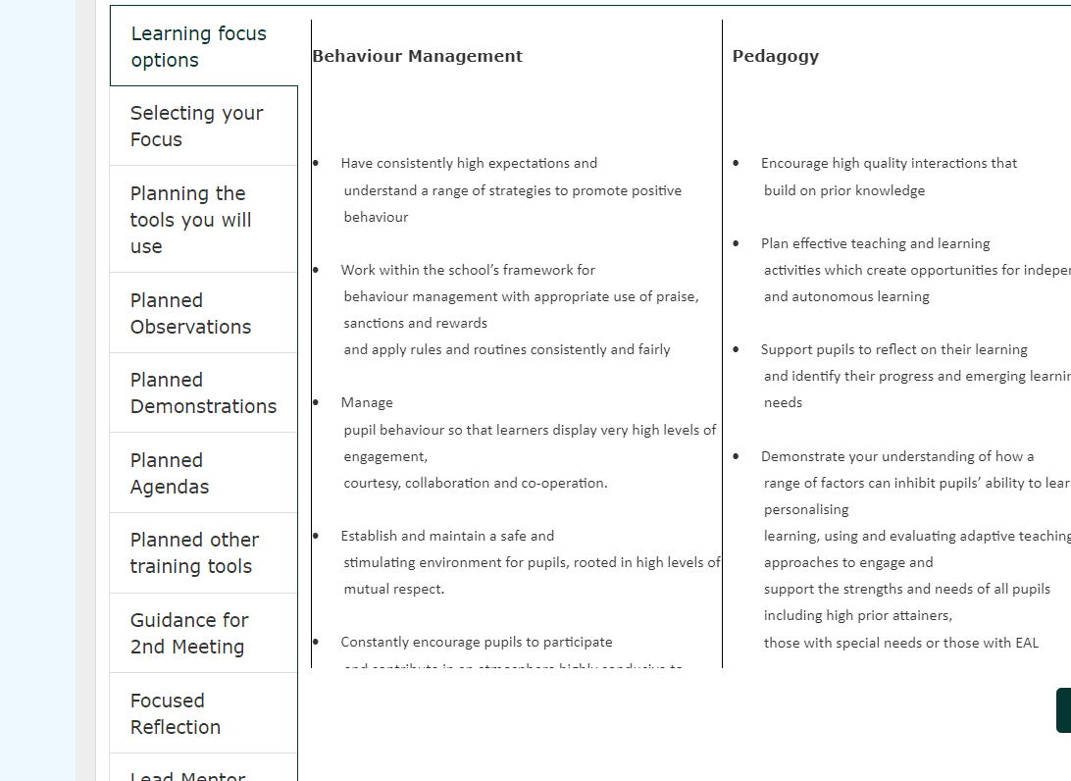
Weekly Development Meeting Template in IDP

Slide 26
Reflective Mentor and Trainee: Reflective Conversation
With Reflective Mentor- one hour- three times a term
Show their RM the relevant Phase Profile Descriptor section of the IDP, explaining the evidence they have linked so far (this evidence is used to write the FRAP)
Talk about an evaluated agenda (or Focused Reflection in DI/EE) to show what they have learned and where they want to focus next
Demonstrate that they have taught across the primary curriculum, if any subjects have not been covered trainees should ask their RM how they might do this (primary only)
Demonstrate that they have experienced (or planned to experience during the placement) all of the year groups within their key stage (for secondary that they have a range of year groups timetabled)
Trainees should choose two foundation subjects (different subjects in each meeting) and talk in detail about how they are teaching these, trainees can show lesson plans to support this discussion (Primary only)
Discuss the wider professional context of being a teacher, including career planning, and exploring cross departmental links
Trainees should be making notes during the meeting on the Reflective Conversation template in the IDP (notes should be in bullet points)

Slide 27
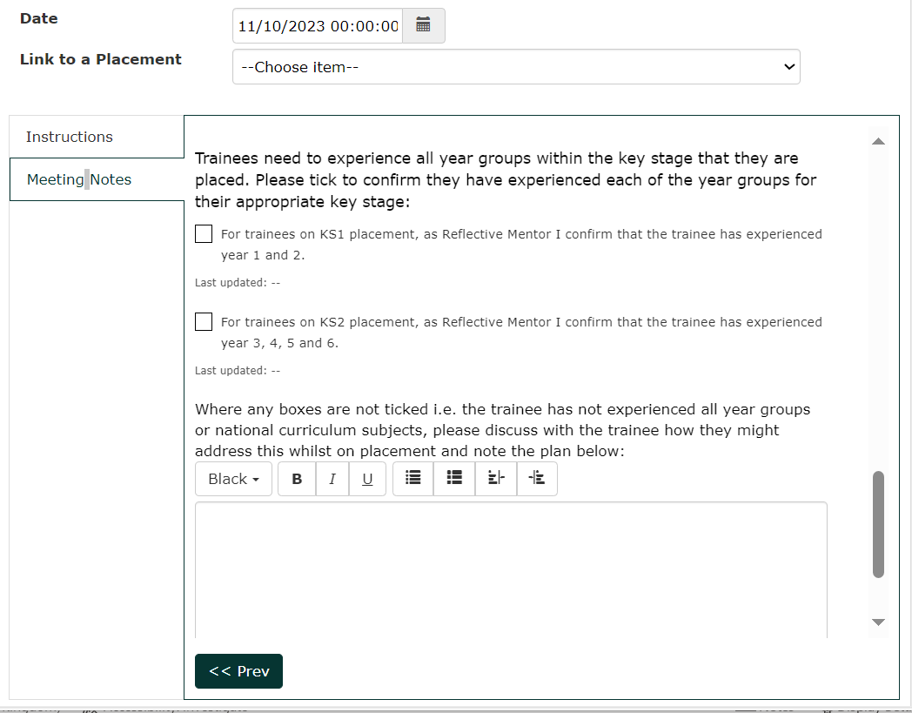
Primary Reflective Conversation Template in IDP

Slide 28
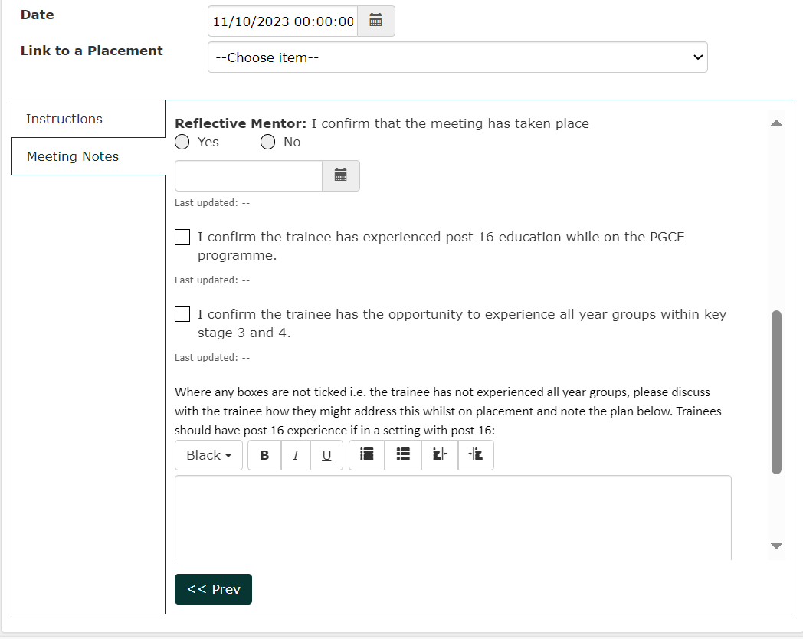
Secondary Reflective Conversation Template in IDP

Slide 29
University Visiting Tutor Visits
University visiting tutors will visit once per placement
They will observe the trainee jointly with the Lead Mentor
Lead Mentor should lead the feedback to the trainee, with UVT supporting (Lead Mentors can ask for support or modelling by the UVT if they are new to the role)
Lead Mentor will be checking the trainee progress
They also quality assure placements and will check support trainee is getting, that Professional Studies programme is in place and that the Exeter Model is being followed
There to support schools as well as the trainee

Slide 30
Supporting trainees
Trainee Support Plans (TSP)
For trainees who are generally on track but experiencing some barriers preventing progress
Create TSP in the IDP
Clear targets
Two week review point
If progress not made and there are concerns regarding failure to progress move to CFC
Cause for Concern action plans (CfC)
For trainees who are not on track due to illness or a variety of other reasons and there is more of a concern about progress

Slide 31
Equality, Diversity & Wellbeing support for trainees
Wellbeing
PGCE trainees receive support from university wide services. Counselling, occupational health, study services, careers and financial advice.
Always inform UVT or Exeter Partner.
Tab on Mentor Zone for further info​
Ruth Flanagan Race Equality Resource Officer (RERO)
- Supports students from all ethnic minorities and other backgrounds who have witnessed racism.
-offers a confidential non- judgemental place to discuss issues and concerns
-Signposts for practical support such as housing and finance
-Can refer to outside agencies
Can support school staff when necessary
R.flanagan@exeter.ac.uk

Slide 32
What to expect from trainees at this point
School 2 Placement dates: 18th March- 26th June (pri) 27th June (sec)
Trainees submit Consolidating Practice FRAP on 29th February
Any associated action plans will be in the IDP
Partnership Relations Manager will be in contact with schools where a trainee is on a CFC at school transition point
Trainees will be in Developing Independence and should work with their Lead Mentor to plan their Focused Reflection in the first week
Induction template in IDP to complete, trainee must complete this in week 1
Safeguarding template in IDP to complete
The Weekly Development Meeting in week one should set up the first Focused Reflection in that placement

Slide 34
IDP Training Videos and Guides
There are a selection of training videos and guides available on the Mentor zone (username and password are both exeterpartner)
https://education.exeter.ac.uk/partnership/mentor_zone/induction_training_and_feedback/

Slide 39
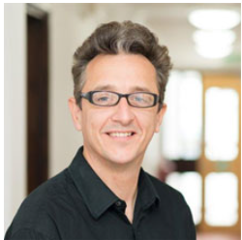
Mentoring – the theory and the Exeter Model Induction, Training and Feedback | Partnership with Schools | University of Exeter LMTD&Cs
School Direct | Partnership with Schools | University of Exeter

Slide 40
Questions and close
For more information or if you have any questions contact the Partnership Office admin team:
exeterpartner@exeter.ac.uk 01392 724841
Partnership Relations Managers:
Gini Williams – g.williams6@exeter.ac.uk
Heidi Long – h.long@exeter.ac.uk
Fiona Bosley- f.bosley@exeter.ac.uk
Director of Mentoring
Bryan Smith - B.P.Smith@exeter.ac.uk

