Slide 1
School Direct Distance Exeter Model and IDP Induction

Slide 2
The Exeter Model Curriculum – a phased approach

Slide 3
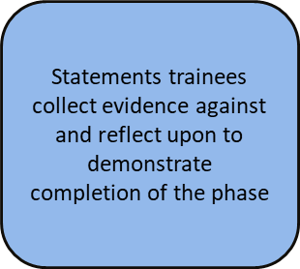
Phase Instructions and Profile Descriptors

Slide 4
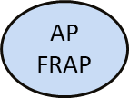
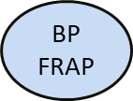
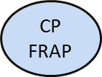
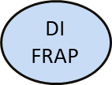
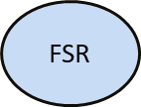
Assessment Points
Formative Reflection on Achievement & Progress
Notes:
There is a deadline
FRAPs can be submitted early

Slide 5
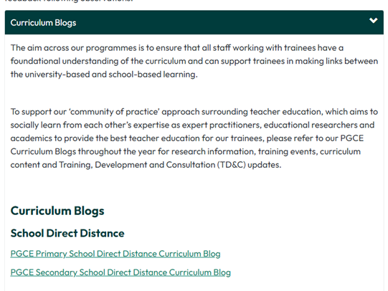
Mentor Zone and Curriculum blogs
Keep an eye on the bulletins and blogs!
Welcome | Partnership with Schools | University of Exeter

Slide 6
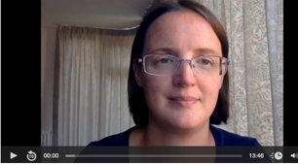
The Exeter Model Curriculum
Dr Annabel Watson – School Direct Distance Secondary Module Lead
Induction, Training and Feedback | Partnership with Schools | University of Exeter
Harriet White -Primary PGCE School Direct Distance Module Lead

Slide 7
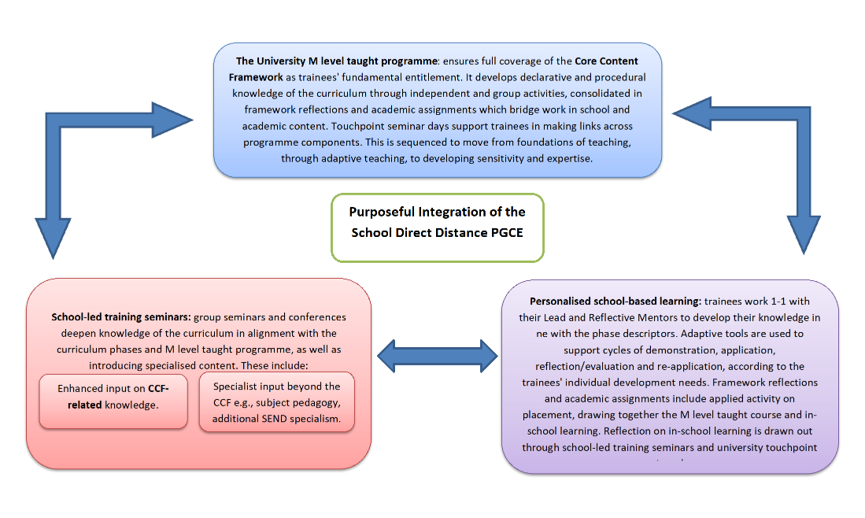
The Core Content Framework
The Ofsted Framework for ITT changed in September 2020, and, like the EIF for schools, is very much focused around the ‘Curriculum as the progression model’, built on the core idea that a well-planned curriculum, appropriately taught and assessed, will secure the training of excellent teachers.
“The approach is built around the connectedness of curriculum, teaching and assessment within the ‘quality of education and training’ judgement” (ITE Framework Inspection Handbook 2020, p. 9)
Purposeful Integration
of the SDD PGCE:

Slide 8
Timetabling in each phase
Beginning Practice & Consolidating Practice Primary and Secondary including School Direct @ exeter | Developing Independence Primary and Secondary including School Direct @ exeter | School Direct Distance (Primary and Secondary)
12 Hours contact time in the classroom per week. | 12-15 hours contact time in the classroom per week. | 8 – 10 hours contact time per week Beginning Practice Phase
Two Demonstrations & Agendas and Observations per week | Focussed Reflections supported by Exeter Model Training Tools | 10-12 hours a week Consolidating Practice Phase
 |  | 12-15 hours a week Developing Independence phase.
Team teaching, episodes or whole lessons |  | Flexible to allow for on-line training and lead school training

Slide 9
Timetabling requirements
Primary:
Trainees are based with the Lead Mentor (LM) but should also have the opportunity to experience all year groups across the key stage. LM should assist with arranging demonstrations in other year groups.
Trainees should have the opportunity to teach all national curriculum subjects.
Secondary:
Trainees should be timetabled to teach their subject across Key Stage 3 and 4, with post 16 experience in schools with 6th Forms. Trainees do not need to be given independence with year 11 or 6th Form groups, but they do need to experience them. They should also be timetabled with a tutor group.
Trainees should be based in lessons with their LM for at least 50% of their timetable minimum

Slide 10
The Exeter Model Tools
Framework Reflection
Exeter Model Framework
Episode
Agenda
Demonstration

Slide 11
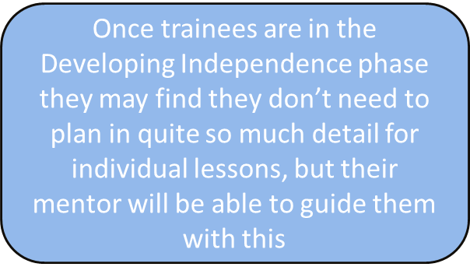
Episode and Lesson Planning

Slide 12
Episode and lesson observations
Observations can be conducted by teachers in the department as well as the Lead Mentor
Focus is on the impact of teaching and pupil learning
2 formal lesson observations per week in BP and CP Phase.
DI and EE phase is more flexible (min. 1 formal lesson observation)
The observer references the profile descriptors against the practice observed. See Phase Instructions and Profile Descriptors
Teacher notes the Areas of Strength and Areas for Development and completes a summary

Slide 13
Demonstrations and Agendas

Slide 14
Learning focuses for Demos and Agendas

Slide 15
Example Demonstration

Slide 16
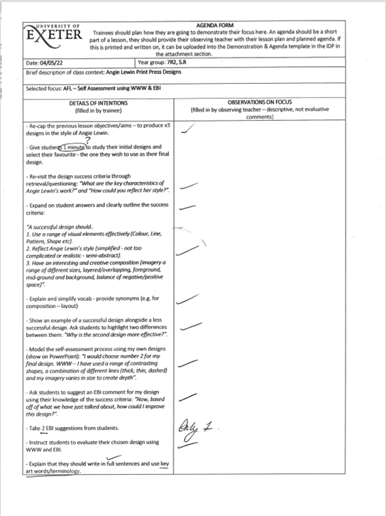
Agendas
The Agenda focuses on an aspect of the trainee’s classroom practice that they want (or need) to develop.
It acts as a ‘microscope’ on a single aspect of their teaching.
The trainee then analyses their teaching and writes a critical reflection, working out what effect they had on the pupils’ learning. They write up their evaluation.

Slide 17
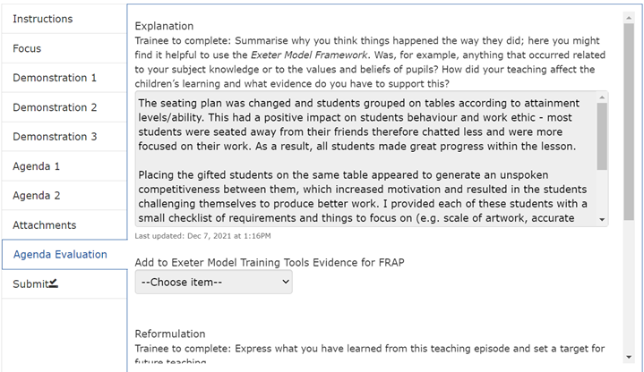
Evaluating an agenda: the main objective
Trainees should draw on research and reading if possible.
Agendas should be a challenge for the trainee.
Agendas should move the trainee’s teaching forward .
Demonstrations and Agendas provide evidence that a trainee can reflect critically on aspects of their own learning

Slide 18
Focused Reflections. DI and EE phase
Trainee decides which focus to work on for 2 weeks
Additional Lesson Observations
Trainee evaluates progress with their chosen focus in a written reflection at the end of 2 weeks – WDMs with Lead Mentor continue every week to review progress

Slide 19
The Exeter Model Framework

Slide 20
Purpose of Mentoring Roles
The different mentoring roles complement each other to ensure that all aspects of the National Standards for school-based initial teaching training (ITT) 2016 are covered. The different roles exist to support theories of mentoring; there is more information about the theories in the Mentor Zone and in the handbook.
Lead Mentors work with trainees in the classroom, supporting their development practically on a day to day basis
Reflective Mentors meet trainees three times a placement to help them critically reflect about their teaching
Lead Schools / ITECs are the first point of contact for the university and oversee the training within the school.
UVTs / Personal Tutors visit trainees on placement to support the trainee and the school mentors. They also offer pastoral support to trainees.

Slide 21
Weekly Development Meeting (WDM)
Lead Mentor with trainee
One hour a week, timetabled
Review progress, plan progression and set targets
Monitor EPS tasks (primary and secondary), and Subject Framework Tasks (primary)
Discuss links to taught curriculum
Complete WDM Record together online. The form provides guidance about what to discuss, there is a different version of the WDM record in the Developing Independence Phase.

Slide 22
Reflective Mentor and Trainee: Reflective Conversation
Three one-hour-long meetings per term, one-to-one with Reflective Mentor.
Reflective Mentor to check:
that the trainee has an appropriate timetable/ experience while on placement. For primary this includes national curriculum subject coverage and for secondary this includes experience of all KS 3&4 and post 16 experience. Details are on the RM Reflective Conversation record in the IDP
The Reflective Conversation should include:
discussion about the trainee’s annotated and evaluated agendas + relevant lesson plans, pupils’ work etc. (Focused Reflections in the DI phase)
discussion about planning/delivery/coverage of the two allocated subjects for primary trainees.
FRAP – to discuss progress within the Profile Descriptor tab on the IDP
Process:
Develop critical evaluation based on agendas, using Framework and Critical Reflection prompts , assess effectiveness of teaching and critically reflect on areas for professional development.

Slide 23
Supporting trainees
Trainee Support Plans (TSP)
For trainees who are generally on track but experiencing some barriers preventing progress
Create TSP in the IDP
Clear targets
Two week review point
If progress not made and there are concerns regarding failure to progress move to CFC
Cause for Concern action plans (CfC)
For trainees who are not on track due to illness or a variety of other reasons and there is more of a concern about progress

Slide 24
University Visiting Tutor Visits - primary
These boxes may change slightly for 23/24

Slide 25
University Visiting Tutor Visits - secondary

Slide 26
Equality and Diversity
Support for trainees
Ruth Flanagan Race Equality Resource Officer (RERO)
- Supports students from all ethnic minorities and other backgrounds who have witnessed racism.
- She offers a confidential non- judgemental place to discuss issues and concerns
-Signposts for practical support such as housing and finance
- Can refer to outside agencies
- Can support school staff when necessary
Always inform UVT or exeterpartner. Tab on Mentor Zone for further info
01392 724871
R.flanagan@exeter.ac.uk
Wellbeing

Slide 27
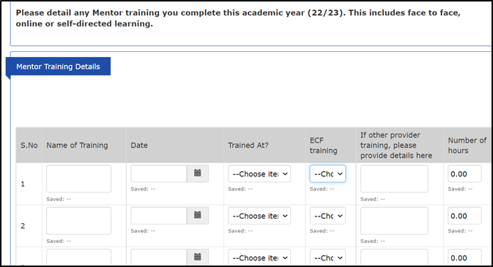
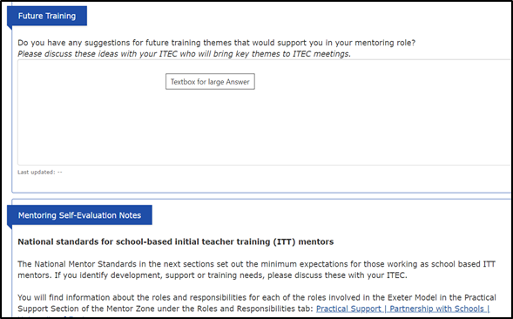
Mentor Training and self-evaluation record
Can be found in IDP under the records tab for all Mentors
Allows mentors to log any mentor training they complete within the year
Also gives a chance for Mentors to feedback training suggestions and comments to ITECs and evaluate themselves against the National Mentor Standards
This information also informs the Training, Development and Consultation sessions that all mentors are invited to throughout the year (see blogs on Mentor Zone Home > Exeter School Direct Distance Primary PGCE)

Slide 28
IDP Q&A
Notes:
Link to Profile descriptors

Slide 29
IDP updates for 23/24
No major updates.
Timeline will have a ‘focused section’ and ‘completed section’ – the focused section showing the tasks and tools that need to be completed that week.
Everything else in Portfolio tab.
Evidence linking is going to change – further information to follow
Will be able to comment on templates with the option to notify a person about the comment
23/24 training videos for Mentors will be available from September

Slide 30
Transition points and questions
How do you manage transition between placements? Could this be a focus group activity with your mentors during training sessions?
Any questions

Slide 31
Mentoring – the theory and the Exeter Model
School Direct | Partnership with Schools | University of Exeter

Slide 32
Trainee Induction Day
To know who key people are
To help understand how the University works in partnership with schools to support training
To begin to establish our ‘community of practice’ and support networks e.g. meet your UVT and other members of the Partnership office
To help understand the Exeter Model of initial teacher education
To explore the online modules and consider the expectations and demands of the course
To develop ‘reflective practice’.

Slide 33
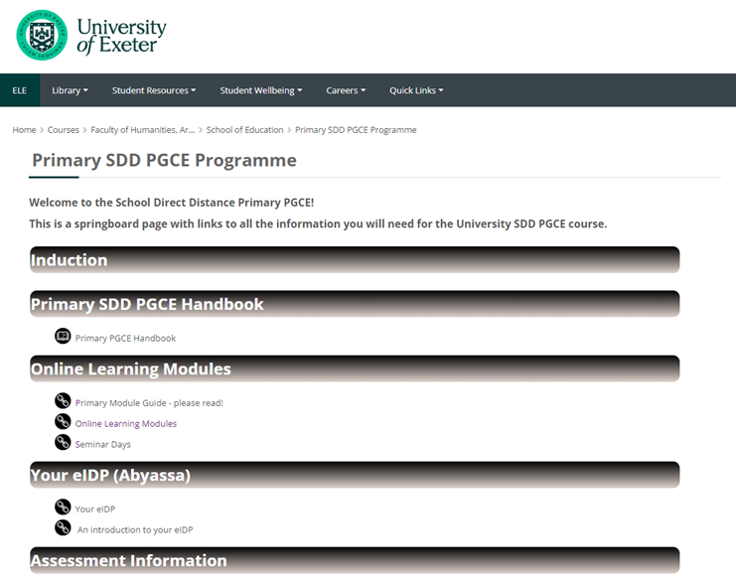
Exeter Learning Environment (ELE) – the learning platform for the trainees

Slide 34
Framework Reflections - Framework tasks
Rationale : Framework reflections link theory to practice with regards to a key topic and provide evidence for QTS:
•Challenging the Gap – exploring disadvantage/ widening participation (gender, ethnicity, geographical regions)
•Learning
•Maths
•Motivation and Behaviour
•Assessment
•Phonics
•SEND 1 and 2
•Interpreting data
•EAL
•Diversity

Slide 35
Framework Reflection Example - Maths

Slide 36
Assignments
Rationale – to support development in schools by further developing knowledge and understanding of key topics, principles and issues, as well as knowledge of educational research.
Subject and Curriculum Studies (SCS) ( 1 x formative; 1 x summative)
marked against Master’s level criteria ( Knowledge and Understanding; Critical analysis and argument; Use of relevant literature ; Organisation, Presentation and Professional Studies)
Range of topics chosen by trainees e.g. use of dialogic talk to avoid errors in maths; importance of phonics to a child’s education; how educators can motivate reading for pleasure; impact of mixed-age classes in KS1 maths lessons
Education and Professional Studies (EPS) ( 1 x formative; 1 x summative)
•marked against Master’s level criteria ( Knowledge and Understanding; Implications for practice and links to Exeter tools; Use of relevant literature; Organisation and Presentation)
Range of topics chosen by trainees e.g. how to nurture a positive reading culture within schools; Strategies in KS2 to support low ability pupils; Developing emotional literacy for leaners with ASD in SEND school setting; Does parental involvement in Primary education matter; Role of outdoor learning and forest schools.

Slide 37
Assignments

Slide 38
Curriculum incl. seminar days
Rationale:
trainees wanting more than just asynchronous learning and a way to connect them to the University more
Having access to subject specialists from academics
Up to date M level knowledge from academics
6 days with input divided in to two half days- subjects this year in order: Phonics, Reading, Maths, Planning for Learning, Science, M Level input, Humanities, Computing, ML, EAL, PE, Geography.
Example of a typical day.
Some subjects are also covered on Training, Consolidation and Development afternoons online, such as this year Music and Creative Writing.

