Slide 1
Community of Practice UVT Annual Training 2023

Slide 2
UVT QA Process

Slide 3
Outcome of UVT Annual Visit Record Review
Outcome of UVT Visit Record Review August 2023.docx (sharepoint.com)
Monitor using evidence
Use of Exeter Model
Professional Studies
Safeguarding
Flag any issues/gaps in text box and note a follow-up date. Complete Follow up of Issues tab within 2 weeks
Monitor opportunities
Flag any issues/gaps in text box and note a follow-up date. Complete Follow up of Issues tab within 2 weeks
Assess English and maths fundamental skills
Let the ITEC, exeterpartner and PRMs know immediately so support can be put in place
Joint reflective discussion of observation
If it wasn't joint – note how it was fedback
Assess progress
If exceeding - provide a little more explanation in next section
Comment of progress against the requirements of the phase including areas of strength and development
Comment on progress against Profile Descriptors and provide areas of strength and development
UVT Visit Record Form Guidance - video

Slide 4
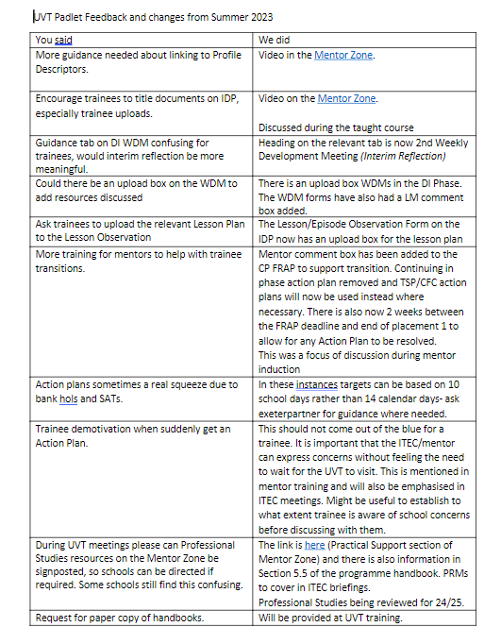
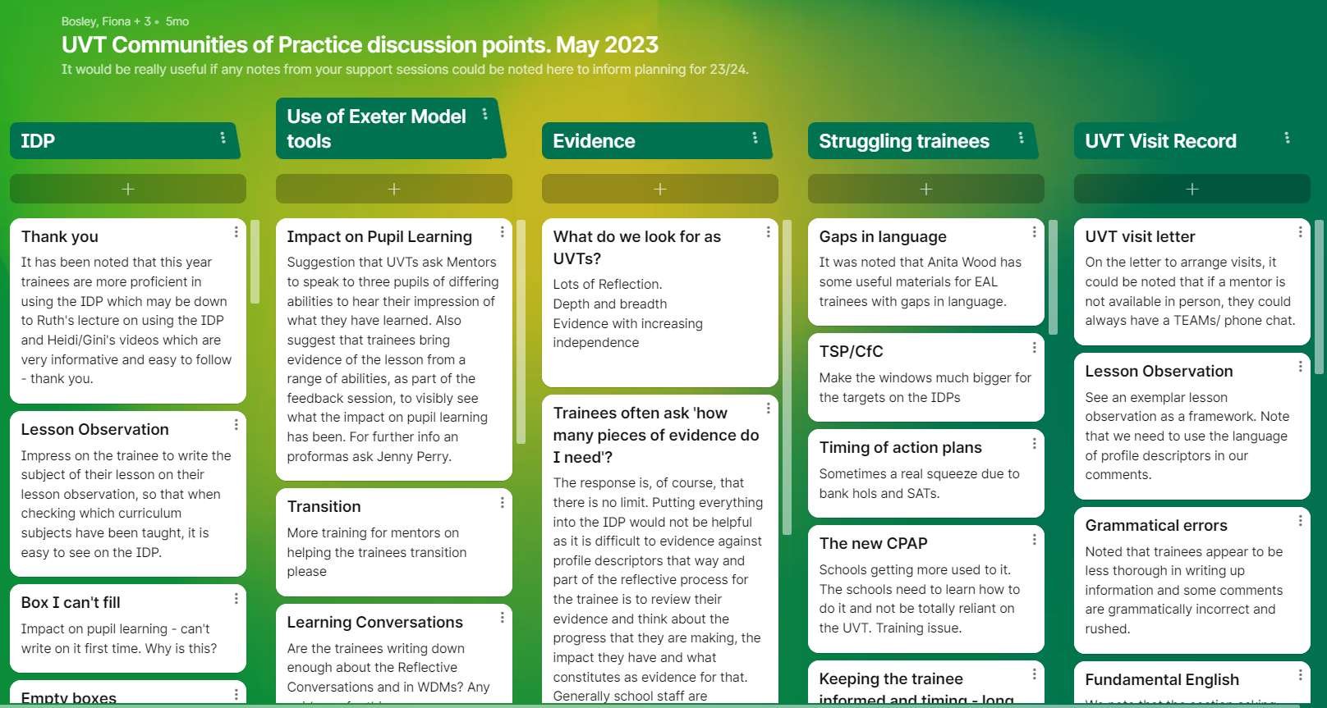
UVT Community of Practice support sessions feedback
Padlet – 22/23 - You said....We did!
*will also inform developments for 24/25

Slide 5
UVT Community of Practice support sessions
CoP support sessions dates are between UVT visit windows:
Week of 13th or 20st November SDD UVTs
Week of 29th January all UVTs
Week of 29th April all UVTs
Primary groups were sent out in the BP UVT Bulletin – please arrange meetings
Secondary groups - online – Bryan Smith to contact UVTs to confirm a date
Foci for Padlets 23/24 - to be sent to SDD UVTs this week.
Any questions

Slide 6
Changes to the Exeter Model and IDP 23-24

Slide 7
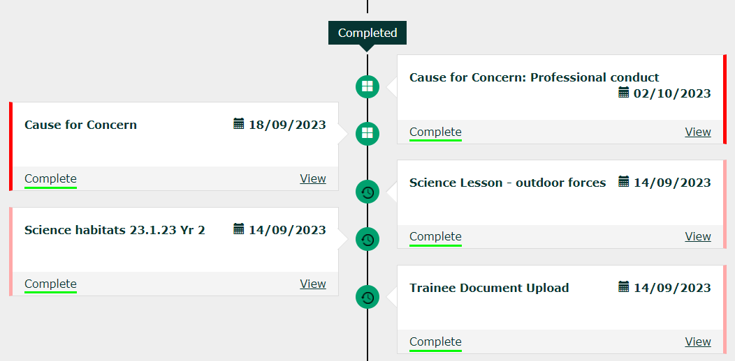
Trainee Timeline
Upcoming – planned tasks
Focused – current tasks
Completed – completed tasks now at the bottom of the timeline

Slide 8
Changes to FRAPs
Moving between phases has been simplified by the removal of the Continuing in the Phase Action Plan and Continuing in the Phase FRAP. This is to reduce administration work for schools and UVTs but will not reduce the support or monitoring of the trainees who have not met the phase
Trainees who have not met a phase should be issued with a Trainee Support Plan or Cause for Concern (and FRAP submitted as Not Met). This must state where the trainee will upload the additional evidence to their IDP and who will check and verify this. If you are issuing a TSP/CFC for someone who has not met a phase, please contact UVT/Partnership Relations Managers for advice

Slide 9
FRAPs continued….
Consolidating Practice FRAP will have a Lead Mentor comment box to support the move from school 1 to school 2 (not relevant for some School Direct Distance trainees)
Each FRAP template explains what should happen, and there will be videos for each FRAP on ELE (for trainees and tutors) and the Partnership website (for school mentors)
Personal Tutors will be asked to confirm that trainees have completed their safeguarding templates on the Beginning Practice FRAP. This includes checking any uploaded certificates

Slide 10
Changes to other Templates
Framework tasks- These are now grouped per phase rather than per term. They are specific to the programme the trainee is on (i.e. primary/secondary/SDD primary/SDD secondary)
Demonstrations and Agendas- are now grouped as one agenda per template with the option of one or two demonstrations
The focuses for Agendas and Focused Reflections are now grouped according to the profile descriptor headings
We have added a comment box for Lead Mentor on WDM record as requested by UVTs
We have made it more explicit on observation template that lesson plan should be uploaded to the template

Slide 11
New Templates
ITAP reflection – scheduled on the timeline for primary, unscheduled for secondary (as not all secondary trainees will take part in ITAP this year)
Fundamental English and Maths action plans can now be added onto the IDP even if a trainee has an existing TSP/CFC

Slide 12
New training videos:
Please watch the videos, they are short and answer most questions.
Trainees have videos available on ELE, school mentors on the Partnership website.
Introduction to the IDP (5 minutes 30 seconds)
Adding and renaming templates (9 minutes 30 seconds)
Linking Evidence (6 minutes 30 seconds)
Anticipating Practice FRAP (5 minutes)
Weekly Development Meeting (4 minutes)
Reflective Conversations (5 minutes)
Videos to follow:
BP, CP and DI FRAPs
WDM in DI phase/ Focused Reflections
FSR
PGCE- ECT Transition

Slide 13
Links for videos
School Direct distance:
https://ele.exeter.ac.uk/course/view.php?id=10655&section=6
HEI and @exeter:
https://ele.exeter.ac.uk/course/view.php?id=9610&section=2
Mentors:
https://education.exeter.ac.uk/partnership/mentor_zone/induction_training_and_feedback/
Found in the ‘IDP user guides and training videos’ section of The Mentor Zone

Slide 14
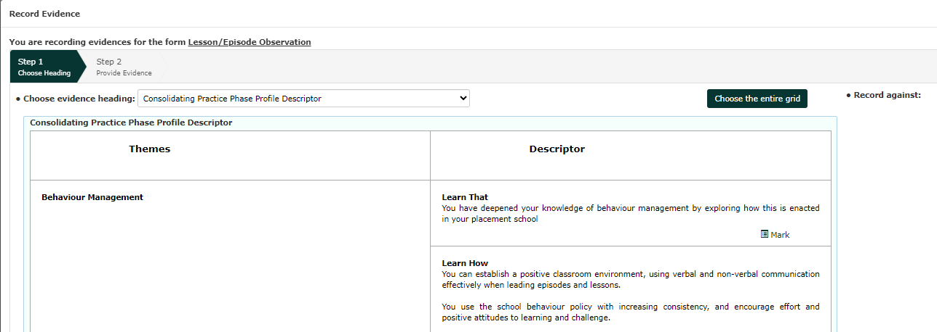
Additional training and instructions for the IDP
We are being much clearer with trainees how they can link evidence to the profile descriptors. This should support them in being ready for their FRAP, and support Mentors and UVTs when looking at IDPs
As they did last year, trainees should use their Phase Instructions on the Profile Descriptors to programme their IDP in each phase. We have done the first two weeks in school for them, and have reduced demos/agendas and observations to one per week for their first week
There is now a complete guide to using the IDP on the Mentor Zone giving clear instructions from how to log on to adding a TSP/CFC

Slide 15
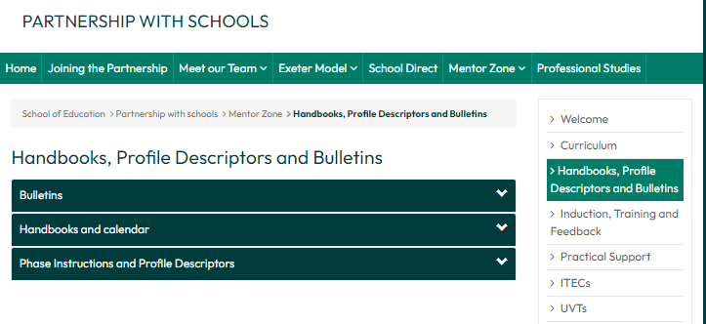
Communications from Partnership- Bulletins:
Send out bulletins at the start of each phase.
There are bulletins for trainees, schools, Lead Schools and Tutors.
They all contain the same information but tweaked as appropriate to each role.
Tutors won't be sent the school and trainee versions but will be put in the bulletin section of the Mentor Zone after they are sent: https://education.exeter.ac.uk/partnership/mentor_zone/coursehandbooksanddocuments/

Slide 16
Any questions?

Slide 17
Impact of the ITT Reaccreditation
Our new courses from 24/25
Competitiveness of placements – changes to local providers

Slide 18
Notes:
If you accept an offer from us, you will be directed to this page. It has will show a tab on the left hand side called 'Offer Holders' and there you will find useful information and details of all tasks required prior to the start of your course. Please check this regularly to ensure a smooth start to your training.

Slide 19
The Exeter Model of ITE
Courses from 24/25
Primary
3 – 7 programme *
5 – 11 programme * (including regional hubs)
Secondary
•Secondary English
•Secondary Geography
•Secondary History
•Secondary Mathematics
•Secondary Modern Foreign Languages
•Secondary Physical Education
•Secondary Science (Biology)
•Secondary Science (Chemistry)
•Secondary Science (Physics)
•Secondary Science (Engineers Teach Physics)
•Secondary Science (Biology and PE)
Those in yellow are new courses
Notes:
*Once you have accepted an offer for the primary programme, you will be invited to select a specialist area of study under the 'Leadership Strand'. The choice of specialist areas will be made from this list:
Art
English
Humanities
Maths
Modern Languages
Science
EAL
SEND
Inclusion and SEND in Special Education
3-7 Leadership Development (for the Primary 3-7 trainees)

Slide 20
The Exeter Model of ITE (Primary)
Subject specialism
Research led
Situated learning
Masters level
Phased route to QTS
Support
Facilities
School placements
Education Theory, Research and Practice
Curriculum Theory, Research and Practice
Assessment:
2 Masters level assignments: pass, merit, distinction
PGCE Programme
Assessment:
Teachers’ Standards
Leadership Development
Professional Learning
Notes:
Key messages:
PGCE is a combined qualification. Assessment of your academic work (top row of graphic) is through written assignments.
Formative assessment of your progress takes place throughout your training year and you will play an active part in this. We use the Core Content Framework for Initial Teacher Education as the basis for all our formative assessment of your progress, enabling you, at the end of your year with us, to demonstrate that you have met the Teachers' Standards.

Slide 21
Primary Leadership Development Module options( available subject to demand/minimum numbers)
PGCE Primary (5-11) with Art
PGCE Primary (5-11) with English
PGCE Primary (5-11) with Humanities
PGCE Primary (5-11) with Mathematics
PGCE Primary (5-11) with MFL
PGCE Primary (5-11) with Science
PGCE Primary (5-11) with Inclusion (EAL)
PGCE Primary (5-11) with Inclusion (SEND)
PGCE Primary (5-11) with Inclusion (SEND in special schools)
PGCE Primary (3-7) with 3-7 Leadership Development
Option variations between the ITE Hubs
Trainees can attend a different ITE Hub for their Leadership Development Module:
Exeter St Luke's offer all options except PGCE Primary (5-11) with Inclusion (SEND in special schools)
North & Mid Devon offer only PGCE Primary (5-11) with Inclusion (SEND)
Somerset & Dorset offer only PGCE Primary (5-11) with Inclusion (SEND in special schools)
Notes:
*Once you have accepted an offer for the primary programme, you will be invited to select a specialist area of study under the 'Leadership Strand'. The choice of specialist areas will be made from this list.

Slide 22
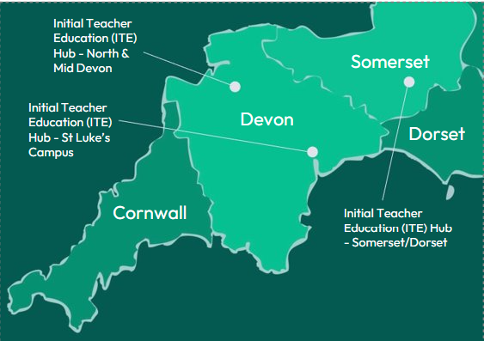
Primary Initial Teacher Education (ITE) Hubs

Slide 23
The Exeter Model of ITE (Secondary)
Education Theory, Research and Practice
Subject specialism
Research led
Situated learning
Masters level
Phased route to QTS
Support
Facilities
School placements
Specialist Subject Knowledge, Pedagogy, Research and Practice
Assessment:
2 Masters level assignments: pass, merit, distinction
PGCE Programme
Assessment:
Teachers’ Standards
Professional Learning
Notes:
Key messages:
PGCE is a combined qualification. Assessment of your academic work (top row of graphic) is through written assignments
Formative assessment of your progress takes place throughout your training year and you will play an active part in this. We use the Core Content Framework for Initial Teacher Education as the basis for all our formative assessment of your progress, enabling you, at the end of your year with us, to demonstrate that you have met the Teachers' Standards.

Slide 24
Secondary DfE Apply Application areas for placements
Trainees choose the option that is the best fit for them.
Aim to reduce commuting costs for trainees both for taught course (max 2 days on campus) and placements + ability to do targeted marketing where placements/mentors are strongest

Slide 25
Changes to providers in the South West 24/25
Still running:
Plymouth Marjon University
South West Teacher Training (will be validated by the University of Exeter from 24/25) - https://www.swtt.net
Cornwall SCITT
No longer running:
University of Plymouth
Devon Primary SCITT
UWE
New!
https://www.swiftteachertraining.org.uk/
The National Institute of Teaching Associate Colleges
Education South West (SWIFT)
Kernow Learning (Cornwall Teaching School Hub + our previous SDD Lead School)
Colyton Grammar School (SWIFT)

Slide 26
How can we maintain partnerships and placements – you are the face of Exeter!
Schools more likely to work with 1 provider due to the DfE Mentoring hours requirement
Schools who own a SCITT (now increased) or associated with a TSH more likely to work with them
Schools like working with us
Access to academic staff
Partnership Office for fast response and support - USP
We have done this for a long time
Our requests
Inform exeterpartner by email as soon as there are concerns about trainees or school provision so PRMs can contact the ITEC to support them
Respond quickly to schools
Arrange visits at least two weeks in advance
Ask us for advice / support

Slide 27
Trainee issue scenarios
Scenario 1
During his UVT visit, Sam has explained to his UVT that he has been finding it difficult to work at home because his flatmates are noisy and don't seem to understand that he has a lot to do each evening. This has meant that his IDP isn't up to date but he promises that it will be by the end of the week.
As a UVT, what would you do in this situation?
Scenario 2
During the UVT visit, the LM has explained to you that Daisy is well liked by staff and pupils, she is enthusiastic and appears very keen to get involved in classes. She has asked for some additional hours on her timetable as she wants to improve her practice (she is currently timetabled for 12 hrs in Consolidating Practice). However, Daisy is often late for classes and has been known to skip Professional Studies sessions and last week didn't arrive at her timetabled tutorial slot or parents evening. The LM is new to her role and has asked the UVT for advice.
As a UVT, how would you respond to the LM and the trainee?
Notes:
Scenario 1 – this is a very common scenario and at times Lead Schools (for SDD) and ITECs are a little frustrated that UVTs haven't passed this information onto them immediately so the trainee can be supported and the issue nipped in the bud.
Action:
Scenario 1
For trainee – explain about the library and other spaces that are available to the trainee if that might be helpful. It could be that staying on at school to plan might be a better/more productive option.
For UVT – to be noted in the UVT Record and make a date to follow this up and check all is well. ? Wellbeing if you feel Sam is really struggling and you feel this is really an excuse to cover up a bigger problem
For LM/UVT - if the trainee asks for 'just one more week' AGAIN to sort it out – think about issuing a support plan.

Slide 28
New DfE Lead Mentor role
30 hours of training (20 hours Mentor training + 10 hours)
Will replace bought in UVTs – will keep current UVTs in touch about process
Will be developing job descriptions over this year and would encourage people to apply
Task
Complete collective mind map

