Slide 1
GRAMMAR FOR WRITING
Choice and Control.
CPD Day 4

Slide 2
INTRODUCtion

Slide 3
Aims of Session: CPD Day 4
To consolidate grammatical subject knowledge developed in the project;
To share our understanding of how the pedagogy has been implemented;
To consider next steps to embed this approach more widely in your school.

Slide 4
Emerging Impressions
Teachers and students have been strongly engaged by the teaching units;
The power of imaginative engagement in ‘Merlin’ unit – it is easy to move so quickly to analysing text or talking about success criteria that young writers have no time to engage with ideas and purpose. But imaginative engagement is key.
Strong take-up of the idea of linking grammar with making meaning in writing;
Some schools reporting strong improvement in writing;
Some schools are planning whole school or whole academy roll-out of this project.

Slide 5
Emerging Impressions
Some development points to consider:
Verbalising more clearly the effect of a particular grammatical choice:
being sure you can articulate the effect yourself, perhaps in your planning, until it becomes more natural;
modelling this kind of language talk for children;
creating tasks which give children opportunities to verbalise their understanding of the effect of a particular choice;
displaying visually examples of expressing the effect;
giving formative feedback where you articulate the effect of a child’s choice for them.

Slide 6
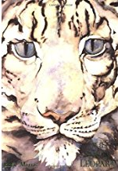
Have a go!
Late one evening, in a cave of soft mosses high in the mountains
where the air was thin and stars sparkled in sky and snow, the Child took the great leopard’s head in her hands.
The Snow Leopard licked the Child’s cold face, rough cat tongue against soft skin, purring her final spirit song. And as she licked, Child became Leopard, thick-furred and wild-eyed, mottled like shadows, spirit cat. As the old Leopard finished her song she leapt from the mountain into the star-filled sky, her dappled coat blending with the stars of the Milky Way, and her song changed to a whisper of starlight. And back in the mountains, the young Snow Leopard looked up at the stars mirrored in her blue cat’s eyes, heard the whisper – and began a new song.

Slide 7
Emerging Impressions
Some development points to consider:
Creating classrooms where children talk about language choices:
group or paired talk tasks discussing different versions of a text or different choices;
inviting children to explain the choices they have made in their own writing and why they think they are effective;
using whole class discussion to generate real enquiry about language and its possibilities
leading a discussion drawing on your expertise but not directed towards a single right answer; naming the effect of a particular choice is not right/wrong but an interpretation, just as in literary interpretation

Slide 8
Have a go!
On Saturday, he ate through one piece of chocolate cake, one ice-cream cone, one pickle, one slice of Swiss cheese, one slice of salami, one lollipop, one piece of cherry pie, one sausage, one cupcake, and one slice of watermelon.
The Very Hungry Caterpillar – Eric Carle
Then Mr Gumpy and the goat and the calf and the chickens and the sheep and the pig and the dog and the cat and the rabbit and the children all swam to the bank and climbed out to dry in the sun.
Mr Gumpy’s Outing – John Burningham
Why do you think Eric Carle chooses to use commas to separate his long list of noun phrases and John Burningham chooses to use ‘and’?

Slide 9
GRAMMAR SUBJECT KNOWLEDGE

Slide 10
Overview of the session
Choosing texts that engage the imagination or stimulate ideas
Identifying how effects have been created grammatically to focus the grammar teaching
Planning grammar activities which will support children’s understanding and independent application when creating their own texts

Slide 11
The Long Walk
The Fib and Other Stories by George Layton
dera.ioe.ac.uk/4825/4/nls_y6t2exunits075202narr2.pdf
Read the story
What is really important about this text?

Slide 12
Writerly Knowledge Charts
Noticing the impact or effect of the text
Identifying how those effects have been created by the writing
Noting specific examples

Slide 13
Planning a sequence of grammar activities that includes:
Noticing, exploring and discussing the effect of the grammar in the text
Learning about and playing with the construction
Practising, discussing and evaluating the effect
Applying independently to create meaning

Slide 14
GfW: Four Key Teaching Principles
Make a link between the grammar being introduced and how it works in the writing being taught;
Explain the grammar through examples, not lengthy explanations;
Build in high-quality discussion about grammar and its effects.
Use examples from authentic texts to links writers to the broader community of writers.

Slide 15
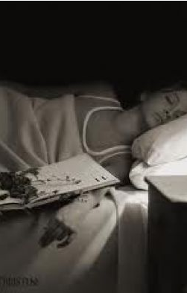
Mr Linden’s Library by Walter Dean Myers
From The Chronicles of Harris Burdick by Chris Van Allsburg
He had warned her about the
book.
Now it was too late.

Slide 16
Focusing on the grammar
In small groups on your table:
Choose one of the ways foreboding is created
Look more closely and identify how the writer has created this effect especially specific grammatical features
Pick the text extract(s) which exemplify this best
Plan a short sequence of grammar for writing activities for children to explore and apply

Slide 17
Planning a sequence of grammar activities
Identifying words and phrases that create effects in texts – text marking
Card sorting and classifying
Using cards to manipulate parts of sentences to create different effects – controlled to freer experimentation
Using a picture to create a phrase and then prompt cards to transform the meaning/mood
Using a chart to generate phrases/clauses and then manipulating them to create different meanings
Using a picture to practise/apply new knowledge
Direct instruction about the form of a grammatical element
Using a film clip to apply film techniques to writing
Experimenting with sentences: adding words/substituting words/ deconstructing sentences

Slide 18
Planning a sequence of activities
In small groups on your table:
Choose one of the ways foreboding is created
Look more closely and identify how the writer has created this effect especially specific grammatical features
Pick the text extract(s) which exemplify this best
Plan a short sequence of grammar for writing activities for children to explore and apply

Slide 19
Read the text and decide what is important about it.
Which sections would you choose to focus on and what does the writer do grammatically to create the effects?
Which specific parts would you use as examples?
What sequence of activities might you do?

Slide 20
EVALUATING GRAMMAR subject knowledge learning

Slide 21
Grammar Subject Knowledge
The project has tried to support you in developing and strengthening grammar knowledge;
This is a journey that all of us are still travelling on, the project team included!
Our current research is showing how important teachers’ grammar knowledge is in helping students understand grammatical concepts and understand how language is working.
Task: Reflect on and evaluate what you have learned and have still to learn.

Slide 22
GfW: Four Key Teaching Principles
Make a link between the grammar being introduced and how it works in the writing being taught;
Explain the grammar through examples, not lengthy explanations;
Build in high-quality discussion about grammar and its effects.
Use examples from authentic texts to links writers to the broader community of writers.
Notes:
!

Slide 23
Part 1: Implementing the intervention
The aim of a randomised control trial is that the implementation of the intervention is as similar as possible in all classes – this is to establish that any change is likely to be caused by the intervention and not other contextual features.
As teachers we understand that all classes are different from each other!
The aim of this feedback sheet is to establish that, as far as is humanly possible, we did all we could to ensure similarity of provision

Slide 24
Part 2: Evaluating change
The aim of Part 2 is to capture your perspectives on what, if anything, has changed.
The questions focus both on
Change in your own practice
Change in student outcomes
Individually complete the tick box sections for the first section (change in your own practice)of the feedback sheet
For the comment section think of one clear example that illustrates the choice you have made
Once you have competed the form share your examples with each other

Slide 25
LOOKING AT STUDENT WRITING
Notes:
.

Slide 26
This is Zak in Year 4, writing a Viking legend. What evidence can you see in this first paragraph that he is deliberately crafting his writing? What grammar features do you think he might have been taught?
Many years ago, in the Kingdom of Norway there was a merciless Viking named Lucas. He would destroy villages, kill people and slice through hearts. After every battle dead bodies will be scattred everywhere houses will be burn’t, smoke from the burning fumes from the hot firery and flaming fire. Every raid will end with death and mayhem. No one will dare to fight Lucas not anyone. He had a helmet made out of reinforced iron a big beard with dust inside it. His body was full of armour he showed no mercy.

Slide 27
Story opening appropriate to traditional tales, myth and
legend: Many years ago
Manipulation of word order to mirror style of older tales:
there lived a merciless Viking named Lucas and
to draw attention to key ideas: No-one will dare to fight Lucas,
not anyone.
Carefully-chosen nouns and noun phrases for historical
authenticity and visual impact: Every raid will end with death and mayhem; a helmet made out of reinforced iron; burning fumes from the hot fiery and flaming fire
Manipulation of syntax for characterisation and to create
distinctive rhythms: He would destroy villages, kill people and slice through hearts....He showed no mercy.

Slide 28
First and final drafts: what do you think of Zak’s changes?
Once upon a time there was a furious, mighty, terrifying Viking his name was SWORD CUTTER the villager will freeze in fear, every single time he would walk down his village. Every battle he’ll put his put his sword deep down through the enemy heart.
Many years ago, in the Kingdom of Norway there was a merciless Viking named Lucas. He would destroy villages, kill people and slice through hearts. After every battle dead bodies will be scattred everywhere houses will be burn’t, smoke from the burning fumes from the hot firery and flaming fire. Every raid will end with death and mayhem. No one will dare to fight Lucas not anyone. He had a helmet made out of reinforced iron a big beard with dust inside it. His body was full of armour he showed no mercy.

Slide 29
Evaluating students’ writing
Essential to this research because we are trying to understand how students learn grammar and how they apply their understanding in their writing.
Evaluating how controlled and deliberate students’ choices are - and how effective they are - is not straightforward, for example:
we want students to try out new structures but not all experiments ‘work’
success in applying one feature may be at the expense of others – what do we prioritise in any one written outcome?
application may be immediately successful but not consolidated or built on in subsequent written outcomes
we want students to understand the effectiveness of their choices, not just deploy what they’ve been taught

Slide 30
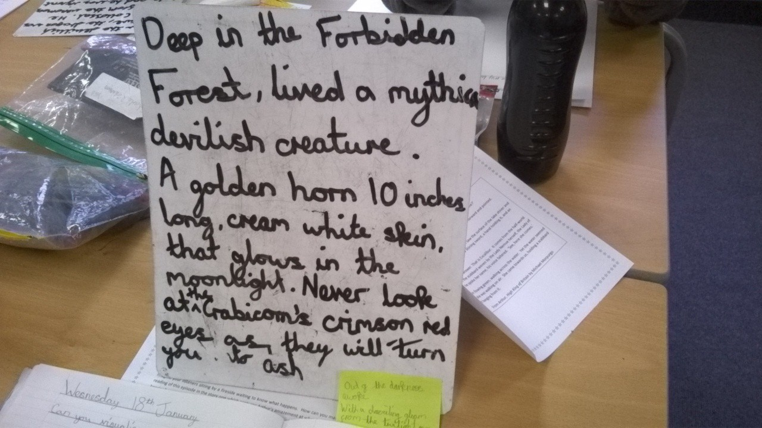
Narrative writing: What has this student learned and applied? How successfully?

Slide 31
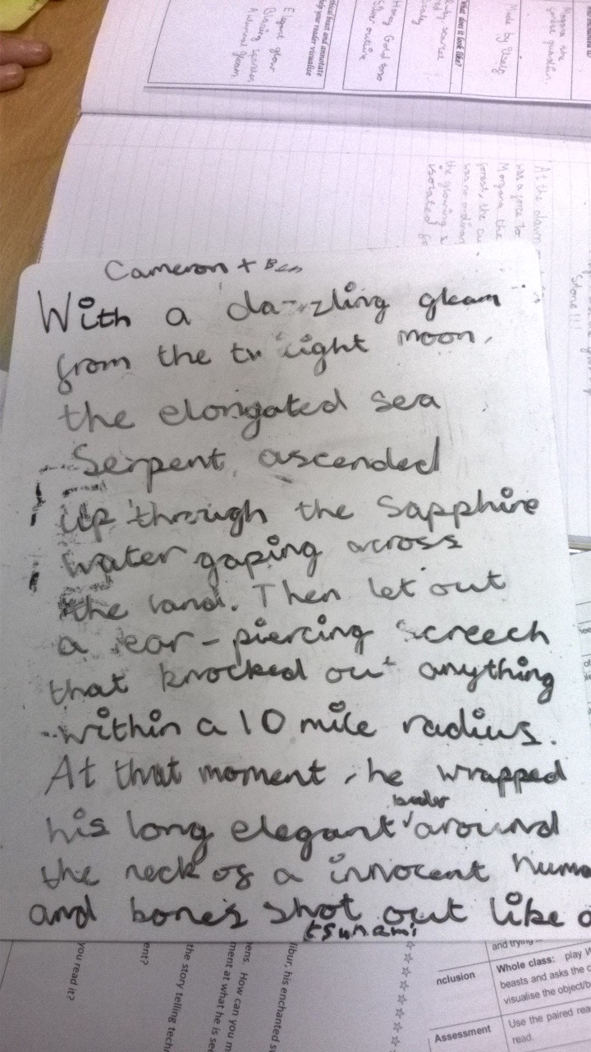
Narrative writing: What has this student learned and applied? How successfully?
With a dazzling gleam from the twilight moon, the elongated sea serpent ascended through the sapphire water gaping across the land. Then let out a ear-piercing scream that knocked out anything within a 10 mile radius. At that moment, he wrapped his long elegant feelers around the neck of a innocent human being and bones shot out like a tsunami.

Slide 32
Persuasive letter: first draft
Notes:
.

Slide 33
Persuasive letter redraft: what has this student learned and applied? How successfully?
Dear Madam Haigh I am writing to you about food waste and how it effects our planet. We live in a sersyety where food waste seems to be everywhere. A staggering 19% of the food bought by households is wasted. This must change! If 7.2 million tonnes of food is wasted each year then think about how much carbon dioxide is released into the atmosfear.

Slide 34
Task in pairs: ideally with someone from another school:
Share a sample of your students’ writing;
Clarify for each other what you think the student has learned and applied in their writing, and how successfully.

Slide 35
Children learn what we teach them!
Teaching grammar purposefully requires strong subject knowledge:
Understanding the grammatical concepts yourself;
Knowing how to teach grammatical concepts;
Knowing how to make links between a grammatical feature and its possible effects in writing
Knowing how and when to intervene to improve students’ writing
Knowing what to look for as evidence of transfer of learning into students’ writing, and to focus feedback

Slide 36
Part 2: Evaluating change
The aim of Part 2 is to capture your perspectives on what, if anything, has changed.
The questions focus both on
Change in your own practice
Change in student outcomes
Individually complete the tick box sections for the second section(change in student outcomes)of the feedback sheet
For the comment section think of one clear example that illustrates the choice you have made
Once you have competed the form share your examples with each other

Slide 37
A cautionary tale

Slide 38
The Dangers of Imitation
The use of authentic texts as models is an excellent way to help young writers see the decisions published writers make.
It also connects their learning about reading with their learning about writing.
The Grammar for Writing Units carefully avoid inviting children to do any writing which risks being too imitative
Playful imitation of small chunks or extracts of a text can be a useful activity to learn about a language structure but the goal is to achieve independent learning.
Asking young writers to imitate a text as a final piece of writing, especially if the text is present, can lead to banal imitation.

Slide 39
Mentor Text: Think of an Eel by Karen Wallace Writing Type: lyrical writing Learning Focus: precise focus unclear
Unclear learning focus; text present during writing
For thousands of years, fishermen have watched every autumn as adult eels migrated down rivers into the sea and again every spring as the young eels returned. But nobody knows what happened in between. Where did the adults go to? And where were the young eels born? Today we think we know the secret of the eel but even now no-one has ever seen a wild eel lay eggs or an eel egg hatch.
Over-dependence and direct imitation; meaning losses
For thousands of years, hunters have watched every summer as hyenas climbed mountains. But nobody has seen baby hyenas fight for dominance. Where do the adults die? Now we think we know the secret of the hyena but nowon has ever seen a wild hyena give birth or a hyena hunt.

Slide 40
Mentor Text: Martin Luther King’s ‘I have a Dream’ speech.
Over-dependence on model: word substitution but meaning/key argument is clear
Let money rain from every miserable stand in the city! Let money rain from the dusty streets of Agora! But not only that: let money rain on us all from the grassy mountains of Sparta, let money rain from the wealthy to the poor! To the slaves and traders! From every part of Greece to Athens, let money rain on us all, so let everyone be rich Zeus almighty.
... (illegible)...money rain from every sparkling beach on the coast of Crete, summit of Olympus and snow capped peak in the nation will be able to speed up the day when every-one, rich, poor, expienetsed or slaves or traders, will be able to come together and cheer, “Profits rising at last! Money raining at last! Thank Zeus Almighty, we are rich at last!”
Edward – able writer (age 10)

Slide 41
Recreation, not imitation
And back in the mountains, the young Snow Leopard looked up at the stars mirrored in her blue cat’s eyes, heard the whisper – and began a new song.
The Snow Leopard – Jackie Morris
Golden Lion Tamarin forced the trees to form a cunning cage to protect the heart of the forest; the magical, black diamond. She wrapped the trees in loving leaves, crowded creatures onto the tropical trees and gave the plants the sun and water they needed.
Year 6 – able writer
At first peak of light, over the ever green mountain, the bald eagle raced to create the wind, soared through the secret forest to awaken all animals and squawked over the green ocean canopy to make the mystical mist.
Year 6 – weak writer

Slide 42
NEXT steps

Slide 43
Taking the Project Forward
Deep, sustained change is only realised if an intervention is embedded and developed;
As teachers, our learning is never complete!
We are keen that you grow and develop what you have been doing on this project in your own practice and in your school.
We want to think about the next steps!

Slide 44
Thank you!

