Slide 1

The Growth in Grammar Corpus:
Corpus Linguistics Progress
Goes “Boink”?
Mark Brenchley
Phil Durrant
Debra Myhill

Slide 2
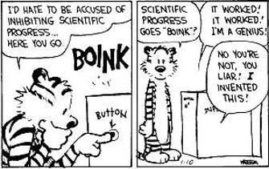

Slide 3
Growth in Grammar (GiG) Project
Current Issues
Principled, reliable transcriptions of children’s writing
Understanding attainment ratings
Accurate, reliable identification of linguistic features

Slide 4
The Problem
MD analyses require target feature list to be as inclusive as possible (Conrad & Biber, 2001)
Original MD analysis = 67 features, 16 categories (Biber, 1988)
GiG project in process of determining target features
How many can we accurately and reliably measure?
If we can’t get them all, what is effect on final analysis?

Slide 5
Analytical Context
Reliant on automated annotation
    6,000 texts (current aim: 4400)
    Handwritten texts: bulk of construction effort going to (a) transcription + (b) feature counting
Reliant on publically available tagger
    Resource contraints
    Our choice: Stanford
No “gold standard”
      Corpora generally L1 adult or L1 pre-school or developmental

Slide 6
General Issues I
Higher Level Features
Many potential target features are “higher” level
Problem with Biber-type counting (Biber, 1988)
e.g. AGENTIVE PASSIVES
= “BE” + (ADV) + (ADV) + VBN + “by”
CAUSATIVE SUBORDINATOR
= “because”
CONDITIONAL SUBORDINATOR
= “if”
parsers < taggers re: accuracy and reliability

Slide 7
General Issues I
“Displaced” AdjPs
The beast, monstrous, ravenous,
roamed the house.
Monstrous, ravenous, the beast
roamed the house.
The beast roamed the house,
monstrous, ravenous.
appos(beast, monstrous) appos(monstrous, ravenous)
nsubj(roamed, monstrous)
appos(monstrous, ravenous)
appos(ravenous, beast)
nsubj(ravenous, house)
appos(house, monstrous)
xcomp(roamed, ravenous)

Slide 8
General Issues I
“Displaced” AdjPs
John chuckled, highly amused.
He’s a great student, dedicated,
hard-working and ambitious.
He is a terrible student, nasty,
lazy, stupid.
xcomp(chuckled, amused)
acl(student, dedicated)
xcomp(dedicated, hardworking)
conj(hardworking, ambitious)
amod(stupid, nasty)
amod(stupid, lazy)
amod(student, stupid)

Slide 9
General Issues II
Register Variation
Wide variety of discourse types
  e.g. “English” vs. “Science”;
  “Narrative” vs. “Exposition”;
  “Fictional Narrative” vs. “Non-Fictional Narrative”
Stanford parser trained on a highly specific register, the Wall Street Journal

Slide 10
General Issues II
Register Variation
“As much mud in the streets as if the waters had but newly retired from the face of the earth, and it would not be wonderful to meet a Megalosaurus, forty feet long or so, waddling like an elephantine lizard up Holborn Hill.”

Slide 11
General Issues II
Register Variation
“As much mud in the streets as if the waters had but newly retired from the face of the earth, and it would not be wonderful to meet a Megalosaurus, forty feet long or so, waddling like an elephantine lizard up Holborn Hill.”
    ✗ ROOT = lizard ✗ NSUBJ(retired, mud)
    ✗ DOBJ(lizard, Hill) ✗ ADVCL(lizard, retired)
    ✗ *?(Megalaurus, waddling)
“lizard” = VBD [?]

Slide 12
General Issues II
Register Variation – Isolated NPs (Science)
folded secondary feathers root(folded-VBN)
dobj(folded, feathers)
twitching ears root(twitching-VBG)
dobj(twitching, ears)
lower beak root(lower-JJR)
dep(lower, beak)

Slide 13
General Issues II
Register Variation – Isolated NPs (English/History)
Clouds of dust as blinding as fog nsubj(roars, clouds)
and the sound of animal roars root(roars)
dancing around the arena. xcomp(roars, dancing)
The sound of the gladiators, nsubj(declaring, sound)
declaring war on each other. root(declaring)
root(sound)
acl(gladiators, declaring)

Slide 14
Specific GiG Issues
Children’s discourse ≠ Wall Street Journal
Children’s discourse ≠ Adult discourse!

Slide 15
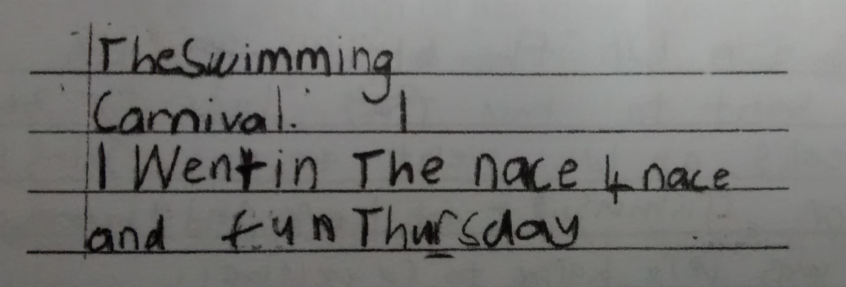
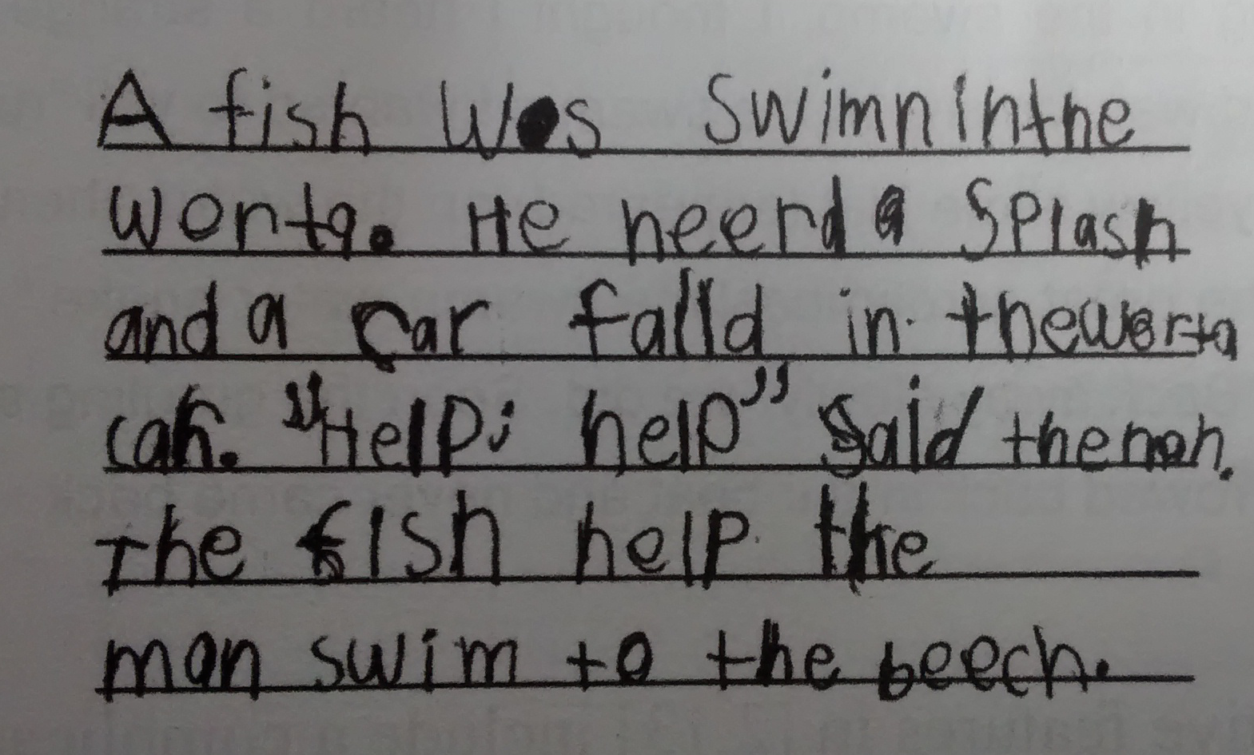
Specific GiG Issues

Slide 16
Specific GiG Issues
GiG Texts
Not published/professionally edited
Not typed (mostly)
Often grammatically “incorrect”
Often grammatically “awkward”
Often diatypically underdeveloped
Wide variation in quality

Slide 17
Specific GiG Issues
Wide variation in quality is what we want
(along with variation in kind)
But creates certain issues

Slide 18
Specific GiG Issues
Grammatical “Errors”
“I feel the opportunities the Divert Trust are life changing and should be taken into consideration.”
→ ACL:REL(opportunities, life)

Slide 19
Specific GiG Issues
Sentential Punctuation
I lost. But she won. → ROOT; ROOT
I lost, but she won. → conj(lost, won)
I lost but she won. → ccomp(lost, won)

Slide 20
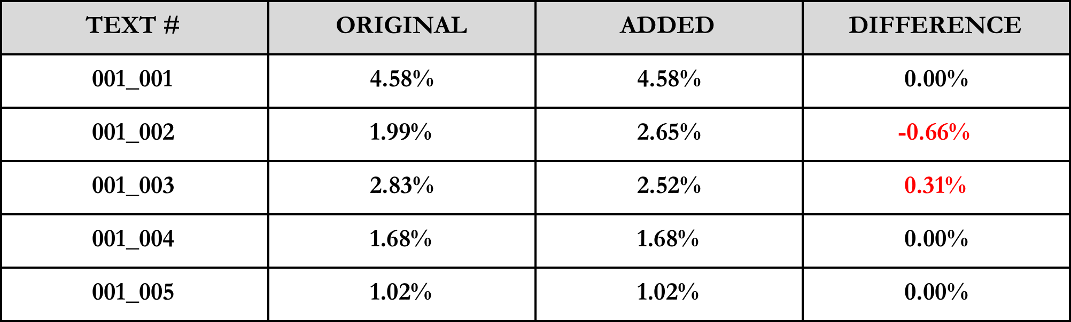
Specific GiG Issues
Sentential Punctuation
Initial piloting suggests a definite, but irregular, impact
This isn't coming from taxpayers' money either, it is entirely fundraised.
→ ccomp(fund-raised, coming)

Slide 21
Conclusion
Maybe not all that much of a surprise – issues are pretty much what you’d expect when working with a variable, even “deviant”, corpus
Besides, we do have some workarounds to at least partially address these issues
And even if we can’t fully address them maybe that’s not a major problem
Perhaps too sparse to substantively affect the final analysis
BUT

Slide 22
Conclusion
Not something we yet know, so it may well be that they are pervasive across the corpus considered as a single register.
And even if they aren’t pervasive across the corpus generally, they might be pervasive for certain kinds of texts within the corpus
      Science reports
      High level science reports
In which case, we lose our capacity to pick up on some core developmental differences, perhaps even the core differences, which is obviously not ideal if our MD-analysis is to do its job effectively
Or, to put it another way…

Slide 23
To what extent is it genuinely possible to systematically and comprehensively analyse the developmentally significant linguistics features of a automatically-parsed corpus of children’s writing without going boink?

Slide 24
http://socialsciences.exeter.ac.uk/education/research/centres/centreforresearchinwriting/projects/growthingrammar/

Slide 25
References
Biber, D. (1988). Variation across speech and writing. Cambridge: Cambridge University Press.
Conrad, S. & Biber, D. (2001). Multi-dimensional methodology and the dimensions of register variation in English. In S. Conrad & D. Biber. (Eds.). Variation in English: Multi- dimensional studies (pp.13-42). Harlow: Pearson.

