Slide 1
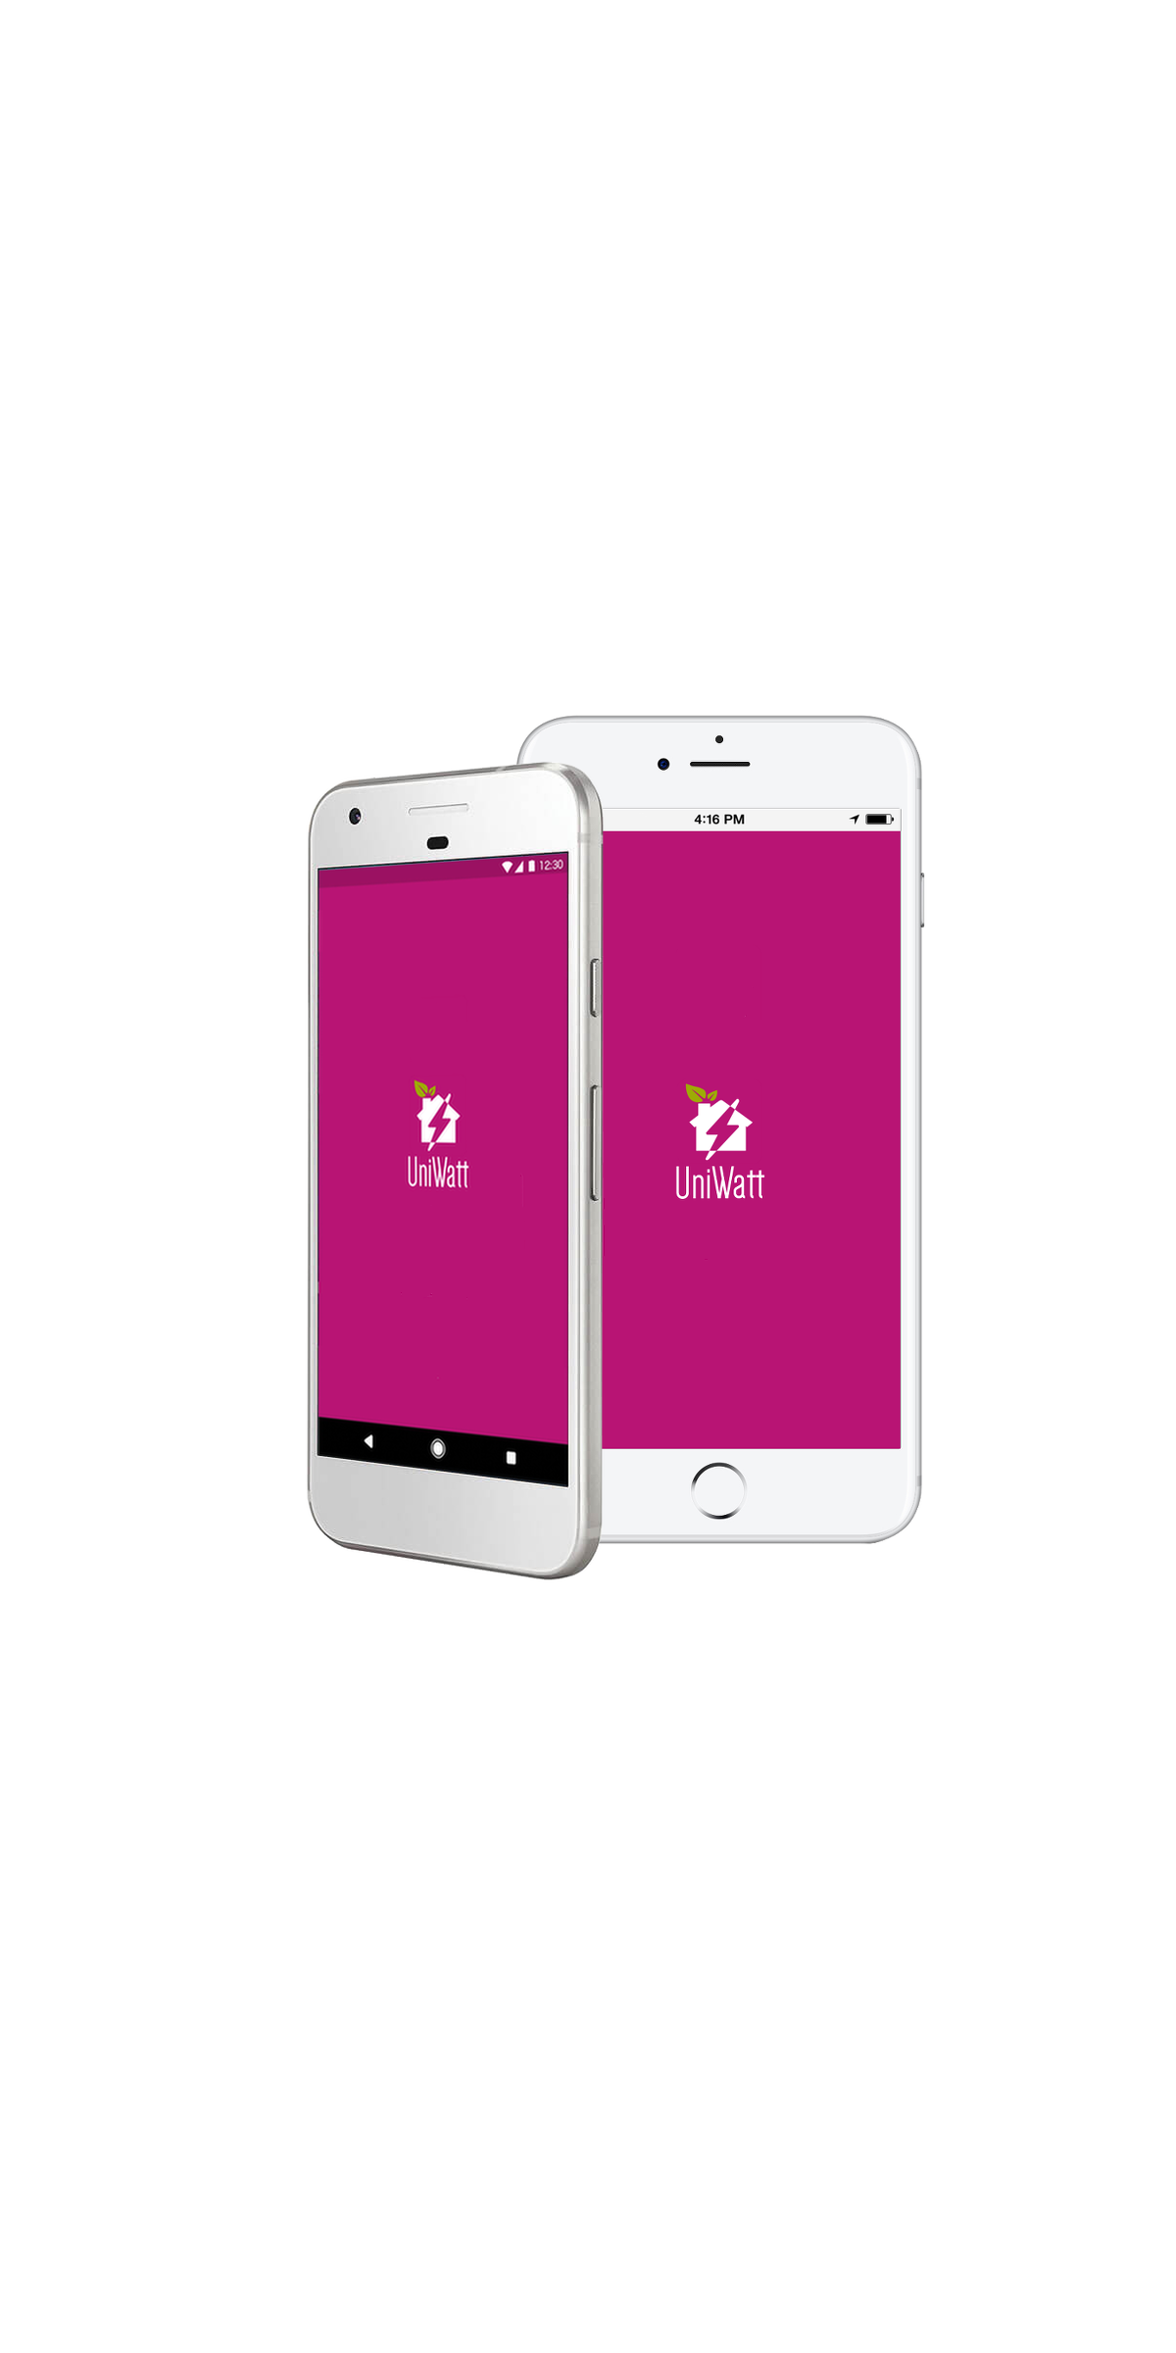
UniWatt
An app to help students reduce energy consumption

Slide 2
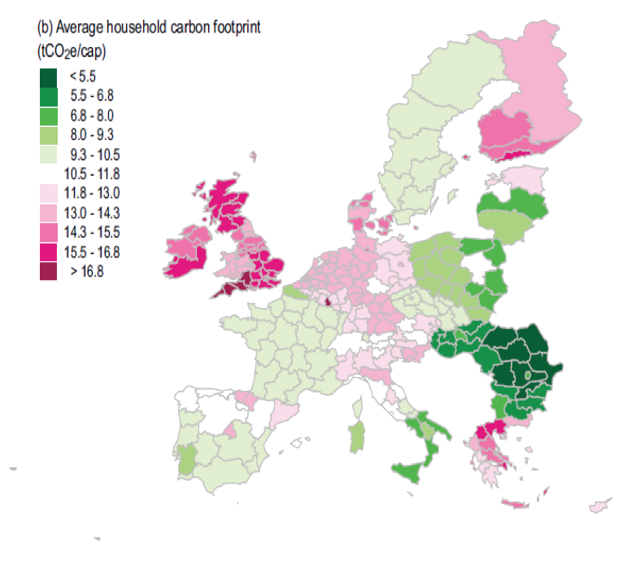
The Issue
Devon has one of the highest average household carbon footprint in the EU
Students can cut their energy consumption by 56% using an interactive energy app
(From: Environmental Research Letters)
http://www.studentsgreenfund.org.uk/articles/students-cuts-energy-consumption-in-their-home-by-56

Slide 3
What does an average student home look like?
On average a house has 6 students living there
Most students live in private housing where rent does not include bills
Saving money is important for students
Lots of students in Exeter have cars!
12% of students bring a car with them to University ^{[1]} – that’s 2400 extra cars in the city during term time
[1] http://www.telegraph.co.uk/education/2016/06/30/campaign-for-elite-university-to-ban-students-from-bringing-cars/

Slide 4
How much energy does our average house use a week?
Collected data from Energy Independence 2025 report and focused on appliances that are typically found in student homes
Typically a 6 bed student household would use around 97.5kWh per week
This is about 30% more than the average UK household

Slide 5
How is this data useful?
UniWatt monitors appliances that typically use up the most energy
A window left open overnight in winter will waste enough energy for a 35-mile car trip
A single light being left on overnight over a year accounts for as much greenhouse gas used for a car to drive from Exeter to Brussels
UniWatt compiles user data on their energy usage to provide users a benchmark to compare their energy usage to.
https://www.environment.admin.cam.ac.uk/facts-figures

Slide 6
What is UniWatt?

Slide 7
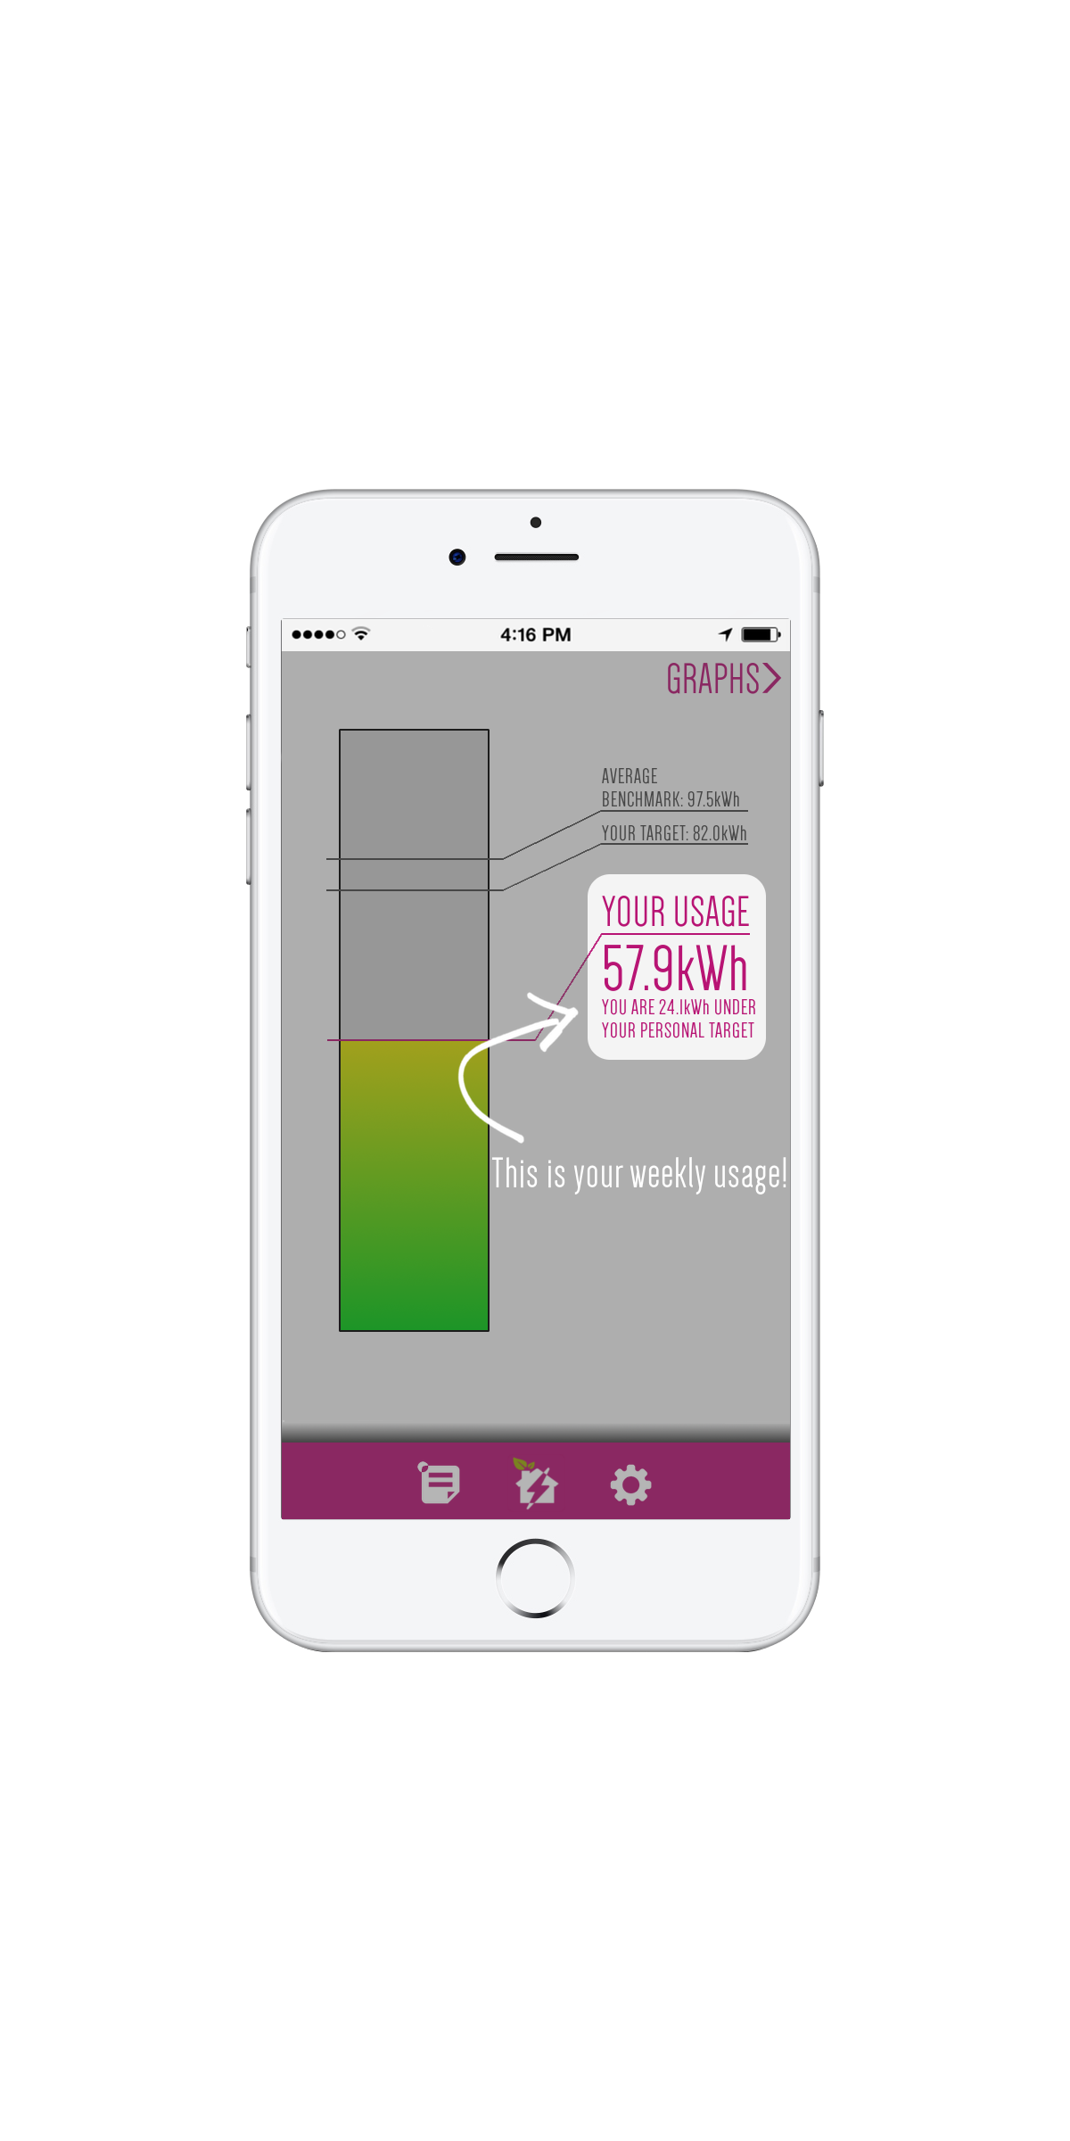
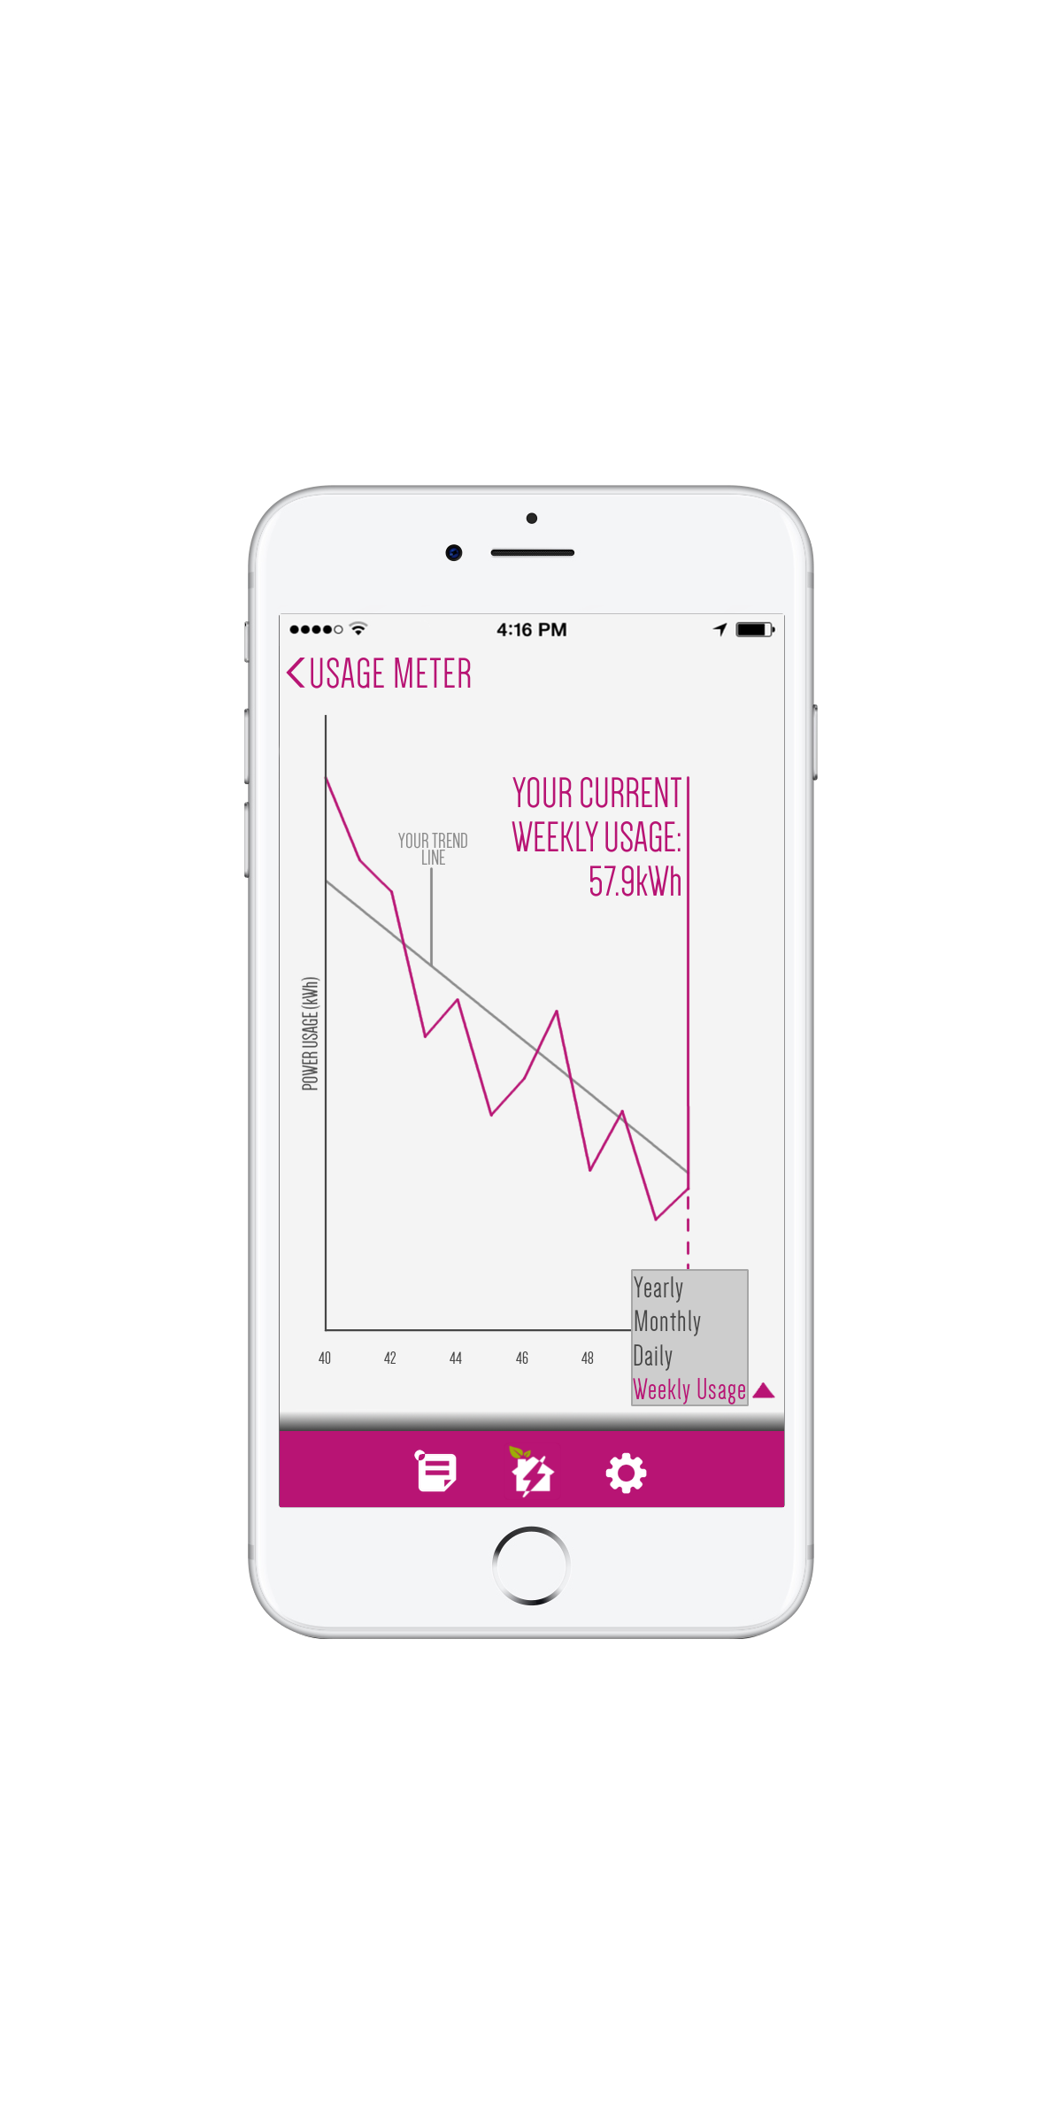
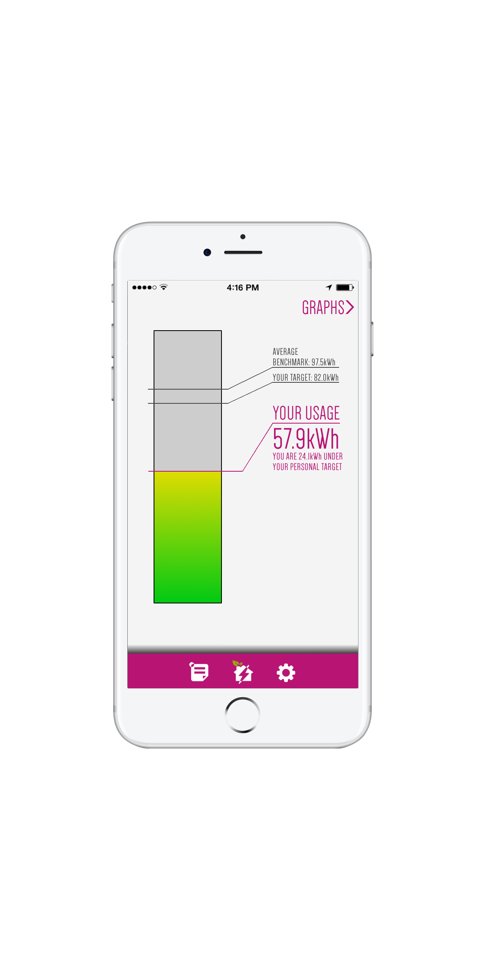
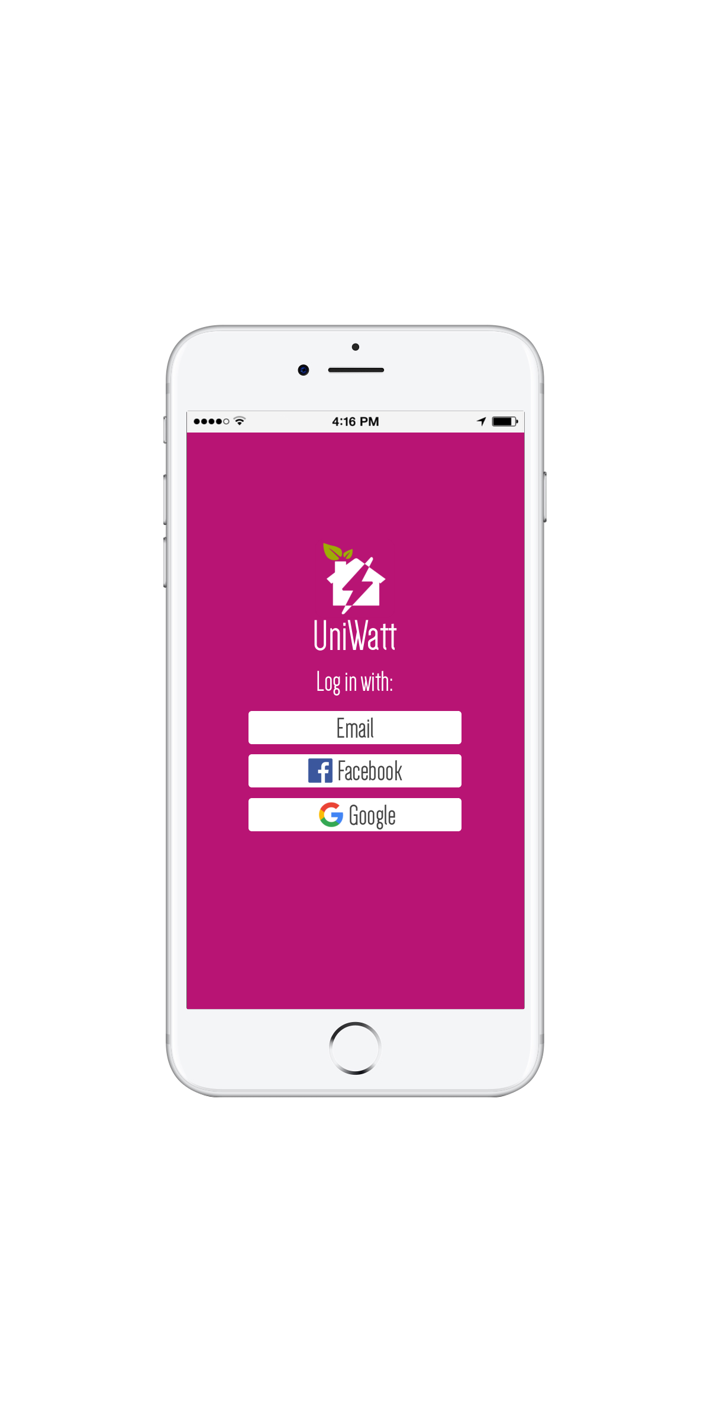

Slide 8
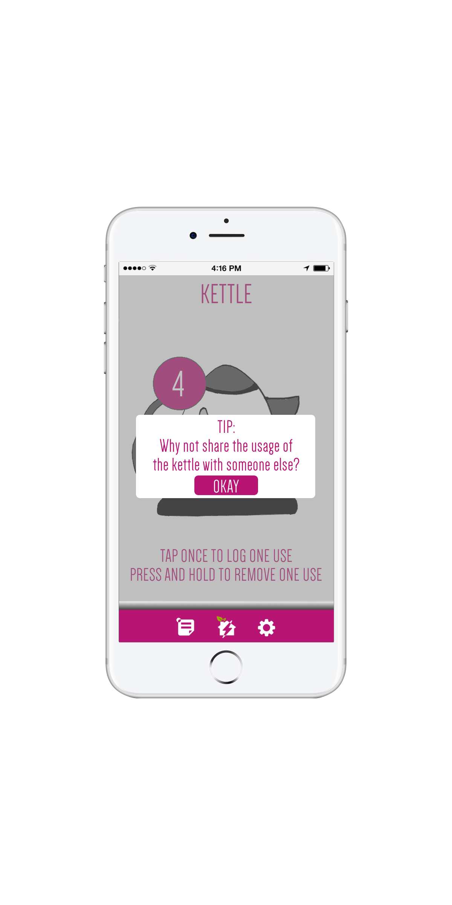

Slide 9
The Calculator
Simultaneously compare result with average UoE students
As well as average Exeter residents
Relying on smart meter to receive up-to date energy consumption in the house.

Slide 10
The Calculator
Manual wattage input is feasible
Wide range of household object options
Default wattage with adjustability
Range options of usage time input method
Additionally quantity and frequency input

Slide 11
Transport
Create a separate app so as to keep UniWatt on-message
Journey planner
Calculate student savings by changing mode of travel to discourage car usage

Slide 12
Smart Meters
Relying on manual input from users is time-consuming and prone to error
Using Smart Meters to automatically measure and categorize power use reduces error and increases savings
https://www.cityscience.com/blog/open-source-domestic-energy-monitoring

Slide 13
Survey and Involvement
In time, the reductions that households can make will begin to plateau
A survey could be sent to consistent users to investigate factors in their lifestyle that are limiting their progress
This data could be used to motivate the University and Local Councils to instigate changes to help resolve these issues
https://www.exeterguild.org/change/ideas/idea241-bicycleparking/

Slide 14
Incentivising the App
Students who are in utility-included properties need an alternative incentives
A large user-base is required for an accurate average power usage

Slide 15
Thank You

Slide 16
UniWatt
An app to help students reduce energy consumption

