Slide 1
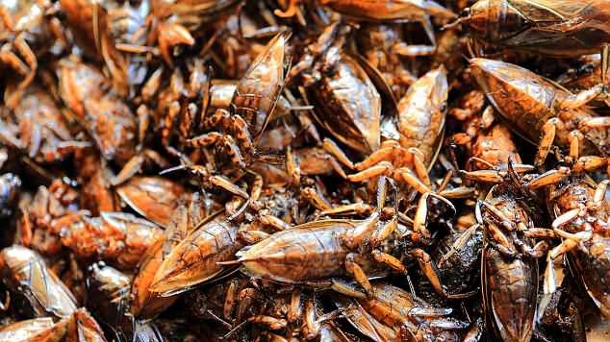
Future Foods
The need for an attitudinal fix

Slide 2
Is food sustainability limited by social and cultural outlook, or will people in developed states, adapt to meet the demands of food shortages in a globalised world?
Notes:
Increasing population growth is estimated to reach 9 billion by 2050, resulting in additional demand globally.
Conventional animal protein sources including beef, pork, and chicken may be insufficient to meet this need, subsequently opening the door to alternative food sources.
To this extent, food sustainability can be defined as being about culture, education, health, equity and respect for the planet we live in, according to the Barilla Centre for Food & Nutrition Foundation.

Slide 3
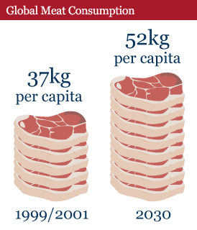
Beef Central, Business Insider
Notes:
Increasing population growth is estimated to reach 9 billion by 2050, resulting in additional demand globally.
Conventional animal protein sources including beef, pork, and chicken may be insufficient to meet this need, subsequently opening the door to alternative food sources.
To this extent, food sustainability can be defined as being about culture, education, health, equity and respect for the planet we live in, according to the Barilla Centre for Food & Nutrition Foundation.

Slide 4
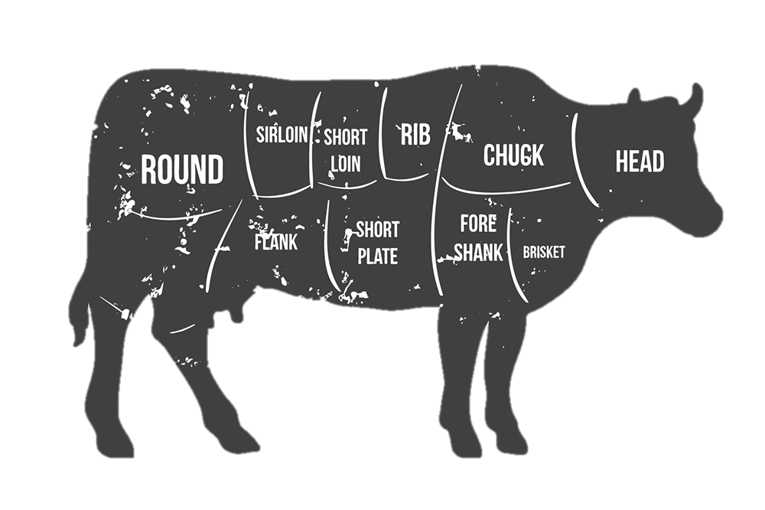
FAO, VIVA, FAO, AHDB dairy, GRACE, Environment Agency, WWF, FAO, Earthsave, WorldWatch institute.
MORE THAN MEATS THE EYE
70% of grain in used as animal feed in the USA
18% of global greenhouse emissions come from the livestock industry
Global consumption has quadrupled since 1960
26% of the world’s non-ice covered land surface is used for agriculture.
27million cattle die every year
The average cow produces 70-120kg of methane a year
An acre of rain forest is cut down every six seconds as a result of cattle farming
414 gallons of water are required to produce 1Lb of boneless meat
Every cow requires 24kg of feed per day
According to the Environmental protection agency, agriculture is the no.1 cause of water pollution.
Notes:
Meat production in its current format is unsustainable – see above.
Possible solutions regarding these issues could be resolved with the development of futuristic foods, namely cultured lab meat and insects.

Slide 5
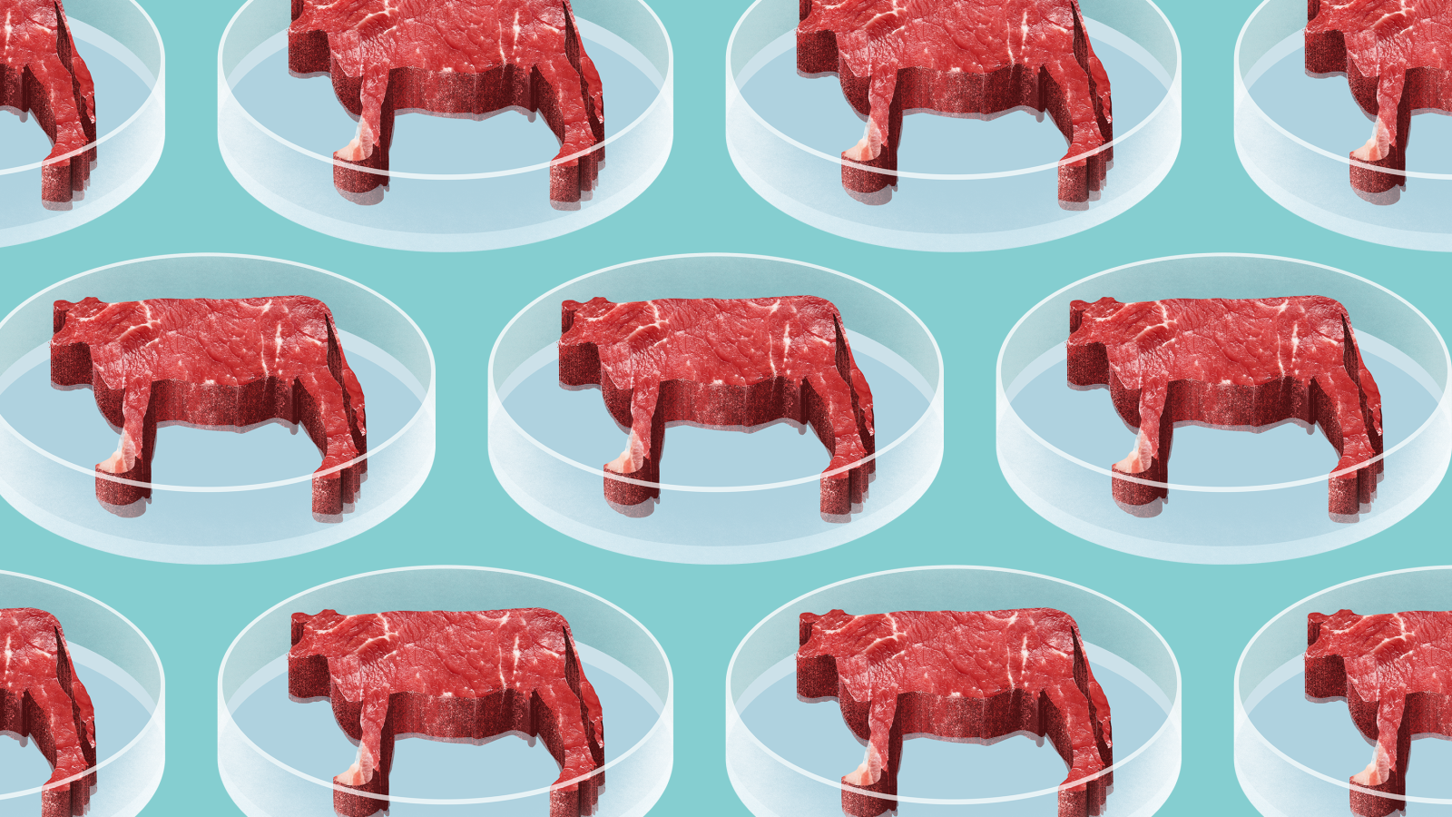
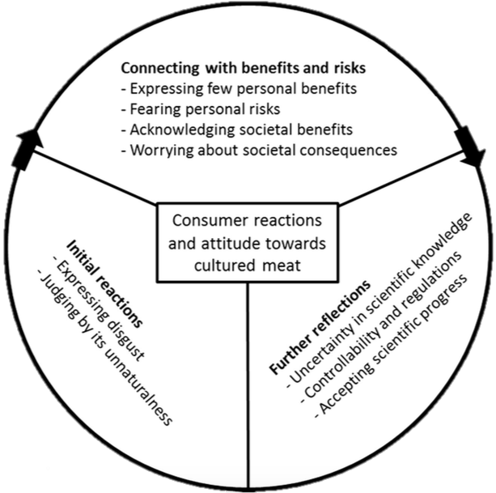
Public Opinion of Lab Meat
W. Verbeke et al. / Meat Science 102 (2015) 49–58
The Guardian said 2/3 of UK citizens participating in the pool, said they would try cultured lab meat.
A study from Verbeke et al. (2015) with Belgium consumers suggests that the majority of people have hesitant attitudes (selecting maybe) when asked if they would try cultured lab meat in the future.
Notes:
Thus far very few studies have focused on consumer reactions and their likelihood of accepting or rejecting cultured meat.
A study conducted by Hopkins and Dacey discovered an overview of potential objectives to cultured meat; including worry about unknown dangers and effects on human consumption.
Despite these hesitations a internet poll by the Guardian in 2013 after the public unveiling of the cultured hamburger, revealed that 2/3 of UK participants expressed interest in trying cultured meat.
The disparity between these two studies shows that consumers hesitate when expressing rejection or acceptance of cultured meat. This has encouraged our study of how consumers make sense of this new technology and its end products.
Discuss survey.

Slide 6
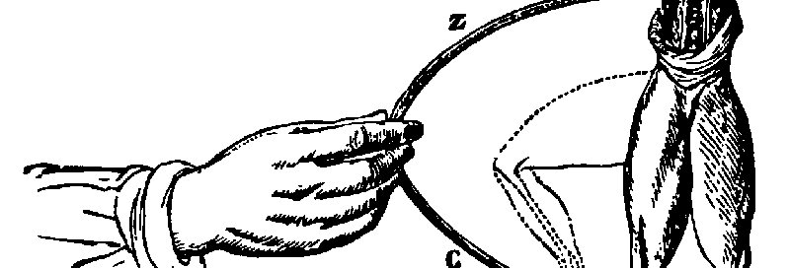
Lab Meat
New technologies are often labelled negatively because people are afraid of change in their day to day lives.
Both lab meats have been referred to as ‘Frankenstein Foods’ by the daily mirror.
“Frankenstein Foods”
Lab meat could be on our tables by 2021
The price of lab meat has fallen by 99%, one burger can cost as little as $11.60.
When lab meat was first developed it took $325,000 to grow just one burger!
Companies that grow lab meat include; JUST Meat, Memphis meats and Finless Fish.
https://www.youtube.com/watch?v=vsqka8QHJfQ
Quartz, Big Think.
Notes:
Research shows that many consumers in Western countries may have already changed their meat consumption habits in the last decade or may still intend to do so in the near future.
Possible reasons are the consecutive meat safety crisis of the mid-90s, followed by the more recent debates about the health and sustainability consequences of meat production and consumption.
According to the Food and Agriculture: future of sustainability report, our population trajectory means that from now to 2030, the world will need to build the equivalent of a city of one million people in developing countries, every five days!

Slide 7
Our findings
Notes:
In general, people thought that lab meat is being grown due to the unsustainable current model – methane being released into the atmosphere (environment) and issues with demand.
There was the view that lab meat was being produced for profit reasons to reduce cost, as well as for convenience and to absolve health issues.

Slide 8
Our findings
If you had to, would you rather eat less meat or substitute your meat consumption with lab meat?
Notes:
Less for environmental sustainability
Focus on cost, consumption, productivity
Results show that of the people surveyed, the Asian community were more willing to substitute their meat consumption with lab meat, rather than reducing meat from their diet.

Slide 9
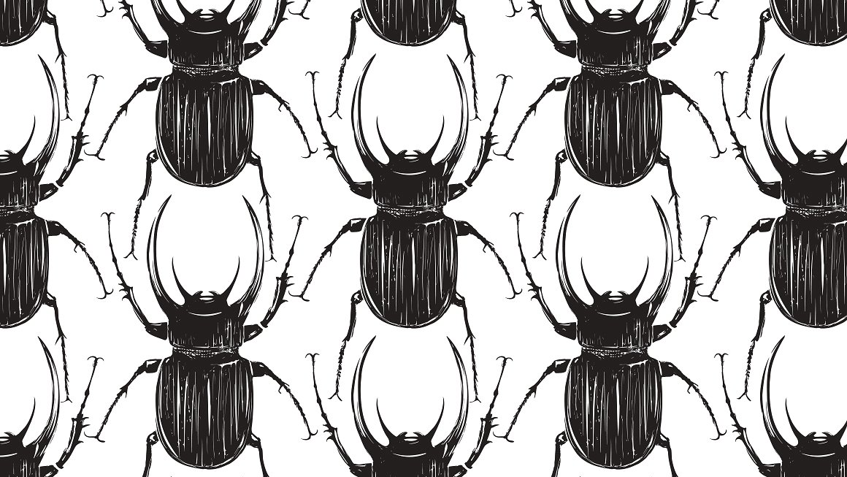
Insect Protein
80% of the world’s population eats insects on a regular basis.
Insects are eaten in 98 countries.
Per 200 calorie serving insects provide 31g of protein whereas 90% lean beef only provides 22g.
Per kilogram of meat produced beef requires 95 x more land, 26 x more water and 8.4 x more feed than insects.
PBS news, a sustainable food source Table 2, Edible insects Aketta
Notes:
Edible insects show great potential as an environmentally friendly choice for future food systems.
The Insect Cook Book (Arnold van Huis et al.) focuses on food for a sustainable planet, arguing that insects can be found in all our food crops, despite farmers attempts to protect them. At harvest time, the best apples are sent to markets and shops, and lesser-quality apples are used to produce apple juice and applesauce. Apples often have an insect or two in them—and these just get ground up along with the apples and become part of the applesauce and juice. Similar processes occur in tomatoes and ketchup, grains and bread and coffee beans and coffee.
Before insects become a large-scale, nourishing food products for humans worldwide, much is yet to be done. In the Western world, we need to overcome culturally determined aversion. Most important, insects must be turned into an appealing alternative; food based on insects will after all have to compete with traditional meat products.

Slide 10
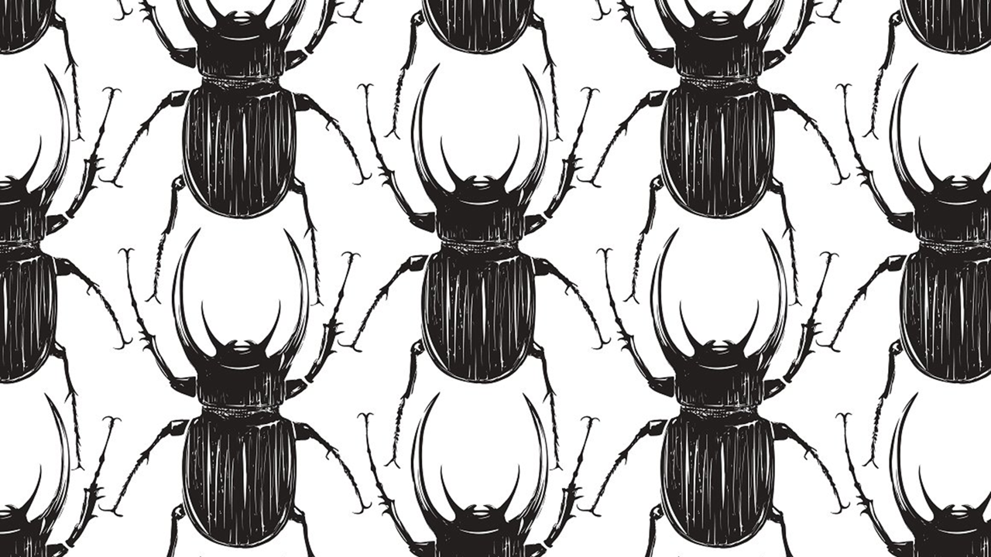
Public opinion of insect protein
Where insects are eaten in the world
Ecology of Food and Nutrition
Notes:
According to the data and analytics company Global Data, the greatest barrier to the uptake of insect protein is that consumers are simply unaware of its numerous benefits and were uncomfortable with the thought of eating insects.

Slide 11
Our findings
PBS news, a sustainable food source Table 2, Edible insects Aketta
Notes:
Our results showed that in general, people were not willing to substitute their meat intake with insects.
However, people were happier to consume them in a processed way.
The main sigma to consuming insects as a form of meat substitute was based on their viual impact.

Slide 12
Our findings
PBS news, a sustainable food source Table 2, Edible insects Aketta
Notes:
Many products which contain red food colouring, are derived from carminic acid extracted from the female cochineal insects.
These products are labelled as containing carmine.
People that we surveyed were often unsure about eating insects and did not realise that so many products contained carminic acid.
Reasons for this include:
Visual uncertainty
Don’t like the idea of eating insects because of the recognition of them as gross and disgusting
Afraid of insects – would not want to eat them

Slide 13
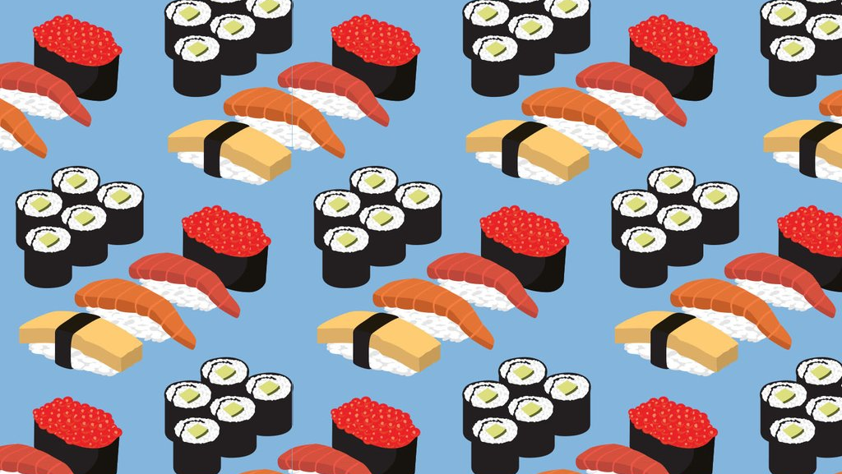
Conclusion
Overall, our research has found that while people are aware of the issues surrounding food sustainability, they were less willing to change their views.
The adjacent graph highlights this dispute between recognition of the problem and a genuine desire to overcome the issue.

Slide 14
A Future for Change - Taste Trends
The first recipe for curry in England was published by Hannah Glasse in 1747.
Now – 9,000 Indian, Pakistani and Bangladeshi restaurants in the UK.
Veganism has increased by 360% in the last decade.
Yo! Shushi’s total sales are at £88.4 million – a traditionally non-Western food, now regularly accepted and consumed.
To Make Curry the Indian way, FSC, Plantbasednews.org, QSR Media, Quinn 2007
Notes:
Having said that, historical case studies show that society and culture will adapt
This was a view confirmed in our results as people said that while they may not wish to change at present, in the future, with effective advertisement and social-cultural appropriation, they may adapt.
With insects in particular, we found that people needed to overcome the idea of eating an insect, and although many said they would not eat insects at they moment, they may change their mind in the future, particularly if it was necessary to do so.
Our earlier diagram of ‘would you eat insects in a processed way’ confirms this as half of the people we surveyed either agreed or strongly agreed.

