Slide 1
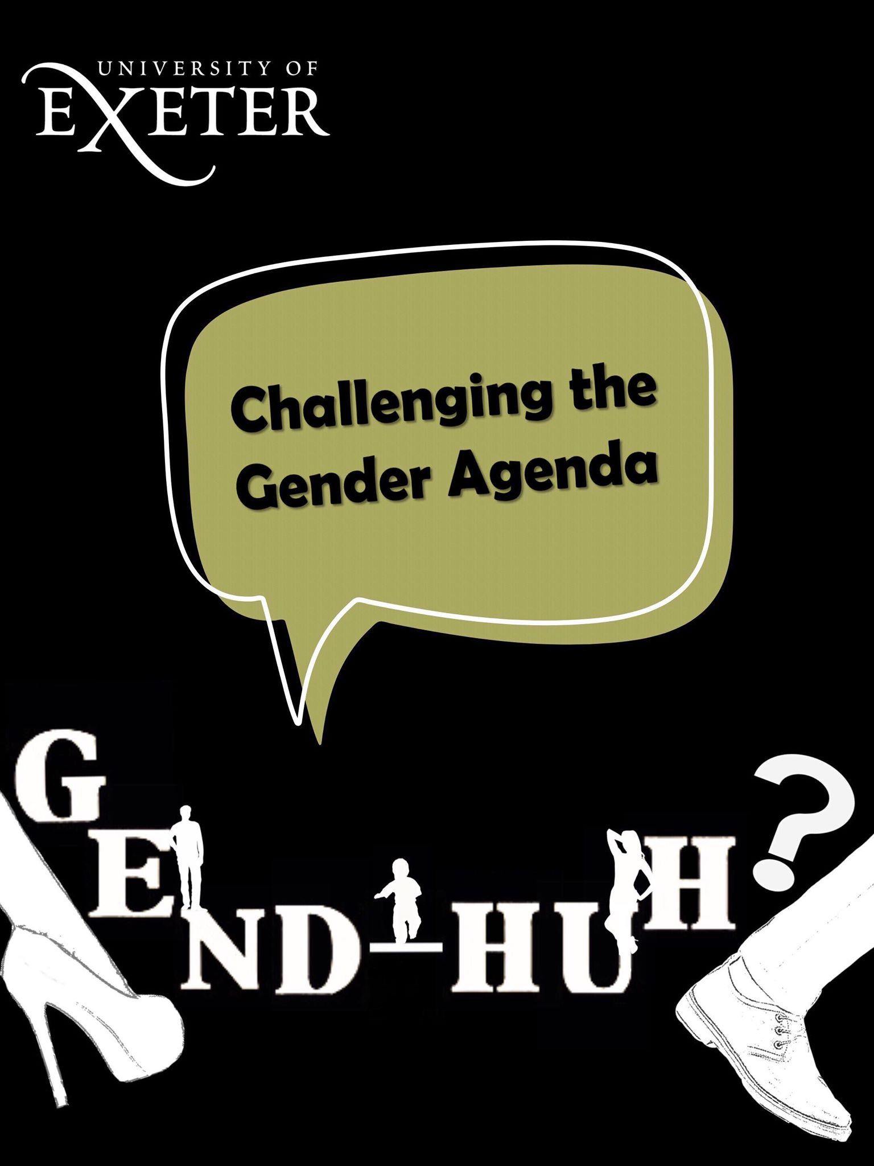
Notes:
Liv

Slide 2
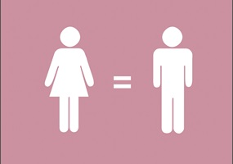
Issue Addressed:
Challenging gender inequality and the language used to describe gender to move towards the adoption and normalisation of a language of equal rights.
Notes:
Liv

Slide 3
Rationale:
Using satire mocking situations where “gender agenda” is being enforced with assumptions made about one’s sex and gender labelling.
Using humour as an accessible device to draw people in and challenge accepted perceptions of gender.
We hope that the use of comedy will help challenge incidences of unconscious bias and encourage people to be more open minded.
Our goal is to highlight and help people recognise the situations when they may fall into being unconsciously biased in the language that they use to describe gender and to challenge derogatory terminology.
Notes:
Tolu

Slide 4
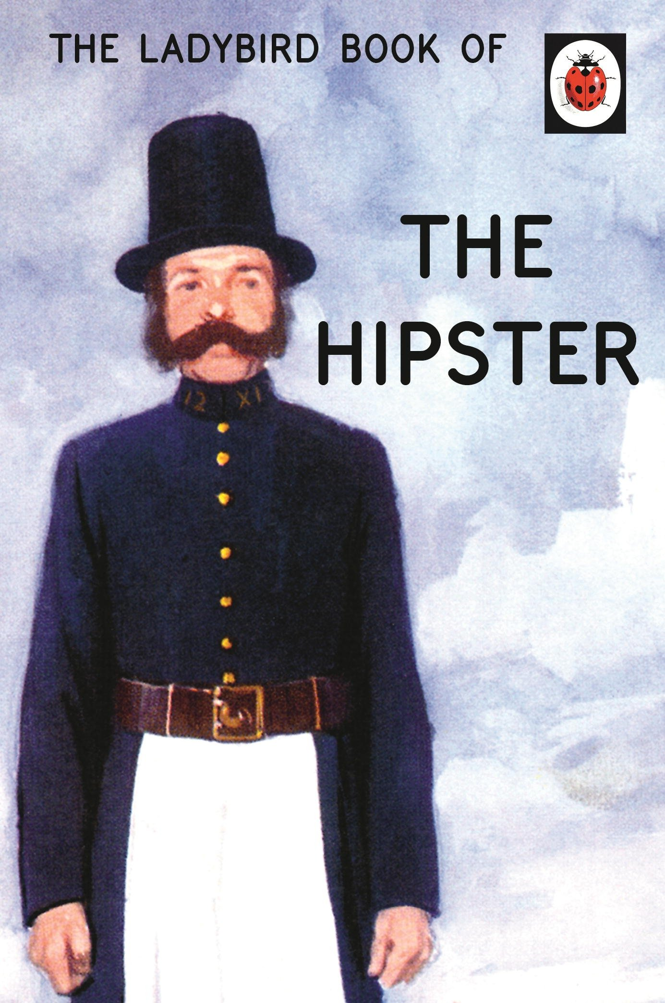
Product:
Product is in a book format which is satirical in genre, and addresses the language of gender inequality by challenging gender labeling and accepted assumptions made about gender.
We were inspired by the Ladybird book instruction manuals.
Notes:
Chara

Slide 5
Target Audience:
We believe that the humour and format of the product would best appeal to young people (16+ years old).
The fact that gender bias affects every age group and the book covers the experiences of different age groups and ethnicities means that the book is more inclusive.
Notes:
Annie

Slide 6
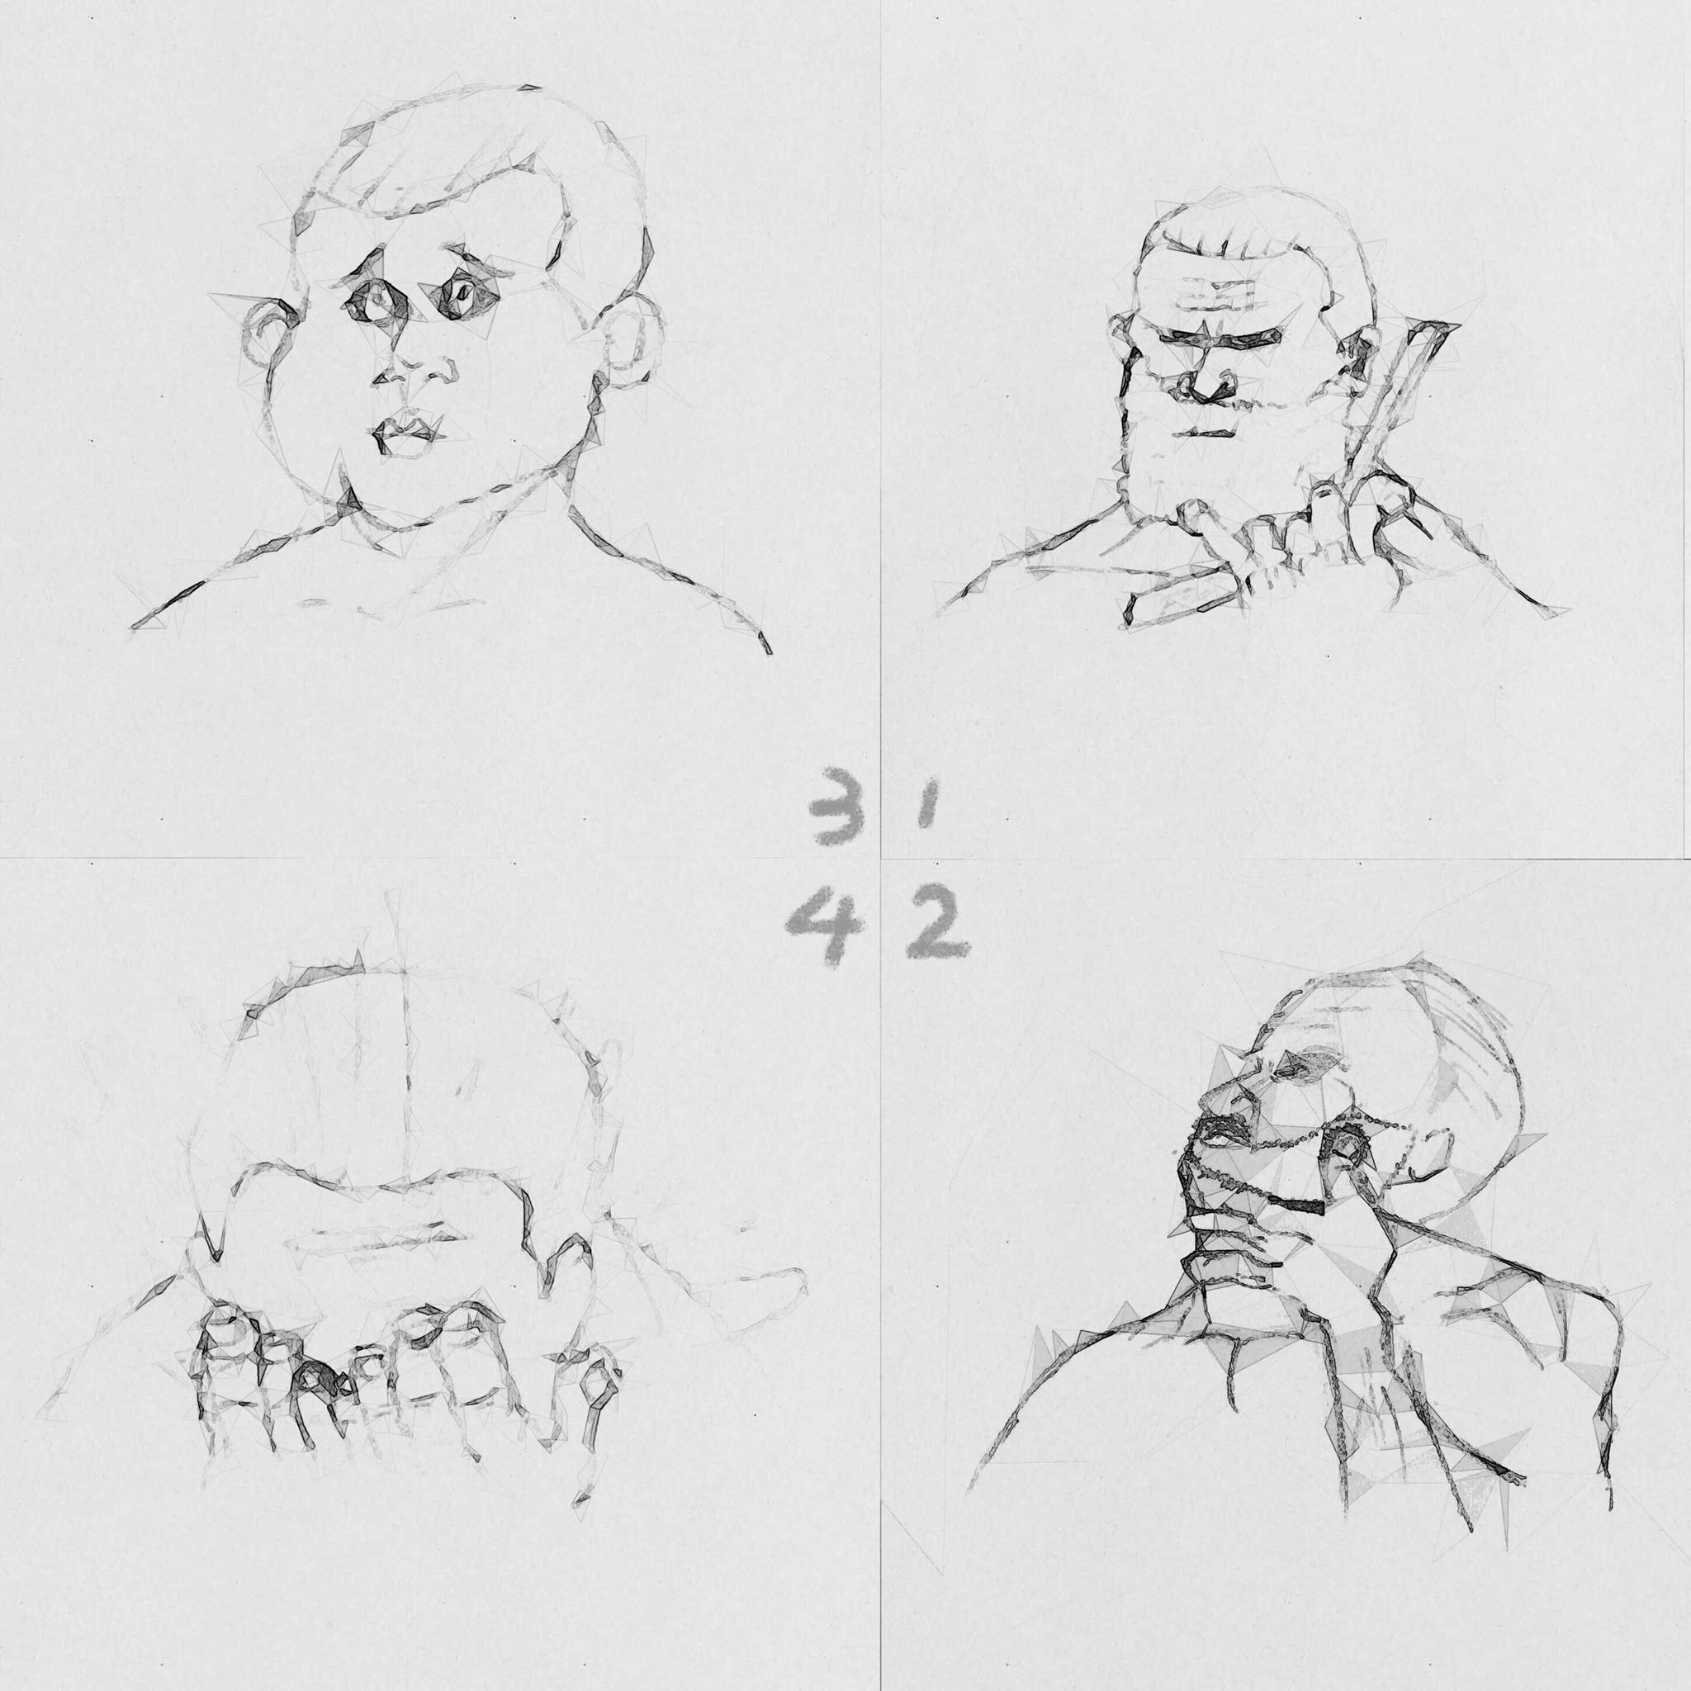
Process:
We first began brainstorming product ideas and settled on the concept of a Ladybird style book.
Then we considered different situations when one is subject to gender assumptions to incorporate within the book.
To represent these situations in a humorous way we came up with appropriate illustrations.
Different members of the group focused on different aspects of the book with some working on the illustrations and formatting, including its graphic design.
Notes:
Jen

Slide 7
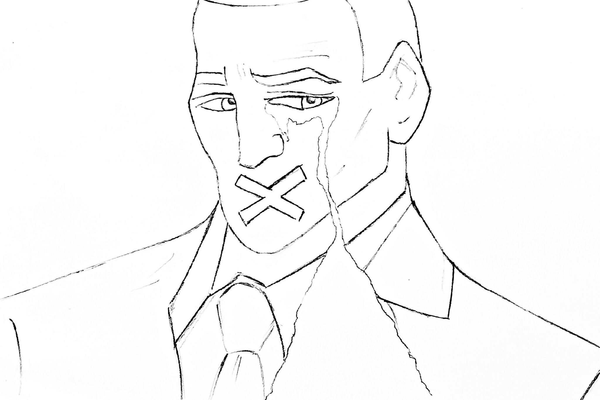
Other members concentrated on writing and the language of the book and found statistics online.
We also collected our own data that we wanted to incorporate.
From this we formed a word cloud - questioning around sixty people about the language they use as an effective visual representation of the different terminology used to describe the sexes.
Next we began the printing process – contacting the printers, finalising the layout of our book and the designs.
Notes:
Molly

Slide 8
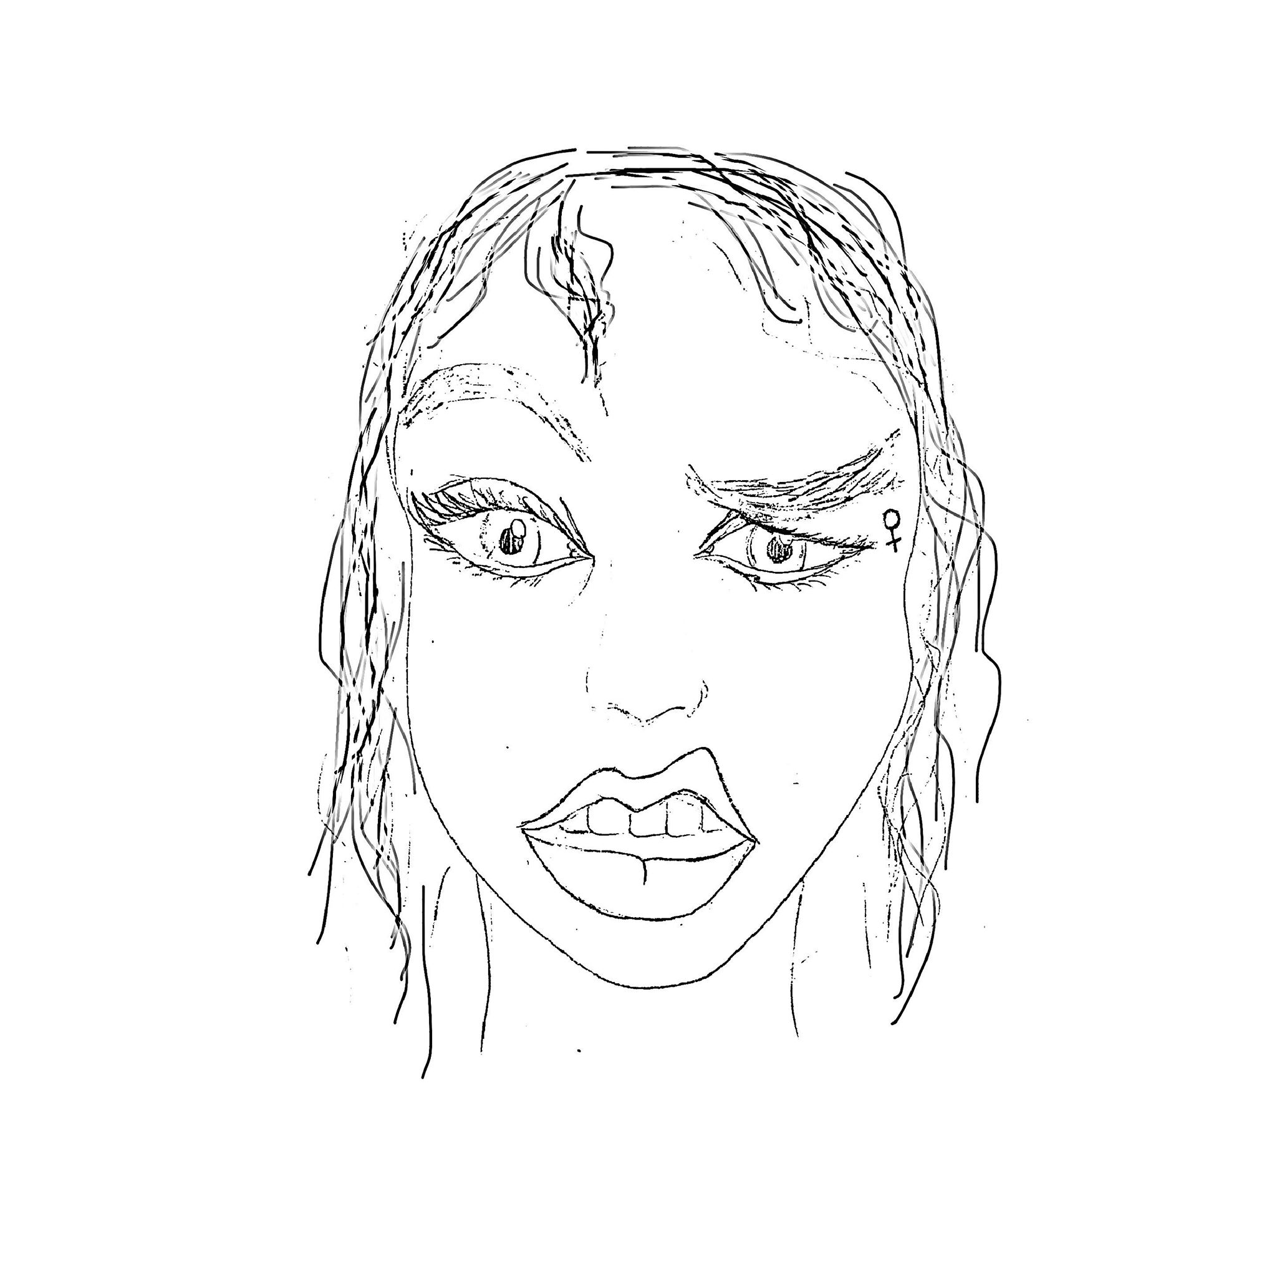
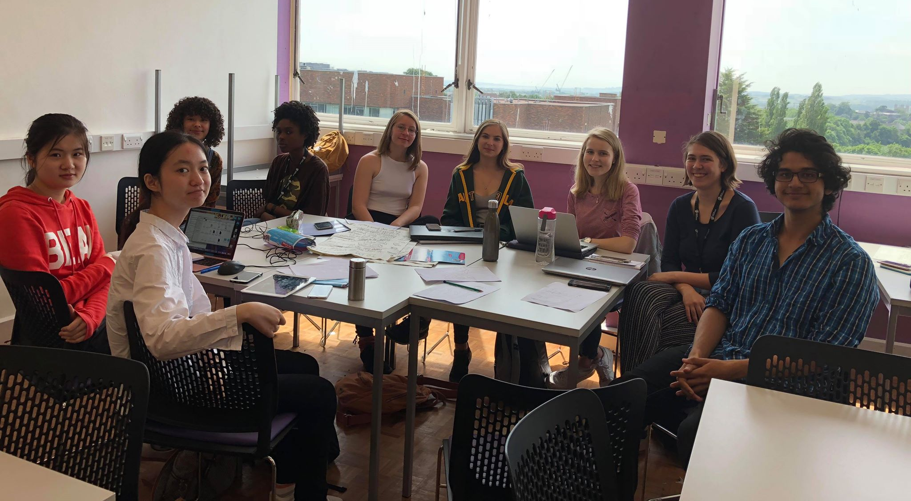
Finally we had enough time to inquire about using Fab Lab to print t-shirts for the group to present in.
After printing the book we began distributing our product in the Forum.
Notes:
Molly

Slide 9
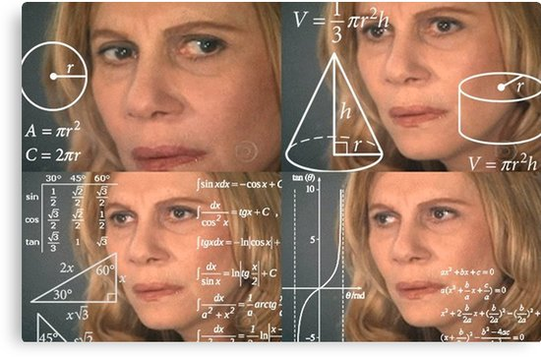
Problems Faced:
Logistics of printing the book and the t-shirts.
Coordinating the formatting of the texts and the illustrations to create a cohesive product.
Time management – working to a schedule.
Narrowing focus – gender is such a wide topic.
Problems of social inclusion within the book – it is difficult
to represent every section of society within twenty pages.
Notes:
Olivia

Slide 10
Future?
We will distribute more copies of our book in the Forum to attempt to reach as many people as possible with our message of empowerment.
We intend to spread our message on social media as well.
We will continue collecting data from a wider group of people from different backgrounds and ethnicities. We could design a survey online and spread it through the internet to reach a greater number of people.
Notes:
Catalina

Slide 11
Reflection:
A wider data set for the word cloud would allow us to perform a statistical analysis of our collected data to determine the significance of the possible numerical results.
If we had had a longer time frame we could have produced a longer book and more copies to disseminate our message.
The work we have carried out this week has allowed us to develop our teamwork skills, leadership skills and learn about gender inequality. On a practical level we have learnt how to produce a book.
Notes:
Rachit

