Slide 1
EXE-CISE
Sarah Vincent, Jade Fallon, Isobel Gray, Yi Zhang, Lily Harris, Hope Moonan, Max Kelly-Gee

Slide 2
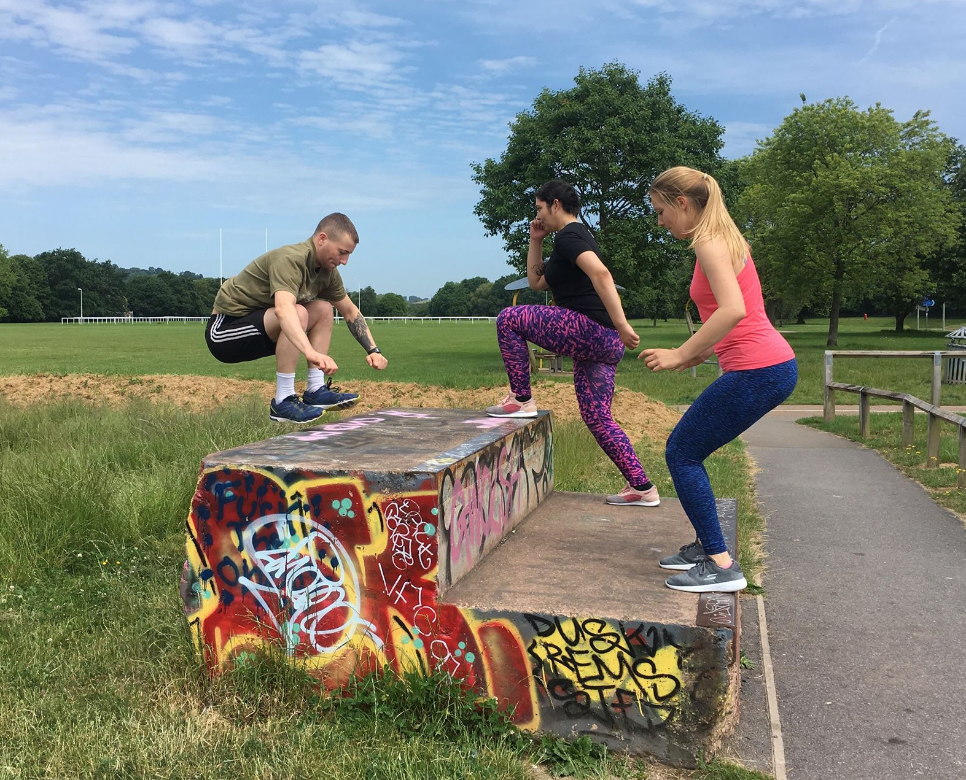
WHAT IS EXE-CISE?
Online site with an interactive map
Targeted at Exeter students
Suggested locations and videos of activities
Notes:
Sarah -
The name came from our desire to promote both physical and mental well-being to Exeter University students and encourage the use of exercise as a tool to reduce problems related to mental health. For this reason EXE relates to the location of Exeter and CISE relates to physical activity (exercise)
It is an online site that is used to highlight different areas where exercise can be done around exeter. Each location and video suggested gives examples of certain activities that get progressively harder in different locations.

Slide 3
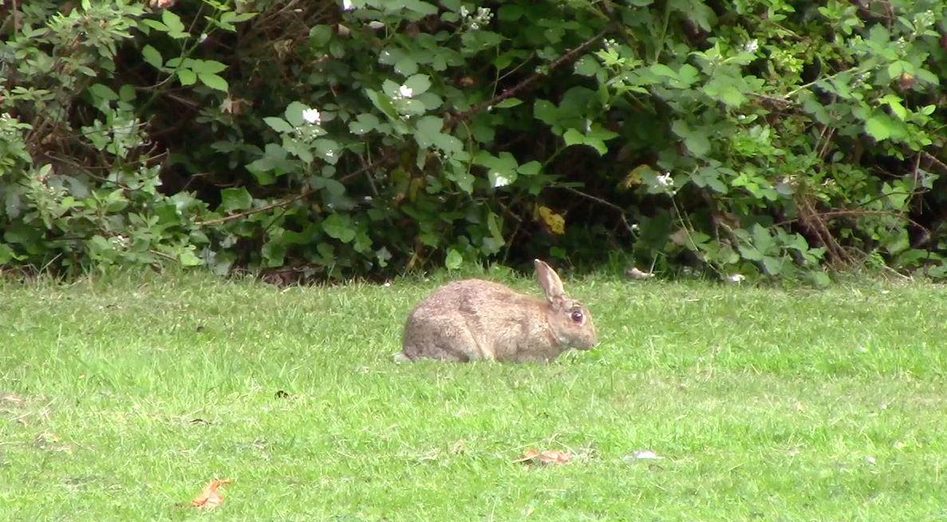
WHY EXE-CISE?
Green spaces
Revitalisation
Decreases tension, confusion, anger, depression
Social
Free!
Notes:
Sarah-
Initiative to promote exercise in green spaces, free of charge
Resource to discover possible workout locations with suggested workouts
Undertaking exercise in the outdoors, around natural elements – rather than just in the gym can also improve physical and mental energy by as much as 40% (Koskie 1). Furthermore, exercising in natural environments is often associated with greater feelings of revitalisation and positive engagement, together with decreases in tension, confusion, anger and depression. (The Peninsula College of Medicine and Dentistry)
Encourage exercise with friends and using free materials that can be found at home

Slide 4
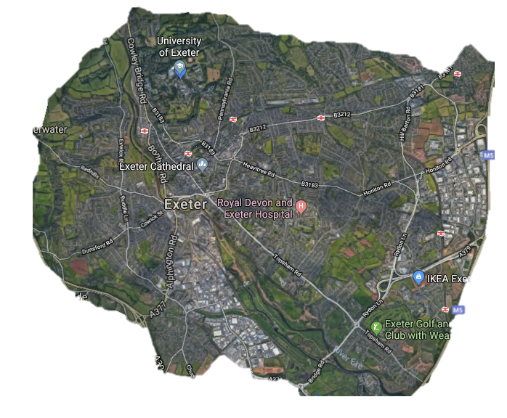
UNIVERSITY
Yoga and Pilates
Sprints up forum hill
BELMONT PARK
Outdoor gym workout using equipment
NORTHENHAY GARDENS
Quiet fields
Yoga and Pilates workout, can be carried out in groups.
HEAVITREE PLEASURE GROUND
‘weights session’ with household items
STAIRCASE
Sprints up and down stairs.
Include other exercises – hopping, two footed jumping.
LUDWELL VALLEY PARK
Hill sprints HIIT workout
Run up hill, 10 reps of exercise at top, walk down. Repeat with different exercise 5 times in row.
QUAY/DUCKES MEADOWS
Group workout
Parkour
Notes:
Max

Slide 5
WEBSITE
https://lily56350.wixsite.com/mysite
Notes:
Lily

Slide 6
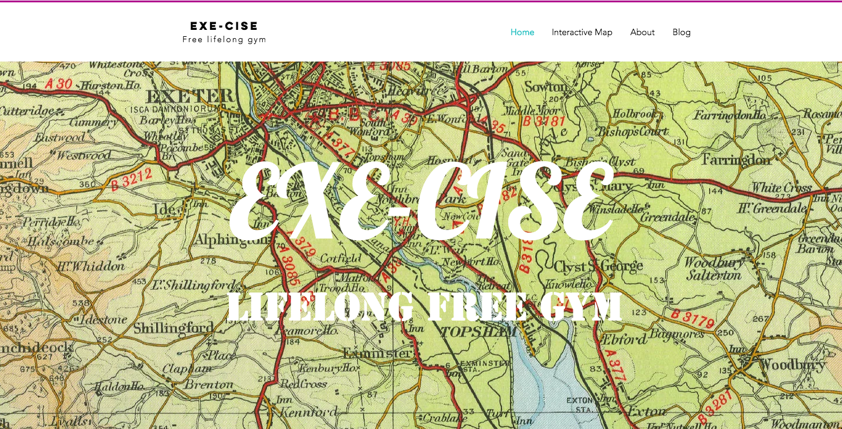
Future work
Create an active website
Followers
Promotion during stressful periods
Notes:
The idea if we had more time would be to create an active website/ blog where more videos can be uploaded finding more places around exeter where we can encourage outdoor activities.
We would organise the site so that followers can post comments and their own videos of specific locations where they have exercised around Exeter to form an online community.
This would also be promoted during particularly stressful times of the year such as exam periods or freshers week to encourage taking breaks and helping to reduce stress which would impact on mental health.

Slide 7
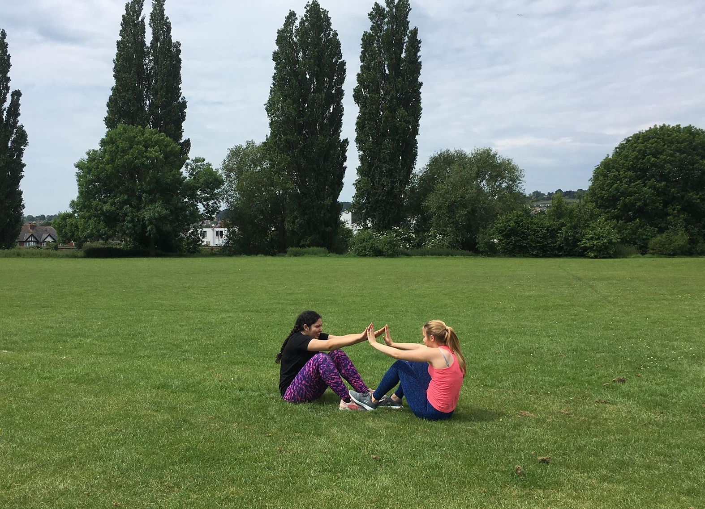
Lifelong FREE Gym
Be active, be happy!
“Natural gym” & Parkour
What can we get?
A fun twist
Quick-thinking skills
Core and bone strength
Socialising
Notes:
Yi-
contemporary research has shown that positive feelings towards exercise predict more frequent exercise behavior (Kwan & Bryan 2010).
Practitioners of Parkour aim to get from one point to another in a complex environment, without assistive equipment and in the fastest and most efficient way possible. Parkour includes running, climbing, swinging, vaulting, jumping, rolling, quadrupedal movement, and other movements as deemed most suitable for the situation. Parkour can be done anywhere, and involves seeing one's environment in a new way, and imagining the potential for navigating it by movement around, across, through, over and under its features.
Adds a fun twist to your usual static gym routine. It encourages play while tackling practical and fundamental movements.
Promotes quick-thinking skills – Parkour requires participants to negotiate obstacles quickly. These sudden moments require you to exercise your brain.
Reduces antisocial behavior – Parkour has been proven to reduce antisocial behavior. In a study conducted through a youth incentive in Westminster in conjunction with parkour coaching, crime rate between youth ages 8-19 was reduced by 69% during the time they coached parkour. Parkour gives people a positive way to direct their time and energy by presenting them with new challenges and obstacles each time they engage in the activity.

Slide 8
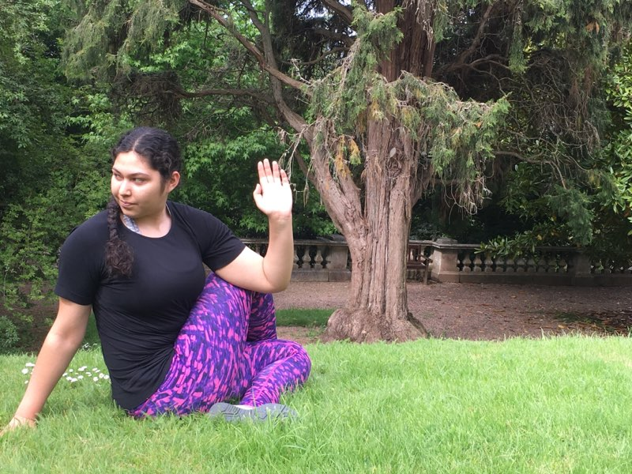
Biological effects of exercise
Improving mood
Content
More awake
Calmer
Kanning, M. & Schlicht, W. 2010
Notes:
Hope
- Physical activity can have a positive impact on mood. A study asked people to rate their mood immediately after periods of physical activity (e.g. going for a walk or doing housework), and periods of inactivity (e.g. watching television). The effect of physical activity on mood was greatest when mood was initially low. The participants felt more content, more awake and calmer after being physically active compared to after periods of inactivity. This illustrates the positive impacts of physical activity on mental wellness. (Kanning, M. & Schlicht, W. 2010)
Enhancing a sense of well-being Reducing anxiety Combating negative emotions Improving self-esteem, body image and confidence Protecting against depression

Slide 9
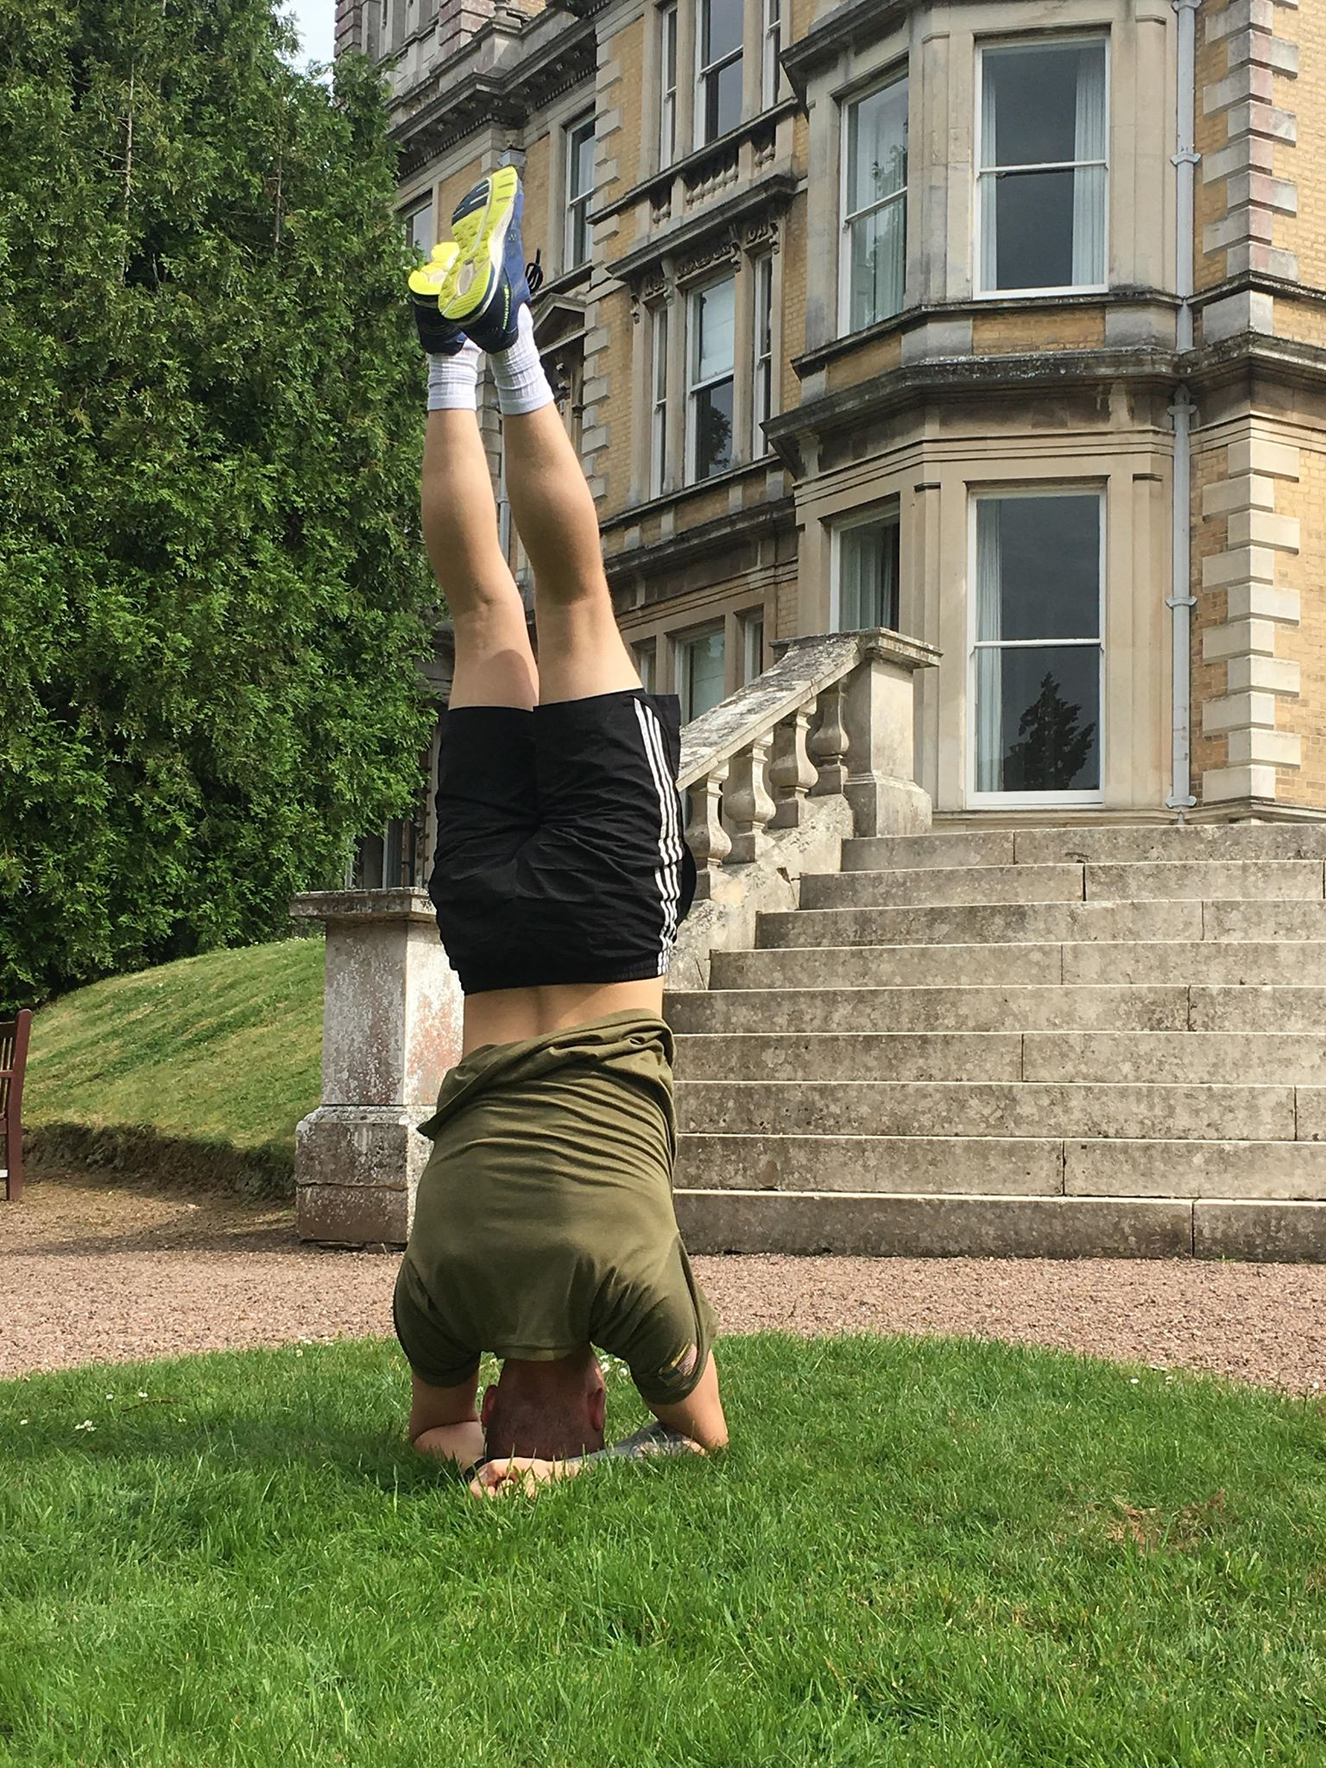
Exercise for mental health
Mental well-being vs. mental illness
Exercise as a healthy coping strategy
Physical activity as an anxiety treatment
Notes:
Jade- One of the hurdles preventing those with mental illnesses from beginning an exercise routine to improve their mental health is their respective mental illnesses. For example in the case of depression, an individual who is depressed will struggle to motivate themselves to begin a workout regimen. Due to our lack of expertise in this area we have chosen to focus on mental wellbeing, rather than targeting on those with mental illnesses.
When faced with mental or emotional challenges in life, exercise can help you cope in a healthy way, instead of resorting to alcohol, drugs, or other negative behaviors that ultimately only make your symptoms worse. Regular exercise can also help boost your immune system and reduce the impact of stress.
Exercise is a natural and effective anti-anxiety treatment. It relieves tension and stress, boosts physical and mental energy, and enhances well-being through the release of endorphins.

Slide 10
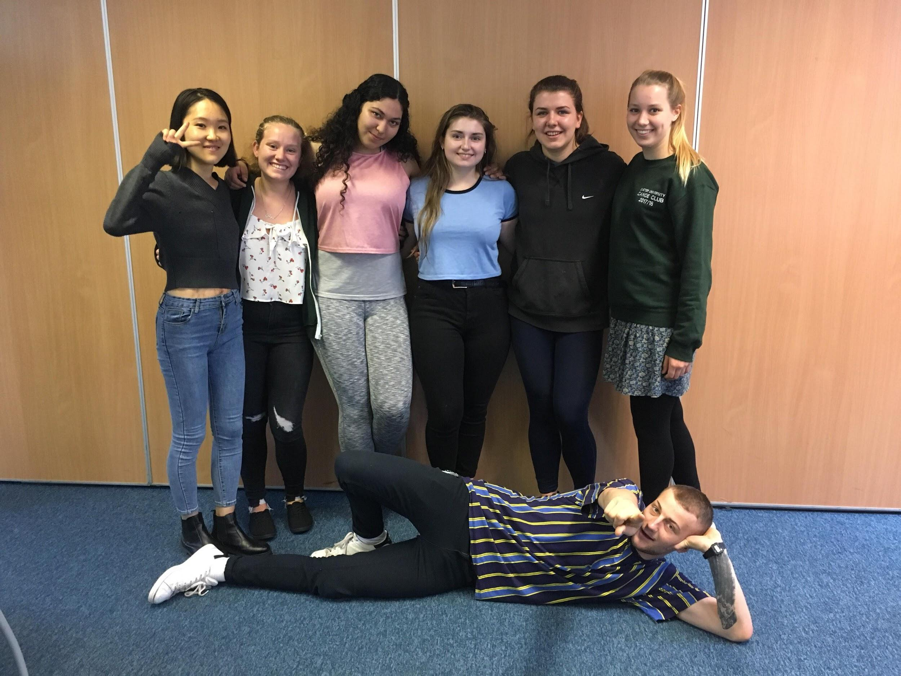
Summary slide
General Benefits
Questions?
Notes:
Max-
Enhancing a sense of well-being Reducing anxiety Combating negative emotions Improving self-esteem, body image and confidence Protecting against depression and other health conditions.

Slide 11
Works Cited
https://www.sciencedaily.com/releases/2011/02/110204130607.htm
https://journals.lww.com/acsm-msse/fulltext/2016/10000/High_Intensity_Interval_Training_for_Cognitive_and.16.aspx
https://www.healthline.com/health-news/exercise-in-groups-get-more-health-benefits#3
http://jaoa.org/article.aspx?articleid=2661140
https://www.helpguide.org/articles/healthy-living/the-mental-health-benefits-of-exercise.htm
http://www.flowjournal.org/2010/05/from-“play-to-display”-parkour-as-media-mimetics-or-nature-reclamation-matthew-ferrari-university-of-massachusetts-amherst/
Kanning, M. & Schlicht, W. (2010). Be Active and Become Happy: An Ecological Momentary Assessment of Physical Activity and Mood. Journal of Sport & Exercise Psychology, 32 (2), 253–261.
Caldwell.K.Harrison,M. Adams, M, Quin, R. & Greeson, J. (2010). Developing mindfulness in college students through movement-based courses: effects on self-regulatory self-efficacy, mood, stress, and sleep quality. Journal of American College Health. 58(5), 433-442.
Caldwell, K., Harrison, M, Adams, M, & Triplett, N. T. (2009). Effect of Pilates and taji quan training on self-efficacy, sleep quality, mood, and physical performance of college students. Journal of bodywork and movement therapies, 13(2), 155-163.

