Slide 1
MENtal Health Heroes
Presented by Group D -
Isobel Pemberton, Joe Hopwood, Jodie Mooney, Lucy Clark, Lucy da Silva, Liming Yang, Sophie Goschen
Notes:
introductions

Slide 2
Our Aim
. To provide a service that raises awareness of the mental health struggles experienced by males throughout secondary education
. Provide wellbeing support for young male students (year 9 - 11)
. Long term strategy to improve the standard of mental health care for men, erase toxic expectations of masculinity and normalise vulnerability
Notes:
Brief overview , state why a hard to reach group
Lucy d
Young male students - transition period of child to adolescent, pressures at school and therefore need that extra support
Difficult to encourage talking among males and in schools - culture of shrugging off and not sharing issues. Hard to reach group
Normalise talking and sharing and being able to let down your guard

Slide 3
Why Young Boys?
More likely to commit suicide About 75% of people to die by suicide are men. This proportion has been about the same for more than a decade.
Less likely to seek support Women are more likely to have been treated for a mental health problem than men (29% compared with 17%).
Early diagnosis, early treatment Over half of mental health problems are established by the age of 14 and 75% are established by the age of 24.
Halliwell, Main and Richardson. The Fundamental Facts. Edited by Isobel Booth. The Mental Health Foundation, 2007. https://www.mentalhealth.org.uk/sites/default/files/fundamental_facts_2007.pdf
Notes:
Rationale
We chose this group because…
Jodie

Slide 4
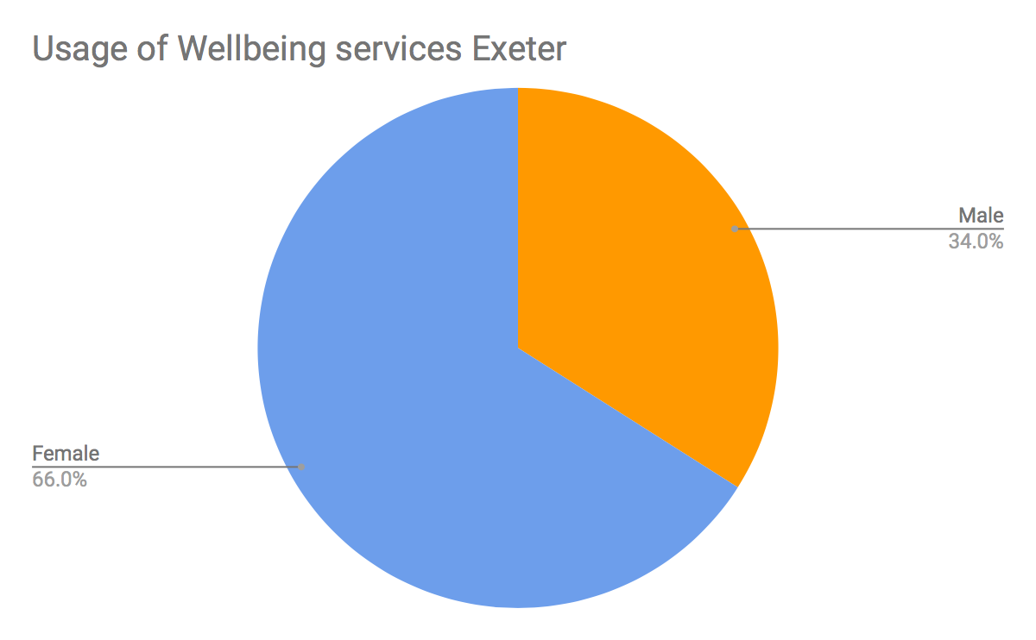
Why Young Boys?
How many people have
sought help from the wellbeing centre:
2016/17 - 34% Male, 66% Female
2015/16 - 30% Male, 70% Female
2014/15 - 30% Male, 70% Female
2013/14 - 32% Male, 68% Female
Pie chart showing proportion of gender seeking help from Exeter wellbeing services in 2016/17
Notes:
This trend is also shown at Exeter university too.
Jodie

Slide 5
What are men saying?
“I have been told to ‘man up’ over my mental health”
Adrian, May 23, 2018
“I feel guilty about my anxiety disorder”
Sean, May 2, 2018
“I made excuses not to talk about my depression”
Chris, April 11, 2018
Quotes from Time to Change https://www.time-to-change.org.uk/personal-stories
Notes:
Combating the stigma around mental health early by engaging with young males would improve the wellbeing of men later in life.
Isobel

Slide 6
What are teachers saying?
“The pastoral side of school is just as important as the academic, so a school is definitely an appropriate place for some form of mental health mentoring”
“I think the scheme would be effective if carried out in school time, as students will be more likely to attend. Form tutors could play a vital role in recruiting boys for the scheme”
“I think this is a great idea and could have the potential to be very successful, if done well.”
Source: C.Pemberton, Kirk Balk Academy
Notes:
Isobel

Slide 7
How do we plan to implement our idea?
Recruit young male volunteers (Under 25) who have experienced mental health difficulties
Train these volunteers with the mental health first aid course
Run a monthly group session in PSHE lesson.
These can continue into one-to-one sessions guided by the students.
Use of ‘The Brain Box’:
Notes:
Lucy C

Slide 8
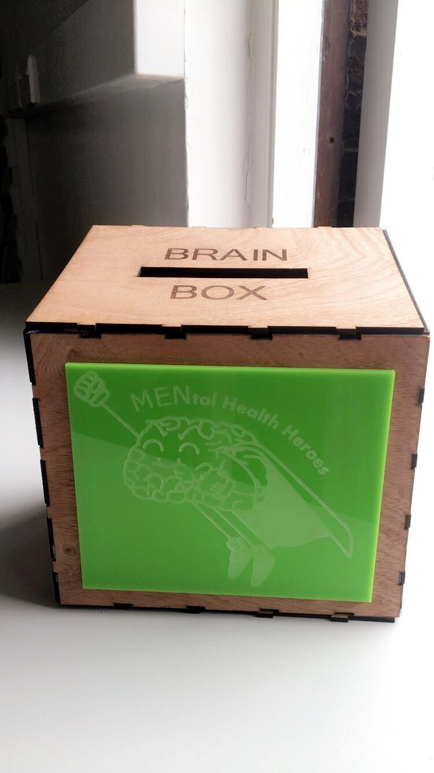
THE BRAIN BOX
To be installed in schools
Anonymous submission
Discussion with volunteer mentors in groups
Notes:
Lucy C

Slide 9
The Group Session
A group session may consist of:
The volunteers sharing their story with the students
Emptying of the brain box
General group discussions about mental health
Q & A between the volunteers and the students
The opportunity to sign up for one-to-one guidance with the volunteer mentors
Notes:
Liming

Slide 10
ONE-TO-ONE SESSIONS
Student led: held in a manner convenient and preferable to the student
Providing an optional and confidential service in order to build trust and provide support
Notes:
Liming

Slide 11
Why Peer Mentoring?
Research Review by the Department of Education found that young people were more likely to respond positively to peer mentoring and support
Nick Coleman, Wendy Sykes and Carola Groom, March 2017.
Independent Social Research
49% of teenage boys do not feel comfortable talking about mental health to their dads
Time to Change (2016)
Mentoring allows them to talk to someone they will feel comfortable with
Notes:
Liming

Slide 12
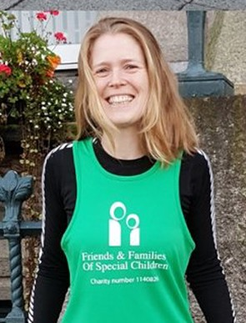
How do we plan to safeguard students?
“Carefully consider how you would advertise/prepare the audience and key support during and after the event in case there are triggers for students/audience members.”
Consent forms will be given to parents
Volunteers will receive training
One-to-one sessions will remain confidential unless the mentor has reason to believe their is a danger to themselves or someone else
Teacher led session to introduce the topic before Mental Health Heroes session
Run in conjunction with other agencies who can offer support immediately after
Jo Weaver - Mental Health Lead at a school
Notes:
As this scheme will deal with very sensitive discussion material, we have taken measures to ensure that the students and volunteers will be protected from any mental damage or harm.
Joe

Slide 13
Volunteer Training
Initial Consultation with Volunteers
Mental Health First Aid Course
Week 1
Week 6
The training timeline...
First Group Session
DBS Check
Week 2-5
Week 7+
Notes:
Joe

Slide 14
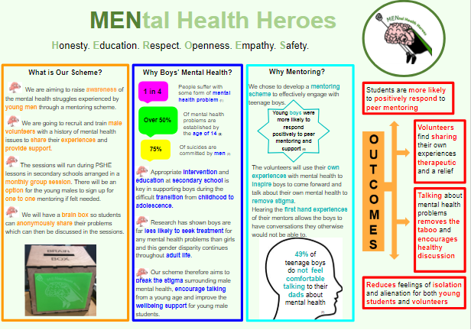
THE POSTER
Targeted at potential users of the scheme
Inform the audience of details
Includes our rationale, what the scheme is and what it hope to achieve
Notes:
Lucy d
Poster created as way of presenting the key ideas of the programme, can be used to inform schools, mentors, students and anyone else interested. Can also be used to inform parents of the scheme.

Slide 15
Our Train of Thought
Notes:
Sophie

Slide 16
Our Journey
Notes:
Sophie

Slide 17
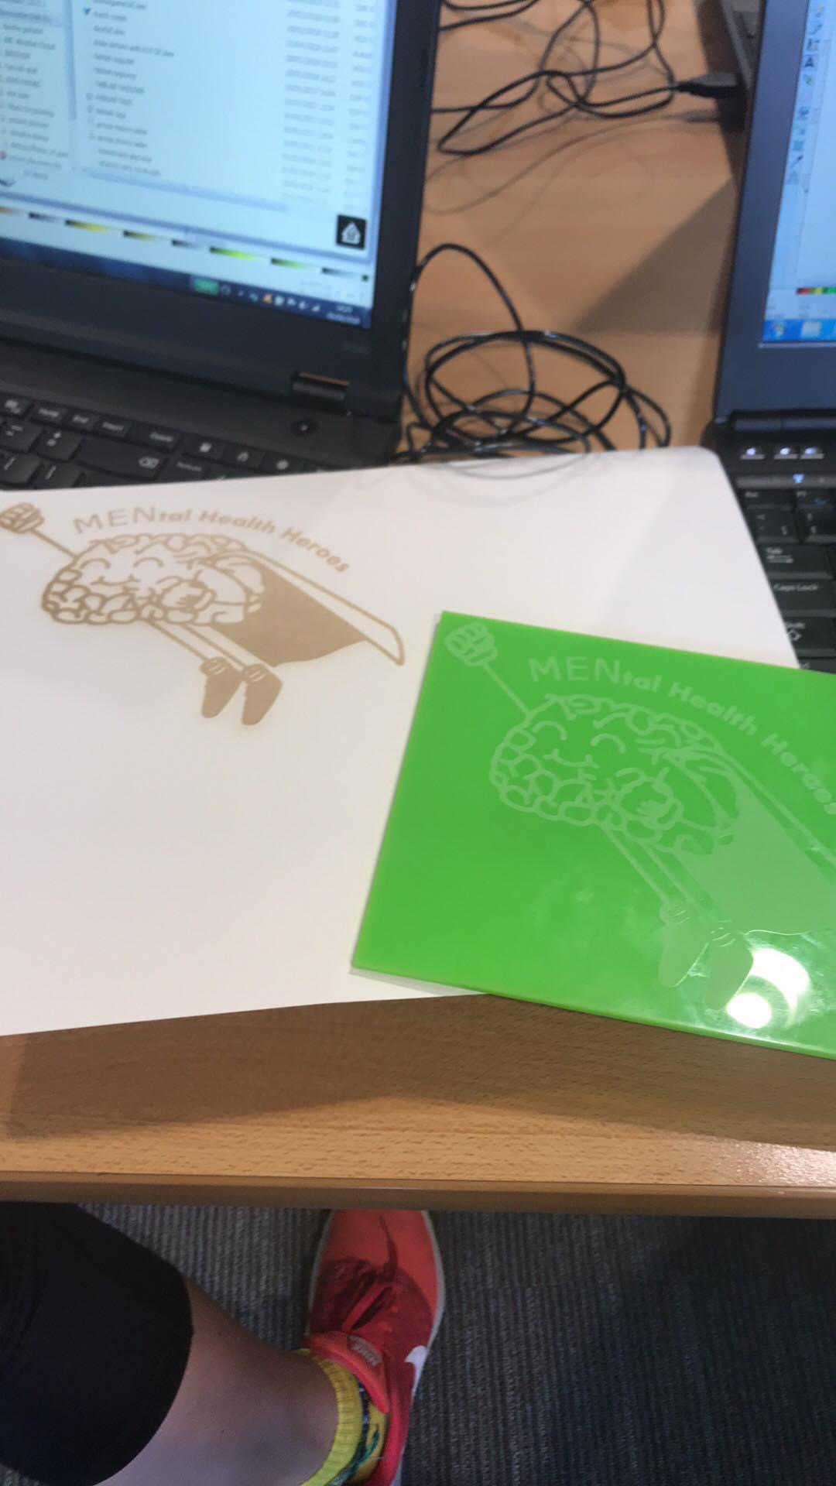
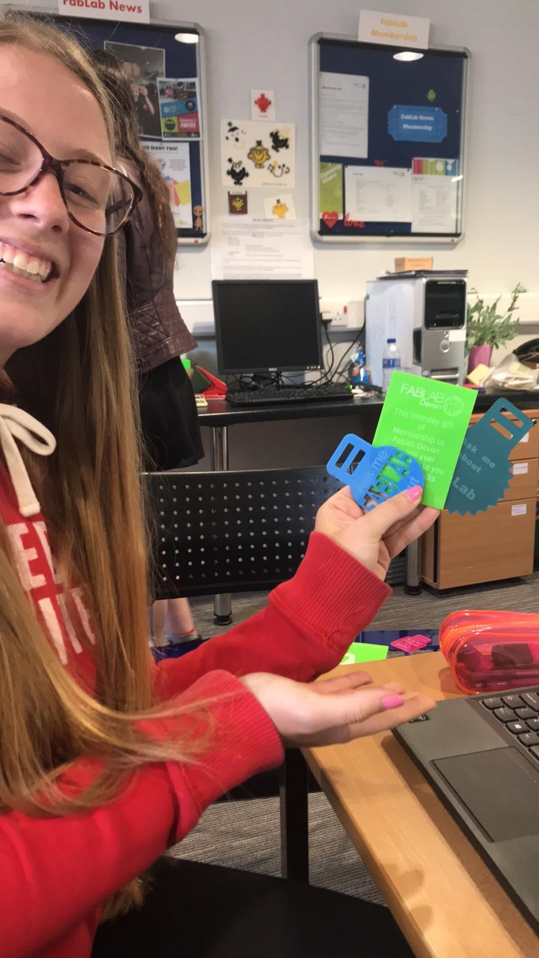
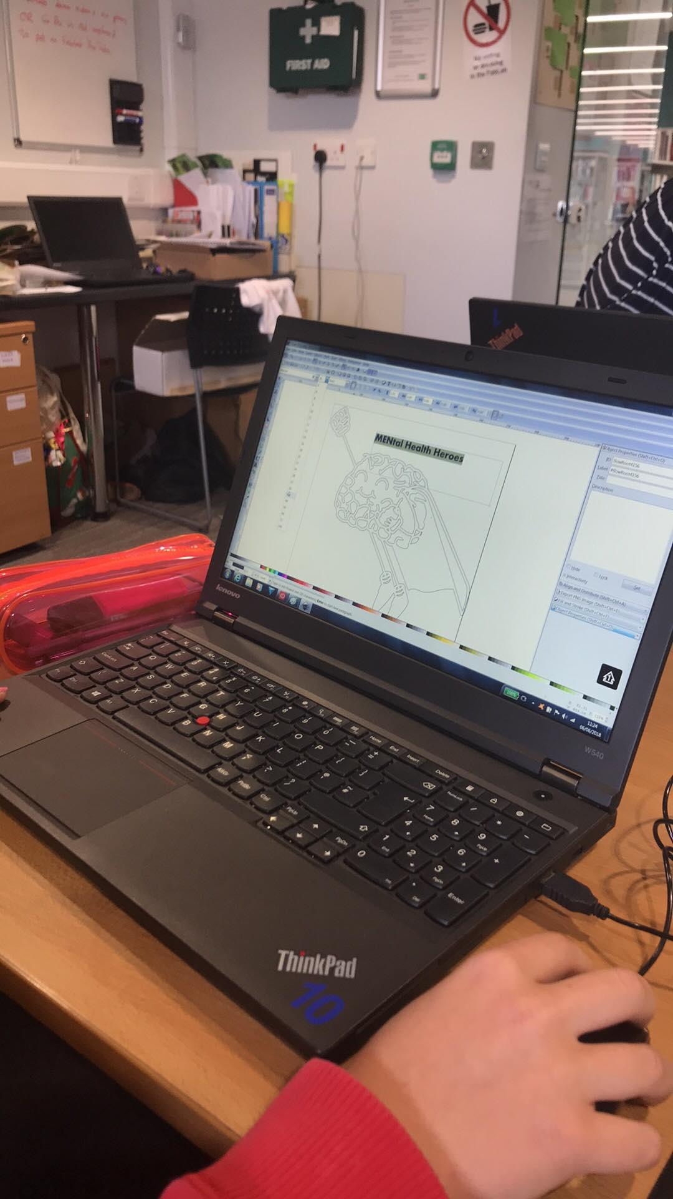
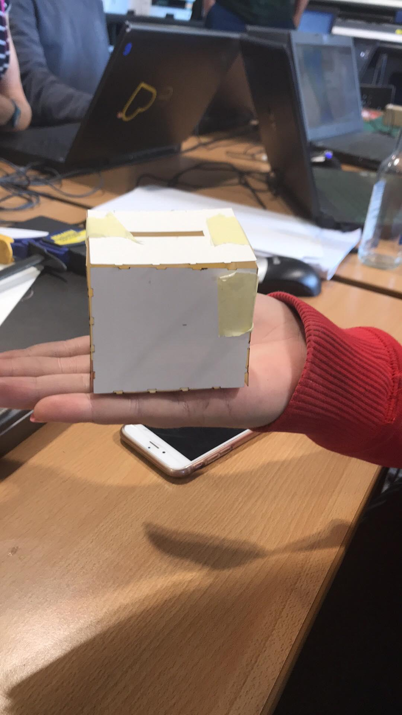
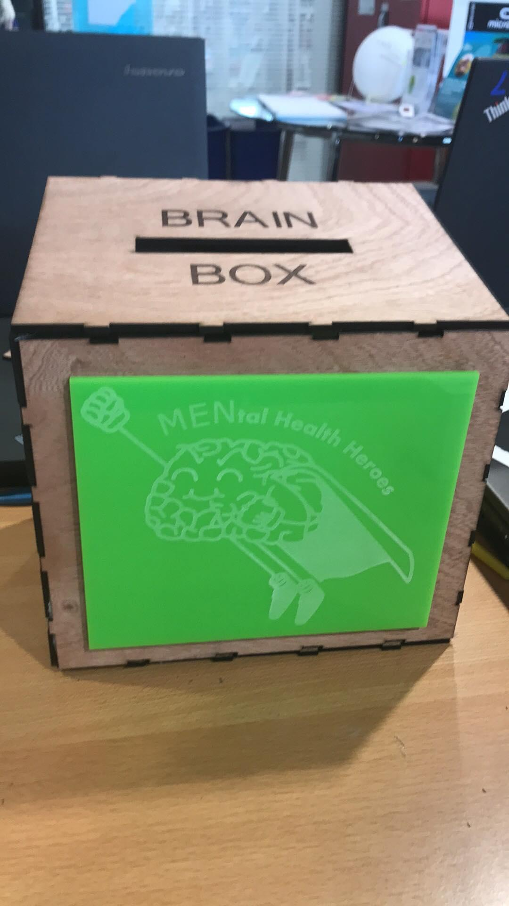
Making the Brain Box
Notes:
Sophie

Slide 18
Thank you for Listening!
Any questions?
Notes:
Sophie

