Slide 1
Stay Well At Exeter
Enhancing Mental Health Services for International and Home Students
By Gabriel Yeap, Scarlett Parr-Reid, Melin Hasan, Bola Olapade, Yifan Liao, Dóra Szerényi, Rebecca Maxwell, Abi Appleby
Notes:
All of us

Slide 2
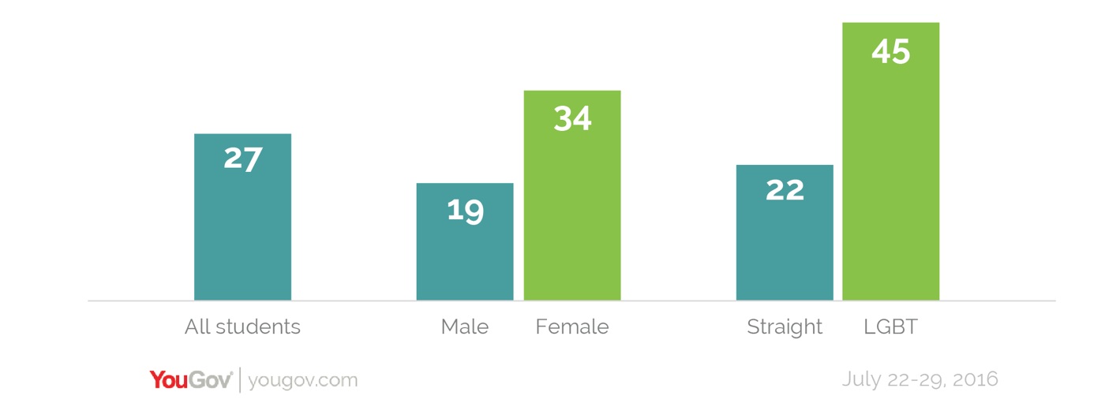
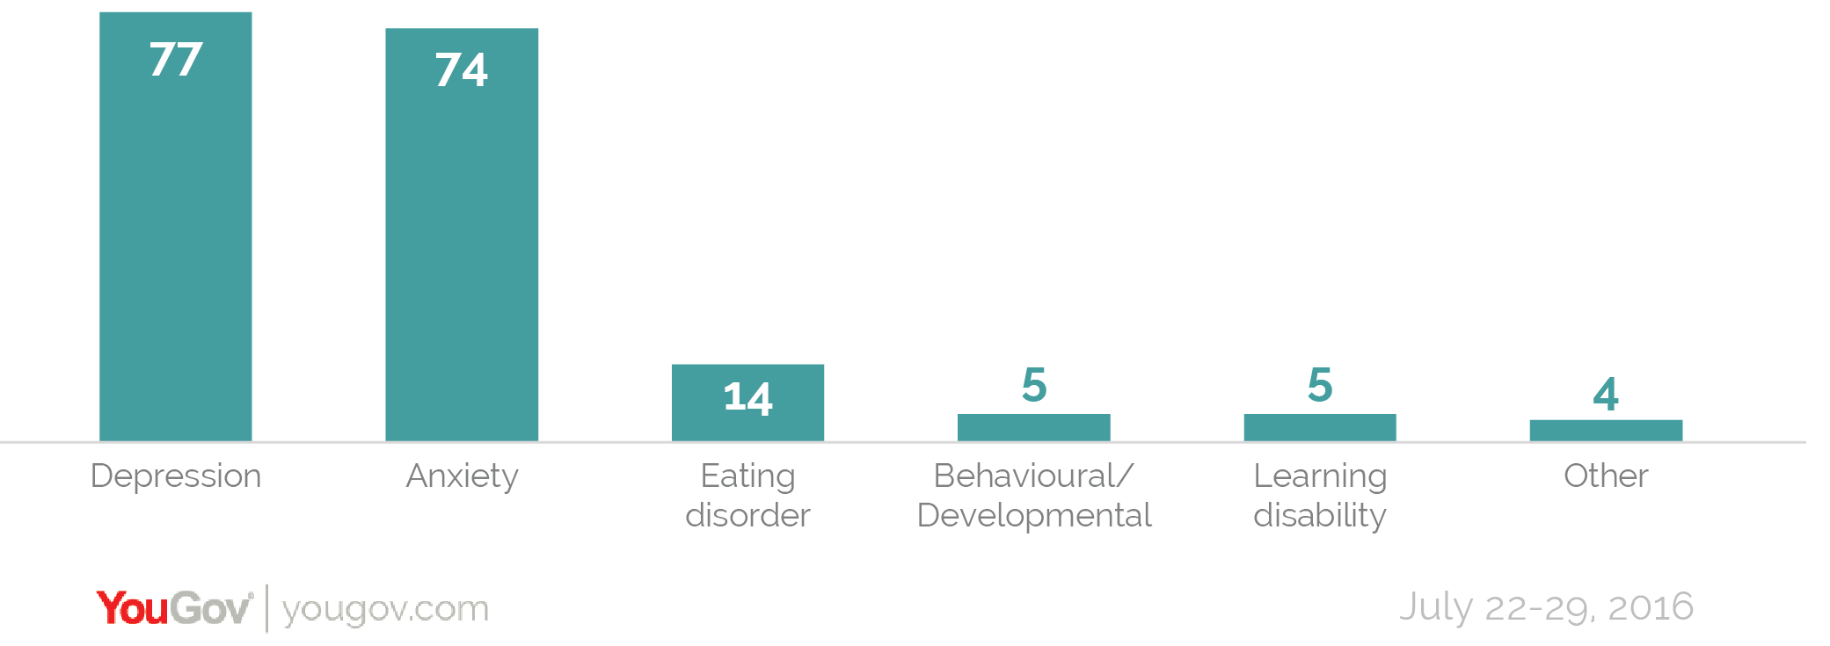
Did you know?!
74% of people in the UK have felt so stressed that they have been overwhelmed or unable to cope.
Females and LGBT students are more likely to experience mental health problems
Depression and anxiety are the two most common mental health problems by a country mile...
Figure 1 shows a bar chart of the distribution by percentage of all university students across the UK experiencing mental health problems. This is a step by step break down, narrowing it down to by sex and sexual orientation.
Figure 2 shows the continuation of figure 1, elaborating on the distribution of those experiencing mental health problems, by different types of issues.
Notes:
Gabe

Slide 3
Key Issues in Mental Health
Lack of awareness about the Wellbeing services at the university
Cultural stigma
Lack of helpful resources
Language barrier
Lack of communication between academic and wellbeing sectors
Academic pressure
geralt, Pixabay
Ma ialisa, Pixabay
geralt, Pixabay
MimiEunice 59.png, Wikimedia Commons
NHS at 70, Healthwatch
freeGraphicToday, Pixabay
Notes:
Dora

Slide 4
Our Aims
Promote Wellbeing services available at the University of Exeter, locally and internationally
Reduce/Remove language barriers between international students and staff members
Identify problems and devise possible solutions for the wellbeing among university students
Notes:
Dora

Slide 5
Our Survey
Survey was aimed primarily at international students
Aim was to inform about available Wellbeing services
We gathered information about the usage of different services and the reasons why students do/do not reach for support
We gathered suggestions for improvement and general feedback on the available services
Notes:
Yifan and Melin

Slide 6
Results
69 (42 females, 26 males) students completed our online questionnaire by 12:00 pm, 7/06/18
Age range 18-31; mean of 21
81% international students
67.6% of our 69 respondents were
non-native English speakers
Notes:
Yifan and Melin

Slide 7
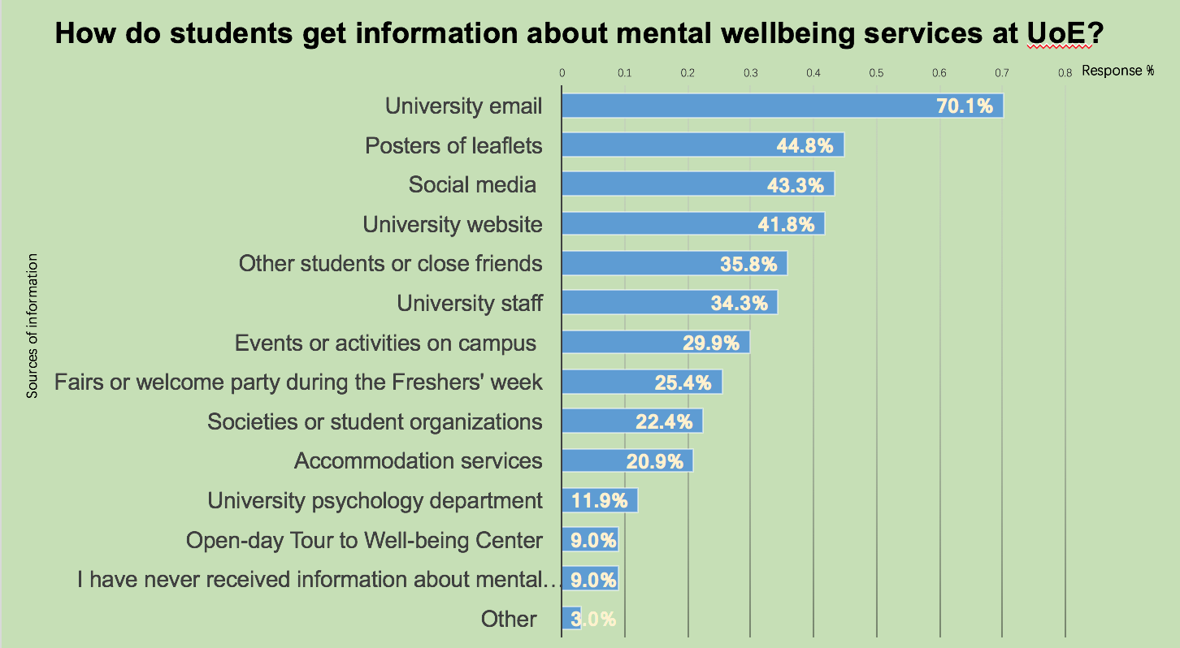
Notes:
Gabe - data tendency to get information about wellbeing services from
Most get information online
Still quite a few have no information about wellbeing services at exeter

Slide 8
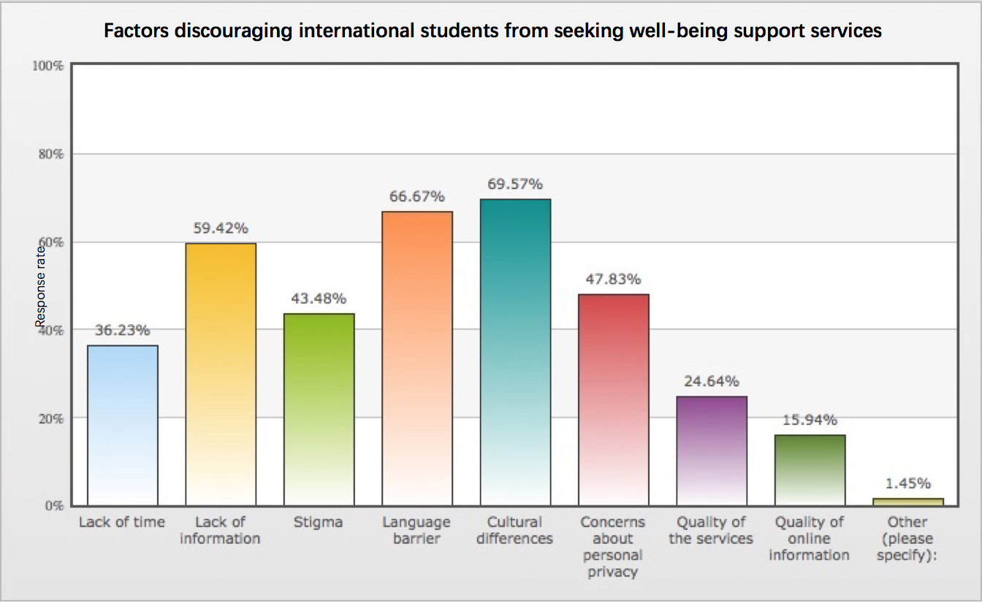
Notes:
Yifan and Melin

Slide 9
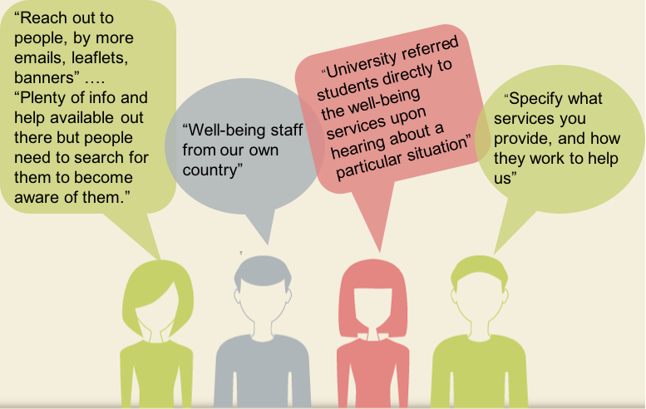
Student voices
The final question on the survey asked students for any suggestions or comments they had for improving accessibility to wellbeing services in Exeter and here were some of the results...
Notes:
Dora

Slide 10
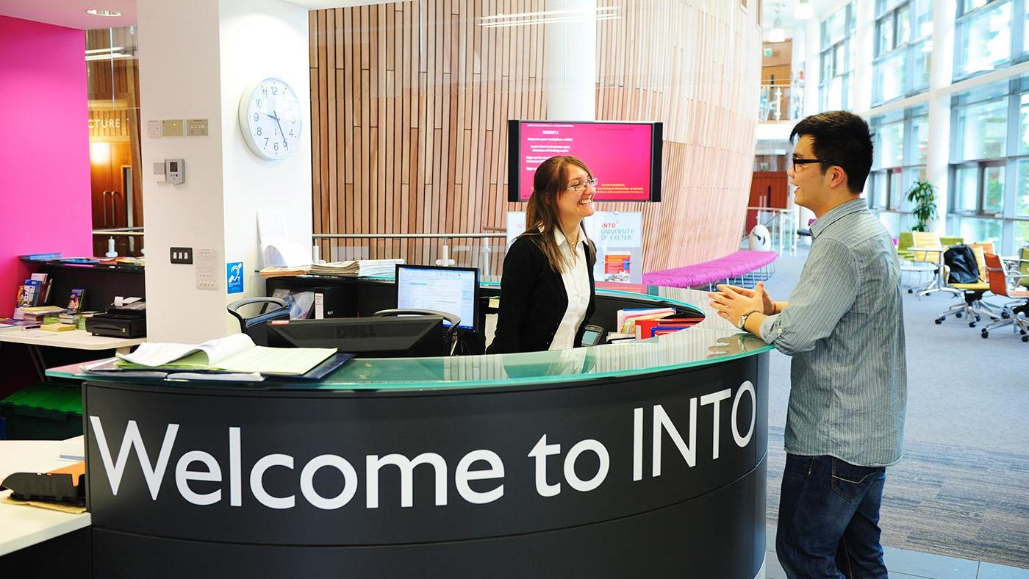
INTO perspective
- Tanya Brown, Welfare officer at INTO
Programme Manager (Personal Tutor)
Students are directed towards GP before Wellbeing (“Wellbeing is for serious issues”)
Booklets with Health page & Induction talk
Specific language speakers, Translators & Interpreters
Need for improvement - More spaces & more meeting rooms
Notes:
Bola

Slide 11
Wellbeing perspective
Rachel Bragg, Wellbeing Consultant
Challenges: language, culture, distance, perceptions
Few interpreters
Mental Health First Aid training
INTO referrals
Suggestions: Ubuntu, interpreters, International Office, society collaboration, improving website accessibility, buddying system
Notes:
Scarlett
Challenges: language, culture, distance, different perceptions of mental health in different cultures
No current training for specific languages; some interpreters
Mental Health First Aid training for staff
INTO referrals - signposting to international support team
Suggestions: Ubuntu (multicultural counselling service), accessing and funding interpreters, linking to International Office to promote wellbeing, collaboration with societies, more to be done promoting for international students on website, buddying system to overcome language barrier

Slide 12
Recommended local and national services
More can be found at: https://www.exeter.ac.uk/wellbeing/services/
Notes:
Melin

Slide 13
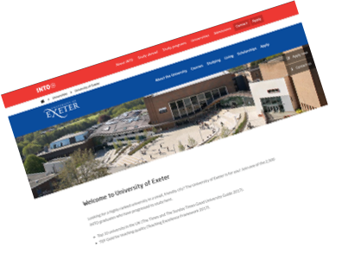
Our Solutions: Improving awareness
Wellbeing service in iExeter app
Having a mental health section in the student health application
Including a direct link to the Wellbeing service page on the INTO page.
Notes:
Bola
-Wellbeing service in iExeter app- where they could enquire about their troubles how they feel or the issues they have, and also possibly book appointments. This will improve the access to the wellbeing service especially getting people to know about the wellbeing centre as well, working a similar function sid but with someone working round the clock.- still more work being done to this
-Having a mental health section in the student health application- Since we have to apply for the student health centre and have to include things about how health. Could possibly add a section talking about mental health asking if they have ever had any issues and if they would interested in seeing someone or having someone to talk to, maybe on a one to one basis or just coming in for checkups or so.- may help address it from early on from 1st term for not only international students who have experienced this before uni but also domestic ones.

Slide 14
Our Solutions: Improving accessibility
Trained foreign language speaking ‘Wellbeing buddies’
Plain English Accreditation for Wellbeing documents and resources
Update self help resources to be accessible in more languages
Offer appropriate cultural training for academic and Wellbeing staff
Funding for interpreters in Wellbeing appointments
Ensuring time for Wellbeing in academic timetables
Ensuring continuity by providing the same counsellor every time
Notes:
Abi

Slide 15
What is next for us?
Enactus
Student-led society, dedicated to enhance student involvement with entrepreneurial action. Go to http://enactusuk.org or join the society at https://www.exeterguild.org/societies/Enactus/
Student as Partners
Work on a self-contained project with a member of staff, aiming to improve academic experience. More information is available on the Student Partners website, or you can speak to the team: studentpartners@exeter.ac.uk
Enterprise and Student start-ups (ThinkTryDo)
Helping graduates benefit from enterprise skills. Support services are available at http://www.exeter.ac.uk/thinktrydo or email thinktrydo@exeter.ac.uk.
Notes:
Melin

Slide 16
Reflecting on our journey so far...
Grouping together, introducing ourselves and discussing our strengths.
Narrowed down our focus to be on improving mental health services for International students.
Facebook group chat, and went on to delegate certain research tasks
This would be aimed at raising awareness of the wellbeing centre and their services. Providing students with this early on is essential. In this pack: the t-shirts we are wearing now would be provided. We chose a light blue colour to reflect the calming influence the wellbeing centre would have on a student, mini-notebooks, wristbands and flyers would be included and all would be contained in a wellbeing bag.
Throughout the week: We completed a poster, a survey, undertook interviews, produced a video, and put together ideas for a Fresher’s welcome pack.
Notes:
Rebecca

Slide 17
Reflecting on our journey so far...
Communication and time management skills have enabled us to be passionate and imaginative throughout, listening to and being respectful towards everyone’s ideas.
Resolve queries quickly through the group chat but also in discussion
We have used online resources and interviews to conduct our research.
Overall, we have been able to develop our enthusiasm for ideas through cooperating, communicating and respecting each other.
Any setbacks faced were resolved through teamwork, discussion, and pulling together to avoid leaving anyone alone on a task.
Notes:
Scarlett

Slide 18
Time for a Q&A...
Notes:
Scarlett

