Slide 2
Overview
Skills employers want
Employability Outcomes
Global Mindset theories
How to articulate your experience
Practice
Questions

Slide 3
What skills are employers looking for
Communication
Problem Solving
Commercial Awareness
Negotiation
Teamwork
Leadership
Organisation
Motivation
Confidence
Ability to work under pressure

Slide 4
Also ……
Soft skills
Flexibility/adaptability
Initiative & Planning
Assertiveness
Independence
Motivation
Better listening skills
Increased tolerance
Increased diplomacy
Effective working in multicultural teams
Willingness to learn and adapt to different culture
Notes:
This is where your year abroad comes in.
These are the skills you have accumulated just by studying or working in a different country and culture.

Slide 5
What employers say*
“Santander believe that all students should have the opportunity to study abroad as it is a great experience that will enhance their job prospects, learning to adapt to different cultures and academic environments and in some cases learning a different language.”
“I would always look favourably on graduates who have spent time working or studying abroad. Not only does it demonstrate a go-getter attitude, it tells me they have many of the skills that the business world value. These include the ability to quickly integrate in unfamiliar teams and situations, a sensitivity and understanding of different cultures to their own, and an overall robustness which so many graduates lack when they first enter a business”.
*http://www.go.international.ac.uk/content/what-next-0
Notes:
We know this is true because the employers tell us.
Adapting to different cultures
Go getter attitude
Ability to integrate quickly
Sensitivity and understanding of different cultures
Self confidence
Stand on their own two feet.

Slide 6
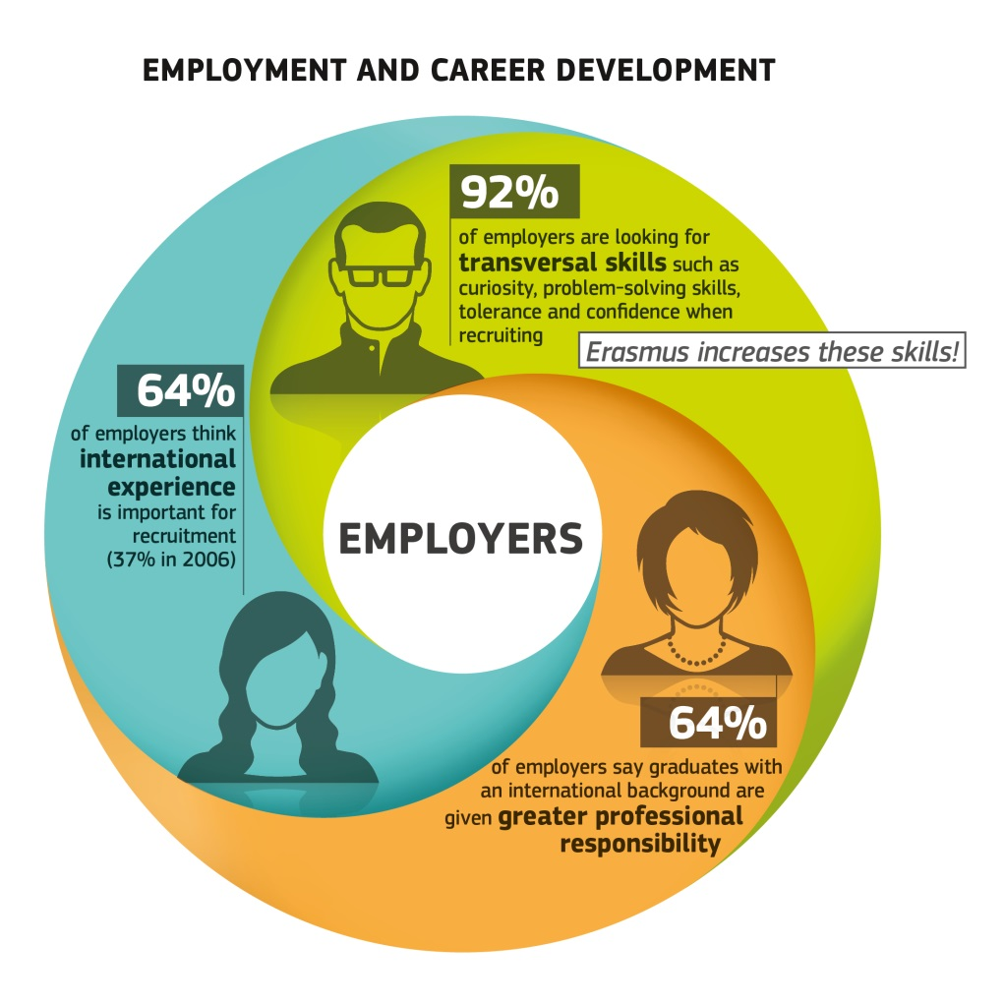
What difference does this make?
It makes you more employable
Graduate jobs are left unfilled because candidates do not have the right skills
Students with international experience are less likely to be unemployed
Notes:
Erasmus Impact study can be used as a benchmark for an international experience, work or study. 64% of employers thing that international experience is important – why do you think that is? Because of the ability to understand that other countries may do things differently and to have the confidence to communicate . Also the personal development in terms of being more robust, more adaptable, more flexible

Slide 7
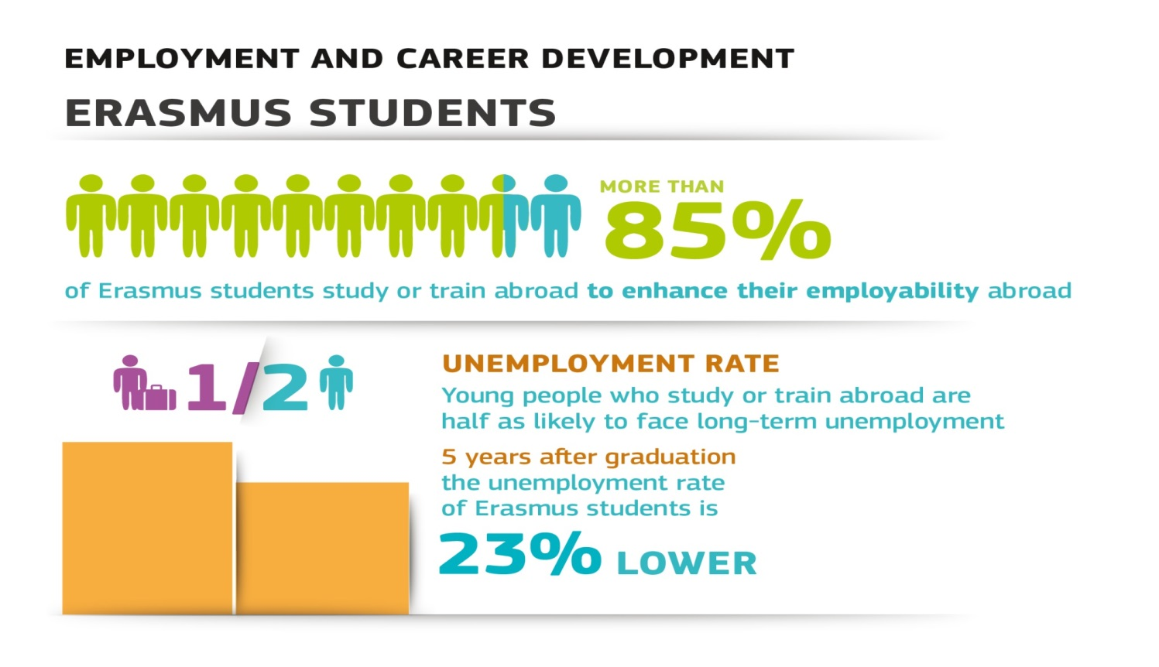
How an overseas experience increases your employability
Notes:
Interesting to note that some students are forward thinking, as are you sitting here today, to recognise that an international experience in any format will enhance your employability and this is the reason they choose to do it.

Slide 8
Introducing a Global Mindset
Intellectual Capital
Social Capital
Psychological Capital
ThunderBird School of Management
(Mansour Javidan, Ph.D)
Notes:
S global mindset consists of three processes – intellectual capital, social capital and psychological capital.

Slide 9
Intellectual Capital
Global Business Savvy – understanding country labour market and sectors
Different cultures – awareness, understanding and working with diverse backgrounds
Problem solving situations
Social Capital
Intercultural empathy
Ability to engage and connect emotionally with people from other part of the world
Interpersonal impact
Diplomacy
Psychological Capital
Open attitudes to diverse experience
Adventurous- passion for learning and exploring other cultures
Positive personality traits = eg
Self assurance
Resilience
Notes:
Breaking this down for you – What this means.
Here’s some examples of how you can include this in your daily situation and link it to your academic work and think about how to use this in interview, application situations.
Intellectual:
Global business savvy - Commercial awareness, where is the company situated amongst it’s peers and what’s it offering, understanding different markets and ways of working; Demonstrating understanding of business environment - Your placement, even if studying now means you can understand how businesses work in that country, this gives you something to talk about in interview and can be valuable to employers
Problem Solving ; Resolving issues in a different cultural environment and how you adapted yourself
Social capital
Intercultural empathy Reflecting on situation and trying another way to resolve it.
Psychological capital
Self assurance and resilience - Confidence to try new things
.
Intellectual capital
Global business savvy
Different cultures
Problem solving situations and examples
Social capital
Intercultural empathy
Intercultural impact
Diplomacy
Psychological capital
Diverse experience
Adventurous
Self assurance
Resilience

Slide 10
Your experience
How did you develop a global mindset on your placement?
Pick one item from each ISP category and write down how or where you used it.
Eg: Intellectual capital – knowledge of different cultures
Social capital – intercultural empathy
Psychological capital – quest for adventure
Notes:
Ok
So I’d like you to take 5 mins and think about how you may have demonstrated one of these whilst on placement.
You can use the sheet I’ve given you.

Slide 11
Graduate Project Coordinator
Position responsibilities:
Be responsible for the entire life-cycle of all projects assigned to the individual
Juggle multiple projects and priorities simultaneously in a fast-paced environment
Understand and abide by individual project instructions
Liaise with sales staff to clarify project parameters
Establish and maintain excellent relationships with contract translators and proofreaders globally
Negotiate with vendors
Coordinate with quality personnel to ensure that the translation perfectly complies with instructions and is linguistically perfect
Communicate any issues/problems/caveats or additional
Distribute information to sales staff as soon as that information is available
Essential skills and experience required:
Excellent written and verbal English communication skills
Minimum Bachelor’s degree or equivalent
Excellent problem solving and analytical skills
Customer service and/or project management experience
Strong interpersonal skills
Effective time management
Strong organizational skills, attention to detail, and the ability to multi-task
Working knowledge of MS Office
Ability to prioritize and schedule tasks and work in a team environment.
Must be willing to learn new things, be open to challenges and thrive on success
Notes:
So what we’re going to do here is look at how we can use the Intellectual, Social and Psychological theory and map it to a real job ad to help you identify how you would use this capital.
Looking at the skills required they mention problem solving, analytical, interpersonal, time management, organisational, team working and being open minded.
Let’s start with intellectual - where are they looking for intellectual capital?
Intellectual
Global business savvy
Knowledge of different cultures (number 2)
Problem solving (number 1)
Social
Intercultural empathy, interpersonal impact, diplomacy (3)
Communication skills (4)
Psychological
Desire for diverse experience (5 – last one)
Quest for adventure
Self assurance

Slide 12
Articulating your experiences
It was great!
Use reflective tools to consider the skills used.
What did you learn?
Selling it to employers in cover letter
Linking it to the job; field, sector or location
STAR technique in interviews
What obstacles did you overcome and what was the result
Notes:
The tricky bit
Worth spending some time thinking about this
COVER LETTER
My studies in Japan provided me with a great insight into the cultural differences that influence consumers in different countries and will improve my ability to contribute to international marketing initiatives
THE INTERVIEW Consider in advance where and how you will refer to your experience abroad. While it is important, you should not use it as your only point of reference. If your interviewer remarks or asks about your international experience, take it as an opportunity to expand. Don’t let the opportunity pass by with a simple, “Yes, it was great!” Prepare specific examples. Did you: • Do a specific project or research applicable to your field of interest while abroad? • Travel independently? • Learn to work with a more diverse group of people to which you had not previously been exposed? • Resolve a conflict based on misunderstandings or cultural differences? • Learn new activities, languages, hobbies, or skills?
: • Enhanced cultural awareness and sensitivity to customs and cultural difference/nuance • Foreign language proficiency (indicate level on resume) • Nonverbal communication skills • Adaptability • Greater flexibility and receptivity • Tolerance, sensitivity, listening and observing skills • Ability to identify and achieve goals • General improvement in communication skills • Increased confidence, initiative, and independence • Ability to deal with personal stress • Sense of humor • Awareness of global economic and political issues and realities • Ability to maintain an open mind and be tolerant of others • Clarification of goals and improved self-awareness • General travel skills • Resourcefulness • Diplomacy and tact • Organizational and people skills • Problem solving and crisis management • Patience • Specific professional skills or knowledge base

Slide 13
STAR Technique
Situation How, when, where, with whom?
“Whilst on my year abroad in Spain….”
Task Describe the situation or the task you were faced with
“I was given the task of arranging virtual project team meetings with people in different countries….”
Action What action did YOU take?
“I recognised that German team members had a different approach to work than the Spanish who often liked to break in the afternoon for siesta. Using my intercultural communication skills I worked with both teams so that the Germans could work on their tasks in the morning and hand over to the Spanish to complete after siesta.”
Result What results did you achieve/conclusions did you reach/what did you learn from the experience?
”As a result the project was completed on time as all parties had a clear understanding of their requirements. This was the first time such a project had met its deadline”.
Notes:
The STAR approach – Situation, Task, Action, and Result can be used to answer situational questions on an application form or in a job interview e.g. “Describe a time when you….” or “Give an example of….” It’s a bit like a mini essay. The Situation and the Task are usually combined and form the introduction. The Action you took, should form the main body of your answer, and the Result should be your conclusion – try to be as specific as possible e.g “we raised £400 for charity”. If you failed to achieve your objective say what you learned and what you would do differently next time.

Slide 14
Interview question
Describe a set back you have had to face. What was it and how did you approach it?
Using the Global Mindset theory and the STAR technique, spend 10 minutes compiling your answer and then sharing with the person next to you.

Slide 15
Recap
Skills employers are looking for
Why this is important
Introduced a global mindset
Articulating your experience
Practical application of your experience to a real life job ad

