Slide 1
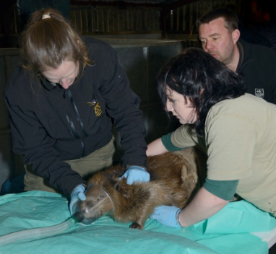
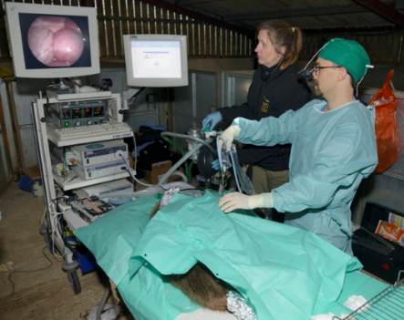
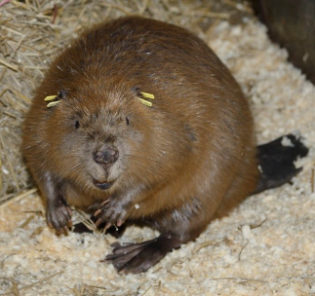
Retrospective health screening of beavers, River Otter, Devon Campbell-Palmer, Pizzi, Elliott, Brown & Girling
Introduction
Two families of breeding beavers were reported on the River Otter, Devon, in February 2014. After a successful public campaign to see them remain in place, Natural England granted Devon Wildlife Trust a 5 year licence to monitor the beavers. A condition of this licence was that the animals were healthy and free of any diseases and parasites of concern. Though beavers are not especially recorded as being major reservoir of disease, as rodents they can harbour pathogens of health concern. Echinococcus multilocularis has been recorded in an imported beaver in an English captive collection¹. An additional consideration of any health screening was to assess the adaptability of beavers to survive in an English landscape after an absence of over 400 years.
Material & Methods
The disease screening protocol for live trapped beavers was based on that already established for the official Scottish Beaver Trial² and Scottish Government commissioned screening of unlicensed beavers within the Tay and Earn catchments, east Scotland³. A full physical examination was conducted under anaesthetic. Anaesthesia was induced with isoflurane in 100% oxygen via facemask while the beaver was restrained (Fig. 1). Each beaver then underwent endotracheal entubation with a portex uncuffed endotracheal tube under visualisation after local anaesthesia of the glottis with xylocaine spray. Anaesthesia was maintained with isoflurane in oxygen via intermittent positive pressure ventilation, while vital parameters such as heart rate and rhythm, respiratory rate and rhythm, peripheral pulses, and oxygenation were monitored throughout anaesthesia. Blood was taken aseptically from the ventral tail vein for diagnostic testing and genetic screening. Testing for European Leptospira serovars was via microscopic agglutination test (MAT) (Animal Health Veterinary Laboratory Agency, Weybridge). Testing for tularaemia was performed by means of polymerase chain reaction (PCR) (National Veterinary Institute, Norway). Testing for Echinococcus multilocularis was performed serologically by means of two different enzyme-linked immunosorbent assays (ELISAs) targeted against the EM 18 and EM 2 antigens, used for human EM diagnosis, as well as a recently developed immunoblot. A specific anti-beaver IgG conjugate was used for testing⁴, at University of Bern, Switzerland. These EM results were interpreted in conjunction with abdominal ultrasonography and laparoscopic examination(Fig. 2). TB screening was via cytological assessment given timeframe for captive retention of beavers. Faecal samples underwent flotation with saturated salt solution for nematodes and sedimentation for trematodes, as well as microscopy for coccidia, Cryptosporidium spp., and Giardia spp. Standard microbiological culture for bacterial enteric pathogens, including Salmonella, Campylobacter and Yersinia spp. was performed (SAC Consulting Veterinary Services, Scotland’s Rural College).
Results
This study found that all 5 animals examined were physically healthy and presented no obvious signs of disease. Evidence of previously healed wounds on all adult tails were observed, most probable as a result of former territorial disputes which is common for this species. All beavers were in good to very good body condition and appear to be adapting well to an English landscape and presented no welfare cause for concern. The two adult females were pregnant. Haematology and serum biochemistry were judged against previously established normal values for beavers⁵ and were largely unremarkable. No haemoparasites were recorded. All beavers were negative for Tularemia, bovine TB and EM. One beaver tested positive for Leptospirosis (Aleppo strain).
Conclusion
All individuals were passed fit for re-release, presenting no health concerns to humans, livestock or other wildlife. All beavers were released back into their respective territories on 23rd and 24th March 2015. Post release health screening is planned for the last year of the trial period to assess
Acknowledgments
Thanks to DEFRA/APHA for providing additional funding for this project, and their expertise in rounding up the beavers and to Dereck Gow Consultancy for the captive care of these animals and assistance on the day. All images used with kind permission from Nicholas Upton.
Fig. 1 Initial facemask induction with isoflurane.
Fig. 2 Laparoscopic examination of abdominal region for EM cysts.
Literature cited
¹ Barlow, Gottstein, Mueller. 2011. Echinococcus multilocularis in an imported captive European beaver (Castor fiber). The Veterinary Record, DOI:10.1136/vr.d4673.² Goodman, Girling, Pizzi, Rosell, Campbell-Palmer R. 2012. Establishment of a health surveillance program for the reintroduction of the Eurasian beaver (Castor fiber) into Scotland. Journal of Wildlife Disease 48: 971-978. ³ Campbell-Palmer, Pizzi, Dickinson, Girling. 2015. Trapping and health screening of wild-living beavers within the River Tay catchment, east Scotland. Scottish Natural Heritage Commissioned Report 681. ⁴Gottstein, Frey, Campbell-Palmer, Pizzi. Barlow, Hentrich, Posautz, Rsyer-Degiorgis. 2014. Immunoblotting for the serodiagnosis of alveolar echinococcosis in live and dead Eurasian beavers (Castor fiber). Veterinary Parasitology doi:10.1016/j.vetpar.2014.06.017. ⁵ Girling, Campbell-Palmer, Fraser, Pizzi, Cracknell, Arnemo Rosell. 2015. Haematology and serum biochemistry parameters in Eurasian beaver. PLoSONE (in press).
Further information
rcampbellpalmer@rzss.org.uk
www.devonwildlifetrust.org

