Slide 1
AI in Society – Digital Societies and Online Harms
Kitty Adhamy-Nichol
Impact and Partnership Development Manager – AI in Society
Email: K.Nichol@Exeter.ac.uk
Tel: 07771438908

Slide 2
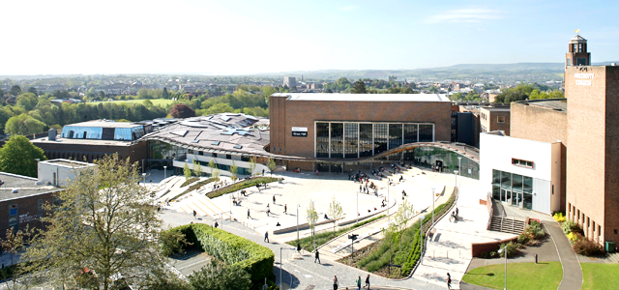
High level skills
High level skills
Collaborative R&D
High level skills
Innovation
Smart Solutions to business challenges
Help businesses to grow, recruit and retain talent
Help small businesses to think bigger
2000 projects a year - £64M

Slide 3
Data Science and AI at the University of Exeter
Institute for Data Science and Artificial Intelligence
Founded in 2018
Research Themes enable focus on data research areas including environment and sustainability, digital humanities, health and data governance
Find a data scientist: www.exeter.ac.uk/idsai/datascientist/
Membership of The Alan Turing as one of 13 University partners of the Turing network
IDSAI is the focus for Exeter’s partnership with the Alan Turing Institute and hosts over 50 Turing Fellows along with a number of Turing sponsored research projects
Our partners
Notes:
The University of Exeter’s Institute of Data Science and Artificial Intelligence (IDSAI) is at the forefront in developing innovative approaches to the use of complex data and artificial intelligence in modern society. A member of the Alan Turing Institute, The University of Exeter specialises in finding optimised solutions to problems that elude even the fastest machines available, using Machine Learning and Artificial Intelligence (AI).
Our cutting-edge research benefits from the large and varied expertise of our researchers as well as from the multiple real-world applications of our work. We pioneer work in several topical research areas that have a multitude of real-world applications, including:
AI, change point analysis, machine automy, evolutionary algorithiims, uncertainty quantifcaiton, multi objective and many objective optimisation and big date
We work with local, national and international businesses to support their growth and evolution. Our commercial and third sector partners include IBM, Pearson, QinetiQ, Save the Children, Lloyds, BT, Age UK and Relate. Our globally recognised academics advise national and international governments as well as United Nations, World Bank, European Commission, the Department of Work and Pensions, the OECD, DSTL, the Ministry of Justice, International Monetary Fund, HMRC, the Health and Safety Executive and HM Treasury.
Our partners include IBM, Pearson, QinetiQ, NATS, Save the Children, Lloyds, BT, Age UK and Relate, the United Nations, World Bank, European Commission, the Department of Work and Pensions, the OECD, DSTL, the Ministry of Justice, International Monetary Fund, HMRC, the Health and Safety Executive and HM Treasury.

Slide 4
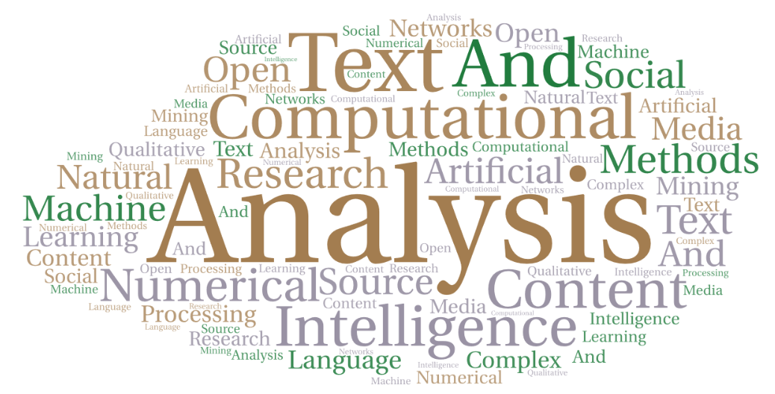
Online Harms: Research methods
Some ways we can help external organisations:
Identification and prediction of harms
Developing Novel, Effective Technical, Regulatory and Policy Interventions to combat the spread of online harms
Analysing the efficacy and impact of technical and policy interventions
Understanding the spread of misinformation and disinformation
Evidencing the impact of online harms (online-offline interactions)
Advising on regulatory changes
Include: Computational Text Analysis Content analysis Numerical and Computational research methods Artificial Intelligence/machine learning | Natural Language Processing Open-Source Intelligence Complex networks Social media mining Qualitative Analysis

Slide 5
Digital Societies – ONLINE HARMS – Core Research Areas
Terrorism, Extremism and Radicalisation
Environmental Misinformation and Disinformation
Health and Wellbeing
Impact on Political and Social Cohesion
Safer Internet for Children
New Methods to analyse online information
Regulatory/Policy Interventions development
Technical Interventions Development
Interventions efficacy evaluations
Cogitative Bias influence
Online identify formation
Offline/Online Interactions
Evaluating ethics of interventions
Misinformation and Disinformation

Slide 6
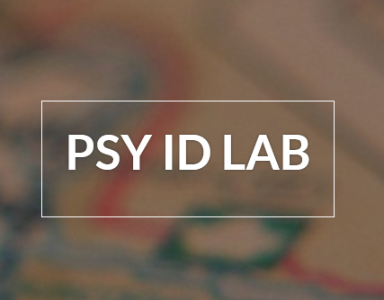
Digital Societies: ONLINE HARMS - Computational Social Science Research Groups
The University of Exeter is home to several established research groups across our Computer Science, Politics, Sociology and Psychology Disciplines, conducting research and developing new methods to explore the impact of online harms and effective interventions
Image
Image
Image
Image
Image
Q-STEP
Centre of Advanced International Studies
The CC Lab
The PsyID Lab
CogNosco Lab
About: Exeter’s Q-Step Centre brings together international research-focused social scientists. Q-Step research takes an interdisciplinary and data-driven focus to address major societal challenges. We are focused on the three themes of connecting people, society and data. Led by Prof. Susan Banducci and Prof. Travis Coan, q-Step Centre has a total 17 core research staff across a number of disciplines including Politics, Sociology, International Relations and Criminology as well as over 20 affiliated staff and several industry partners.
W: http://socialsciences.exeter.ac.uk/q-step/projects/
About: The CogNosco Lab focuses on next-generation models for understanding cognition through data science, AI and complex networks. Our multilayer cognitive networks unveil predictive and quantitative patterns in fields like language learning, mindset reconstruction, clinical impairments and knowledge modelling in online systems.
Based in the Computer Science Department, the group is led by Dr. Massimo Stella.
W: Http://cognoscoexeter.compscicons.net/
About: The Centre for Advanced International Studies (CAIS) has developed one of the UK’s leading International Relations programmes, inc. teaching and research around international security, IR theories, foreign policy, conflict analysis, globalisation and resistance.
W:https://socialsciences.exeter.ac.uk/politics/research/centres/cais/
About: The CC Lab studies the evolution of information – how media in today’s digital age shapes our beliefs about the world in new and increasingly complex ways. The CC Lab develops computational tools to study how information is organised, used, misused and its effects, by combining strong expertise in data science, mathematically modelling and complex systems with evolutionary biology, cultural sociology and social psychology.
W: https://cclab.science/
About: The PsyID lab uses a multi-method approach, with computational analyses of naturally occurring (online) data, experiments and surveys, to understand how social identities develop, interact and are expressed in the online world.
Based in the Psychology Department, the Group is led by Dr Miriam Koschate-Reis.
W: https://blogs.exeter.ac.uk/identitrack/

Slide 7
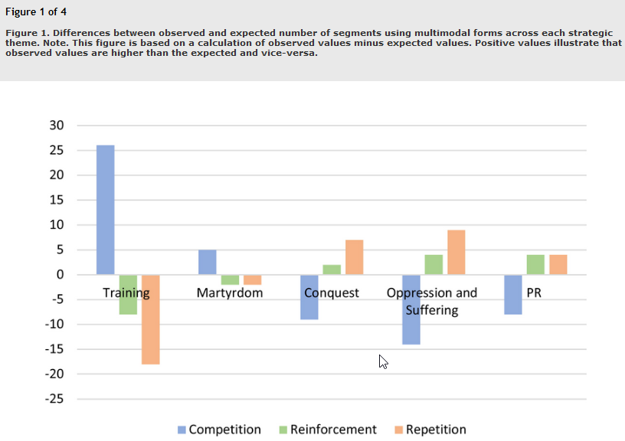
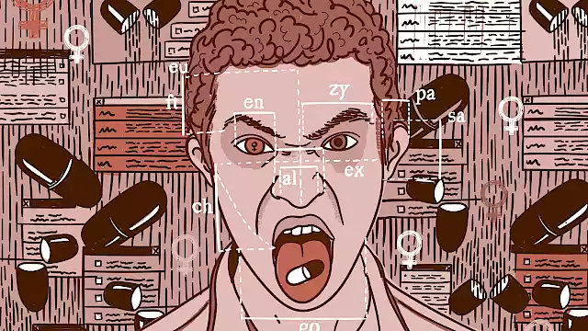
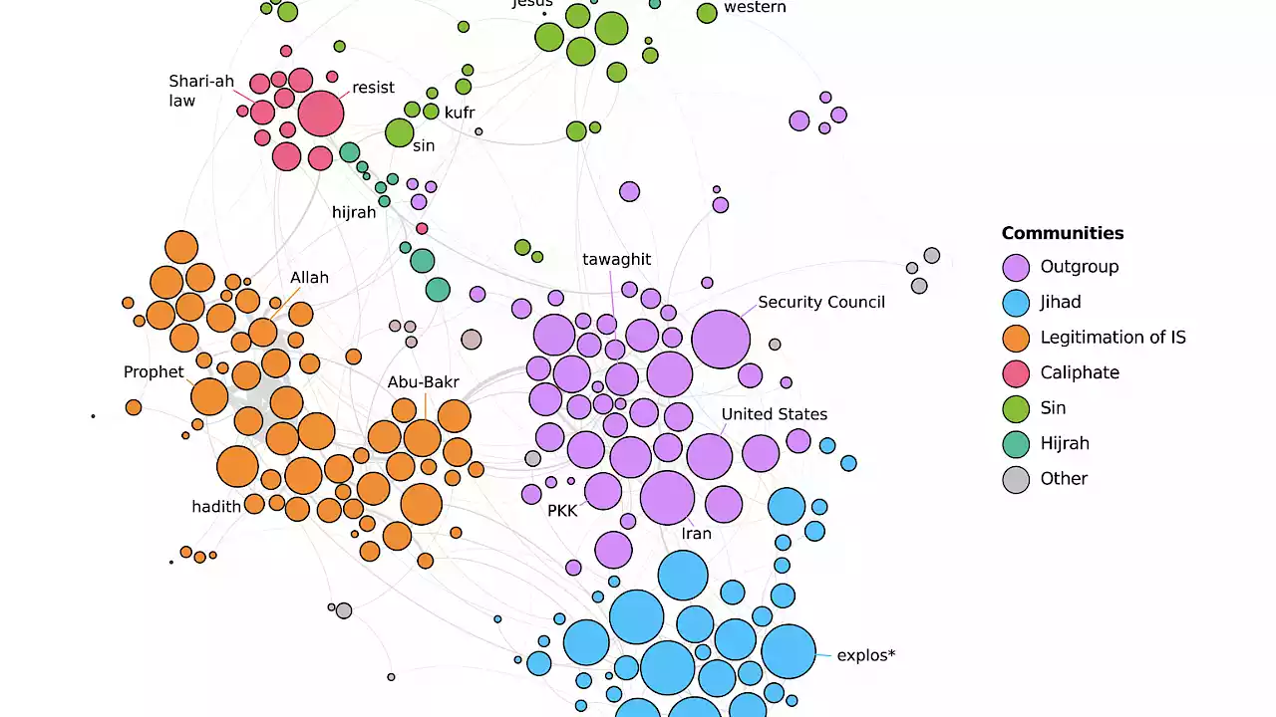
Digital Societies – ONLINE HARMS: Terrorism, Extremism and Radicalisation
Studying the spread and drivers for online terrorist and extremist content and its contribution towards radicalisation
Image
Image
Image
Image
How does ISIS’ online propaganda demonstrate mechanisms of radicalisation?
Deep Analysis of Taliban Videos
Con.Cel: Tracking the online contagion of Incel and male supremacist ideology
Mining The Chans
Lead: Weeda Mehran Co-Leads: Umniah Al Bayati, Matthew Mottet & Anthony F. Lemieux
Sponsor: Minerva Research Initiative of the U.S. Department of Defense
About: This paper first identifies and analyzes five predominant strategic themes in Taliban videos: martyrdom, military training, military conquest, oppression and suffering, and public relations (e.g. distribution of aid to local populations, engaging with local communities). The findings point to differential use of sonic and visual forms and multimodal techniques across these five themes, pointing to strategic decisions made by the group in choosing particular techniques and forms to amplify specific strategic themes.
Lead: Dr Lewys Brace, Co-Ieads: Dr Stephane Baele (UoE), Dr Debbie Ging (Dublin City University)
Funding awarded: £96,000
Sponsor(s): Centre for Research and Evidence on Security Threats (CREST)
About: The Con.Cel project focuses on the InCel ideology, a misogynistic worldview whose proponents blame women for their lack of sexual activity, and the “Incelosphere”, a loose conglomerate of online InCel communities spread across various digital platforms.
Leads: Dr Stephane Baele, Co-Leads: Dr Katharine Boyd, Dr Travis Coan
Funding awarded: £ 150,000 (Sept .2016-17)
Sponsor(s): CREST – ESRC
About: This research sought to identify how ISIS’ online propaganda demonstrates the dynamics of radicalisation by conducting a large-scale, computer-assisted analysis of ISIS’ online content—both video- and text-based—and by linking the results of this narrative structure to the cognitive dynamics theorized to play a role in individual’s commitment to political extremism and violence.
Lead: Dr Stephane Baele, co-leads: Dr Lewys Brace, Dr Travis Coan
Research partners: UK Home Office (OSCT)
Funding awarded: £ 7,000
Sponsor(s): CREST
About: The MineChans project seeks to expose and analyse the visual and linguistic practices of two image-boards (4Chan/pol, 8Chan) that play a central role in the emergence and cementing of a new transnational far-right subculture linked to several recent instances of terrorism.

Slide 8
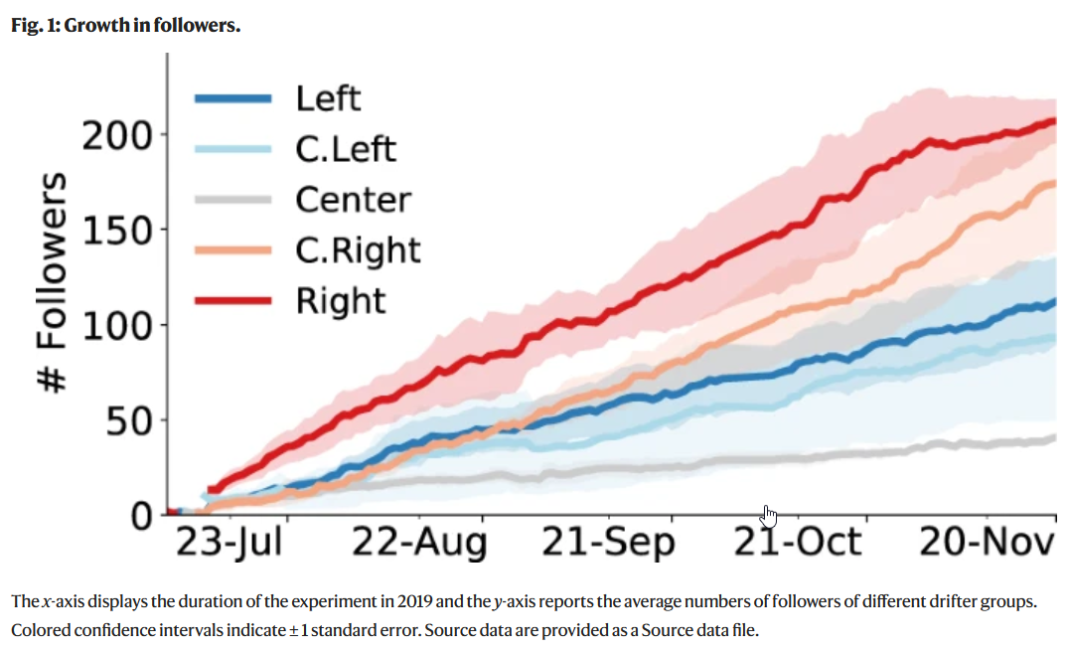
Digital Societies – ONLINE HARMS: Combatting Misinformation and Disinformation and Understanding Cogitative Bias
Combatting the spread of misinformation and disinformation requires a multipronged approach. At the University of Exeter we are investigating and challenging algorithms which encourage the sharing of misinformation; increasing understanding of what makes us susceptible to sharing misinformation, and designing and evaluating the efficacy of new technical interventions to reduce the spread of ‘fake news’
Image
Image
Social Media, Cognitive Reflection, and Combating Misinformation
Using Social Media Analysis and Complex Networks to combat misinformation and in authentic behaviour online
Computer-assisted classification of contrarian claims about climate change
User-generated corrections of misinformation on social media.
Leads: M. Mosleh, Co-Leads: G. Pennycook, A Arechar, and D.G. Rand, Z. Epistein*, A. Arechar, D. Eckles, and D.G. Rand
About: Dr Mosleh et al devised a hybrid lab-field setup on Twitter to investigate how individual differences in cognitive style–the tendency to rely on intuitive gut responses versus engaging in careful analytic thinking– relate to behavior on the social media platform. They also designed an online experiment to prime users to use analytical thinking to improve the quality of content subsequently shared by them.
Publication: “Shifting attention to accuracy can reduce misinformation online” Nature, 2021
Lead: Mohsen Mosleh.
About: How can online communication most effectively respond to misinformation posted on social media? To shed more light on how correction style affects users' willingness to correct information, researchers looked at different correction styles to determine what worked and what didn't. The results help elucidate the efficacy of user-generated corrections of misinformation on social media. Publication: You’re Definitely Wrong, Maybe: Correction Style Has Minimal Effect on Corrections of Misinformation Online
Lead: Wen Chen (from Observatory On social media), Co-lead: Diogo Pacheco (UoE), Kai-Cheng Yang & Filippo Menczer
About: In this study, we aim to reveal biases in the news and information to which people are exposed in social media ecosystems. We are particularly interested in clarifying the role of social media interactions during the polarization process and the formation of echo chambers.
Publication: “Neutral bots probe political bias on social media” Nature Communications, 2021
Lead: Travis Coan (from QStep, Exeter)
About: This study found that the claims utilised by conservative think tanks and contrarian blogs have focused on attacking the integrity of climate science and scientists and, increasingly, has challenged climate policy and renewable energy. A comprehensive taxonomy of contrarian claims was developed that is sufficiently detailed to assist in monitoring and counteracting climate contrarianism. Publication: Computer-assisted classification of contrarian claims about climate change

Slide 9
Combatting Misinformation and Disinformation through challenging algorithmic transparency and bias
YouTube Regrets Reporter
Title: YouTube Regrets
Leads: Dr Chico Camargo, with >40 UoE Students
Sponsor: Mozilla Foundation
About: Working with Mozilla, the University of Exeter investigated the potentially harmful effects of videos suggested to people on YouTube. The campaign that inspired the development of Regrets Reporter was cited in the European Commission’s impact assessment for its proposal of a Digital Services Act
Web: https://foundation.mozilla.org/en/youtube/findings/

Slide 10
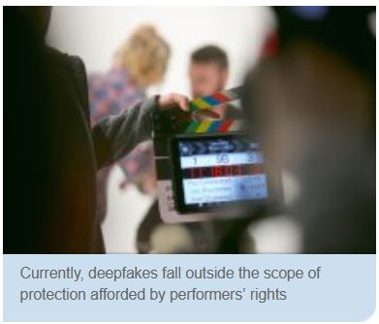
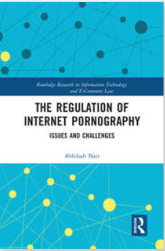
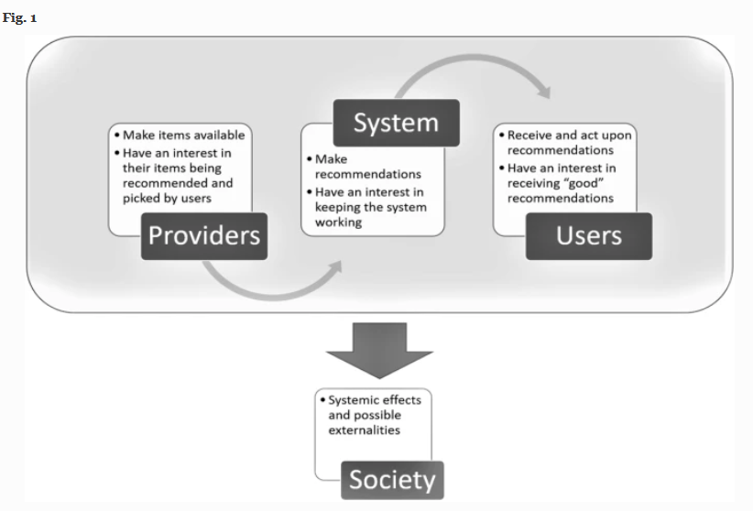
Digital Societies - Online Harms: Regulation, Governance and Ethics
Exeter is home to several academics in across our departments of law and ethics researching aspects related to the regulation and ethics of emerging online technologies.
Rebalancing our regulatory response to Deepfakes with performers’ rights (2021).
Regulatory Responses to ‘Fake News’ and Freedom of Expression Evaluation
Combatting Online Child Sexual Exploitation through Content Regulation
Recommender Systems and their Ethical Challenges
Leads: Professor Rebecca K Helm and Professor Hitoshi Nasu
About: National authorities have responded with different regulatory solutions in attempts to minimise the adverse impact of fake news and associated information disorder. This article reviews three different regulatory approaches that have emerged in recent years— information correction, content removal or blocking, and criminal sanctions—and critically evaluates their normative compliance with the applicable rules of international human rights law and their likely effectiveness based on an evidence-based psychological analysis
Lead: Professor Abhilash Nair’s principal area of expertise is internet law, with specific reference to combating online child sexual exploitation, online child safety, and content regulation online. He has published widely on internet law and his book, 'The Regulation of Internet Pornography: Issues and Challenges‘. Prof. Nair’s current research focuses on the issue of regulating internet pornography generally, and the protection of children in this context. He has also researched other associated areas within internet law, including online gambling regulation from a child and young people protection perspective, copyright on the internet, and child safety and privacy on social media and networking sites.
Lead: Dr Silvia Milano is a Lecturer in Philosophy of Data and Data Ethics in the SPA Department and Egenis centre at the University of Exeter. interests lie primarily in epistemology, ethics, and intersections between the two, especially in connection with Artificial Intelligence. Dr Milano's current research investigates epistemological and ethical issues relating to recommender systems.
You can find more on her past and current projects on her Research page.
Lead: Dr Mathilde Pavis
About: Dr Mathilde Pavis (Senior Lecturer in Law) Mathilde Pavis is an expert on intellectual property law, with a focus on copyright, performers’ rights, and their intersections with new technologies. Her more recent work investigates the legal protection of people’s voice, face, body and likeness in light of AI-driven ‘deepfake’ technology.

Slide 11
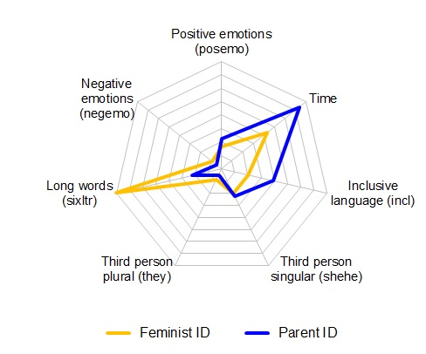
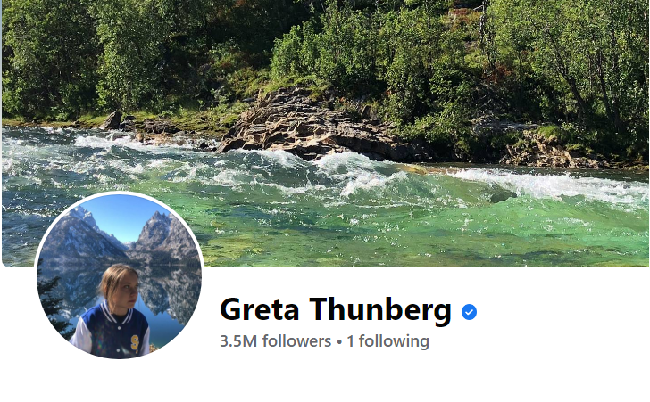
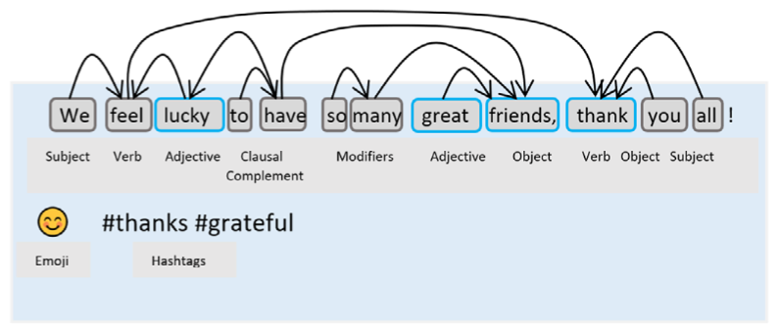
Digital Societies – Online Harms: Identify, Cognition, Psychology
Exeter conducts world-leading research to better understand the cognition and psychology underlying people’s behaviour online
Image
Image
Psychological Identity in a Digital World
Understanding Online Social Cognitions
Shifting attention
Tackling Cyberbullying
Lead: Dr Massimo Stella (2021)
About: This work outlines how cognitive network science can open new, quantitative ways for understanding cognition through online media like: (i) reconstructing how users semantically and emotionally frame events with contextual knowledge unavailable to machine learning, (ii) investigating conceptual salience/prominence through knowledge structure in social discourse; (iii) studying users’ personality traits like openness-to-experience, curiosity, and creativity through language in posts; (iv) bridging cognitive/emotional content and social dynamics via multilayer networks comparing the mindsets of influencers and followers. Publication: Cognitive network science for understanding online social cognitions: A brief review - M. Stella, Topics in Cognitive Science (2021):
Lead: Dr Mohsen Mosleh
About: Simple interventions to reduce the spread of misinformation could shift attention towards accuracy and help social media users become more discerning about what they share. Dr MosleAdvance HEh research concerns how information and misinformation spread on social media, collective decision-making, and cooperation. The findings have implications for how social media companies can stem the flow of misinformation.
Publication: Shifting attention to accuracy can reduce misinformation online
Lead: Dr David Lopez
About: Greta Thunberg, a seventeen-year-old teenager has risen as a prominent public figure spearheading the climate change movement worldwide. Unfortunately, Greta has been subject to unacceptable abuse on social media platforms even by prominent citizens. The use case of Greta Thunberg exposes the urgency and relevance of protecting citizens online. Further analysis was conducted on the toxicity of cyberbullying on Twitter within UK Poltics. The research exposes the urgency and relevance of protecting citizens online. The results of our analysis provide arguments supporting the use of Artificial Intelligence to monitor abusive behaviour online.Mitigating Online Harms at speed & scale
Lead: Dr Miriam Koschate-Reis
About: The PsyID lab uses a multi-method approach, with computational analyses of naturally occurring (online) data, experiments and surveys, to understand how social identities develop, interact and are expressed in the online world. Detecting shifts allows social scientists to learn more about the development and impact of social identities in natural social contexts in applied areas such as organizations, healthcare, marketing or security.
Publication: Predicting a Salient Social Identity from Linguistic Style. M Koschate-Reis et al.

Slide 12
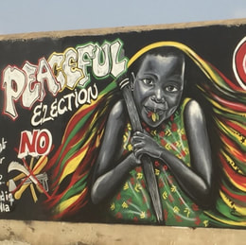
Digital Societies – ONLINE HARMS: Political Impacts
Blub
Image
Electoral Misinformation on Social Media in Low Digital Literacy Environments
The Distorting Prism of Social Media
Nudging Away False News
Understanding Social Media Echo Chambers
Lead: Prof Jason Reifler
About: Less is known about how selection into commenting behaviour and exposure to other people’s comments changes the tone and content of political discourse. The research raised many points and has added to a small but growing body of evidence illustrating how algorithms optimized to boost engagement can contribute to toxic environments on social media. Online discussion could amplify extreme views that very few citizens share, or it could centre on particular topics in which most people are not interested. Publication: The Distorting Prism of Social Media: How Self-Selection and Exposure to Incivility Fuel Online Comment Toxicity
Lead: Dr Simge Andi.
About: False news has the potential to misinform voters and alter voting behaviour in ways that threaten democratic institutions. A behavioural approach described as "social norm-based nudges" can help address this issue by changing the sharing behaviour of social media users. Dr Andi's work has shown that presenting users with a message warning them about inaccurate news decreased the proportion of people willing to share the article by 5.1 percentage points, with a 46.7% increase in the proportion of respondents stating that they do not want to share the article because it is false or inaccurate. Publication: Nudging Away False News:Evidence from a Social Norms Experiment
Lead: Prof Hywel Williams
About: The research focus was to understand Twitter sharing behaviour around the issue of climate change. At the highest level, there is polarisation and segregation with a large left-wing/environmentalist grouping and a smaller right-wing/sceptic grouping clearly visible in the sharing network. This work demonstrates that media communication of information around climate change faces many challenges in the age of social media. Users return to the same trusted sources for information. Understanding how these trusted ties form will be key to combating the spread of misinformation that currently challenges online social networks and vital for promoting action on climate change and other societal challenges.
Publication: Ideological biases in social sharing of online information about climate change
Lead: Dr Elena Gadjanova
About: The project sought to examine what effects does social media have for electoral politics in Africa. Broader questions as to whether social media contributes to a more fragmented political discourse, whether the enhanced opportunities for micro-targeting are leading to an increased personalization of politics, and the extent to which social media groups are conducive to the survival of diverse political opinions in plural societies. Publication: Competitive Elections, Status Anxieties, and the Relative Strength of Ethnic versus National Identification in Africa. Political Behavior

Slide 13
How we can work with you
Collaborations
Organisation – Your needs
Consultancy
Student Projects
Centres for Doctoral Training
Knowledge Transfer Partnerships
Training & CPD
Co-funded Studentships
Degree Apprenticeships
Industry-led Roadmapping
We work with many companies from large multi national corporations to SMEs, and we have the flexibility and agility to partner each business to their requirements…
Notes:
Significant growth
Over 500 degree apprentices – MBA, Digital and Tech Solutions, Research lab training
Aiming for 10% of total students

Slide 14
Contact Us:
Kitty Adhamy-Nichol
Impact and Partnership Development Manager, Advanced Engineering / AI in Society
Email: K.Nichol@Exeter.ac.uk
Tel: 07771438908

