Slide 1
SPECIAL COLLECTIONS FOR RESEARCH Books…. Archives… Support!
Notes:
Introductions
C Faunch, head of Heritage Collections ecompassing the Special Collections, the Cinema Museum (colleague PW will discuss) and Art and Sculpture collections)
Special collections is based in the Old Library
Own dedicated reading room open 5 days per week
Today’s focus, rare books and archives – collectively the Special Collections
We have c.100,000 books and over 400 archives - specialism in collections relating to the south west
we support both postgraduate and undergraduate projects and research
small team of dedicated and knowledgeable staff

Slide 2
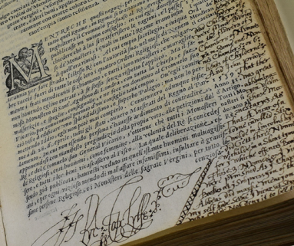
Rare Book Collections – pre 19th century
Library Rare Books collection
Significant Devon historic parish libraries collection
Syon Abbey Medieval manuscripts and
Historic Library
A L Rowse library
Historic Libraries
Copy of Girolamo Pollini’s L'historia ecclesiastica della Rivoluzion d'Inghilterra..., from the library of A.L. Rowse; … signature of Richard Topcliffe
Syon Abbey – leaf from 16th Century “Dutch Missale” EUL MS 262

Slide 3
Rare Book Collections: 19th-20th Centuries
John Betjeman’s working library (poetry, architecture, religion, fine bindings)
Professor Chris Brooks’ library (fiction, architecture, Gothic Revival)
Hypatia collection books by and about women
Libraries
Notes:
Library collections relating to themes and Institutions Particular strengths in Victorian and early 20th century, women’s writing religious collections – parish libraries.
Hypatia Library of books and materials by and about women – over 5000 books, mainly 19th and 20th century occupations, politics, etiquette, fashion, travel, cooking, etc.,
Small but significant collection of anti-apartheid pamphlets and materials
Chris Brooks library of 19th and early 20th-century books, nearly 10,0000 books mainly 19th and early twentieth century. Both excellent resources for popular fiction, periodicals and publications which shed light on gender, imperialism, youth “culture” and the home -
We also have a rare books collection and a reserve book collection – valuable, rare or vulnerable individual items
All catalogued on the University’s library catalogue and available for research.

Slide 4
Writer’s book collections include:
Sir John Betjeman’s working library; Charles Causley’s library and books from the libraries of AL Rowse and Ronald Duncan
Writers’ Book Collections/Libraries

Slide 5
Ephemeral printed and archive collections:
Printed Materials
Both printed and archive collections relating to Middle East collections and UK pressure groups - the Anti-Apartheid national and local Anti-Apartheid campaigns in the UK, 1970s-1990s (also includes archive materials (EUL MS 216)

Slide 6
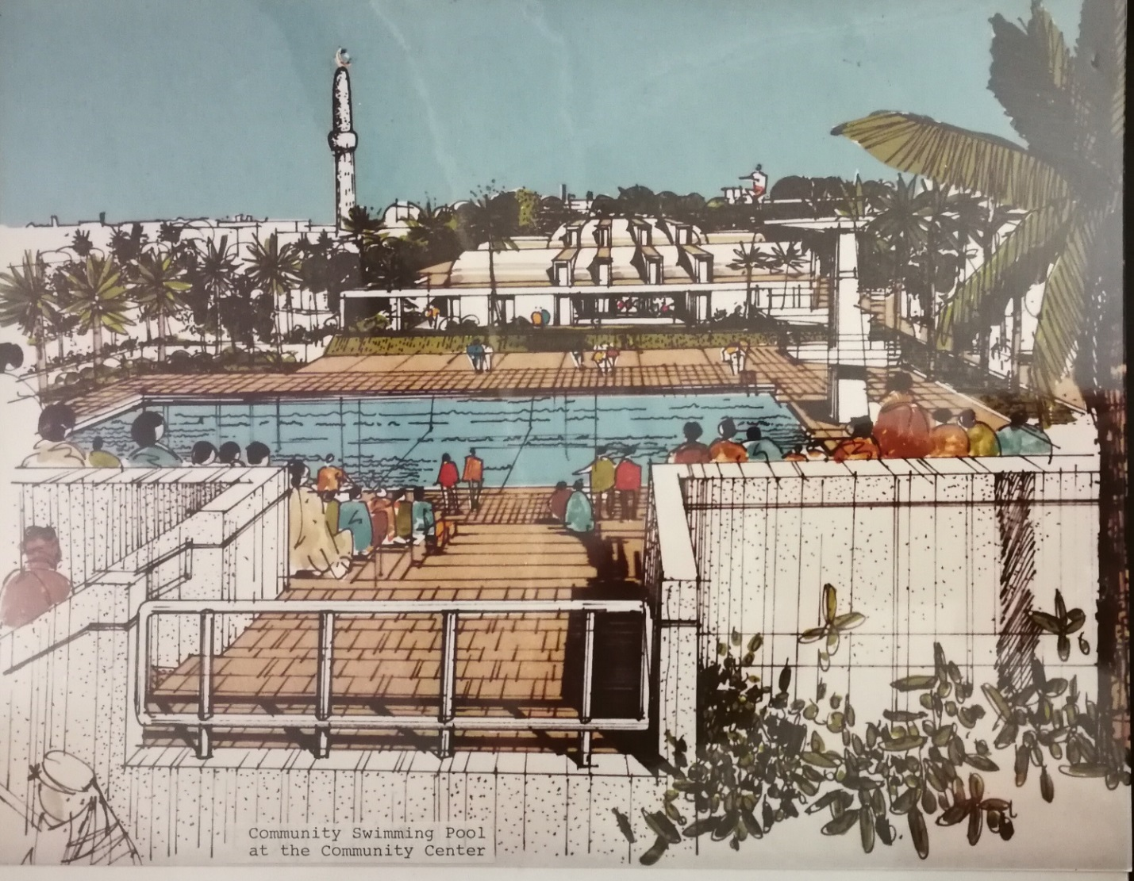
Over 30 archives relating to Middle East and Politics
Strengths: Relationship between middle east and west, British involvement in the Middle East, culture, energy, resources and development, Kurdish identity and independence, pan-Arabism
ARCHIVES

Slide 7
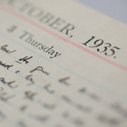
Individuals South West Writers and Artists in the Archive
Leonard Baskin
Patricia Beer
R D Blackmore
Arthur Caddick
Charles Causley
Agatha Christie
Jack Clemo
R F Delderfield
Ronald Duncan
Daphne du Maurier
John Fowles
James Farrar
William Golding
Ted Hughes
John Jarmain
Sylvia Kantaris
R J Lloyd
John Cooper Powys
Littleton Powys
Llewelyn Powys
A L Rowse
Lawrence Sail
Flora Thompson
Denton Welch
Henry Williamson
ARCHIVES

Slide 8
Du Maurier papers
We hold papers on:
Daphne du Maurier
Father, Gerald du Maurier,
Actor/Producer, in
West-End:
Alias Jimmy Valentine
Raffles
Grandfather, Georges du Maurier, author and illustrator, Trilby, The Martian
Du Mauriers

Slide 9
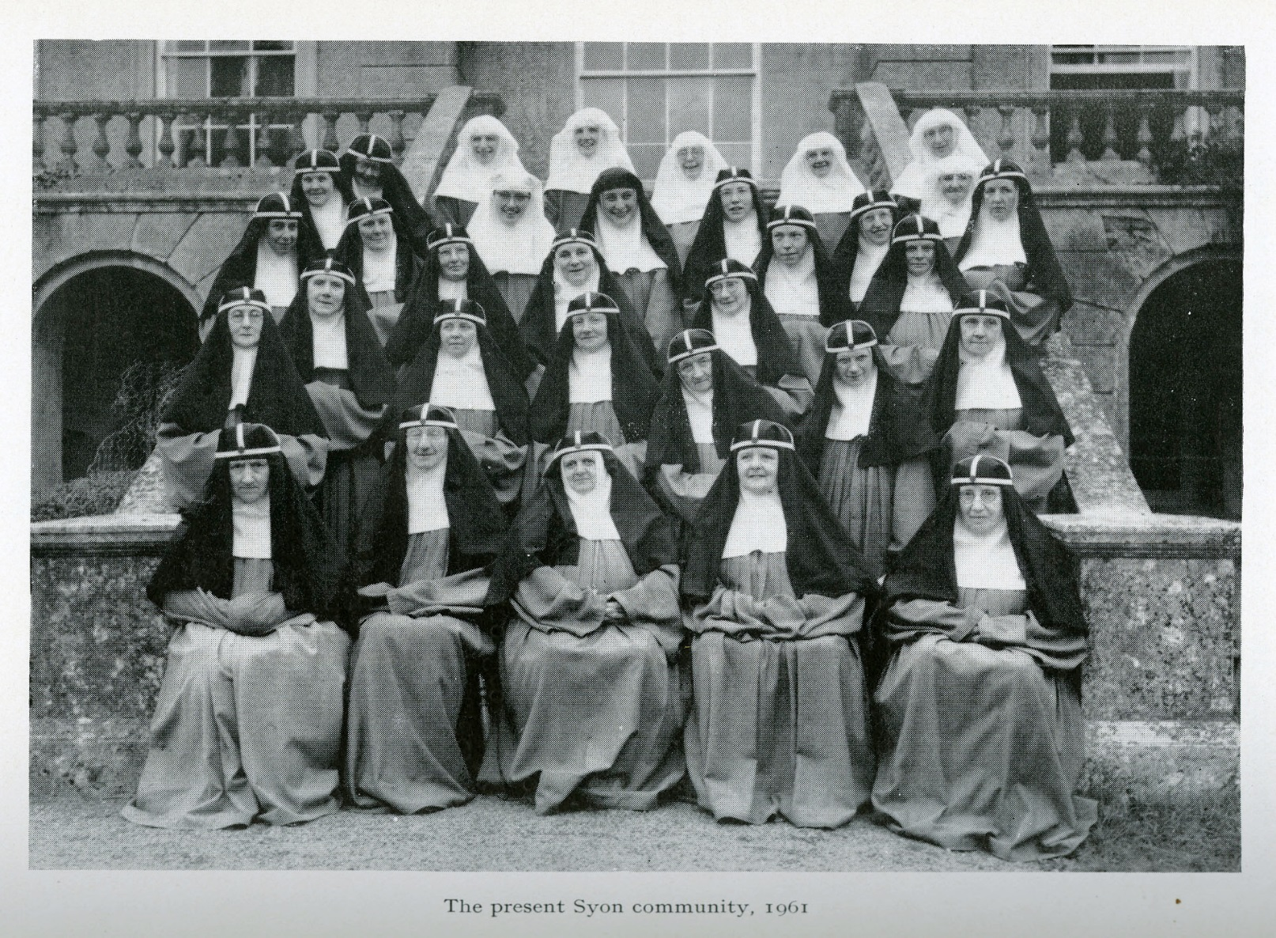
Organizations - Syon Abbey
Historic library archive of religious institution. Founded 1415 – closed 2011. Archive mainly later 18th century to present – newly catalogued and ready for research!
Strengths women’s studies and history, communities, diaries, social networks, place, identity
ARCHIVES
Notes:
Strengths: womens’ studies and history, communities of women, diaries/chronicles, social networks, place, identity

Slide 10
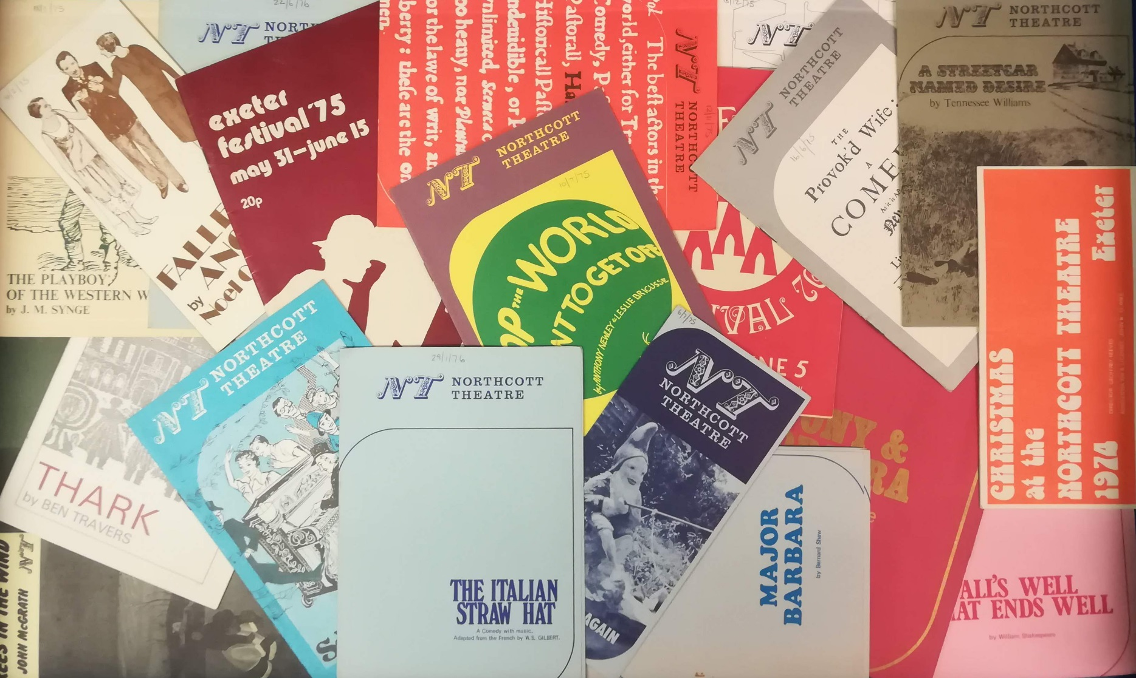
Organizations
Northcott Theatre archive
Strengths: set design and staging, censorship, regional repertory and regional sensibilities, publicity, criticism. Includes news cuttings relating to other theatres
ARCHIVES

Slide 11
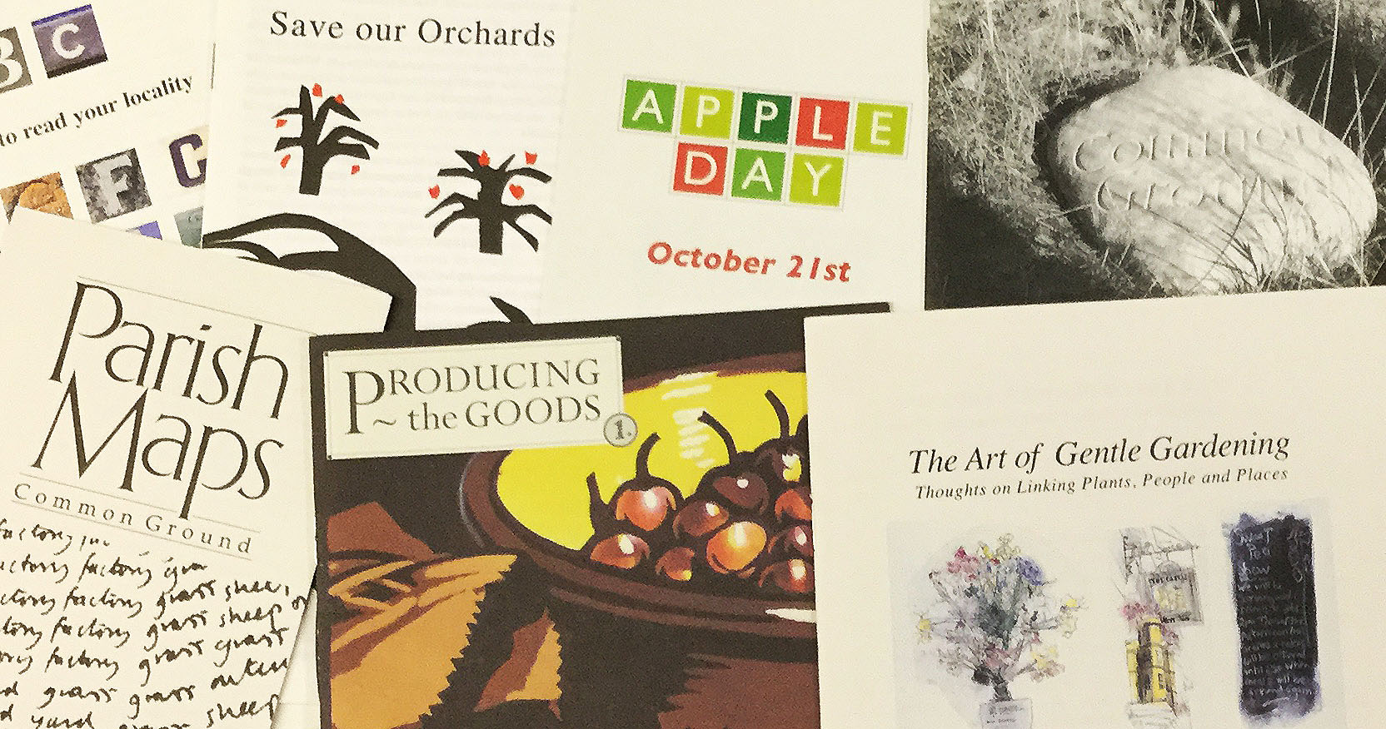
Organizations
Common Ground Archive – environmental activist organization.
Strengths: sense of place, sustainability, relationship between nature and culture, British landscape and culture, art, literature, custom and pastimes
ARCHIVES

Slide 12
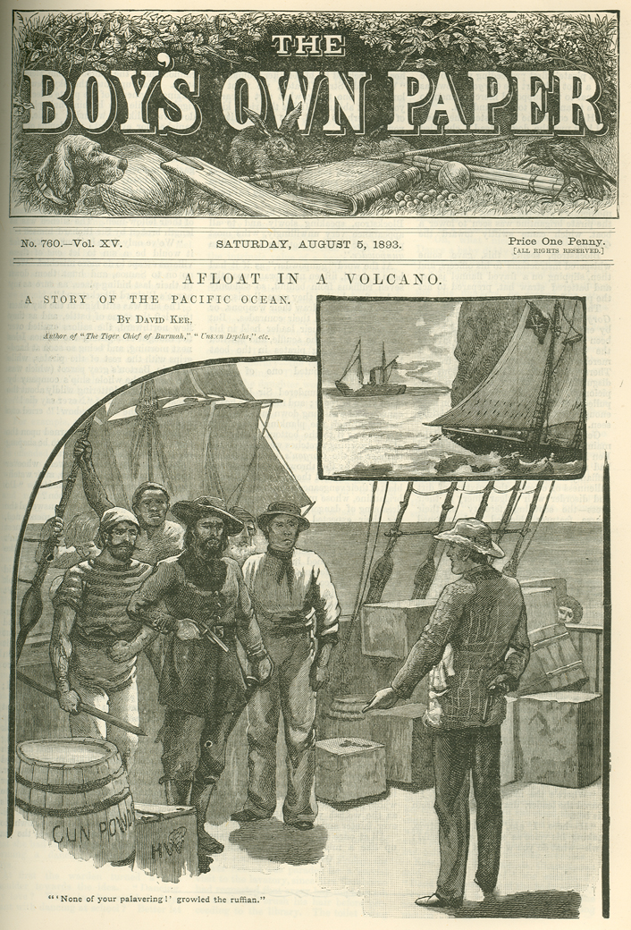
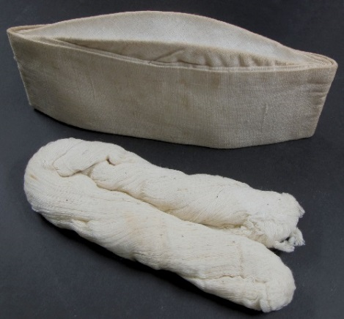
Why Use Special Collections at Exeter?
Left Page from Boys Own Paper, Chris Brooks book Collection
Right Cap and skein of cotton given to writer Ronald Duncan by Mahatma Gandhi. Ronald Duncan archive EUL MS 397
Collectively our resources are known as Unique and Distinctive collections of primary sources, contemporary resources, manuscripts and even the odd artefact. Many items are unique to Exeter.

Slide 13
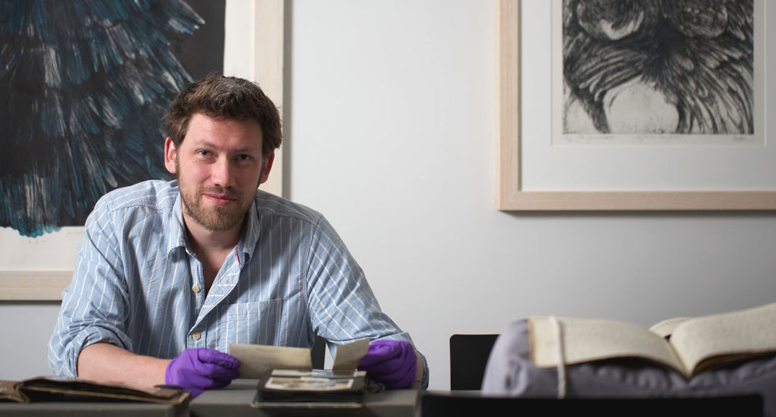
How else can we help you?
“Show and Tell” seminars and symposia (with Centre for Literature and Archives)
Research support 1:1s to discuss resources with archive professionals
Dedicated Special Collections Reading Room in Old Library – An oasis of calm for serious research.
Support

Slide 14
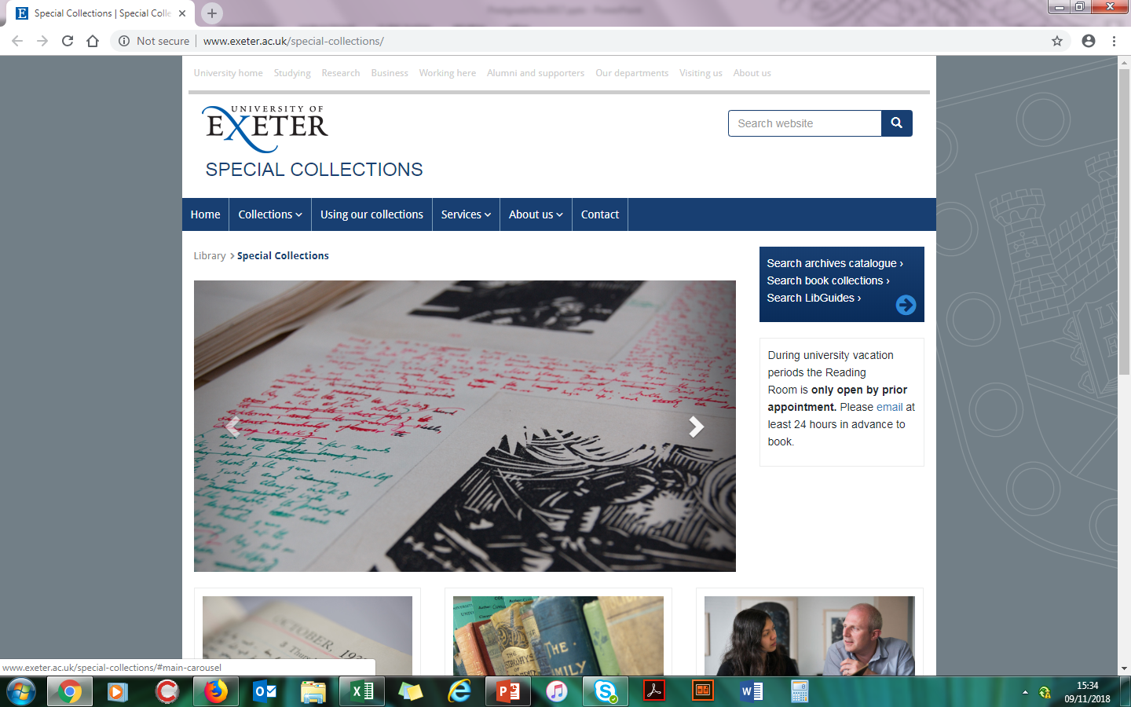
For more information
http://as.exeter.ac.uk/special-collections/collections/
Follow us on Twitter @UOEHeritageColl
Read our project blog at http://specialcollections.exeter.ac.uk/
Use our Libguide Archives
Cataloguing new resources

