Slide 1
v
Black Britons in the Civil Rights Era
Dan Appiah

Slide 2
Beyond the Civil Rights Movement
The importance of the American Civil Rights Movement in the emancipation of black people cannot be understated. However, while events in the USA garner overwhelming attention and coverage, what is often neglected are the struggles of black communities in Britain during the 50s and 60s.
What follows is a brief exploration of three events from Britain’s black history which offer a counterpoint to the more well-known American movement. Some contextual themes unique to Britain to keep in mind are:
The Windrush Generation and debates about immigration
Britain’s post-war economy and labour shortages.
Decolonisation of the British Empire
The US civil rights movement’s influence on black British communities
Mind map or write down few things you already know about the American Civil Rights movement and the above themes.

Slide 3
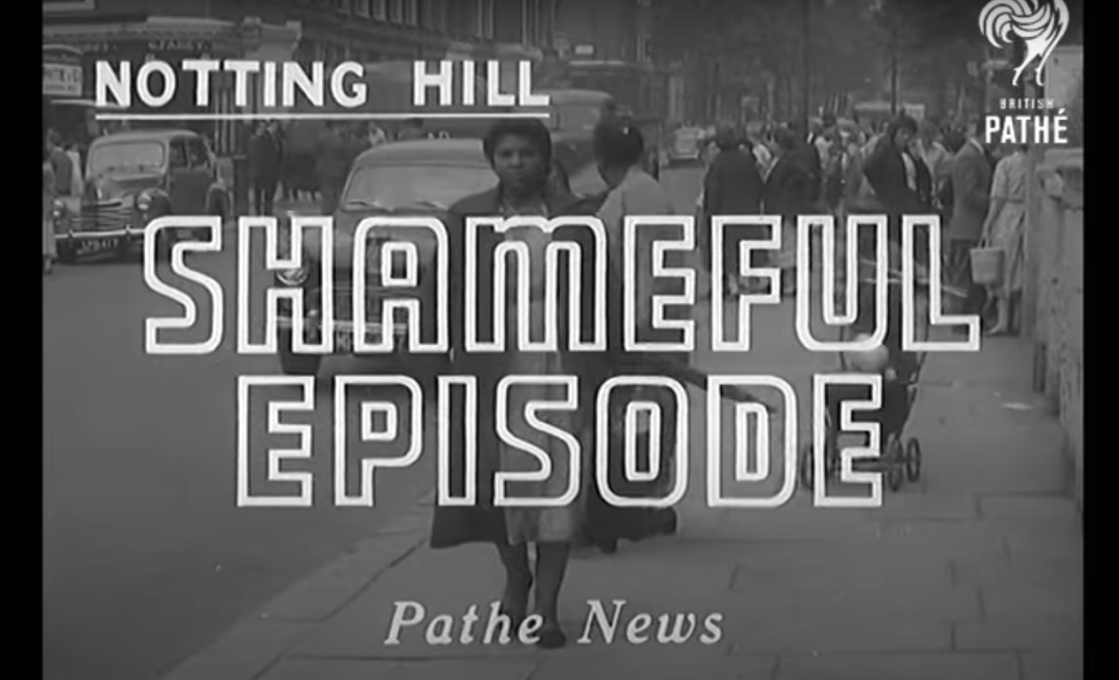
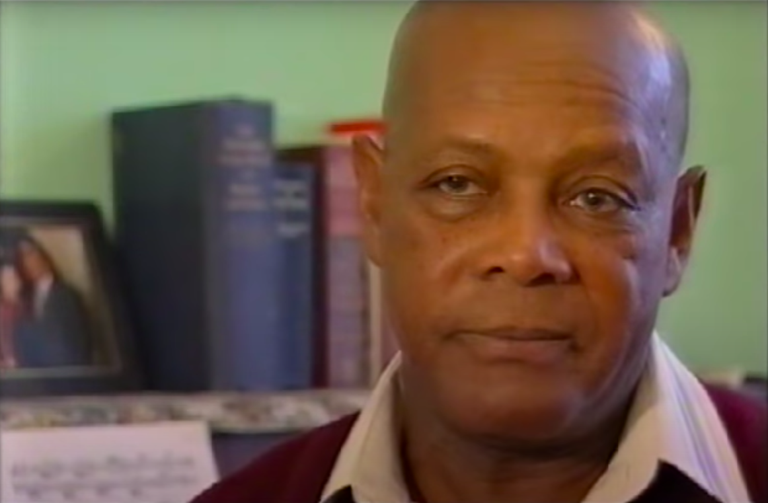
Notting Hill Race Riots, 1958
With the arrival of the SS Windrush ten years before, and an increase of immigration into the UK of West Indians and others people from British colonies, as well as newly independent ones, white political movements began to exploit working class prejudices and fears about black people. Although the government had encouraged immigration to make up for the labour shortage after the Second World War, many communities saw this as a threat to their jobs and to their local communities – particularly working class communities. This led to the race riots in Notting Hill and elsewhere in 1958.
‘Shameful Episode Aka Racial Riots (1958)’
https://www.youtube.com/watch?v=bzDItpuBcEg
‘Racist Riots of 1958 Notting Hill London England’
https://www.youtube.com/watch?v=LvhkOokRm-I

Slide 4
Discussion
  Why were residents of Notting Hill attacking black residents?
  What does the British Pathé report tell us about what people used to think about black immigrants?
  How did the black community react to the violence?
  How do the principles of self-defence and non-violence during the Notting Hill riots compare to what you know about the US civil rights movement?

Slide 5
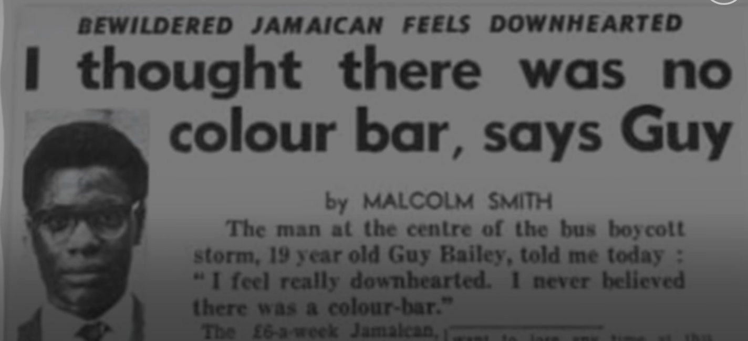
Bristol Bus Boycotts, 1963
While the British government in the years after the Second World War encouraged immigration from the colonies and newly independent countries of the British Empire to make up for labour shortages, many white communities and companies still refused to employ black people. One such example was the Bristol Omnibus Company. Despite the large number of black, minority, and ethnic people working on public transport in London and other English cities, Bristol buses continued to refuse employment to black people.
‘Bristol Bus Boycott: Remembering the First Black Bus Driver in Bristol’
https://www.youtube.com/watch?v=Nht6pyQFQ40

Slide 6
Discussion
How did the colour bar affect black people living in Britain in the 50s and 60s?
What reasons did white people give for not wanting black people driving or working on buses?
How were the Bristol Bus Boycotts similar/different to what you know about the American civil rights movement?
How do the Bristol Bus Boycotts compare to recent protests in Bristol about the city’s legacy of slavery?

Slide 7
Smethwick, 1964
Smethwick in the West Midlands was the site of an extremely racially charged political campaign during the 1964 election. It was here that Conservative candidate Peter Griffiths stood with the now infamous slogan “If you want a [n-word] for a neighbour, vote Liberal or Labour”. Griffiths managed to win the Smethwick constituency following years of animosity towards new black and minority residents in the predominantly white communities of Smethwick. So bad was the racism they faced that Malcolm X made a visit in one of his last public engagements before his assassination.
‘The UK street Malcolm X thought was ‘worse than US’ for racism’ – ITV News
https://www.youtube.com/watch?v=CFeGEi74Z5E

Slide 8
Discussion
How were the white residents of Marshall Street trying to discriminate against potential black residents?
What role did politics play in supporting their racism?
What impact did Malcolm X and the US civil rights movement have on the black community in Smethwick?
What problems of discrimination do black, minority, and ethnic people continue to face today?

