Slide 1

Online Open Day for the Doctoral Training Programme in Clinical Psychology (DClinPsy)

Slide 2




Doctorate in Clinical Psychology
Associate Professor Catherine Butler
Programme Director
Notes:
programme structure, support and appraisal systems,
the progression through the programme and what leads to programme failure,

Slide 3
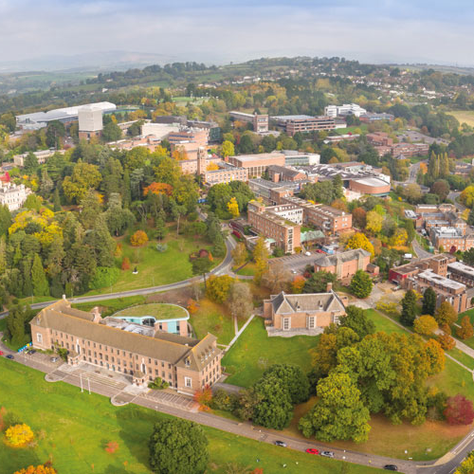
The University Of Exeter
A Russell Group University: 24 leading UK universities committed the very best research, an outstanding teaching and learning experience, and unrivalled links with business and the public sector
25,000 students from over 130 countries
We have always been among the leaders for student satisfaction in the National Student Survey
We won GOLD on the Teaching Excellence Framework (TEF)
Number 1 sports university in the South of England and Wales and consistently finish top 10 in the British Universities and Colleges Sport (BUCS) rankings each year

Slide 4

Psychology Department
One of the foremost Psychology departments in the UK; listed within the top 100 Psychology departments in the world
85% of our research is classified as world-leading or internationally-excellent
Our world-renowned academics work in partnerships with large multinational organisations including Microsoft, IBM, the NHS, etc.

Slide 5
DPGR Portfolio
  Clinical Associate in Psychology: Degree Apprenticeship
  Doctorate in Clinical Research
  Doctorate in Psychodynamic/Psychoanalytic Psychotherapy Clinical Practice
  Doctorate in Clinical Practice (Research)
  Coming soon … Doctorate in Forensic Psychology

Slide 6
What makes the DClinPsy at Exeter unique
You create your individual learning pathway: specialise in either CBT, Systemic or CAT
Everyone completes the Systemic Foundation in Year 1, you then opt into secondary accreditation by BABCP, AFT or ACAT (or none)
Experienced Research supervisors of both quantitative and qualitative methodology
Cutting edge focus on EDI and sustainability
Large part time staff team with a wide range of experience
A diverse range of placement opportunities in some of the most beautiful places in the UK – Devon, Dorset and Somerset
We will help you reach your potential to make a difference in your chosen clinical field and become a future leader in Clinical Psychology
We have an active Lived Experience Group whom we work closely with

Slide 7

DClinPsy Internationalisation
Since 2018, the DClinPsy at Exeter has been training international trainees. Currently 5 International DClinPsy students from across the world (India, Saudi Arabia, Singapore, Jordan, Spain)
We are keen to internationalise the Programme as we see many benefits pedagogically, and also in terms of research and impact
Our DClinPsy staff have many excellent relationships with international colleagues from across the world

Slide 8
EDI is at our core
Positive Action in our trainee recruitment
We run 2 mentoring schemes for those from the global majority: aspiring clinical psychologists (BREAKING THROUGH) and those already in training (ASPIRE)
We provide anti-racism training to our NHS supervisors
We provide training to our internal and external lecturers on decolonization, working in partnership with Experts by Experience in teaching, and offer guidance on creating inclusive classrooms
Our trainees run a Disability Peer Network
Check out our soon to be launched EDI website

Slide 9
How we support you
Every trainee has an assigned line manager and trainee buddy from a higher year
Each cohort has a Year Cohort Tutor who meets termly for cohort related issues
Every trainee has a clinical tutor who works with them through their placement journey
Every trainee has 2 research supervisors assigned to their main research project and quality improvement project
Members of the senior management team (programme/academic/research/clinical directors) are available if you feel you need to escalate anything
We work closely with the University’s Accessibility team to ensure that all your learning needs are met

Slide 10
Importance of the student voice
We have two trainee reps from each year on each of our committees: Joint Training Committee; Curriculum; Selection; Placement; PGRLF; EDI
Each teaching strand has a ‘link trainee’ in each cohort
We collect teaching feedback after every session and analyze this every term
We collect feedback on placements and the research journey through anonymous surveys
We conduct an annual anonymous Equity Impact Survey

Slide 11

Apply to DClinPsy at Exeter. You have the skill, talent & discipline to benefit from it!
Training at Exeter has been a wonderful experience - it has given me the opportunity to cultivate knowledge and clinical skills to develop into an authentic practitioner. My practice has been enhanced through the opportunity to develop knowledge of different models and application of these to clinical work. The staff are supportive and flexible. They create a friendly environment in which they challenge and encourage me to meet professional goals.

