Slide 1
v
Emotive language in Poetry and Spoken word with
Focus on African poets and spoken word speakers

Slide 2
Learning outcomes
To understand the purpose of story telling, poetry and spoken word in African culture
To be able to recognize emotive language and it’s uses in poetry and spoken word.
To be able to identify the importance of voice, audience and purpose in poetry and spoken word.
To be able to identify emotive language in given examples.
Write your own creative pieces.
Share and perform your creative pieces.

Slide 3
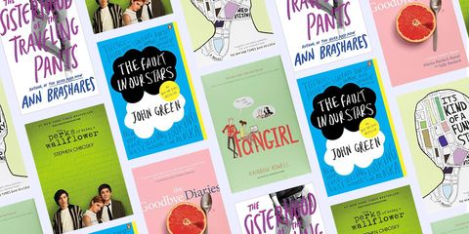
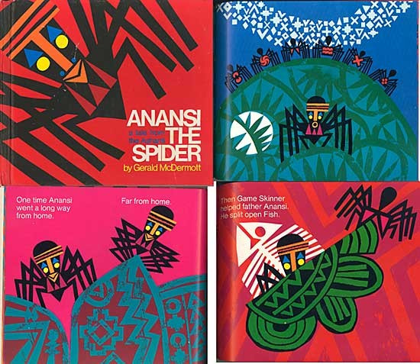
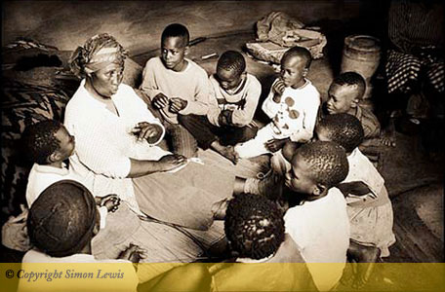

The role of Storytelling
Notes:
What methods of storytelling can you think off? What is the purpose of storytelling ? And what stories could you retell of the back of your head ? Out of all the examples you’ve said did any of you mention your own life story?
Storytelling has always played a fundamental role in African culture dating centuries back. Apart from the beautiful descriptions and the tone it sets, it’s the oral traditions of the Elders passing it on the younger generation that carried weight in sharing life lessons, history and advice from one to another this is how beliefs and traditions could be continued, it is how many could understand and learn their roots and where they came from. This fact was particularly important during the slave trade and colonial era when black culture was being stripped away from people. Story telling wasn’t just about a bedtime story but recording the memories that time can wash away. These stories often build the foundation of what many children know, for example many Ghanaian children are pretty much raised on ‘Ananse spider’ stories which all carry a moral to the story in teaching them what is right and wrong.
However, it isn’t only through what the story entails but how the story is told which guides us onto the lesson theme.

Slide 4
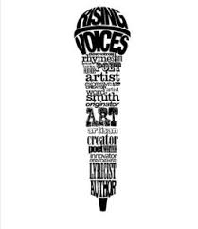
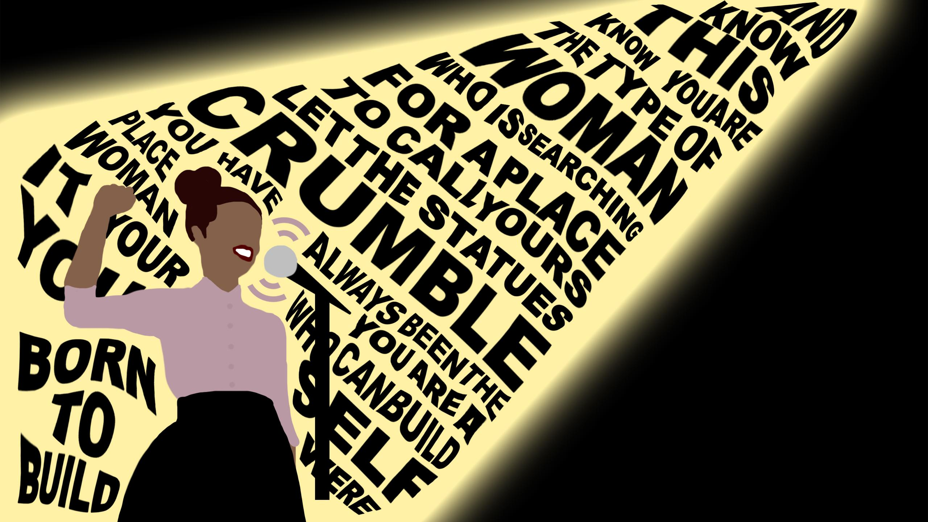
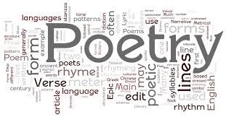
Poetry and Spoken Word
Notes:
The use of poetry and spoken word was born out of the storytelling style, as it became an experience, in order to keep stories alive and interesting the storyteller and the audience would interact, especially because stories were told more than once so the audience would know how and when to react or respond. So, with everyone sitting around listening, and participating in stories and reflections of morals, beliefs, and myths, a harmonious interaction would begin.
What is it about stories or poems that make them memorable to you ?
We will go over a few techniques during this lesson but the main two characteristics that are used are Repetition – either of words or and the rhythm. Repetition makes the stories easy to understand and recall from memory.
Poetry allows a story to be shortly packaged but in a way that still evokes the same emotions and feelings, additionally taking you on the same journey but more efficiently, it makes you feel something. Which is why when performed, poets could just like with storytelling tell a story through the few lines they have, using gestures and their voices to create a story from a poem. Spoken word has a purpose and speakers get to share their beliefs, stand for what matters to them or share a piece of their lives with the audience all methods of storytelling.

Slide 5
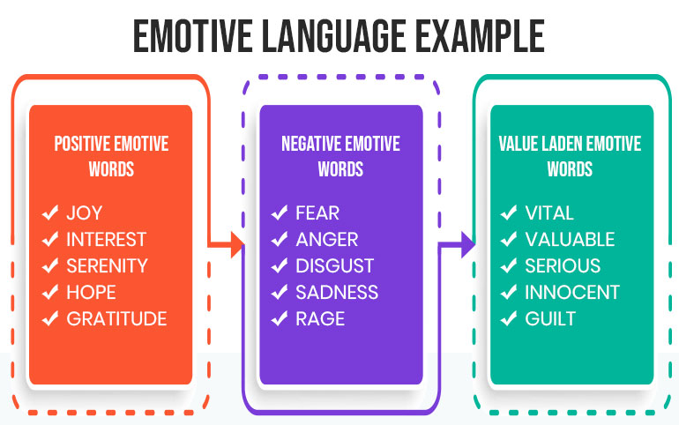
v
Emotive Language

Slide 6
What is Emotive Language ? And Why is it used?
Emotive language is the choice of wording that is used to evoke an emotion or range of emotions in a reader or audience where specific diction by the speaker is used to evoke emotion in the reader.
Examples such as : Elated, Gut-wrenching and Innocent
Techniques include: Observation – think 5 senses and
Wording – superlatives and adjectives. Pathetic fallacy, Onomatopoeia, Hyperbole,
Metaphor, Personification, Anecdotes, Rhetoric and Simile.
Can you recall examples of literature or speeches that evoked emotions in you ? (Joy, anger etc.)
Why did it evoke such emotion in you ?
Notes:
The important thing to remember is that emotive language can generally evoke emotion but the size of reaction maybe linked to what it meant to you
Which language techniques are used?

Slide 7
How can emotive language be applied to create different emotions?
On the 28th August 1963 in Washington DC Martin Luther king spoke one of his greatest speeches of all time. Memorable both because of his important role in abolishing racial segregation but also for the language used. Read the following excerpt analysing the emotive language and discuss in pairs
Five score years ago, a great American, in whose symbolic shadow we stand today, signed the Emancipation Proclamation. This momentous decree came as a great beacon light of hope to millions of Negro slaves who had been seared in the flames of withering injustice. It came as a joyous daybreak to end the long night of their captivity.
But one hundred years later, the Negro still is not free. One hundred years later, the life of the Negro is still sadly crippled by the manacles of segregation and the chains of discrimination. One hundred years later, the Negro lives on a lonely island of poverty in the midst of a vast ocean of material prosperity. One hundred years later, the Negro is still languished in the corners of American society and finds himself an exile in his own land. And so we've come here today to dramatize a shameful condition.

Slide 8
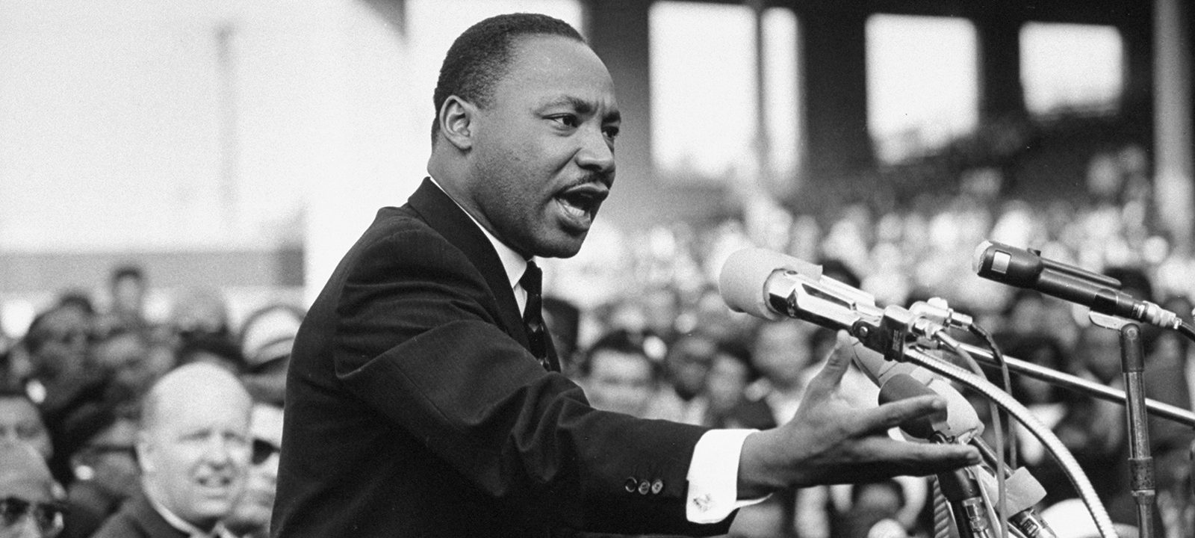
Five score years ago
great
symbolic
Activity
Review
Five score years ago, a great American, in whose symbolic shadow we stand today, signed the Emancipation Proclamation. This momentous decree came as a great beacon light of hope to millions of Negro slaves who had been seared in the flames of withering injustice. It came as a joyous daybreak to end the long night of their captivity.
momentous
a great beacon light of hope to millions
Negro slaves
seared in the flames
withering
Joyous daybreak to end the long night of their captivity
one hundred years later, still
One hundred years later,
But one hundred years later, the Negro still is not free. One hundred years later, the life of the Negro is still sadly crippled by the manacles of segregation and the chains of discrimination. One hundred years later, the Negro lives on a lonely island of poverty in the midst of a vast ocean of material prosperity.
One hundred years later, the Negro is still languished in the corners
of American society and finds himself an exile in his own land.
And so we've come here today to dramatize a shameful
condition.
sadly crippled by the manacles of segregation and the
chains of discrimination.
One hundred years later,
lonely
Island of poverty in the midst of a vast ocean
One hundred years later,
still languished in the corners
exile
dramatize a shameful
Notes:
The first paragraph is an allusion- so Dr King never directly states what he is talking about but indirectly describes and refers to the emancipation proclamation, he suggests there was hope but not entirely or completely fulfilled.
Five score years ago – Time is a powerful indicator for change and one of the greatest themes in literature.
Great – the double entendre of an adjective but also noun emphasizes the importance
Symbolic – another adjective that only further builds up the ‘American’ in all his greatness and impresses the listener
Momentous –adjective further highlighting the significance of the decree, the addition of all these adjectives makes obvious how important the decree is and creates an excitement
A great beacon light of hope to millions of Negro slaves, who had been seared in the flames of withering injustice – The use of metaphor comparing the emancipation to a beacon of light, a powerful description which helps the listener picture just how influential and important it is and to so many, being the eventual peace. Use of the adjective withering is so intensely descriptive that a painful image is created.
Joyous daybreak to end the long night of their captivity – a hopeful metaphor
One hundred years later still/One hundred years later – the repetition and use of the word ‘still’ creates a sense of frustration of how things still hadn’t changed, repetiton is an emotive tool that drives forward a point as well as creating rhythm, it can make a speech more memorable if you can recall Obama’s speech it was ‘Education, Education, Education’. This is called ANAPHORA – the deliberate use of repitition
Sadly crippled by the manacles of segregation and the chains of discrimination – again metaphor used for powerful imagery - segregation is described as a manacle the metal band of handcuffs that goes round the wrist , just as discrimination is a chain something that holds back or holds down someone/something
Lonely island of poverty in the midst of a vast ocean – metaphor emphasizing the difference in wealth of black people in America compared to the wealth of the country that surrounds them.
Exile – a harsh word for outsider which incites sympathy from the listener, black people did not have their human rights and were pushed to the edges of society in a place they should call home.
Dramatise a shameful

Slide 9
v
Audience, Purpose and Voice techniques

Slide 10
Voice
Why does voice matter in performance of poetry and spoken word ?
It is a decider for how an audience interprets the piece
To emphasise/ highlight a point
Set a mood/ create an atmosphere
To convey the feelings, ideas, thoughts and emotions behind words. / the personality of the speaker or character
To evoke some emotion
Think of examples of voice control and techniques? How can they be used to create an atmosphere/mood or to express an emotion ? e.g. joy, fear, sadness, mystery
Pitch
Volume
Accent
Pace
Emphasis
Specific enunciation
Intonation
Pause and silences
Tone
Plosives
Notes:
Examples of tone that can be created:
1. accusatory-charging of wrong doing
2. apathetic-indifferent due to lack of energy or concern
3. awe-solemn wonder
4. bitter-exhibiting strong animosity as a result of pain or grief
5. cynical-questions the basic sincerity and goodness of people
6. condescension; condescending-a feeling of superiority
7. callous-unfeeling, insensitive to feelings of others
8. contemplative-studying, thinking, reflecting on an issue
9. critical-finding fault
10. choleric-hot-tempered, easily angered
11. contemptuous-showing or feeling that something is worthless or lacks respect
12. caustic-intense use of sarcasm; stinging, biting
13. conventional-lacking spontaneity, originality, and individuality
14. disdainful-scornful
15. didactic-author attempts to educate or instruct the reader
16. derisive-ridiculing, mocking
17. earnest-intense, a sincere state of mind
18. erudite-learned, polished, scholarly
19. fanciful-using the imagination
20. forthright-directly frank without hesitation
21. gloomy-darkness, sadness, rejection
22. haughty-proud and vain to the point of arrogance
23. indignant-marked by anger aroused by injustice
24. intimate-very familiar
25. judgmental-authoritative and often having critical opinions
26. jovial-happy
27. lyrical-expressing a poet’s inner feelings; emotional; full of images; song-like
28. matter-of-fact--accepting of conditions; not fanciful or emotional
29. mocking-treating with contempt or ridicule
30. morose-gloomy, sullen, surly, despondent
31. malicious-purposely hurtful
32. objective-an unbiased view-able to leave personal judgments aside
33. optimistic-hopeful, cheerful
34. obsequious-polite and obedient in order to gain something
35. patronizing-air of condescension
36. pessimistic-seeing the worst side of things; no hope
37. quizzical-odd, eccentric, amusing
38. ribald-offensive in speech or gesture
39. reverent-treating a subject with honor and respect
40. ridiculing-slightly contemptuous banter; making fun of
41. reflective-illustrating innermost thoughts and emotions
42. sarcastic-sneering, caustic
43. sardonic-scornfully and bitterly sarcastic
44. satiric-ridiculing to show weakness in order to make a point, teach
45. sincere-without deceit or pretense; genuine
46. solemn-deeply earnest, tending toward sad reflection
47. sanguineous -optimistic, cheerful
48. whimsical-odd, strange, fantastic; fun

Slide 11
Importance of Audience and Purpose
Before you write or perform there are specific points you should think about to ensure your creative pieces are suitable for a particular situation or context:
Why you are speaking to them
  - What matters to you
  - Why should they listen to you?
What do you want them to take away/remember from what you say
  - What do you want them to do or feel?
Who you are speaking to
  - Who are your audience?
  - How old are they (if it matters)?
  - What matters to them?
Who are you speaking about
Your answers to these questions should help you focus on what exactly your passions are to write.
Be clear about your purpose: Why have you chosen this topic? And What is important about this topic?
And think about what your aim is:
To persuade your audience to do something, eg to speak up for important issues
To express an important memory
To share an important part of history (personal or general)
To explain and to educate
To give advice or an explanation?

Slide 12
v
Now let’s apply it to some examples !
Notes:
Think emotive language and techniques, Audience, voice and purpose. How does it make you feel?

Slide 13
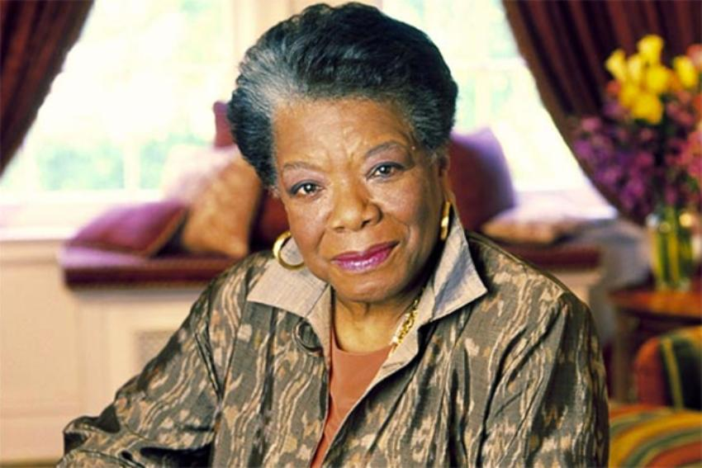
Maya Angelou
APRIL 4, 1928 – MAY 28, 2014
Maya Angelou, born as Marguerite Annie Johnson, was one of the most renowned and well celebrated figures of the 20th century. In her lifetime she was a singer and dancer; then she worked as a civil rights activist and journalist; she wrote seven autobiographies; taught at Wake Forest University; and received many honors including the 2010 Presidential Medal of Freedom, the highest civilian honor in the United States.
Maya Angelou explored numerous themes in her poems including that of women, love, loss, music, struggle, discrimination and racism. She has been referred to as “people’s poet” and as “the black woman’s poet laureate”. She was the first female poet and the second ever after Robert Frost to be so honored. Among other things, her poem Still I Rise was recited by Nelson Mandela at his presidential inauguration. Maya Angelou is the most famous black poet till date.

Slide 14
Poems
Still I Rise
BY MAYA ANGELOU
You may write me down in history
With your bitter, twisted lies,
You may trod me in the very dirt
But still, like dust, I'll rise.
Does my sassiness upset you?
Why are you beset with gloom?
’Cause I walk like I've got oil wells
Pumping in my living room.
Just like moons and like suns,
With the certainty of tides,
Just like hopes springing high,
Still I'll rise.
Still I Rise
BY MAYA ANGELOU
You may write me down in history
With your bitter, twisted lies,
You may trod me in the very dirt
But still, like dust, I'll rise.
Does my sassiness upset you?
Why are you beset with gloom?
’Cause I walk like I've got oil wells
Pumping in my living room.
Just like moons and like suns,
With the certainty of tides,
Just like hopes springing high,
Still I'll rise.
Out of the huts of history’s shame
I rise
Up from a past that’s rooted in pain
I rise
I'm a black ocean, leaping and wide,
Welling and swelling I bear in the tide.
Leaving behind nights of terror and fear
I rise
Into a daybreak that’s wondrously clear
I rise
Bringing the gifts that my ancestors gave,
I am the dream and the hope of the slave.
I rise
I rise
I rise.
Out of the huts of history’s shame
I rise
Up from a past that’s rooted in pain
I rise
I'm a black ocean, leaping and wide,
Welling and swelling I bear in the tide.
Leaving behind nights of terror and fear
I rise
Into a daybreak that’s wondrously clear
I rise
Bringing the gifts that my ancestors gave,
I am the dream and the hope of the slave.
I rise
I rise
I rise.
Did you want to see me broken?
Bowed head and lowered eyes?
Shoulders falling down like teardrops,
Weakened by my soulful cries?
Does my haughtiness offend you?
Don't you take it awful hard
’Cause I laugh like I've got gold mines
Diggin’ in my own backyard.
You may shoot me with your words,
You may cut me with your eyes,
You may kill me with your hatefulness,
But still, like air, I’ll rise.
Did you want to see me broken?
Bowed head and lowered eyes?
Shoulders falling down like teardrops,
Weakened by my soulful cries?
Does my haughtiness offend you?
Don't you take it awful hard
’Cause I laugh like I've got gold mines
Diggin’ in my own backyard.
You may shoot me with your words,
You may cut me with your eyes,
You may kill me with your hatefulness,
But still, like air, I’ll rise.
Notes:
Split into 4 groups, the last poem can be divided into 2

Slide 15
Poems
Caged Bird
BY MAYA ANGELOU
A free bird leaps
on the back of the wind
and floats downstream
till the current ends
and dips his wing
in the orange sun rays
and dares to claim the sky.
But a bird that stalks
down his narrow cage
can seldom see through
his bars of rage
his wings are clipped and
his feet are tied
so he opens his throat to sing.
Caged Bird
BY MAYA ANGELOU
A free bird leaps
on the back of the wind
and floats downstream
till the current ends
and dips his wing
in the orange sun rays
and dares to claim the sky.
But a bird that stalks
down his narrow cage
can seldom see through
his bars of rage
his wings are clipped and
his feet are tied
so he opens his throat to sing.
The caged bird sings
with a fearful trill
of things unknown
but longed for still
and his tune is heard
on the distant hill
for the caged bird
sings of freedom.
The free bird thinks of another breeze
and the trade winds soft through the sighing trees
and the fat worms waiting on a dawn bright lawn
and he names the sky his own
The caged bird sings
with a fearful trill
of things unknown
but longed for still
and his tune is heard
on the distant hill
for the caged bird
sings of freedom.
The free bird thinks of another breeze
and the trade winds soft through the sighing trees
and the fat worms waiting on a dawn bright lawn
and he names the sky his own
But a caged bird stands on the grave of dreams
his shadow shouts on a nightmare scream
his wings are clipped and his feet are tied
so he opens his throat to sing.
The caged bird sings
with a fearful trill
of things unknown
but longed for still
and his tune is heard
on the distant hill
for the caged bird
sings of freedom.
But a caged bird stands on the grave of dreams
his shadow shouts on a nightmare scream
his wings are clipped and his feet are tied
so he opens his throat to sing.
The caged bird sings
with a fearful trill
of things unknown
but longed for still
and his tune is heard
on the distant hill
for the caged bird
sings of freedom.
Notes:
Split into 4 groups, the last poem can be divided into 2

Slide 16
Poems
You, created only a little lower than
The angels, have crouched too long in
The bruising darkness,
Have lain too long
Face down in ignorance.
Your mouths spilling words
Armed for slaughter.
The Rock cries out today, you may stand on me,
But do not hide your face.
Across the wall of the world,
A River sings a beautiful song,
Come rest here by my side.
Each of you a bordered country,
Delicate and strangely made proud,
Yet thrusting perpetually under siege.
Your armed struggles for profit
Have left collars of waste upon
My shore, currents of debris upon my breast.
Yet, today I call you to my riverside,
If you will study war no more. Come,
Clad in peace and I will sing the songs
The Creator gave to me when I and the
Tree and the stone were one.
Before cynicism was a bloody sear across your
Brow and when you yet knew you still
Knew nothing.
The River sings and sings on.
There is a true yearning to respond to
The singing River and the wise Rock.
So say the Asian, the Hispanic, the Jew
The African and Native American, the Sioux,
The Catholic, the Muslim, the French, the Greek
The Irish, the Rabbi, the Priest, the Sheikh,
The Gay, the Straight, the Preacher,
The privileged, the homeless, the Teacher.
They hear. They all hear
The speaking of the Tree.
On the pulse of a morning
BY MAYA ANGELOU
A Rock, A River, A Tree
Hosts to species long since departed,
Marked the mastodon,
The dinosaur, who left dry tokens
Of their sojourn here
On our planet floor,
Any broad alarm of their hastening doom
Is lost in the gloom of dust and ages.
But today, the Rock cries out to us, clearly, forcefully,
Come, you may stand upon my
Back and face your distant destiny,
But seek no haven in my shadow.
I will give you no more hiding place down here.
Notes:
Split into groups, on the pulse of a morning can be divided into 2
Lots of symbolism – i.e. think about he history and meaning behind thr tree, rock and river

Slide 17
Poems
You, created only a little lower than
The angels, have crouched too long in
The bruising darkness,
Have lain too long
Face down in ignorance.
Your mouths spilling words
Armed for slaughter.
The Rock cries out today, you may stand on me,
But do not hide your face.
Across the wall of the world,
A River sings a beautiful song,
Come rest here by my side.
Each of you a bordered country,
Delicate and strangely made proud,
Yet thrusting perpetually under siege.
Your armed struggles for profit
Have left collars of waste upon
My shore, currents of debris upon my breast.
Yet, today I call you to my riverside,
If you will study war no more. Come,
Clad in peace and I will sing the songs
The Creator gave to me when I and the
Tree and the stone were one.
Before cynicism was a bloody sear across your
Brow and when you yet knew you still
Knew nothing.
The River sings and sings on.
There is a true yearning to respond to
The singing River and the wise Rock.
So say the Asian, the Hispanic, the Jew
The African and Native American, the Sioux,
The Catholic, the Muslim, the French, the Greek
The Irish, the Rabbi, the Priest, the Sheikh,
The Gay, the Straight, the Preacher,
The privileged, the homeless, the Teacher.
They hear. They all hear
The speaking of the Tree.
On the pulse of a morning
BY MAYA ANGELOU
A Rock, A River, A Tree
Hosts to species long since departed,
Marked the mastodon,
The dinosaur, who left dry tokens
Of their sojourn here
On our planet floor,
Any broad alarm of their hastening doom
Is lost in the gloom of dust and ages.
But today, the Rock cries out to us, clearly, forcefully,
Come, you may stand upon my
Back and face your distant destiny,
But seek no haven in my shadow.
I will give you no more hiding place down here.
Notes:
Split into groups, on the pulse of a morning can be divided into 2
Lots of symbolism – i.e. think about he history and meaning behind thr tree, rock and river

Slide 18
Poems
Sold, stolen, arriving on a nightmare
Praying for a dream.
Here, root yourselves beside me.
I am the Tree planted by the River,
Which will not be moved.
I, the Rock, I the River, I the Tree
I am yours--your Passages have been paid.
Lift up your faces, you have a piercing need
For this bright morning dawning for you.
History, despite its wrenching pain,
Cannot be unlived, and if faced
With courage, need not be lived again.
Lift up your eyes upon
The day breaking for you.
Give birth again, To the dream.
Women, children, men,
Take it into the palms of your hands.
Mold it into the shape of your most
Private need. Sculpt it into
The image of your most public self.
Lift up your hearts
Each new hour holds new chances
For new beginnings.
Do not be wedded forever
To fear, yoked eternally
To brutishness.
The horizon leans forward,
Offering you space to place new steps of change.
Here, on the pulse of this fine day
You may have the courage
To look up and out upon me, the
Rock, the River, the Tree, your country.
No less to Midas than the mendicant.
No less to you now than the mastodon then.
Here on the pulse of this new day
You may have the grace to look up and out
And into your sister's eyes, into
Your brother's face, your country
And say simply
Very simply
With hope
Good morning.
Today, the first and last of every Tree
Speaks to humankind. Come to me, here beside the River.
Plant yourself beside me, here beside the River.
Each of you, descendant of some passed
On traveller, has been paid for.
You, who gave me my first name, you
Pawnee, Apache and Seneca, you
Cherokee Nation, who rested with me, then
Forced on bloody feet, left me to the employment of
Other seekers--desperate for gain,
Starving for gold.
You, the Turk, the Swede, the German, the Scot ...
You the Ashanti, the Yoruba, the Kru, bought
Notes:
Think listing

Slide 19
Poems
Sold, stolen, arriving on a nightmare
Praying for a dream.
Here, root yourselves beside me.
I am the Tree planted by the River,
Which will not be moved.
I, the Rock, I the River, I the Tree
I am yours--your Passages have been paid.
Lift up your faces, you have a piercing need
For this bright morning dawning for you.
History, despite its wrenching pain,
Cannot be unlived, and if faced
With courage, need not be lived again.
Lift up your eyes upon
The day breaking for you.
Give birth again, To the dream.
Women, children, men,
Take it into the palms of your hands.
Mold it into the shape of your most
Private need. Sculpt it into
The image of your most public self.
Lift up your hearts
Each new hour holds new chances
For new beginnings.
Do not be wedded forever
To fear, yoked eternally
To brutishness.
The horizon leans forward,
Offering you space to place new steps of change.
Here, on the pulse of this fine day
You may have the courage
To look up and out upon me, the
Rock, the River, the Tree, your country.
No less to Midas than the mendicant.
No less to you now than the mastodon then.
Here on the pulse of this new day
You may have the grace to look up and out
And into your sister's eyes, into
Your brother's face, your country
And say simply
Very simply
With hope
Good morning.
Today, the first and last of every Tree
Speaks to humankind. Come to me, here beside the River.
Plant yourself beside me, here beside the River.
Each of you, descendant of some passed
On traveller, has been paid for.
You, who gave me my first name, you
Pawnee, Apache and Seneca, you
Cherokee Nation, who rested with me, then
Forced on bloody feet, left me to the employment of
Other seekers--desperate for gain,
Starving for gold.
You, the Turk, the Swede, the German, the Scot ...
You the Ashanti, the Yoruba, the Kru, bought
Notes:
Think listing

Slide 20
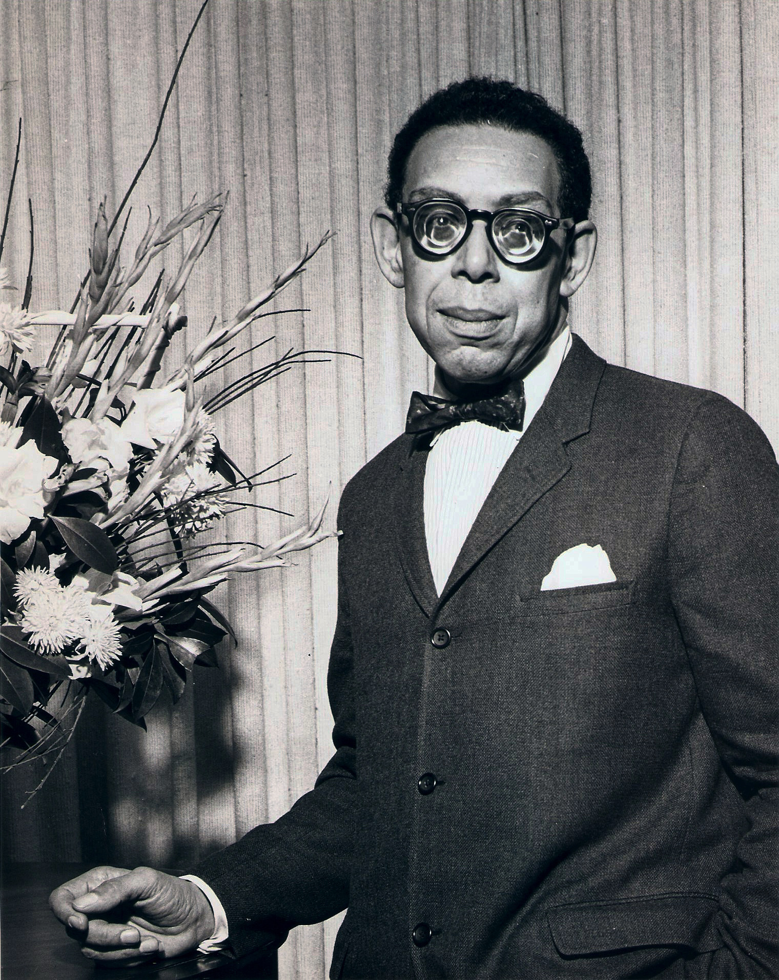
Robert Hayden
AUGUST 4, 1913 – FEBRUARY 25, 1980
Robert Hayden was born as Asa Bundy Sheffey. He was a passionate African American poet who wrote about the black experience and the struggle related with it. His poems can emotively reflect his deep knowledge and study of all the American history he did. Roberts’ poetry became internationally renowned in the 1960s. In 1976, he became the first African American to be appointed as US Poet Laureate. Hayden authored nine poetry collections during his lifetime. With his most famous poem being ‘Those Winter Sundays’ which is among the most anthologized American poems of the 20th century.

Slide 21
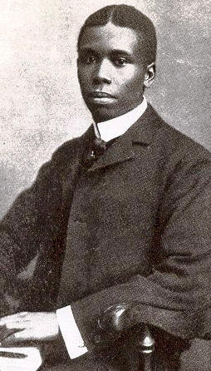
Paul Laurence Dunbar
JUNE 27, 1872 – FEBRUARY 9, 1906
Paul Laurence Dunbar was the son to parents who had been freed due to the American Civil War (Northern states of America against the abolishing of slavery which the southern states wanted legalised). He wrote his first poem at the age of 6 and gave his first public recital at the age of 9. With time, Dunbar became acclaimed across America with his poems and essays being published in the leading journals and papers of the day. Unfortunately, his career was cut short when he died of tuberculosis at the age of just 33. Much of Dunbar’s best-known poetry is known for its colorful language and conversational tone.

Slide 22
Poems
Those Winter Sundays
BY ROBERT HAYDEN
Sundays too my father got up early
and put his clothes on in the blueblack cold,
then with cracked hands that ached
from labor in the weekday weather made
banked fires blaze. No one ever thanked him.
I’d wake and hear the cold splintering, breaking.
When the rooms were warm, he’d call,
and slowly I would rise and dress,
fearing the chronic angers of that house
Speaking indifferently to him,
who had driven out the cold
and polished my good shoes as well.
What did I know, what did I know
of love’s austere and lonely offices?
We Wear the Mask
BY PAUL LAURENCE DUNBAR
We wear the mask that grins and lies,
It hides our cheeks and shades our eyes,—
This debt we pay to human guile;
With torn and bleeding hearts we smile,
And mouth with myriad subtleties.
We smile, but, O great Christ, our cries
To thee from tortured souls arise.
We sing, but oh the clay is vile
Beneath our feet, and long the mile;
But let the world dream otherwise,
We wear the mask!
Why should the world be over-wise,
In counting all our tears and sighs?
Nay, let them only see us, while
We wear the mask.
Notes:
Split into 4 groups, the last poem can be divided into 2

Slide 23
Poems
Those Winter Sundays
BY ROBERT HAYDEN
Sundays too my father got up early
and put his clothes on in the blueblack cold,
then with cracked hands that ached
from labor in the weekday, weather made
banked fires blaze. No one ever thanked him.
I’d wake and hear the cold splintering, breaking.
When the rooms were warm, he’d call,
and slowly I would rise and dress,
fearing the chronic angers of that house
Speaking indifferently to him,
who had driven out the cold
and polished my good shoes as well.
What did I know, what did I know
of love’s austere and lonely offices?
We Wear the Mask
BY PAUL LAURENCE DUNBAR
We wear the mask that grins and lies,
It hides our cheeks and shades our eyes,—
This debt we pay to human guile;
With torn and bleeding hearts we smile,
And mouth with myriad subtleties.
We smile, but, O great Christ, our cries
To thee from tortured souls arise.
We sing, but oh the clay is vile
Beneath our feet, and long the mile;
But let the world dream otherwise,
We wear the mask!
Why should the world be over-wise,
In counting all our tears and sighs?
Nay, let them only see us, while
We wear the mask.
Notes:
Split into 4 groups, the last poem can be divided into 2

Slide 24
Poems
Sympathy
BY PAUL LAURENCE DUNBAR
I know what the caged bird feels, alas!
When the sun is bright on the upland slopes;
When the wind stirs soft through the springing grass,
And the river flows like a stream of glass;
When the first bird sings and the first bud opes,
And the faint perfume from its chalice steals—
I know what the caged bird feels!
I know why the caged bird beats his wing
Till its blood is red on the cruel bars;
For he must fly back to his perch and cling
When he fain would be on the bough a-swing;
And a pain still throbs in the old, old scars
And they pulse again with a keener sting—
I know why he beats his wing!
I know why the caged bird sings, ah me,
When his wing is bruised and his bosom sore,—
When he beats his bars and he would be free;
It is not a carol of joy or glee,
But a prayer that he sends from his heart’s deep core,
But a plea, that upward to Heaven he flings—
I know why the caged bird sings!
Notes:
Split into 4 groups, the last poem can be divided into 2

Slide 25
Poems
Sympathy
BY PAUL LAURENCE DUNBAR
I know what the caged bird feels, alas!
When the sun is bright on the upland slopes;
When the wind stirs soft through the springing grass,
And the river flows like a stream of glass;
When the first bird sings and the first bud opes,
And the faint perfume from its chalice steals—
I know what the caged bird feels!
I know why the caged bird beats his wing
Till its blood is red on the cruel bars;
For he must fly back to his perch and cling
When he fain would be on the bough a-swing;
And a pain still throbs in the old, old scars
And they pulse again with a keener sting—
I know why he beats his wing!
I know why the caged bird sings, ah me,
When his wing is bruised and his bosom sore,—
When he beats his bars and he would be free;
It is not a carol of joy or glee,
But a prayer that he sends from his heart’s deep core,
But a plea, that upward to Heaven he flings—
I know why the caged bird sings!
Notes:
Split into 4 groups, the last poem can be divided into 2

Slide 26
Spoken word – What is it ?
A performative oral form of poetry that often refers to themes of social justice, race and matters that are of great importance to the speaker themselves
Whilst watching use this list to analyse the videos:
What is the topic/theme of the spoken word?
What is the purpose?
Who do you think it is aimed at – so who is the audience?
What do you feel when listening to the video?
How is voice used and what vocal skills are used?
What is the tone of the piece? How is it achieved?
What emotive language techniques do you recognise?
a. Metaphors b. Similes c. Imagery d. Allusions e. Personification
f. Symbols and more
Explain the use of any sound devices and whether or not they aid in conveying tone or theme.
Is physical movement used ? How does it make you feel? How does it portray the theme ?

Slide 27
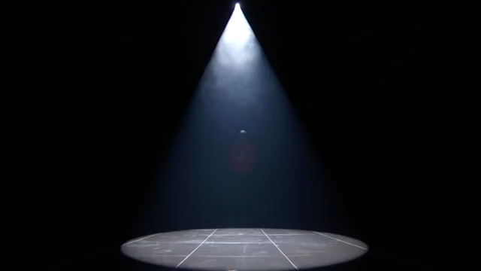
Brandon Leake - AGT
This year on Americas got talent it was the first year a black poet performing spoken word was on the show and won with one of his greatest performances discussing the fear a mother has for their young black child .
Notes:
https://youtu.be/vaM-OrZi6IA

Slide 28

J Chambers – Letter to self
J is a spoken word artist who takes his inspiration from his Jamaican heritage, the Black British experience and the fight for equality. His piece you just watched was written for black history month on black peter.
Notes:
https://www.youtube.com/watch?v=XSOS611xToc

Slide 29
I am limitless - Lina abojaradeh
Lina performed this spoken word competition on Identity. It placed her as one of the top 8 finalists for Black History Month’s Spoken Word competition in Amman where she eventually came second. Lina uses art as a way to engage others. Her hope is to use her skills in writing poetry, art, and video-making to spread positive messages, especially about her home country, Palestine.
Notes:
https://www.youtube.com/watch?v=f5CLnmN2QcQ

Slide 30

Somewhere in America - Belissa Escobedo, Rhiannon McGavin, and Zariya Allen
These three teen spoken-word poets are members of the Get Lit organization, a nonprofit that uses spoken word to improve literacy rates in Los Angeles, where 40 percent of teens won't graduate high school. The piece you just heard performed was their response to issues that affect them including books that were banned and gun violence.
Bullet point
Bullet point
Bullet point
Bullet point
Notes:
https://youtu.be/OadZpUJv8Eg

Slide 31
v
Now it’s your turn

Slide 32
Thinking caps on – idea forming.
Reflect on the last few activities and think about what you are passionate about.
Use your senses, how do you recall memories, is it through smell, taste, hearing, feeling or sight? How does this help you connect with an important memory or emotion.
Connect to that and create a piece of writing based either on the range of poems and spoken word we have studied or on the memory you have and build upon it.

Slide 33
Performing time
Things to remember:
Voice – tone - pitch and volume – diction – pace - pauses and silences
Facial expressions
Body language
Movement
Posture
Gesture
Be clear, take your time and be respectful to one another

