Slide 1
Budgeting for Fellowships: Thinking Beyond the Numbers
Written by: Julie Mason
Research Development and Partnerships Manager

Slide 2

What is budgeting?
It is a strategic articulation of your research and career plan
Key question:
What story does my budget tell about me as a future research leader?

Slide 3

Your Time: The Core of the Budget
Your time is often the largest cost on a fellowship
But the easiest to include
Remember: it still requires justification.
Key question:
What am I protecting time for—and what happens if I don’t?

Slide 4

What staff support do you need?
Research staff
Technicians
Administrative support
Project management
Specialist expertise
Key questions:
Where would lack of support create risk?
What expertise do I need that I do not yet have?

Slide 5
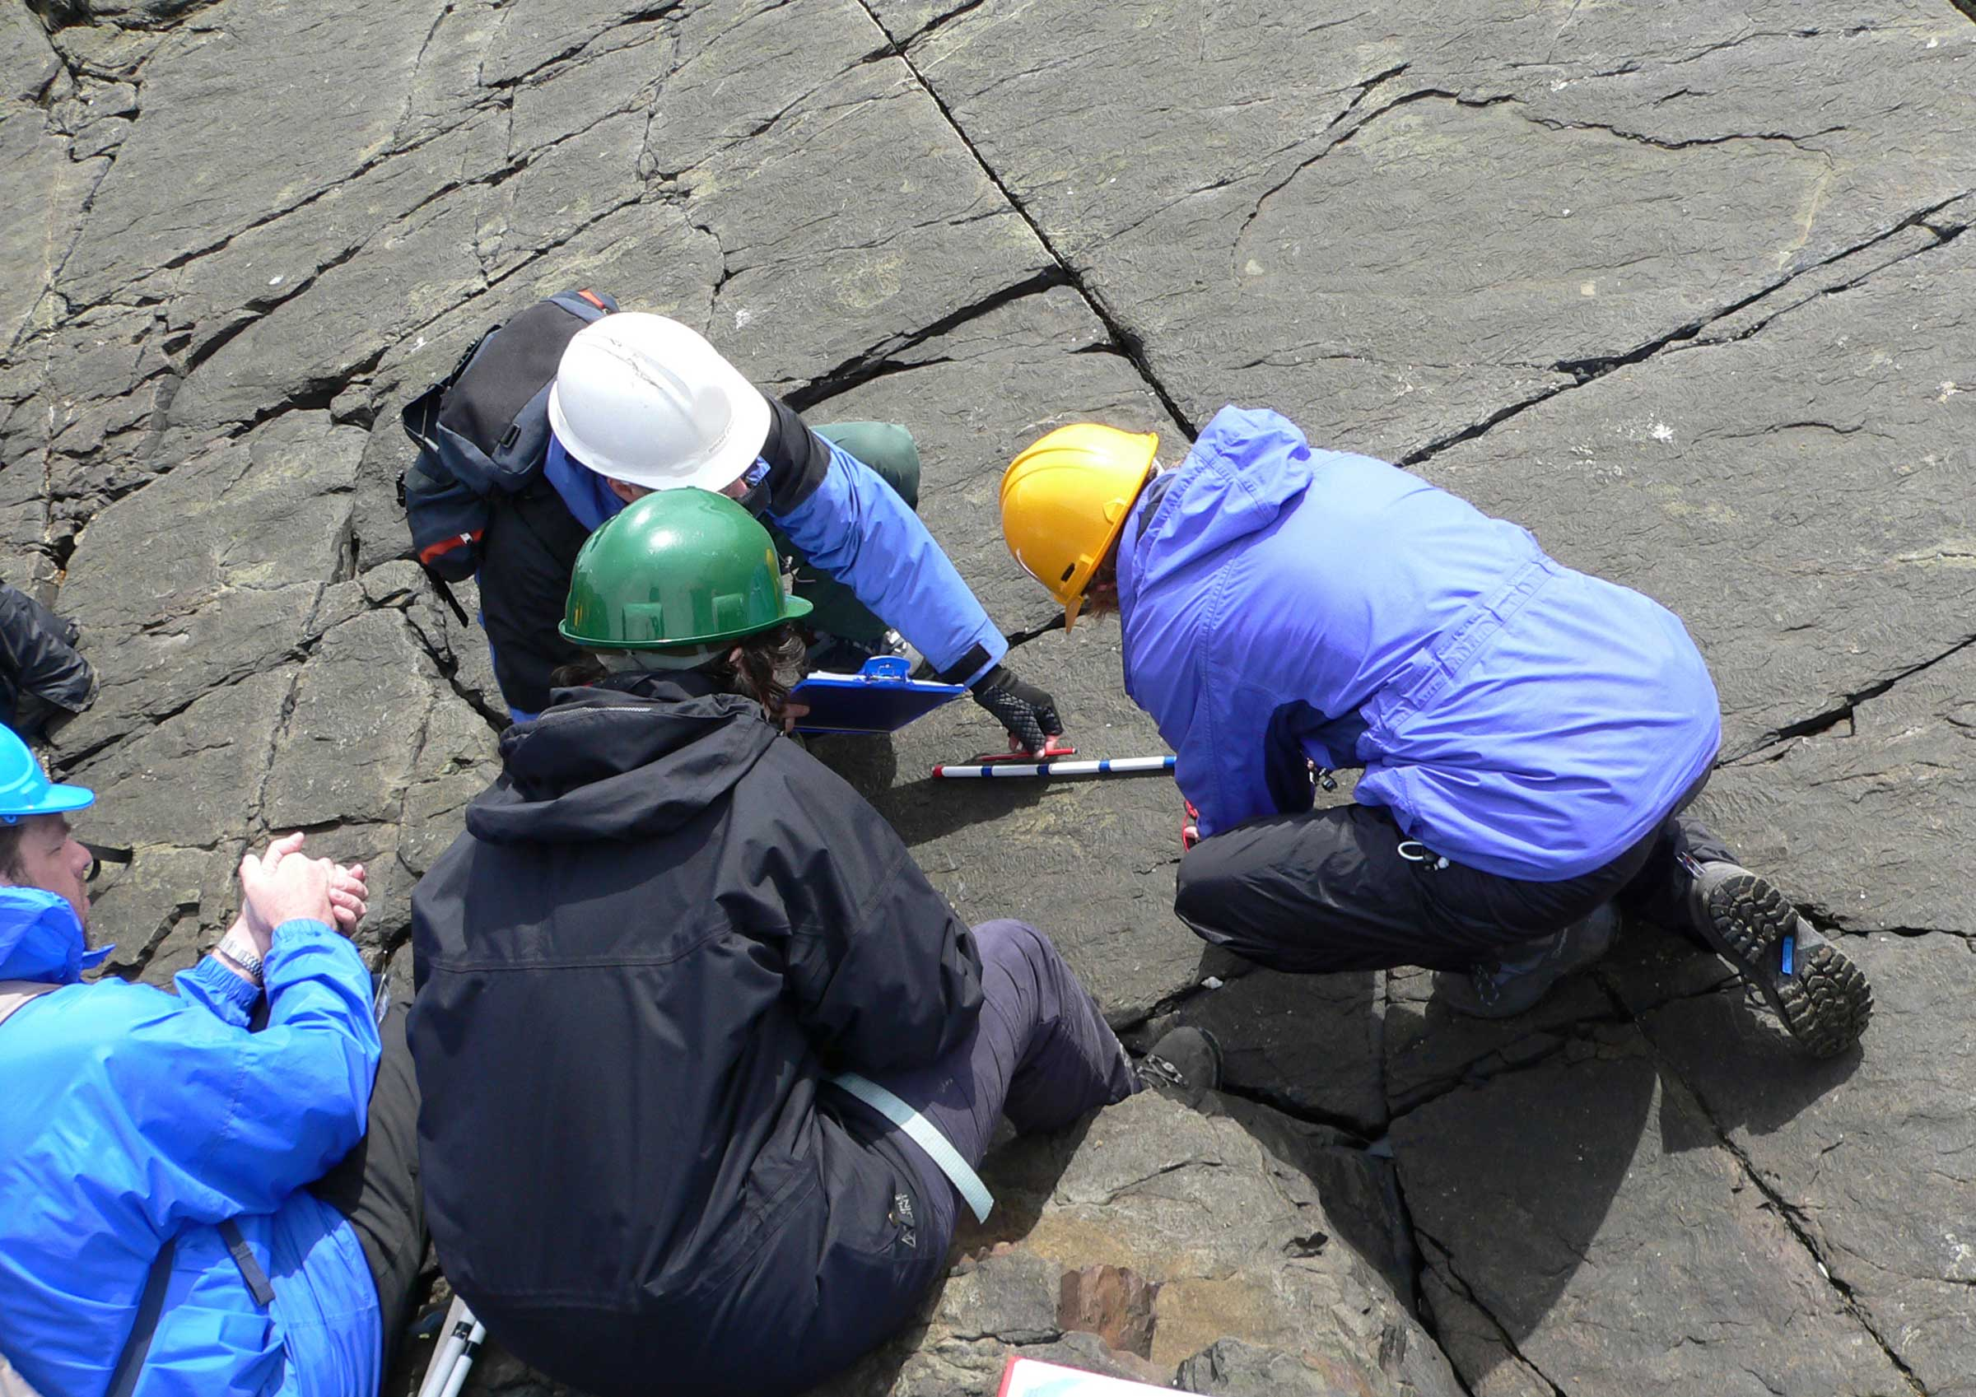
Fieldwork and Data Collection
Include all real-world delivery costs
Travel and subsistence
Accommodation
Participant costs
For International work speak to Global Mobility early
Question:
Have I fully mapped what it will take to collect my data in the real world?
Notes:
Remember Carbon Offsetting for Wellcome

Slide 6

IT, Data and accessibility
Laptops and equipment
Software licences
Cloud storage
Data collection tools
Accessible equipment for both participants and researchers.
Key question:
Have I designed this to be deliverable and inclusive?
This Photo by Unknown Author is licensed under CC BY-SA

Slide 7

Training and Development
Your own training (courses, placements, leadership)
Training for support roles (research staff, technicians)
This strengthens delivery and credibility.
Key question:
What do I need to learn to reach the next level?
What does my team need to deliver effectively?

Slide 8

Public and Patient Involvement and Engagement
Think about co-design at the very start of your project development
For many funders PPIE is essential.
Use appropriate rates such as NIHR
Think about meaningful, ongoing involvement—not tokenistic input.
Key questions:
Where does PPIE genuinely shape my research?
Have I costed involvement fairly?

Slide 9

Creative and Non-Traditional Approaches
Will the following enhance your research?
Artists
Creative facilitators
Filming and editing
Documentaries
Question:
Why is this approach necessary?
Can I clearly justify it?

Slide 10
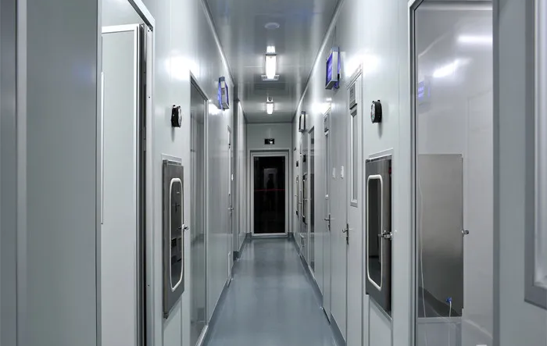
Facilities
Laboratories
Clean rooms
Shared Equipment
Biological Servies Unit
Technicians
Digital Humanities
Aquatic Research Centre
Bioimaging
Medical Research (MRI)
Notes:
Facilities & Systems | Technical Strategy & Operations | University of Exeter
Have I verified costs with the correct people?

Slide 11

Advisory Board
Do you need an advisory board or similar structure?
Consider:
Expertise required
Honoraria (aligned with guidance)
Travel and subsistence
Frequency of meetings
Key questions:
What expertise strengthens my project?
Have I resourced it properly?

Slide 12

Conferences and External Engagement
Which conferences?
Who will attend – think of the whole team?
When during the project?
What will you contribute?
Key question:
Where will this work have visibility?
Am I under-budgeting for influence?

Slide 13
Easily missed costs
Recruitment
Transcription
Visa costs
Website design, domain and hosting
Licencing fees for secondary data sets
Key questions:
Which costs, if overlooked, could create problems later?

Slide 14

Justifying your budget
Look for the reason you need everything:
Every cost should link to:
Output
Development
Feasibility
Key question:
Can I explain every major cost confidently?

