Slide 1
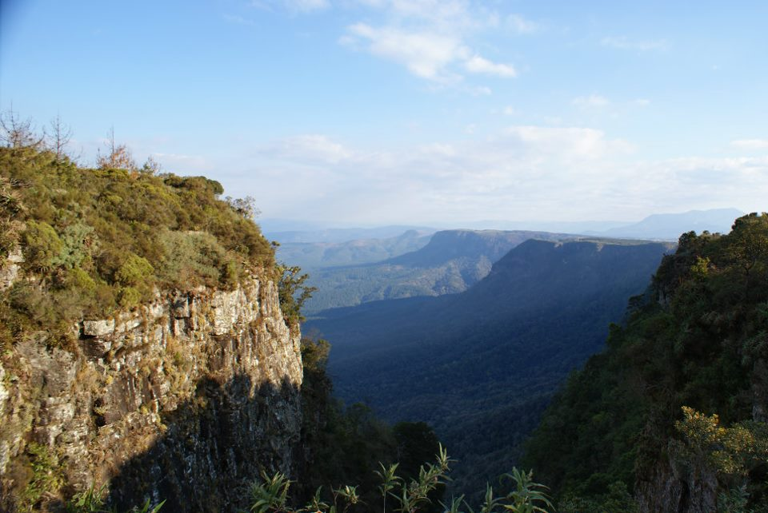
Is Christianity to Blame?
Introducing Christian Beliefs
about Environmental Ethics
Background image copyright Helen C. John

Slide 2

Click for an introductory video: Blame

Slide 3
Lesson aims
To introduce critical questions about Christianity's influence on attitudes to the environment
To provide a brief overview of Lynn White's influential critique
To indicate the importance of biblical texts in shaping Christian views of the environment

Slide 4
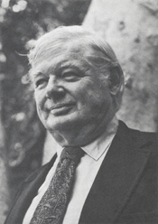
Lynn White Jr.
‘The Historical Roots of our Ecologic Crisis’ (1967)
This article argues that our Western Christian worldview supports and encourages the exploitation of nature.

Slide 5
‘...[Christianity] not only established a dualism of man and nature but also insisted that it is God’s will that man exploit nature for his proper ends… '[Western] Christianity is the most anthropocentric religion the world has seen.’
Lynn White Jr., ‘The Historical Roots of our Ecologic Crisis’, Science 155 (1967) 1203-207 (p. 1205)

Slide 6
Genesis 1.26-30
‘Then God said, ‘Let us make humankind in our image, according to our likeness; and let them have dominion over the fish of the sea, and over the birds of the air, and over the cattle, and over all the wild animals of the earth, and over every creeping thing that creeps upon the earth.’
So God created humankind in his image, in the image of God he created them; male and female he created them. God blessed them, and God said to them, ‘Be fruitful and multiply, and fill the earth and subdue it; and have dominion over the fish of the sea and over the birds of the air and over every living thing that moves upon the earth.’ God said, ‘See, I have given you every plant yielding seed that is upon the face of all the earth, and every tree with seed in its fruit; you shall have them for food.’

Slide 7
Christianity therefore ‘bears a huge burden of guilt’.
Lynn White Jr., ‘The Historical Roots of our Ecologic Crisis’, p. 1206

Slide 8
‘Human ecology is deeply conditioned by beliefs about our nature and destiny - that is, by religion… More science and more technology are not going to get us out of the present ecologic crisis until we find a new religion, or rethink our old one.’
Lynn White Jr., ‘The Historical Roots of our Ecologic Crisis’, p. 1205-206

Slide 9
For discussion
What are your reactions to White’s argument?
To what extent, if at all, do you think Christianity is to blame for our environmental crisis?

