Slide 1
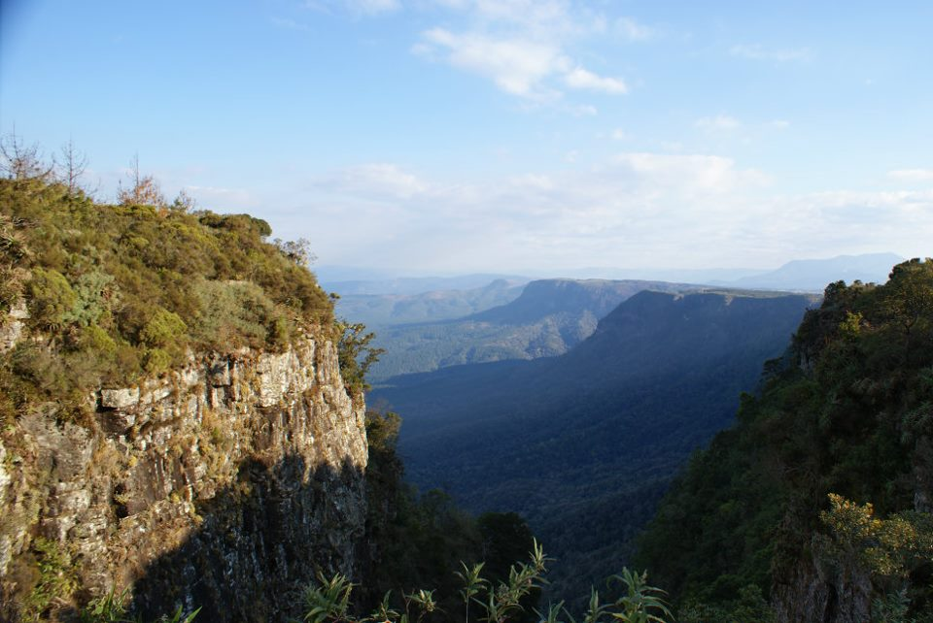
The Origins of Stewardship
Background image copyright Helen C. John

Slide 2

Click for an introductory video: Origins

Slide 3
Lesson aims
To examine key critical texts from which ideas of stewardship are derived
To show that words meaning 'stewardship' do not explicitly appear
To indicate how crucial terms in the texts are open to various interpretations

Slide 4

What are we looking for?
Relationship: Human-Earth
Harmony
Domination
Stewardship

Slide 5
Texts to consider in groups
Extracts from Genesis 1, 2, and 3
What does your text tell us about the relationship between humans and the environment?
Here are some questions to guide your discussions…

Slide 6
Questions to consider
Does your text:
Encourage care for the planet?
Suggest humans are ‘in charge’?
Suggest the land has intrinsic or instrumental value?
Offer a similar/different approach to any other environmental ethical theory you might be aware of?
Suggest that the human/earthling is in the image of God? What does that mean for the relationship between humans and the Earth?

Slide 7
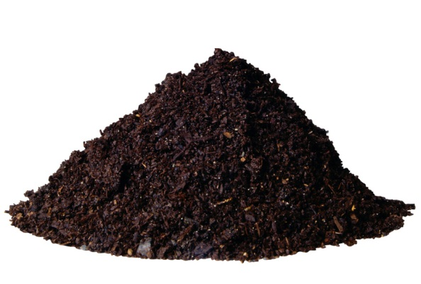
Genesis 1
26 Then God said, "Let us make humankind
אָדָם
adam
adamah

Slide 8
Genesis 1
27 So God created the human in his image
הָאָדָם
ha-adam

Slide 9
Hebrew
The ground = ha-adamah (Gen. 1:25)
‘The human’ = ha-adam (the ‘earthling’?)
The first human = later known as Adam
A man = ish
A woman = ish-shah (only named Eve in 3:20)
Eve = Life

Slide 10
Genesis 1:26-28
26 Then God said, "Let us make humankind in our image, according to our likeness; and let them have dominion over the fish of the sea, and over the birds of the air, and over the cattle, and over all the wild animals of the earth, and over every creeping thing that creeps upon the earth." 27 So God created humankind in his image, in the image of God he created them; male and female he created them. 28 God blessed them, and God said to them, "Be fruitful and multiply, and fill the earth and subdue it; and have dominion over the fish of the sea and over the birds of the air and over every living thing that moves upon the earth."
רָדָה
radah = to rule, have dominion, dominate, tread down, subjugate (associations with monarchy, military assault)
Notes:
Radah: to rule, have dominion, dominate, tread down, to have dominion, rule, subjugate, to cause to dominate
to scrape out

Slide 11
Genesis 2:5
⁵ when no plant of the field was yet in the earth and no herb of the field had yet sprung up—for the Lord God had not caused it to rain upon the earth, and there was no one to till the ground;
No adam to till the adamah
No earthling to till the earth

Slide 12
Genesis 2:7
…then the Lord God formed man from the dust of the ground, and breathed into his nostrils the breath of life; and the man became a living being.
adam formed from the adamah
How does the Hebrew add to or change our understanding of the role of humans/their relationship with the Earth as depicted in Genesis?

Slide 13
Genesis 2:15
What do you think this verse means?
15 The Lord God took the man and put him in the garden of Eden to till it and keep it.
עָבַד
abad
שָׁמַר
shamar
Notes:
“Till” in Hebrew is “abad,” meaning work, serve, be a servant to, keep, be bonded to.
“Keep” in the Hebrew is “shamar,” meaning guard, protect, watch over, attend, observe, save.
Uses in HB:
become slaves (1), been slaves (1), bondage (2), burdened (2), cultivate (7), cultivated (2), cultivates (1), do (6), do the work (1), enslaved (3), given (1), holding in bondage (1), imposed (1), keep (2), labor (3), laborers* (2), make servant (1), make slaves (2), manufacturers (1), observe (1), perform (9), performed (2), plowed (1), rendered (1), serve (141), served (52), serves (2), serving (5), slave (1), slaves (1), subject (1), till (1), tiller (1), tiller* (1), tills (2), use as slaves (1), used (1), uses services (1), work (7), worked (2), workers (2), working (1), worship (7), worshipers (6).

Slide 14
Summary
In which texts did we find an emphasis on dominion?
In which texts did we find an emphasis on stewardship?
In general, do the texts suggest that the land has intrinsic value / instrumental value?
What was significant about the Hebrew adam/adamah?

