Slide 1
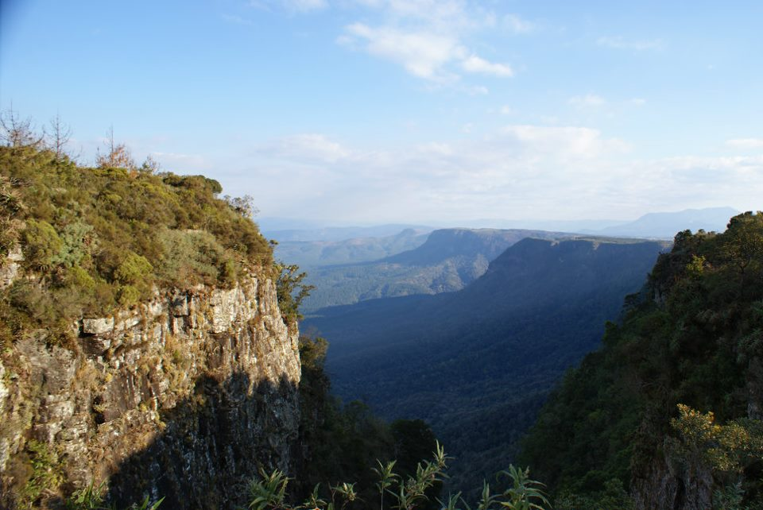
The Future of the Earth
Background image copyright Helen C. John

Slide 2

Click for an introductory video: Future

Slide 3
Lesson aims
To investigate the views of Christian groups who are opposed to environmental care
To look at the biblical texts that these groups use to support their views
To consider how Christians who support environmental care might respond to the claims of these groups

Slide 4
Eschatology
Beliefs about the future
Particularly about the ultimate ‘end’ of the world: the Eschaton
From Greek ‘eschatos’, meaning last or final
Includes talk about God’s plans for the future of the earth, including humans, animals and the environment

Slide 5
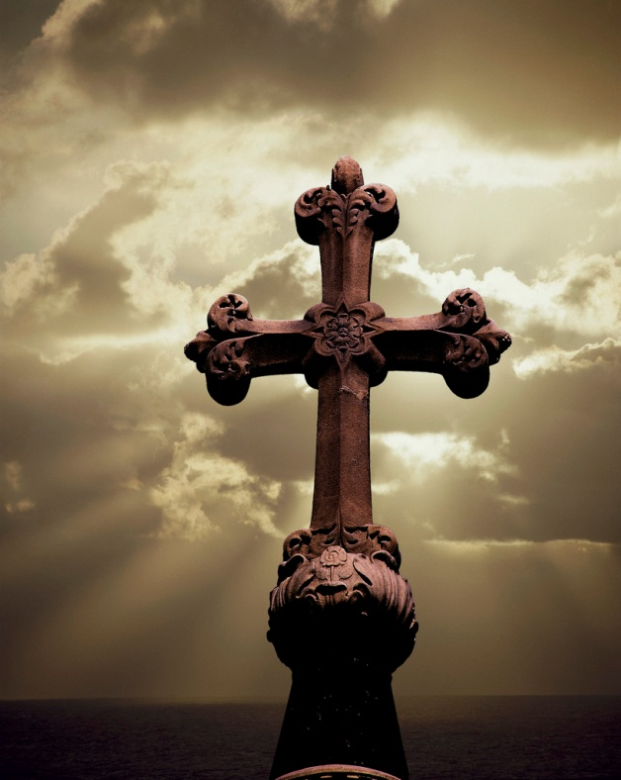
Early Christianity: imminent expectation

Slide 6
Mark 9:1
‘And he said to them, “Truly I tell you, there are some standing here who will not taste death until they see that the kingdom of God has come with power.”’

Slide 7
1 Thessalonians 4:15-17
‘For this we declare to you by the word of the Lord, that we who are alive, who are left until the coming of the Lord, will by no means precede those who have died. For the Lord himself, with a cry of command, with the archangel’s call and with the sound of God’s trumpet, will descend from heaven, and the dead in Christ will rise first. Then we who are alive, who are left, will be caught up in the clouds together with them to meet the Lord in the air; and so we will be with the Lord for ever.’

Slide 8
1 Corinthians 15:52
‘In a moment, in the twinkling of an eye, at the last trumpet. For the trumpet will sound, and the dead will be raised imperishable, and we will be changed.’

Slide 9
2 Peter 3:3-4
‘First of all you must understand this, that in the last days scoffers will come, scoffing and indulging their own lusts and saying, “Where is the promise of his coming? For ever since our ancestors died, all things continue as they were from the beginning of creation!”’

Slide 10
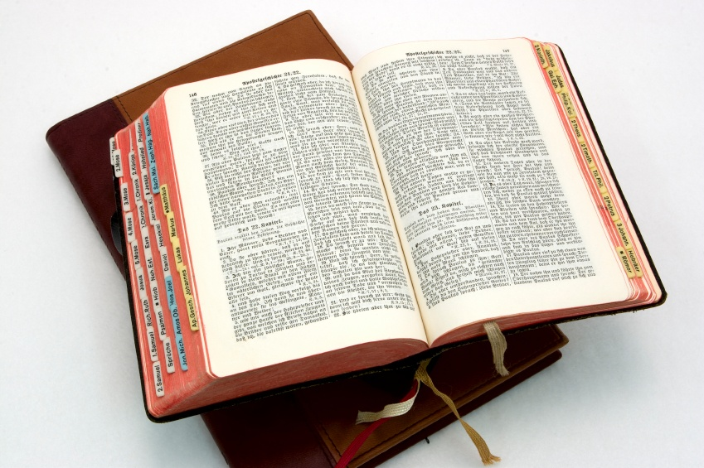
Biblical depictions of the future of the earth

Slide 11
Isaiah 11:6-9
‘The wolf shall live with the lamb, the leopard shall lie down with the kid, the calf and the lion and the fatling together, and a little child shall lead them. The cow and the bear shall graze, their young shall lie down together; and the lion shall eat straw like the ox. The nursing child shall play over the hole of the asp, and the weaned child shall put its hand on the adder’s den. They will not hurt or destroy on all my holy mountain; for the earth will be full of the knowledge of the Lord as the waters cover the sea.’

Slide 12
Joel 2:1-3
‘Blow the trumpet in Zion; sound the alarm on my holy mountain! Let all the inhabitants of the land tremble, for the day of the Lord is coming, it is near— a day of darkness and gloom, a day of clouds and thick darkness! Like blackness spread upon the mountains a great and powerful army comes; their like has never been from of old, nor will be again after them in ages to come.
Fire devours in front of them, and behind them a flame burns. Before them the land is like the garden of Eden, but after them a desolate wilderness, and nothing escapes them.’

Slide 13
Mark 13:24-27
‘But in those days, after that suffering, the sun will be darkened, and the moon will not give its light, and the stars will be falling from heaven, and the powers in the heavens will be shaken. Then they will see “the Son of Man coming in clouds” with great power and glory. Then he will send out the angels, and gather his elect from the four winds, from the ends of the earth to the ends of heaven.’

Slide 14
2 Peter 3: 10-13
‘But the day of the Lord will come like a thief, and then the heavens will pass away with a loud noise, and the elements will be dissolved with fire, and the earth and everything that is done on it will be disclosed.
Since all these things are to be dissolved in this way, what sort of people ought you to be in leading lives of holiness and godliness, waiting for and hastening the coming of the day of God, because of which the heavens will be set ablaze and dissolved, and the elements will melt with fire? But, in accordance with his promise, we wait for new heavens and a new earth, where righteousness is at home.’

Slide 15
Revelation 21:1-5
‘Then I saw a new heaven and a new earth; for the first heaven and the first earth had passed away, and the sea was no more. And I saw the holy city, the new Jerusalem, coming down out of heaven from God, prepared as a bride adorned for her husband. And I heard a loud voice from the throne saying,
‘See, the home of God is among mortals. He will dwell with them; they will be his peoples, and God himself will be with them; he will wipe every tear from their eyes. Death will be no more; mourning and crying and pain will be no more, for the first things have passed away.’
And the one who was seated on the throne said, ‘See, I am making all things new.’’

Slide 16

Eschatological beliefs and environmentalism

Slide 17
Some questions...
If the ‘old’ earth will be replaced by a new earth (and a new heaven), as some biblical texts suggest, why preserve the old one?
If humans will be saved, why should caring for the environment be a priority?
If the end will come very soon, why worry about future generations?

Slide 18
Interpretation 1: ‘Transformation’ rather than ‘destruction’
‘If the present creation will not be destroyed but renewed, it would seem important to care for it today.’ Thomas Finger, Evangelicals, Eschatology, and the Environment, p. 1
Christian environmentalists see caring for the earth as joining in the work God is doing to bring creation to its transformed and peaceful future.

Slide 19
Interpretation 2: ‘Evangelism’ rather than ‘environment’
Some fundamentalist and evangelical Christians, particularly from the USA, argue that current environmental disasters are signs of the imminent end of the world and Jesus’ return.
Given that the earth will be destroyed, they believe it is more important to convert people to Christianity than to care for the environment.

Slide 20
‘Christians should not be carried away into the frenzy that is being stirred up in popular culture. While it is true that we are all stewards of the earth and should thus take care of it, we should also be aware of the fact that the “heavens and earth which are now” are being prevented from being destroyed by the Word of God (2 Pet. 3:7). God will one day destroy the earth with the fire of judgment, and this is the warning that Christians must take to those who are lost, in order that they might be saved through the obedience of the Gospel.’
Spencer Strickland, ‘Beware of Global Warming! (2 Peter 3:6-7)’

Slide 21
The Cornwall Alliance
American evangelical organisation
Sees environmentalism as a ‘Green Dragon’ – a dangerous threat to Christianity
Watch a video clip about their views

Slide 22
We believe Earth and its ecosystems—created by God’s intelligent design and infinite power and sustained by His faithful providence —are robust, resilient, self-regulating, and self-correcting, admirably suited for human flourishing, and displaying His glory. Earth’s climate system is no exception. Recent global warming is one of many natural cycles of warming and cooling in geologic history.
We believe abundant, affordable energy is indispensable to human flourishing, particularly to societies which are rising out of abject poverty and the high rates of disease and premature death that accompany it. With present technologies, fossil and nuclear fuels are indispensable if energy is to be abundant and affordable.
Cornwall Alliance, ‘Evangelical Declaration on Global Warming’

Slide 23
For discussion
Can you see why Christians who do not support environmentalism hold the views they do, based on the Bible passages above?
How do you think those Christians who do want to support environmentalism deal with biblical passages like these?
What are your reactions to these biblical texts? Do you think they encourage Christians to be good or bad at preserving the earth for future generations?

