Slide 1
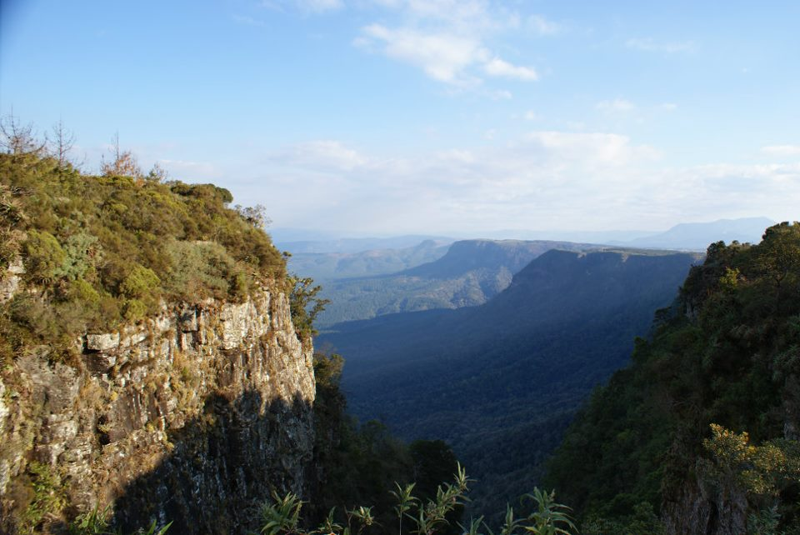
Criticisms of Stewardship
Background image copyright Helen C. John

Slide 2

Click for an introductory video: Criticisms

Slide 3
Lesson aims
To show that stewardship is not universally accepted as a good basis for environmental ethics
To highlight some of the main criticisms made of the idea that humans should see themselves as stewardship of the earth

Slide 4
Biblical criticisms
There is no strong biblical basis for stewardship.
Nowhere is humanity explicitly given the role of stewards of creation.

Slide 5
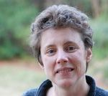
Biblical criticisms
Clare Palmer:
'Claiming a biblical pedigree for the idea is at best to oversimplify, and may be largely mistaken.’
Palmer, ‘Stewardship: A Case Study in Environmental Ethics', p. 66

Slide 6

Theological criticisms
Stewardship gives humans a ‘managerial’ role over God’s creation.
Does this mean God has disappeared from the scene?

Slide 7
Theological criticisms
Clare Palmer
'...perceptions of stewardship have great difficulty in accommodating the idea of God's action or presence in the world. God is understood to be an absentee landlord, who has put humanity in charge of his possessions.’
Palmer, ‘Stewardship’, p. 68

Slide 8
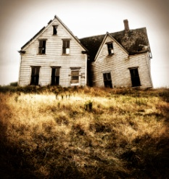
Political criticisms
The idea of stewardship comes originally from societies where feudal landlords left managerial slaves in charge of their property.
Clare Palmer: 'The political message encoded in stewardship is one of power and oppression; of server and served’.
Palmer, ‘Stewardship’, p. 69

Slide 9

Ecological criticisms
Stewardship regards the world as a 'natural resource', to be managed well for human benefit.
It is an arrogant ethic, suggesting that humans have both the right and the ability to organise creation.
It is also highly anthropocentric, putting humans in a unique and privileged position.
Clare Palmer: ‘In the light of evolutionary science, the idea that the earth “needs to be managed” by humans is obviously a nonsense.’
Palmer, ‘Stewardship’, p. 71

Slide 10
Group discussion
As a group, read the questions on your sheet.
Take 10 minutes to discuss your answers to them. Do you all agree? Why or why not?
Nominate one member of your group to explain your discussion to the rest of the class in less than 2 minutes.

Slide 11


And finally...
Clare Palmer: 'Stewardship of the natural world, whether Christian or otherwise… remains profoundly anthropocentric and un-ecological, legitimating and encouraging increased human use of the natural world’. Palmer, ‘Stewardship’, p. 75
Do you agree?
Why or why not?

