Slide 1
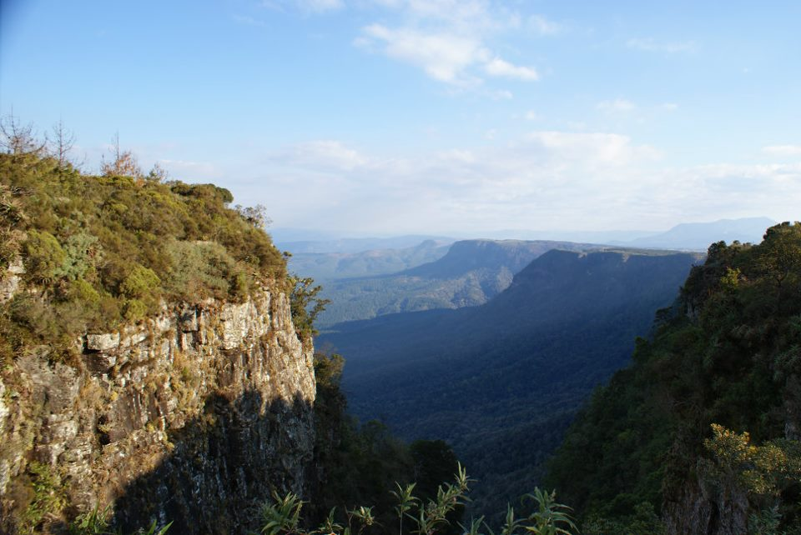
Humans and (Other) Animals
Background image copyright Helen C. John

Slide 2

Click for an introductory video: Animals

Slide 3
Lesson aims
To introduce issues about the moral status of animals
To consider the range of biblical perspectives on this topic
To think about the arguments for vegetarianism, including biblical texts used in support

Slide 4
Starter Activity
Watch the video
from Understanding Animal Research
WARNING: CONTENT MAY BE DISTRESSING
http://www.understandinganimalresearch.org.uk/resources/video-library/
What does it tell us about some of the ways in which humans treat animals?

Slide 5
A selection of biblical texts are displayed around the room. Each group will begin by looking at a different text. You have one minute to read through the text and make notes on your chart. When the minute is up, move on to the next text. Ready?
On your marks...
Get set...
...GO!

Slide 6
1. Leviticus 1:14-17
If your offering to the Lord is a burnt-offering of birds, you shall choose your offering from turtle-doves or pigeons. The priest shall bring it to the altar and wring off its head, and turn it into smoke on the altar; and its blood shall be drained out against the side of the altar. He shall remove its crop with its contents and throw it at the east side of the altar, in the place for ashes. He shall tear it open by its wings without severing it. Then the priest shall turn it into smoke on the altar, on the wood that is on the fire; it is a burnt-offering, an offering by fire of pleasing odour to the Lord.

Slide 7
Discussion...
Animal sacrifice in Leviticus 1 suggests that animals can be used and killed, both for food and religious ritual, in ways that humans cannot.

Slide 8
2. Deuteronomy 25:4
You shall not muzzle an ox while it is treading out the grain.

Slide 9
Discussion...
In contrast to the previous passage, this text shows that the rules of the Jewish law, the Torah, include regulations implying a compassionate and moral concern for animals.

Slide 10
3. 1 Corinthians 9:9-10
For it is written in the law of Moses, ‘You shall not muzzle an ox while it is treading out the grain.’ Is it for oxen that God is concerned? Or does he not speak entirely for our sake? It was indeed written for our sake, for whoever ploughs should plough in hope and whoever threshes should thresh in hope of a share in the crop.

Slide 11
Discussion...
In this text, Paul quotes the previous passage but applies it to humans, suggesting that God is not concerned about animals.

Slide 12
5. Luke 12:24
Consider the ravens: they neither sow nor reap, they have neither storehouse nor barn, and yet God feeds them. Of how much more value are you than the birds!

Slide 13
Discussion...
In this text, Jesus is clear that humans are of much greater value.

Slide 14
6. Mark 5:11-13
Now there on the hillside a great herd of swine was feeding; and the unclean spirits begged him, ‘Send us into the swine; let us enter them.’ So he gave them permission. And the unclean spirits came out and entered the swine; and the herd, numbering about two thousand, rushed down the steep bank into the lake, and were drowned in the lake.

Slide 15
Discussion...
The drowning of pigs following one of Jesus' recorded exorcisms also seems to suggest a greater value placed on human life.

Slide 16
7. Romans 8:19-23
For the creation waits with eager longing for the revealing of the children of God; for the creation was subjected to futility, not of its own will but by the will of the one who subjected it, in hope that the creation itself will be set free from its bondage to decay and will obtain the freedom of the glory of the children of God. We know that the whole creation has been groaning in labour pains until now; and not only the creation, but we ourselves, who have the first fruits of the Spirit, groan inwardly while we wait for adoption, the redemption of our bodies.

Slide 17
Discussion...
Biblical ideas about the liberation of the whole creation in Christ, such as in Romans 8.19-23, could be used to argue that all living things have moral and religious value.

Slide 18
8. Genesis 1:30
And to every beast of the earth, and to every bird of the air, and to everything that creeps on the earth, everything that has the breath of life, I have given every green plant for food.’ And it was so.

Slide 19
Discussion...
In Genesis 1.30, the food originally allocated for all animals and humans consists only of plants.

Slide 20
9. Genesis 9:1-4
God blessed Noah and his sons, and said to them, ‘Be fruitful and multiply, and fill the earth. The fear and dread of you shall rest on every animal of the earth, and on every bird of the air, on everything that creeps on the ground, and on all the fish of the sea; into your hand they are delivered. Every moving thing that lives shall be food for you; and just as I gave you the green plants, I give you everything. Only, you shall not eat flesh with its life, that is, its blood.

Slide 21
Discussion...
Explicit permission to eat meat only comes about in Genesis 9.1-5, which is after the story of the Flood. This implies that this is not how things were originally intended to be.

Slide 22
10. Isaiah 11:6-9
The wolf shall live with the lamb,
the leopard shall lie down with the kid,
the calf and the lion and the fatling together,
and a little child shall lead them.
The cow and the bear shall graze,
their young shall lie down together;
and the lion shall eat straw like the ox.
The nursing child shall play over the hole of the asp,
and the weaned child shall put its hand on the adder’s den.
They will not hurt or destroy
on all my holy mountain;
for the earth will be full of the knowledge of the Lord
as the waters cover the sea.

Slide 23
Discussion...
The prophets' visions of a renewed creation, where violence and conflict are no more, include an end to predation and killing in the animal world.

Slide 24
For discussion
What do the biblical texts tell us about the relationship between humans and other animals?
Is it a simple answer?
Are there varying interpretations?
Why?

