Slide 1
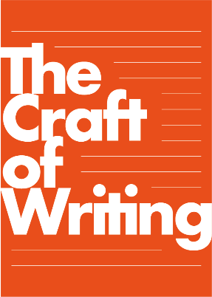


CPD Day 2: Welcome!
All art is achieved through the exercise of a craft, and every craft has its rudiments that must be taught.
  Fairfax and Moat (1998)

Slide 2
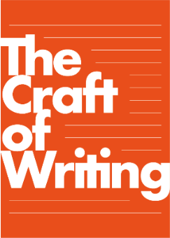
From Arvon to the Classroom
A key goal for this project is to help you as teachers transfer what you have learned/will learn from the Arvon residentials into your classrooms, particularly in relation to:
How you see yourself as a writer and how you help children to see themselves as writers;
How you adapt what you learn at Arvon to be effective in your own classrooms;
How you combine the Arvon learning with the demands of the curriculum.
Anthology of Writing
Residential 2:
Celebrating you as writers!

Slide 3
Today
10.00-10.30 Introduction and Reflection on Gap Task
10.30-10.45 Facing up to Feedback!
10.45-11.15 Craft of Writing Framework: Text Level Choices
11.15 Coffee
11.30-12.30 Another Taste of Arvon
12.30-13.00 Craft of Writing Framework: Reader-Writer relationship
13.00 Lunch
13.45-14.30 Learning from Children’s Writing
14.30-15.00 From Arvon to the Classroom
15.00-15.30 Plenary

Slide 4

How are you using this to inform your teaching of writing?
The Craft of Writing Framework
Language
Choices
Text-Level choices
Being an author
Writing
process
Reader-writer
relationship

Slide 5
REFLECTING ON THE GAP TASK

Slide 6
Gap Task 2
This Gap Task is to help you build on both the June Arvon Residential experience and the September CPD day and to actively use what you are learning in your own classrooms. We would like you to continue using the strategies and ideas you have already been exploring, but also to:
continue to use the Just Write (freewriting) approach, but experiment with not always using it at the start of writing; it can be used as a piece of writing is developing to explore a particular aspect eg just write about what this character is going to do next; or just write about this moment in the plot;
think about how to incorporate what you have learnt about the craft of writing into your teaching of writing, with a particular focus this time on the writing process, being an author, and making language choices;
create A3 representations which show the journey/process of a piece of writing from initial ideas to finished piece for three children, and for yourself (4 in total). Choose three children of differing abilities, and represent less successful journeys as well as successful ones. You might annotate the journeys with categories from the craft framework. Bring these to CPD Day 2.

Slide 7
Gap Task 2: Reflection
From Arvon to the classroom
How have you used freewriting at different points in the process of writing, rather than just as an initial idea generation strategy?
How have you incorporated what you have learnt about the craft of writing into your teaching of writing, with a particular focus this time on the writing process, being an author, and making language choices;
In groups, share your reflections on what you have done and the challenges or successes of this.
Your writing journey: share your A3 representation of your writing journey with a partner, talking through both what you did and how you see yourself as a writer.

Slide 8
GIVING FEEDBACK TO WRITERS

Slide 9
Giving Critical Feedback
Teachers are often reluctant to give feedback, other than bland praise, to children’s creative writing (especially poetry);
Creative writing is put on a pedestal, where it can’t be touched;
We give lots of feedback to other kinds of writing in the curriculum;
But writers need feedback on their creative work too, and this is crucially important for developing writers.
Why is there such reluctance to give feedback on creative writing?

Slide 10
‘Creativity is not simply a matter of letting go’: rather genuine creative work ‘relies on knowledge, control of materials and command of ideas’ and involves not just innovation, but also knowledge and skills.
National Advisory Committee on Creative and Cultural Education (NACCCE, 1999: 6)
Why is writing so tricky? Because it requires mastery of two conflicting skills: a creative skill and a critical skill. The former is of the imagination, the latter of the intellect, and they come from different brain hemispheres. To write well, we have to employ both to maximum effect.
Tim Bowler (2002)

Slide 11
Giving Critical Feedback
Feedback develops children’s critical capacities – their understanding of how to discuss and improve their own writing;
It is hard to revise writing if you have no real sense of how to judge what you have written, or how to change what you have written;
The Arvon residentials create rich creative spaces for writing, but the tutorials offer space for constructive and critical feedback;
Critical feedback generates a shared vocabulary and language to talk about writing;
Critical feedback demands subject knowledge of the craft of writing.
The Craft of Writing Framework: a shared way of thinking about writing.

Slide 12
TEXT-LEVEL CHOICES
THE CRAFT OF WRITING FRAMEWORK

Slide 13
TEXT LEVEL CHOICES
Knowledge about structural and text-level features and their effects
TEXT LEVEL CHOICES

Slide 14
TEXT LEVEL CHOICES
Knowledge about structural and text-level features and their effects
Poetic
Structures
Dialogue
and tone
Viewpoint
Narrative
Structure
TEXT LEVEL CHOICES
Characterisation
Show, not Tell

Slide 15
Giving Feedback: Text-Level
Choices
What critical feedback might you give to Nicola Davies on her Text Level Choices in King of the Sky?
Look especially at:
Narrative structure
Repetition
Viewpoint
Remember that critical feedback is not negative: it focuses as much on what has been successful as on what needs improvement. But it verbalises why something is successful or less so?

Slide 16
Giving Feedback: Text-Level Choices
How does better understanding of Text level choices support feedback and revision?

Slide 17
ANOTHER TASTE OF ARVON

Slide 18
READER-WRITER RElATIONSHIP
THE CRAFT OF WRITING FRAMEWORK

Slide 19
READER WRITER RELATIONSHIP
Knowledge about the interaction between reader, writer, and the ways in which readers become engaged in or affected by writing
READER WRITER RELATIONSHIP

Slide 20
READER WRITER RELATIONSHIP
Knowledge about the interaction between reader, writer, and the ways in which readers become engaged in or affected by writing
Affecting the Reader
Helping
the Reader
READER WRITER RELATIONSHIP
Engaging the Reader
Reader Writer Interaction

Slide 21
Category | Explanation | Example
Helping the reader understand | Strategies to ensure the reader is able to follow the text | It’s always about taking the simple way of getting to your reader
Engaging the reader | Strategies to involve the reader and keeping them in the moment | Make the reader feel like they’re there
Affecting the reader | Strategies to influence readers’ feelings | What is it you want your reader to feel when they close the book
Reader-writer interaction | Comments about the collaboration between reader and writer | The reader is as much a part of your piece of writing as you, the writer

Slide 22

Reader-writer interaction
‘We authors think of our books not as monologues, but rather as the openings of conversations: conversations between authors and readers, between characters and readers, between readers and other readers, and between readers and their communities’.
Sara Pennypacker

Slide 23

If I can't hook a reader right away, I don't have a job, so I've spent a lot of time thinking about how to do it .

Slide 24
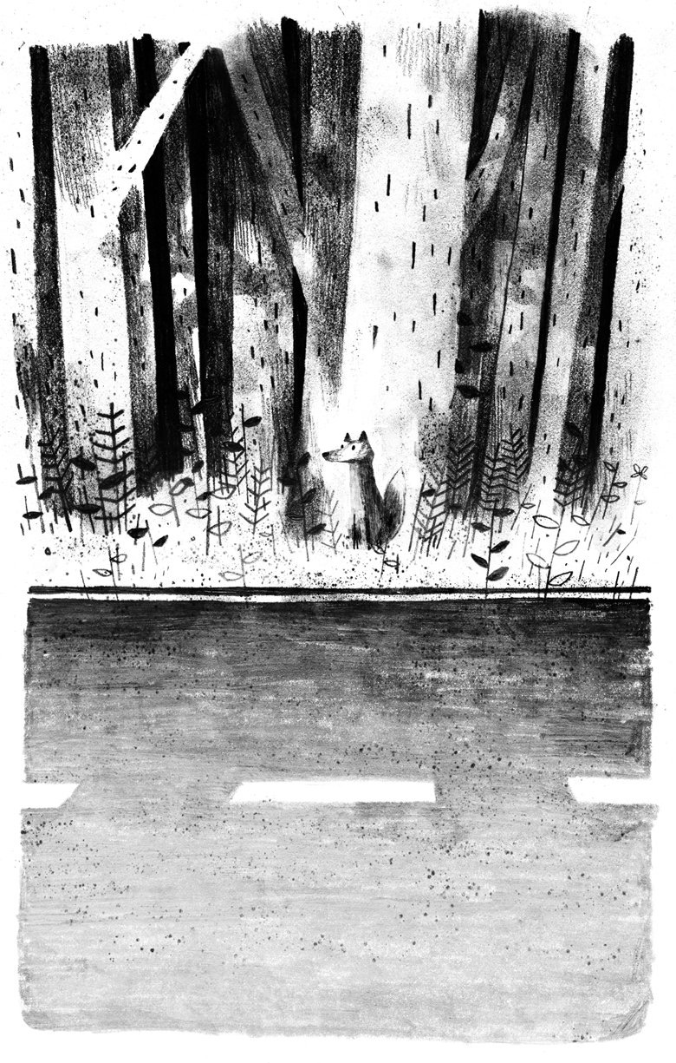
Teresa to complete

Slide 25

Engaging the reader
Children read for pretty much the same reasons adults read, [so I try to offer..]
Pleasure (which can include safely experiencing terror or regret or grief, not just laughter or fun)
Curiosity - humans are wired to want to know what happens next!
Self-understanding - People read to find out who they are, and who they could be.
Connection with others - We humans are pack animals, and having successful relationships is high on our priority list. Books that show people forming friendships, working through diffs, finding common ground or exploring new experiences together are extremely attractive to kids as they grow.
Information - Children are born into small worlds which expand rapidly - family, neighbors, school, and beyond. They value books which help them understand how the world works.
Sara Pennypacker

Slide 26
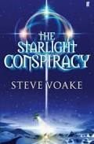

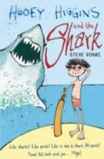
Affecting the reader
I’ll say to writers what is it that you want your reader to feel when they close the book or they finish the poem. What’s that feeling that you’re looking for?
Steve Voake
I’ll be kind of ruthless and say right that needs to go, I don’t need that, I needed it to tell me what was going on, but now I know the reader doesn’t necessarily need it.
Usually as an author you end up needing to know far more than the reader does.
Steve Voake
Notes:
I think about how to talk about difficult things in a way which is ‘kind’, … ‘grace notes’
Sara Pennypacker

Slide 27
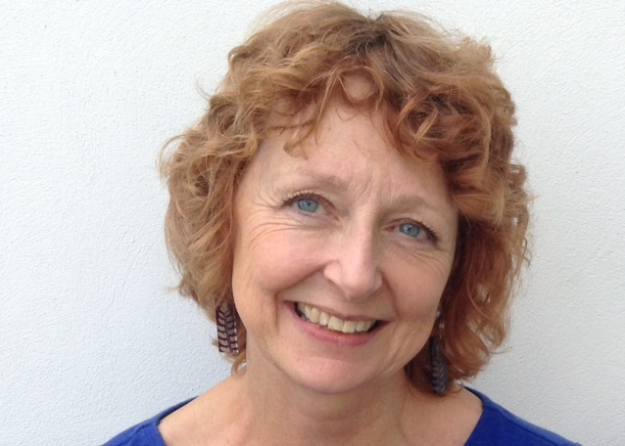

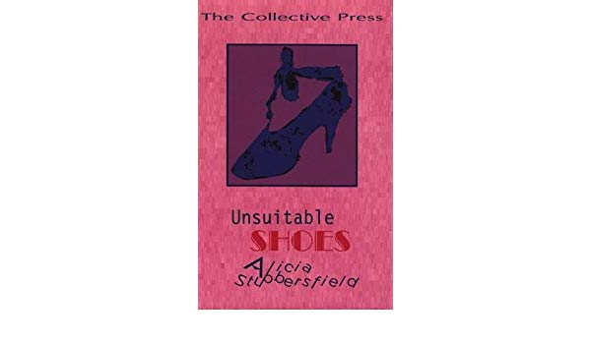
Helping the reader understand
…we want to know is what’s happening. We don’t want to know the whole story because we want to be able to fill it in for ourselves a bit.
You know you have to leave room for the reader.
Alicia Stubbersfield
‘
Notes:
They are more likely to talk about their relationships with their characters than their readers.

Slide 28
Reader-writer relationships
How does better understanding of the reader-writer relationship support feedback and revision?
Notes:
Relationship with the reader in contrast to relationship with the system

Slide 29
LEARNING FROM CHILDREN’S WRITING

Slide 30
Student Writing Journeys
In threes: share one of the student writing journeys represented on A3, including giving a little vignette about the writer (context).
What are the writing journeys telling you about each child as a writer; and about how you teach writing?
Use the writing journey from each teacher and together decide what feedback you might give the writer, and what prompts for revision you might offer? Use the Craft of Writing Framework as a guide.

Slide 31
FROM ARVON TO THE CLASSROOM:
FeedBack

Slide 32
Offering Feedback to each other
In pairs, share one piece of writing from the Arvon Residential: read it aloud to each other.
Allow yourselves 5 minutes for each of you as the reader to consider what feedback to give, using the Craft Framework, and write these down.
In turn, offer your partner constructive focused peer feedback related to the Craft Framework
Each time, the writer needs to consider what revision s/he might do now and share these.

Slide 33
PLENARY: NEXT STEPS

Slide 34
Pedagogical Principles
These principles have been developed by drawing on both the values underpinning Arvon and research about what makes effective teaching of writing:
Create inclusive classrooms where children are given time and space to write, opportunities to write without being assessed, and to take risks and be experimental;
Offer inspiring opportunities and starting points for writing, including writing from the heart and writing from experience so that children experience being an author;
Support young writers in understanding and managing the writing process and being aware of the reader-writer relationship;
Explicitly teach the language and textual choices students can make in their writing;
Create a community of writers where writing is shared, critiqued and celebrated, where feedback is purposeful.

Slide 35

Seasonal Short story Collection

Slide 36
Gap Task 3: Part 1
We would like you to:
Commit at least one session a week to developing your Seasonal Short Story Collection with your class using the pedagogical principles and Craft of Writing framework.
Keep a diary in your journal, (at least 6 full reflections) reflecting on the journey you took to produce your class publication. Reflect on how you managed and how the class responded to different elements of the journey:
Free writing time - to explore ideas for their seasonal story as authors;
The teaching of elements of the Craft of Writing Framework - especially text level choices and language choices;
The writing process - reviewing and revising time, and offering focused feedback;
Reader writer relationship - writing for an audience;
The final outcome - publishing or performing within your community of writers.

Slide 37
Gap Task 3: Part 2
2. Choose three children of differing abilities and with different relationships to writing. Reflect on how they each responded to these elements of the journey in your diary.
3. Write a concluding reflection about:
what worked well and why
where the challenges were and why
how you plan to build on all these elements of writing in your everyday teaching in the Spring Term
January 2018 prior to Arvon residential
4. Look at your medium term plans for the Spring term and start to plan a unit of work. If time allows before the Residential, deliver your short unit of work. Consider how you can embed the elements of the Craft of Writing Framework and pedagogical principles into your plan. What elements are easier to fit in? Equally, what are the challenges you will want to circumnavigate?

Slide 38
Project Website
http://socialsciences.exeter.ac.uk/education/research/centres/centreforresearchinwriting/projects/craftofwriting/
‘Resources for Intervention Teachers’
Username: Arvon
Password: TedHughes

Slide 39
We meet again!
Residential 2: Jan 11-13th Lumb Bank
CPD Day 3: May 8th 2019

