Slide 1
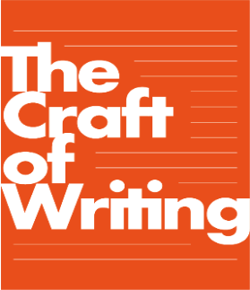
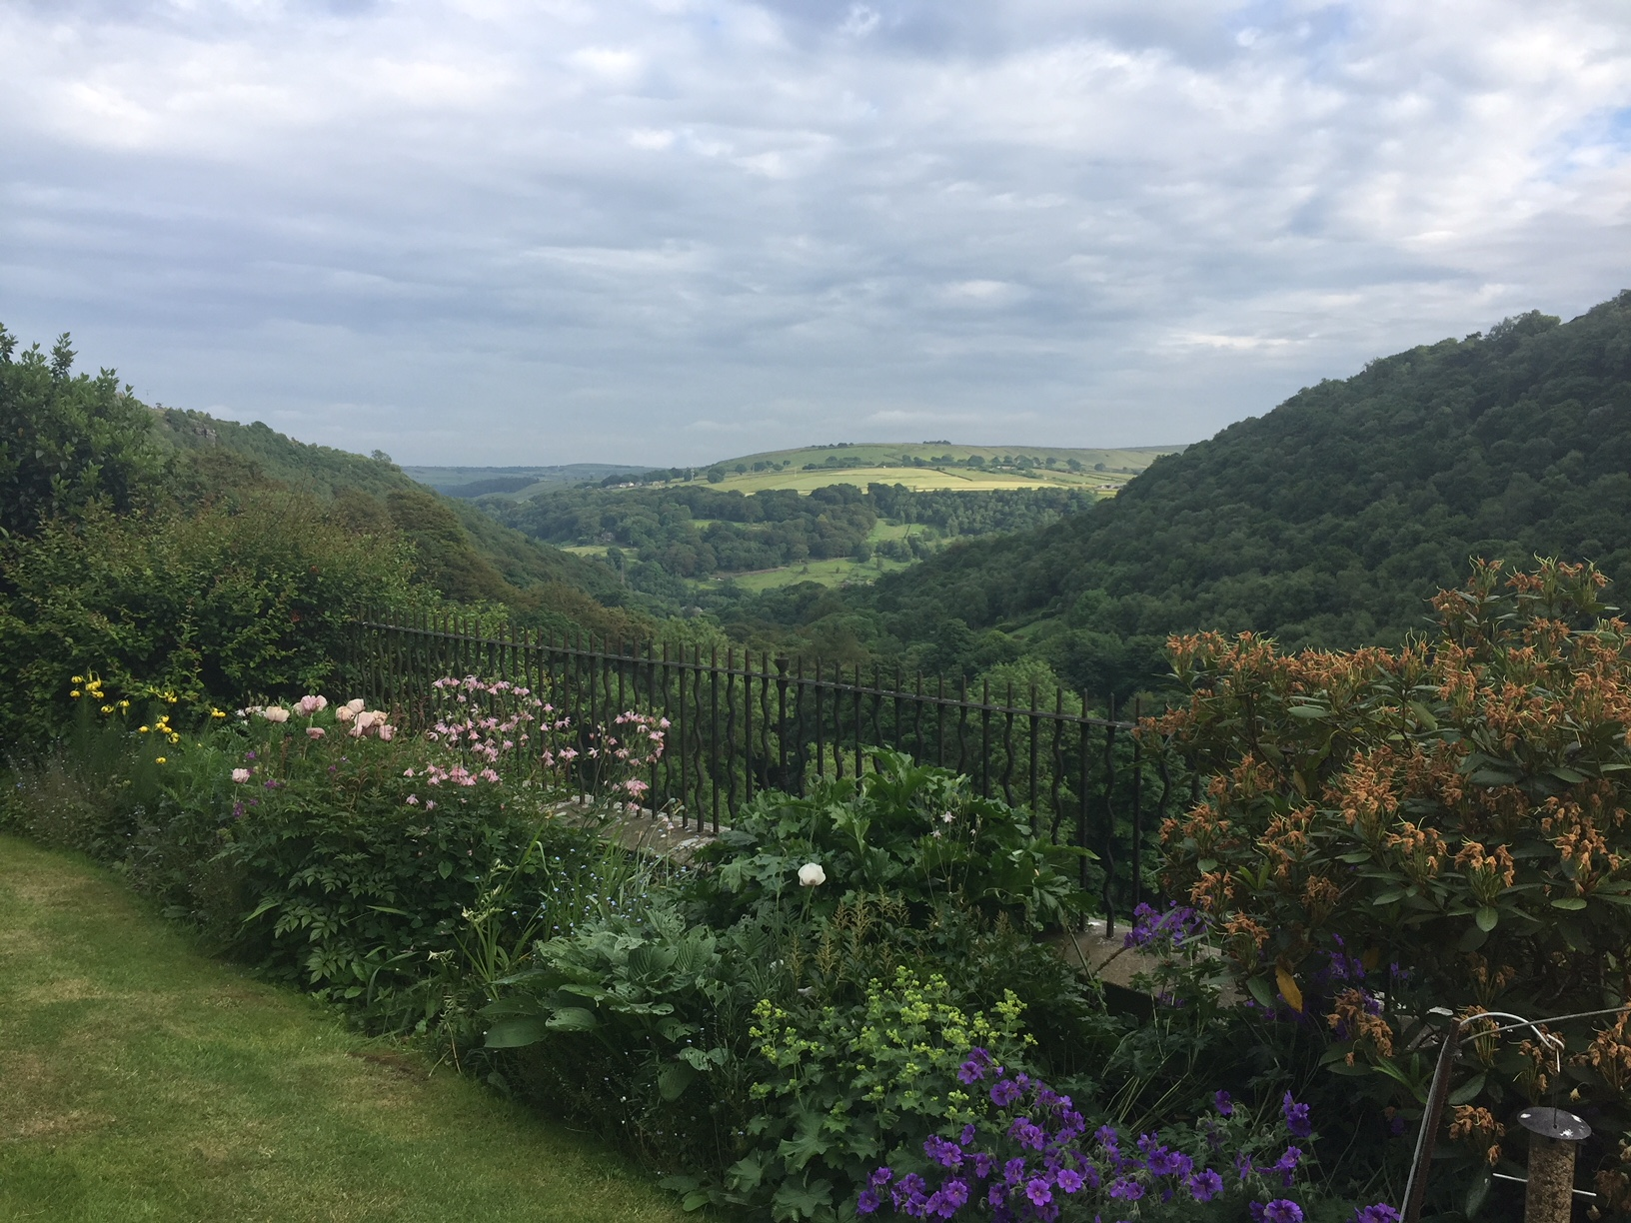
From Arvon to the classroom workshop

Slide 2
Plan for the Morning
Key messages from the two CPD days;
Challenges and Opportunities in the Classroom;
Using texts to model the Craft of Writing Framework;
Spotlight on Feedback;
Planning Lesson Sequences using the Craft of Writing Framework;
My Arvon autobiography;
Gap Task 4.

Slide 3
Not Craft of Writing on the side!
Embedding the Arvon experience and the Craft of Writing into your mainstream teaching of writing

Slide 4
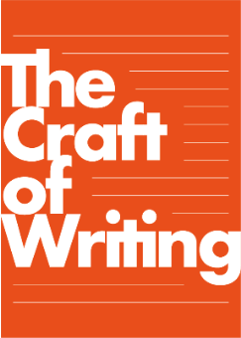
Pedagogical Principles
These principles have been developed by drawing on both the values underpinning Arvon and research about what makes effective teaching of writing:
Create inclusive classrooms where children are given time and space to write, opportunities to write without being assessed, and to take risks and be experimental;
Offer inspiring opportunities and starting points for writing, including writing from the heart and writing from experience so that children experience being an author;
Support young writers in understanding and managing the writing process and being aware of the reader-writer relationship;
Explicitly teach the language and textual choices students can make in their writing;
Create a community of writers where writing is shared, critiqued and celebrated, where feedback is purposeful.

Slide 5

Key Messages from CPD Day 1
The introduction of the Craft of Writing Framework, its provenance from Teachers as Writers and its use within this project.
The introduction of three strands: writing process, being an author and language-level choices.
The importance of reading critically and employing the Craft of Writing Framework in text study, using texts as models to enable reading to feed writing.
The importance of continuing to apply learning from Arvon in the classroom and using the Craft of Writing Framework.

Slide 6
Key Messages from CPD Day 2
The introduction of two new strands from the Craft of Writing Framework:
Text Level Choices; and Reader-Writer Relationship;
The importance of giving critical feedback to writers:
to generate a shared vocabulary and language to talk about writing;
to help revision skills - It is hard to revise writing if you have no real sense of how to judge what you have written, or how to change what you have written;
The value of the Craft of Writing Framework in supporting feedback conversations.
The importance of sustained efforts to take learning from Arvon to the classroom, and to use the Craft of Writing Framework to inform planning and teaching.

Slide 7

Craft of Writing Framework
One point of learning you find challenging to understand or to implement from the Craft of Writing Framework.
One point of learning you still feel unsure/unclear about in the Craft of Writing Framework.
One point of learning you have taken and used successfully in practice from the Craft of Writing Framework.

Slide 8
Problems and possible solutions
Craft Knowledge:
The knowledge on which writers draw in order to shape language and make choices that fulfil their authorial intentions and their awareness of how they manage the process of composing text.

Slide 9
Texts as Models: Creating a Setting
Beyond the footsteps of the greatest explorers and up past the reach of the trustiest maps there lies a kingdom called Erkenwald.
Here, the sun still shines at midnight in the summer, glinting off the icebergs in the north and slipping between the snow-capped Never Cliffs in the west. But it does not rise at all in the long, cold winters. Then, the nights bleed on and on and the darkness is so thick you cannot see your hands in front of your face.
From the opening of Sky Song by Abi Elphinstone
Can you visualise this country – in summer and in winter?
What feedback might you give Abi Elphinstone on how well she has created a setting?

Slide 10
Creating a Setting
Beyond the footsteps of the greatest explorers and up past the reach of the trustiest maps there lies a kingdom called Erkenwald.
Here, the sun still shines at midnight in the summer, glinting off the icebergs in the north and slipping between the snow-capped Never Cliffs in the west. But it does not rise at all in the long, cold winters. Then, the nights bleed on and on and the darkness is so thick you cannot see your hands in front of your face.
From the opening of Sky Song by Abi Elphinstone
Language Choices: (visual and geographic) detail in noun phrases;

Slide 11
Creating a Setting
Beyond the footsteps of the greatest explorers and up past the reach of the trustiest maps there lies a kingdom called Erkenwald.
Here, the sun still shines at midnight in the summer, glinting off the icebergs in the north and slipping between the snow-capped Never Cliffs in the west. But it does not rise at all in the long, cold winters. Then, the nights bleed on and on and the darkness is so thick you cannot see your hands in front of your face.
From the opening of Sky Song by Abi Elphinstone
Language Choices: word choices; avoiding cliché;

Slide 12
Creating a Setting
Beyond the footsteps of the greatest explorers and up past the reach of the trustiest maps there lies a kingdom called Erkenwald.
Here, the sun still shines at midnight in the summer, glinting off the icebergs in the north and slipping between the snow-capped Never Cliffs in the west. But it does not rise at all in the long, cold winters. Then, the nights bleed on and on and the darkness is so thick you cannot see your hands in front of your face.
From the opening of Sky Song by Abi Elphinstone
Language Choices: sentence structure

Slide 13
Texts as Models: Viewpoint
Look at Chapter 1: from whose viewpoint is the narrative opening told?
Ch 1 -Pennypacker is all-knowing narrator (see p5) but she chooses to tell this chapter through Pax’s eyes - we see what Pax is doing and how he is feeling.
Look at chapters 2-33: from whose viewpoint is each chapter told?
The chapters alternate between Peter and Pax (odd numbers Pax, even numbers Peter)
Each chapter signals the viewpoint in the first paragraph by using the character name (to help younger readers?) and by using an image at the start of each chapter
Look at chapter 34: from whose viewpoint is the ending told?
Ch34 is principally from Peter’s perspective, but note the alternation of ‘Peter’ and ‘Pax’ on the final page – we are still seeing two perspectives.
Noticed by a year 5 child on the project!

Slide 14
Texts as Models: Viewpoint
When did you make the choice to tell the story through alternating points of view? Were there certain parts of the story that were best told through Peter’s point of view and others from Pax’s perspective?
In the early drafts, I only had one point of view—the fox’s. Peter’s came later, halfway into the writing, when I realized how much more light I could shed on the whole story if I included a human’s understanding. Once I decided that, I next had to figure out which piece of the story belonged to which character. I made the decisions based on two factors: who had the most insight to share, and whose view was the most moving. The hardest to choose were the first and last chapters—I wrote them each out from both points of view, and only hope I chose the right ones. As a writer, the most rewarding parts of Pax were the events that were told from both Peter’s and Pax’s perspectives— they reminded me how differently we all perceive the same thing.
http://www.sarapennypacker.com/pennypacker-pax.htm

Slide 15
Texts as Models: Narrative Structure
What might you note about the narrative structure of Pax?
Chapter 1 establishes the close relationship between Peter and Pax and sets the narrative problem – why is Peter distressed? Why do they leave Pax in the forest? Why are they separated?
The alternating viewpoints, in alternate chapters, develops two separate but intertwined narratives – Peter’s story and Pax’s story. These narratives are both external (plot development) and internal (the emotional story).
The first and last chapter have thematic/verbal links: the setting is the forest in both; Pax licks away Peter’s tears in both; the toy soldier is thrown for Pax in both. But the reader is invited to think about what has changed for Pax and Peter.

Slide 16

Texts as Models: Narrative Structure
Opening: Peter and Pax are together
Narrative Development:
Peter’s story and Pax’s stories are separate but intertwined:
two journeys;
new friends;
new understandings.
Close: Peter and Pax are together

Slide 17
Texts as Models: Narrative Structure
Once upon a time… there was a boy called Peter who had a pet fox, Pax, that he had looked after since he was a cub.
And every day… they grew closer as boy and animal.
Until one day… Peter’s father made him abandon Pax in the forest.
And because of that… Peter ran away from home
And because of that… Pax had to live independently in the forest
And because of that… they made new friends and learned new things
Until finally… they were reunited in the forest, but Peter knew he had to give Pax his liberty
And every day after that… Peter remembered Pax
And the moral of this story is… … …

Slide 18
Texts as Models
We have looked at Pax in terms of viewpoint and narrative structure (from Text Level Choices in the Craft of Writing Framework.
Our reading is an adult reading.
How could you use Pax as a model text to teach about viewpoint in narrative, and/or about narrative structure to meet the learning needs of your class?

Slide 19
Feedback: reviewing and revising
Writing is meaning making: feedback should support this
Feedback linked to the author’s intentions and choices
The Craft of Writing Framework needs to be integrated and profiled enabling student self-evaluation and enhancing metacognition
How:
When:
On what:
More time to practice:

Slide 20
Feedback and Evaluation
When: after some genuine drafting, not after Just Write, which is within the writing process as creative experiment.

Slide 21

Feedback and Evaluation
On what?
Language
Choices
Text-Level choices
Being an author
Writing
process
Reader-writer
relationship

Slide 22
Focused Craft of Writing Framework feedback
Select a short piece of your own writing
Pass it your partner
Offer each other focused feedback, on ONE or more aspect of the Craft of Writing Framework, following a check on what they, as the author, were trying to achieve.

Slide 23
Focused Craft of Writing Framework feedback
Select a short piece of your children’s writing
Pass it your partner, explain the authorial intention
Using the post-it notes offer child focused feedback, on ONE or more aspects of the Craft of Writing Framework
NB could be connected to the lesson objective.

Slide 24
Planning with the Craft of Writing Framework
A sequence of 3 lessons within a longer unit of work;
Keep what you do in line with how your school requires you to plan;
Use the Craft of Writing Framework to shape and inform your decision-making about planning for learning;
Link the learning objective to something in the Craft of Writing Framework;
Plan in how you will provide feedback.

Slide 25
My Arvon Autobiography
Reflecting on what you have learned about being a writer and a teacher of writing through this project thus far. FOCUS ON PEDAGOGY
What have you learned about being a writer?
How has being a writer changed your thinking about teaching writing?
What principles of teaching writing have you developed?
What has changed in your classroom practice as a consequence?
What are the things that remain challenging?

Slide 26
Gap Task 4: January-May
We would like you to:
1. a) Embed the Craft of Writing within your normal teaching OR Commit at least one session a week OR three dedicated 3 week (min) units of work. Whichever you select in response to your local circumstance make explicit use of the pedagogical principles and Craft of Writing Framework. Ensure one of these units has a real purpose and audience.
b) Create Displays /Working Walls that are used regularly as a resource to help you teach using the Craft of Writing Framework and to help children become writers and learn about writing. Take photographs of these and included in your Arvon to the Classroom book.
c) Make a Weekly Diary entry in your From Arvon to the Classroom book (at least 6 full reflections) reflecting on this work. Use the Framework to reflect on how you managed to integrate the pedagogical principles and how the class responded.
2. Select three children of differing abilities and with different relationships to writing. Reflect on how they each responded to the unit, the half term or the embedded work and include an example of their writing each time.
3. Write a concluding reflection at the end of each half term (i.e. 3 February/ April/May )or at the end of the three units or at the end of each half term series of weekly sessions .
what worked well in terms of children’s learning and why
where the challenges were and why
4. Be ready to discuss this with one of the research team in a phone conversation or visit.

Slide 27
Project Website
http://socialsciences.exeter.ac.uk/education/research/centres/centreforresearchinwriting/projects/craftofwriting/
‘Resources for Intervention Teachers’
Username: Arvon
Password: TedHughes
Email the moderation criteria lists:
d.a.myhill@exeter.ac.uk
teresa.cremin@open.ac.uk

Slide 28
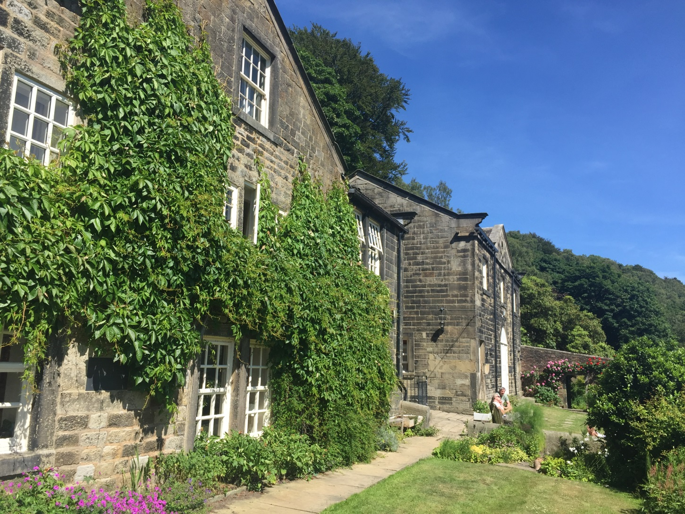
Au revoir to Lumb Bank but not to the Craft of Writing

