Slide 1

The Growth in Grammar Corpus: On Working with Children (but not Animals) Mark Brenchley Phil Durrant Debra Myhill

Slide 2
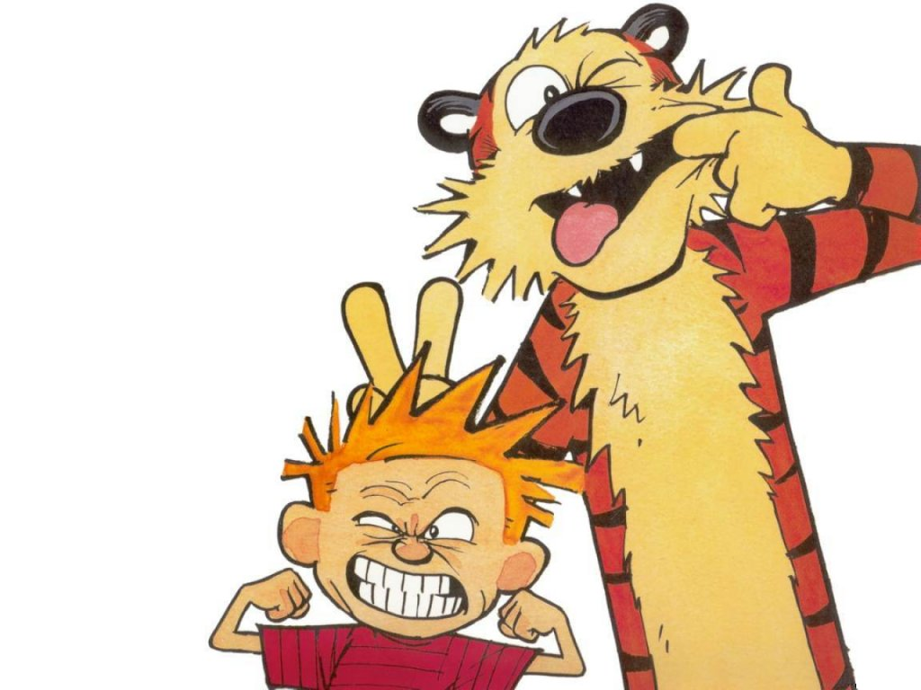
?

Slide 3
Growth in Grammar Project
CONTEXT
Increasing curricular emphasis on grammatical development
Not much contemporary evidence to guide this emphasis
Especially re: quality
No interest in grammatical “accuracy” (at least for now)
Grammar approached as a resource for “meaning-making”

Slide 4
Growth in Grammar Project
RESEARCH QUESTIONS
How does children’s written language change as they get older?
How does it change depending on the quality of the writing?
How does it change according to the kinds of writing asked of students?
Are there differences between how children’s texts group “grammatically” and how they are grouped conceptually?

Slide 5
Growth in Grammar Project
THE CORPUS
Build & (MD-)analyse corpus of “school writing”
Naturalistic: already produced as part of normal classwork
England-wide: north/south, rural/urban, PP/¬PP
3 curricular areas: English, Science, Humanities (History)
4 ages: 6-7, 10-11, 13-14, 15-16
3 attainment levels: “weak”, “average”, “good”
Not “EAL” (i.e. not not-native speakers!)

Slide 6
Where We Are Now
1,200-1,500 texts (out of 6,000)
Mix of primary and secondary
Good mix of primary genres
OK mix of secondary genres
Begun transcription and annotation process

Slide 7
Challenges
“Authentic” vs. “Relevant” vs. “Ethical”

Slide 8
Challenges
Their’s no hope
There’s no hope
Their’s no hope
Exeter School
The School of Exeter
Anon
Anon Anon
Anon
The Anon of Anon

Slide 9
Challenges
“Want” vs. “Can”

Slide 10
Challenges
Subordinate Clause Types
Modifiers per NP
Adverbial Placement
Appositional Structures
Finiteness
Subject-Verb Inversions
Depth of Embedding
Ellipsis
Cohesive Ties
Relative Clause Gap Position

Slide 11
Challenges
“Raw” material (i.e. ¬adult, ¬published, ¬typed)

Slide 12
Challenges

Slide 13
Challenges
Material that varies in kind

Slide 14
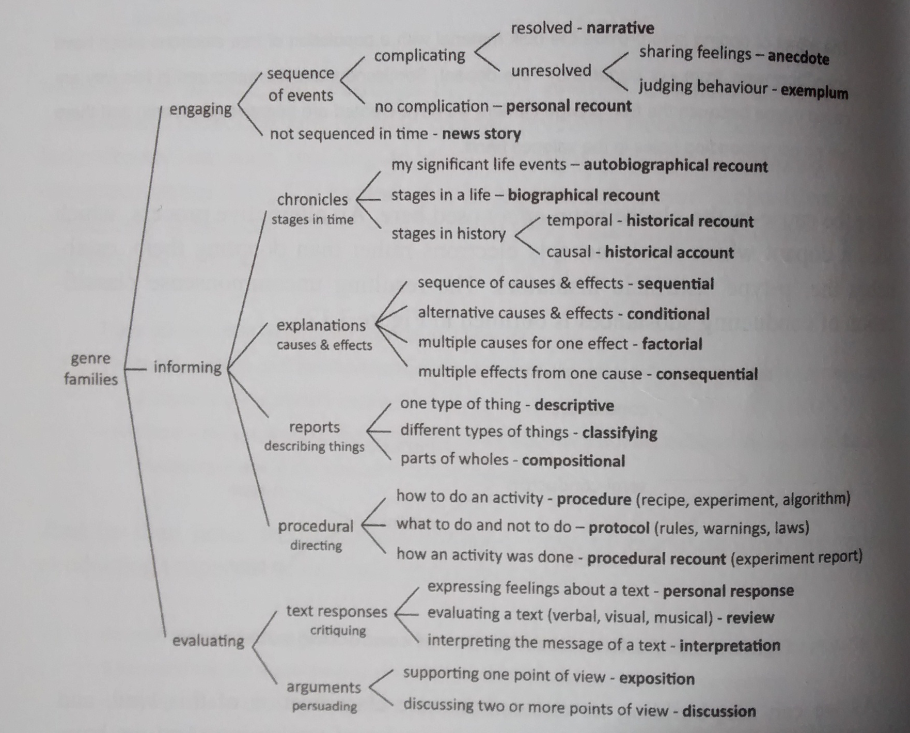
Challenges
Rose & Martin (2012)
Learning to Write, Reading to Learn

Slide 15
Challenges
Material that varies in quality

Slide 16
Challenges

Slide 17
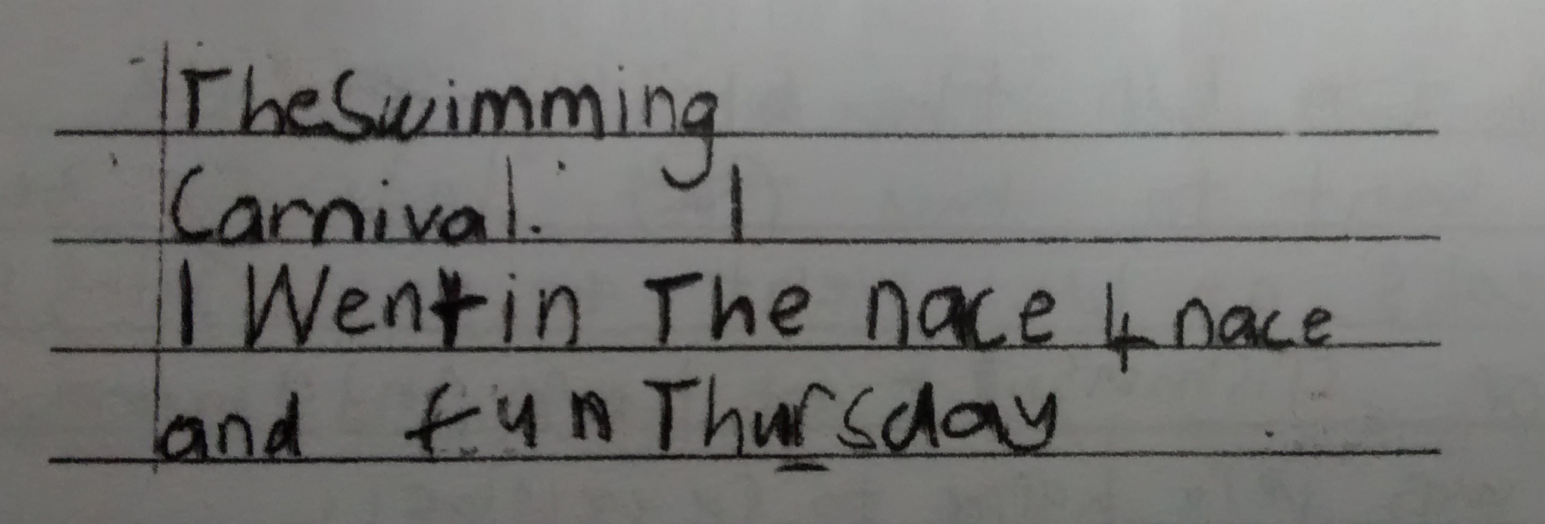
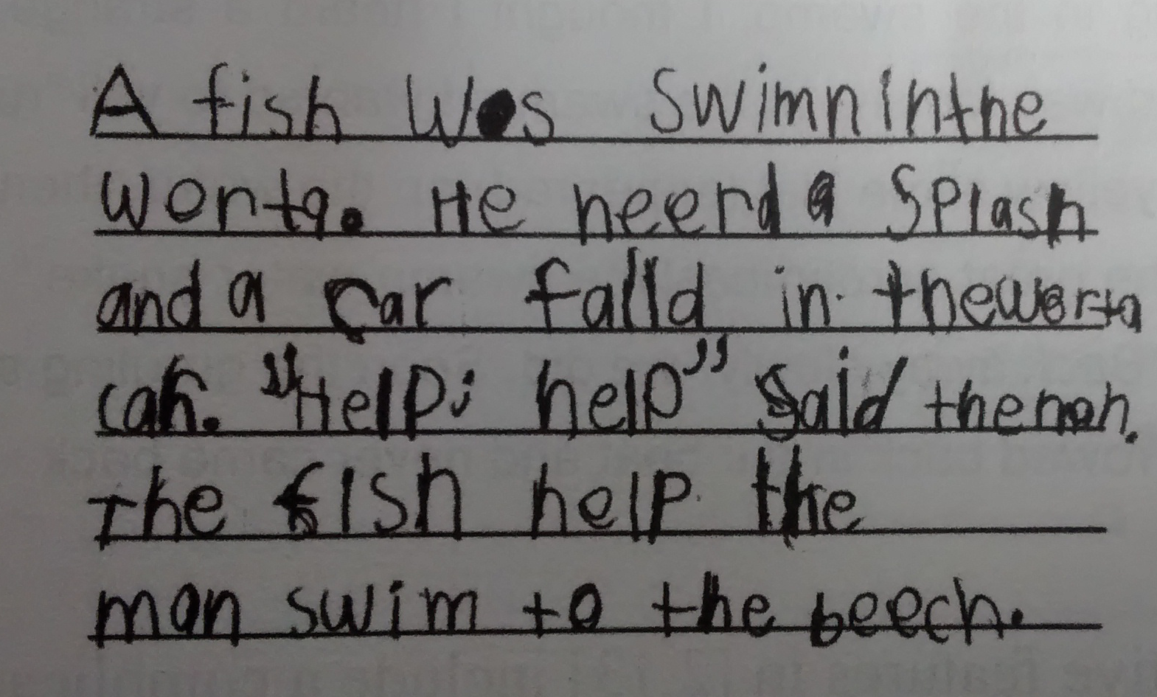
Challenges

Slide 18
Some “Simple” Solutions ?
Anonymise the whole name:
Exeter School → Institution_name
The School of Exeter → Institution_name
Mark up spelling “errors”:
worta → <sp worta>water</sp>

Slide 19
Some Interim Solutions
Mark up grammatically “incoherent” stretches:
They went into to town
→ <garble>They went into to town</garble>
Mark up verb “errors”:
He does loves her
→ He does <gram>loves</gram> her

Slide 20
Some Less Simple Problems ?
PUNCTUATION
I lost. She won. → ROOT; ROOT
I lost, she won. → ccomp(won, lost)
I lost she won. → ccomp(lost, won)
I lost. But she won. → ROOT; ROOT
I lost, but she won. → conj(lost, won)
I lost but she won. → ccomp(lost, won)
I lied. Then I died. → ROOT; ROOT
I lied, then I died. → parataxis(lied, died)
I lied then I died. → ccomp(lied, died)

Slide 21
Some Less Simple Problems ?
PUNCTUATION
Piloted full stop insertion after “independent” clauses
I lost she won → I lost<sent>.</sent> She won.
Definite differences between two versions
Mostly not critical
But some are…

Slide 22
Some Less Simple Problems ?
This isn't coming from taxpayers' money either, it is entirely fundraised.
→ ccomp(fund-raised, coming)

Slide 23
Some Less Simple Problems ?
PUNCTUATION
“Interpretive” Issues
I hope your readers remember that travel broadens the mind<sent ,>.</sent> and that trips like these have been proven to work in the past.
I think he’s great and she’s great.
I think that’s terrible and we should do better.
Make our peace with it?

Slide 24
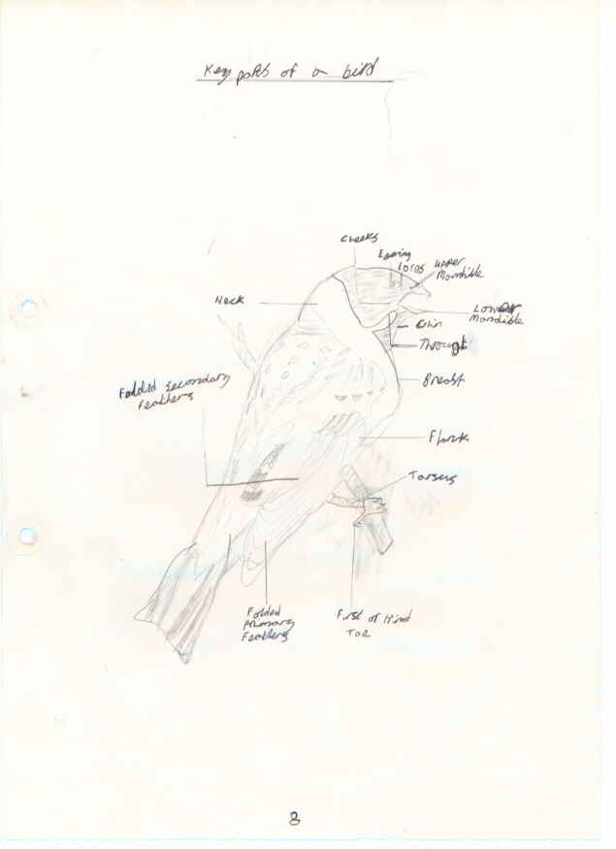
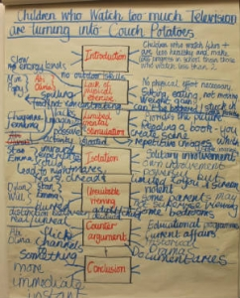
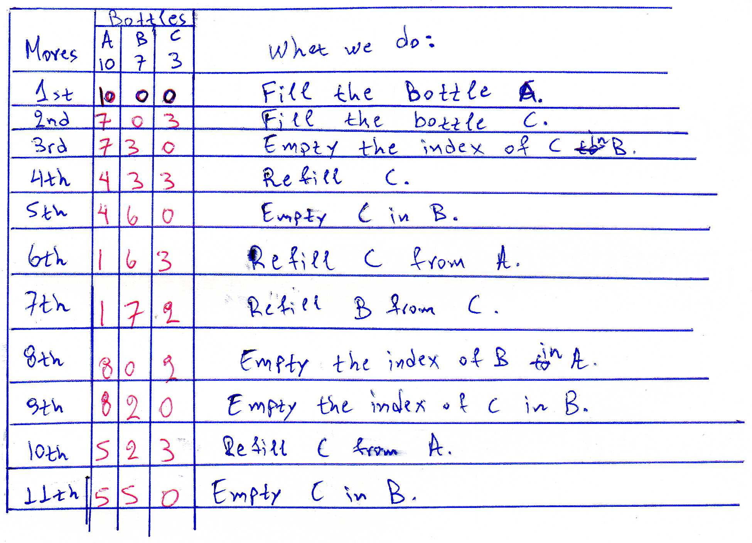
Some Less Simple Problems ?
GRAPHICAL TEXT

Slide 25
Some Less Simple Problems ?
GRAPHICAL TEXT
Laborious to transcribe
Error-prone

Slide 26
<table rows="4" cols="4”>
<head>Features of Birds</head>
<row role="label">
<cell/> <cell>Main colour</cell>
<cell>Has wings</cell>
<cell>Can fly</cell>
</row>
<row>
<cell role="label">Blackbird</cell>
<cell>black</cell>
<cell>yes</cell>
<cell>yes</cell>
</row>
<row>
<cell role="label">Parrot</cell>
<cell>loads!</cell>
<cell>yes</cell>
<cell>yes</cell>
</row>
<row>
<cell role="label">Penguin</cell>
<cell>black and white</cell> <cell>yes</cell> <cell>no</cell>
</row>
<row>
<cell role="label">Seagull</cell>
<cell>white</cell>
<cell>yes</cell>
<cell>yes</cell>
</row>
</table>
 | Main Colour | Has wings | Can fly
Blackbird | black | yes | yes
Parrot | loads! | yes | yes
Penguin | black and white | yes | no
Seagull | white | yes | yes

Slide 27
Some Less Simple Problems ?
GRAPHICAL TEXT
Laborious to transcribe
Error-prone
Grammatically Awkward

Slide 28
Some Less Simple Problems ?
folded secondary feathers root(ROOT, folded-VBN) dobj(folded, feathers)
twitching ears root(ROOT, twitching-VBG) dobj(twitching, ears)
lower beak root(ROOT, lower-JJR) dep(lower, beak)
lower beak nsubj(beak, lower) root(ROOT, beak)

Slide 29
Some Less Simple Problems ?
“CHARACTERISTIC” FEATURES
Need to track the grammatical bases of writing development
Requires identifying two characteristic features:
Different types of discourse – the “genres” of school writing
General later language development, especially re: “quality”
Many such structures not all that straightforward

Slide 30
Some Less Simple Problems ?
FORMULAIC MARKERS
Dear X,
Yours sincerely/faithfully, Y.

Slide 31
Some Less Simple Problems ?
Yours sincerely/faithfully
yours sincerely/faithfully
root(ROOT, yours-NNP) advmod(Yours, sincerely/faithfully)
root(ROOT, yours-PRP$) advmod(yours, sincerely/faithfully)

Slide 32
Some Less Simple Problems ?
Dear Editor, compound(Editor-NNP, Dear-NNP) nsubj(MAIN CLAUSE, Editor)
Dear Sir, compound(Sir-NNP, Dear-NNP) nsubj(COMP. CLAUSE, Sir)
Dear Sir or madam, compound(Sir-NNP, Dear-NNP) nmod:tmod(MAIN CLAUSE, Sir)
dear editor/sir/sir or madam, amod(sir-NN, dear-RB) ccomp(MAIN CLAUSE, editor/sir)

Slide 33
Some Less Simple Problems ?
ISOLATED NPs
folded secondary feathers
twitching ears
lower beak
Clouds of dust as blinding as fog
and the sound of animal roars
dancing around the arena.
The sound of two strong, sturdy,
swords clashing together.
The sound of the gladiators,
declaring war on each other

Slide 34
Some Less Simple Problems ?
ISOLATED NPs
Potentially characteristic of:
narrative fiction
scientific descriptions
poetry
?
“sophisticated” writers

Slide 35
Some Less Simple Problems ?
folded secondary feathers root(ROOT, folded-VBN) dobj(folded, feathers)
twitching ears root(ROOT, twitching-VBG) dobj(twitching, ears)
lower beak root(ROOT, lower-JJR) dep(lower, beak)

Slide 36
Some Less Simple Problems ?
Clouds of dust as blinding as fog
and the sound of animal roars
dancing around the arena.
The sound of two
strong, sturdy, swords clashing together.
The sound of the gladiators,
declaring war on each other.
nsubj(roars-VBZ, clouds)
root(ROOT, roars-VBZ)
xcomp(roars-VBZ, dancing)
amod(sturdy, strong)
amod(sound, sturdy)
dep(sound, clashing)
nsubj(declaring, sound)
root(ROOT, declaring)
root(ROOT, sound)
acl(gladiators, declaring)

Slide 37
Some Less Simple Problems ?
“DISPLACED” AdjPs
The beast, monstrous, ravenous, roamed the house.
He’s a great student, dedicated, hardworking and ambitious.
He is a terrible student – nasty, lazy, stupid.
Monstrous, ravenous, the beast roamed the house.
The beast roamed the house, monstrous, ravenous.
Green, bronze, and golden, it flowed through the weeds.
John chuckled, highly amused.

Slide 38
Some Less Simple Problems ?
“DISPLACED” AdjPs
Potentially characteristic of:
Fiction
?
“sophisticated” writers

Slide 39
Some Less Simple Problems ?
The beast, monstrous, ravenous, roamed the house.
Monstrous, ravenous, the beast roamed the house.
The beast roamed the house, monstrous, ravenous.
appos(beast, monstrous) appos(monstrous, ravenous)
nsubj(roamed, monstrous—JJ) appos(monstrous, ravenous) appos(ravenous, beast)
nsubj(ravenous, house) appos(house, monstrous) xcomp(roamed, ravenous)

Slide 40
Some Less Simple Problems ?
Green, bronze, and golden, it flowed through the weeds
John chuckled, highly amused.
He’s a great student, dedicated, hard-working and ambitious.
He is a terrible student, nasty, lazy, stupid.
dep(flowed, Green-NNP)
conj(Green-NNP, bronze-NN)
conj(Green-NNP, golden)
xcomp(chuckled, amused-VBN)
acl(student, dedicated-VBN)
xcomp(dedicated, hardworking-VBG) conj(hardworking-VBG, ambitious)
amod(stupid, nasty-JJ)
amod(stupid, lazy-JJ)
amod(student, stupid-JJ)

Slide 41
Some Less Simple Problems ?
Maybe not all that much of a surprise – what you’d expect when working with a highly variable, even “deviant” corpus
And maybe we can’t “count” these more problematic features
And maybe that’s not a major problem -
Perhaps too sparse for substantive, reliable counts anyway
BUT

Slide 42
Some Less Simple Problems ?
This isn’t something we yet know, which raises two issues:
First, even if they aren’t pervasive across the corpus generally, they might be pervasive for certain kinds of texts
Science reports
High level science reports
In which case, we will lose our capacity to pick up on some core developmental differences
Perhaps even be the core differences

Slide 43
Some Less Simple Problems ?
Second, the annotations marking these more obviously problematic features also implicated in other features that we might like to measure
But suppose we can’t reliably separate out these annotations when they the mark the problematic features from when they mark these other features
Then these other features also become compromised
In which case, we’ll lose even more of our capacity to pick out those grammatical features that really count in the development of school writing

Slide 44
?

Slide 45
http://socialsciences.exeter.ac.uk/education/research/centres/centreforresearchinwriting/projects/growthingrammar/

