Slide 1

GRAMMAR FOR WRITING ACROSS THE CURRICULUM:
TEACHING SENTENCES
Centre for Writing Research, University of Exeter
© University of Exeter
Notes:
Key message:
Need for explicit teaching of sentence structures that will enable clear thinking and expression for success in your subject.
Grammar focus:
Precise choice of verbs
Summary sentences for clarity eg short, one clause statements of the topic to start or end paragraphs
Co-ordination and subordination for adding detail and signalling relationships between ideas.
See cross-curricular grammar glossary for examples and explanation.

Slide 2
Key Messages
Writing is key to success in all subjects
Academic writing to explain and analyse is particularly challenging for students
Each subject teacher needs to show students explicitly how they can ‘write like an expert’ in that subject
Vocabulary is absolutely key to communicating ideas with precision and accuracy
We can build students’ expert use of vocabulary by explicitly teaching them the key noun phrases and verbs that are necessary for explanation and analysis in a particular topic
Notes:
‘Explicit’ is deliberately repeated here as a precursor to recapping grammar for writing key principles, shown on next slides. Can stress need to be explicit because many students have only vague ideas about how to improve their writing e.g. “I need to add more detail”; “I need to use better words”. Expectation in National Curriculum that teachers at KS3 and KS4 will build on explicit teaching of language features in KS2, including shared grammatical terminology.

Slide 3
Teaching writing explicitly: key principles
Link a grammar feature to its effect in the writing
e.g. show how using a well-chosen noun phrase can convey meaning precisely and succinctly: human-caused climate change; Kruschev’s policy of de-Stalinisation
Use grammatical terms but explain them through examples
e.g. provide a list of modal verbs (can, could, shall, should, will, would, might, must, may) and use them to write an evaluation of a Science method or a Drama performance
Encourage discussion about language and effects
e.g. Compare two opening paragraphs to an argument and decide which is most effective and why
Notes:
Key principles for teaching writing, within which the teaching of vocabulary and sentences can be framed.

Slide 4
Teaching writing explicitly
Use authentic examples from authentic texts
e.g. highlight the noun phrases and verbs used in an artist’s statement explaining their work
Use model patterns for students to imitate
e.g. The use of a short sentence at the start of a paragraph that clearly states the main idea
Notes:
Key principles for teaching writing, within which the teaching of vocabulary and sentences can be framed.

Slide 5
Activities to support students’ understanding and use of noun phrases in explanations
Before reading an explanation text, display some of the noun phrases that carry the main ideas in the text. Ask students to use them in predicting what the text will say.
When you read the text with students, highlight the noun phrases that explain the main ideas in the topic – e.g. by underlining or consistent colour coding.
Summarise the main ideas in a text by writing a title and subheadings for each paragraph. Do this in the form of a noun phrase e.g. Title: Causes of global warming; Paragraph 1: Our use of fossil fuels etc.
Get students to revise a topic by mind-mapping it, using noun phrases to show links between ideas. Encourage them to speak an answer before they write it, using the noun phrases as prompts.
Notes:
Useful strategies for improving subject vocabulary that integrate reading and writing skills.
See the document ‘Cross-curricular teaching activities’ for further suggestions.

Slide 6
Activities to support students’ understanding and use of noun phrases in explanations
Model how to use noun phrases alongside verbs in complete sentences e.g.
Concentrations of greenhouse gases in the atmosphere are increasing, mainly due to our use of fossil fuels.
The problem of human-caused climate change can be tackled.
We chose the design with the least environmental impact.
Notes:
In academic writing, the noun phrase often forms a considerable ‘chunk’ of a sentence; we can model for students how to build sentences around this element.

Slide 7
TEACHING SENTENCES

Slide 8
TASK: Sentence combining: try two different ways of joining each set of sentences into one sentence
A metal reacts with an acid. Bubbles of gas are produced.
William was a good leader. He was ambitious. He was determined. He won the Battle of Hastings.
How do language and thinking work together here?
Which version makes you ‘sound like an expert’ in Science or History?
Notes:
TASK: Try out 2 different ways of combining these sets of sentences into one.
Sentence combining could be a regular starter activity; geared to topic/task underway? It’s a quick way of modelling the kind of thinking required in the subject e.g. In Science – dependency of one thing on another; in History, how one thing causes another.
Which is more expert sounding?
A metal reacts with an acid and bubbles of gas are produced.
Or
When a metal reacts with an acid, bubbles of gas are produced.
Which is more expert sounding?
William was a good leader who was ambitious and determined and he won the Battle of Hastings
OR
William won the Battle of Hastings because he was a good leader who was ambitious and determined.
(or advanced version: William’s good leadership, ambition and determination won him the Battle of Hastings)

Slide 9
Why does this student NOT sound like an expert in Geography?
Using a case study of a quarry you have studied,
describe how it has been managed during extraction
and restored following the extraction of the resources.
(9 marks)
Level 1 (Basic: 1-4 marks)
Trees are planted on edges. Roads are cleaned at night.
The quarry is used for other things like lakes.
Notes:
Use the Geography exam answer to stress how language and thinking go hand in hand.
Basic answer consists of simple, generalised statements, list-like ; separate, disconnected ideas

Slide 10
Why does this student sound more like a Geography expert? Focus on these clauses to help you explain.
Level 2 (Clear: 5-7 marks)
At Hope in Derbyshire, a lot of trees have been planted to
make the quarry and cement works less obvious. Much is
transported by train and traffic on narrow roads in the
countryside is reduced. Road cleaning is arranged to get
rid of dust in immediate area. After an area is finished it is
restored to farming or a different use, such as fishing lakes.
Notes:
Concept of subordination being used to provide important additional detail and clarify timescale of the operation.

Slide 11
Why does this student sound even more like a Geography expert? Focus on these clauses to help you explain.
Level 3 (Detailed: 8-9 marks)
At Lafarge Cement in Hope in Derbyshire, over 75000 trees have been planted to make the quarry and cement works less obvious and make it blend in with the environment. Two and a half million tonnes of limestone that could not be used for making cement have been used to help conceal the entrance by altering the landscape. Much is transported by train, so traffic on narrow roads in the countryside is reduced. Road cleaning is arranged to get rid of dust in immediate area. After an area is finished it is restored to farming or a different use, such as fishing lakes, and a 9- hole golf course has been opened.
Notes:
What makes this a good Geography answer?
Detailed development of statements, response is organised and focussed.
Both aspects are addressed – during and after extraction - in greater balance.
Highlights the grammatical features at sentence level that create this detail and precision

Slide 12
Writing to explain or analyse
Explaining involves the presentation of factual information, rather than opinion, and providing reasons for how or why something happens. An explanatory piece of writing needs to help a reader to understand, and is objective, balanced and accurate. It should have authority so that your reader trusts the explanation given.
Analysing involves identifying the key parts of a topic and discussing their meaning, qualities and inter-relationships in order to be able to discuss the topic as a whole. An analytical piece of writing compares and contrasts, presents arguments and makes judgements. It should be detached and objective, rather than personal.
Notes:
Reminder of key text types common to subjects across the curriculum. As you read the descriptions, ask yourself:
What demands do these text types place on students’ use and control of sentences?
Think of a specific topic/writing task in your subject eg one that you are currently teaching. What demands does it place on students’ control of sentences?
Rest of slides focus on key teaching to develop students’ control over sentences.
See cross-curricular grammar glossary for sentences for examples and explanations.

Slide 13
SENTENCES SUBJECT KNOWLEDGE

Slide 14
Verbs
Verbs drive the meaning of a sentence by expressing an action or a state:
Breath rate and heart rate increase gradually.
This could make his muscles ache but may improve the athlete’s range of movement.
His heart and lungs will need to work harder.
As in the examples above, a verb can be a single word or a string of words. The form of the verb will dictate whether a text is in the present or past tense:
Loneliness is an important theme in ‘Of Mice and Men’; NATO was established in 1949.
Notes:
Examples from PE writing about effects on body of running 5000 metre race.
Remind that verbs are sometimes single words but are often in the form of a verb phrase or verb string. As with noun phrases, you might want to teach subject vocabulary in the form of key verb phrases (to dispose of; can be combined with ; is caused by etc). These will help students add detail to explanations and analyses and strengthen cause and effect connections.

Slide 15
Verbs
Note that the definition of a verb as ‘a doing word’ can be a little misleading because the most common verbs (variations of ‘be’ and ‘have’) are vital for completing the meaning of a sentence but are ‘static’ e.g. NATO is an alliance of countries from North America and Europe.
Modal verbs (can, could, will, would, shall, should, may, might, must) are used with other verbs to express possibilities. They can help students speculate and evaluate, and connect and balance ideas.
This could make his muscles ache but may improve the athlete’s range of movement.
His heart and lungs will need to work harder.
Notes:
Ask: How are modal verbs important to writing in your subject? They are crucial to evaluations (eg suggesting improvements to a design brief) but what about other uses such as speculating about consequences in History?

Slide 16
In your classroom
Teach more formal and precise verbs to replace informal constructions: endure, ruin, omit rather than put up with, mess up, leave out.
Teach the verbs associated with key processes or ways of thinking that are crucial to a subject or a topic, building verbs from nouns to expand vocabulary e.g. migration -migrate; juxtaposition -juxtapose; alliance – ally with; aligned against.
Consider teaching subject vocabulary in the form of key verb phrases (to dispose of; can be combined with ; is caused by etc). These will help students add detail to explanations and analyses and strengthen cause and effect connections.

Slide 17
Improving an answer: what would be better verb choices here?
Adolf Hitler came into power and promised the people of Germany that he would get them back on track.
Notes:
Frequent small-scale modelling of how to improve sentences can be very helpful. Better verb choices for precision and ‘sounding like an expert’ might be: ‘Adolf Hitler rose to power and promised the people of Germany that he would restore the economy/improve their lives.’ Don’t change the sentence structure, just choose more precise verbs.
Example from Edexcel GCSE Modern History mid-range answer.

Slide 18
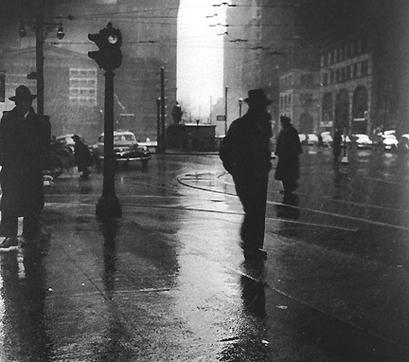
Single-clause (simple) sentences
The detective hurried along the street.
The detective hurried along the rain-swept streets, his hands deep in his pockets.
With his hands deep in his pockets one cold November night, the detective from New York hurried anxiously along the half-deserted, rain-swept streets, a troubled frown on his face.
Most students define a simple sentence as a short sentence. Using the examples, how could you explain that a simple sentence can be any length? How could the term ‘single-clause sentence’ help you do this?

Slide 19
Single-clause sentences
Sentences with only one verb can be good for summing up ideas and for stating factual information precisely and concisely:
During the 5000m race, the athlete’s heart rate increases gradually.
Stalin created Comecon as a response to Marshall Aid.
A supervolcano is a volcano on a massive scale.
Geothermal energy can be generated in volcanic areas.

Slide 20
Improving an answer: write the main points as single-clause sentences
Weaker writers often lose control of their sentences by chaining ideas together so that clarity is lost:
Events in Europe in the years 1945-47 led to the Cold War because Nazi Germany had finally been defeated in 1945 and in that year they held two conferences to decide the fate of Germany in Yalta and Potsdam and some would say that Yalta was a success because they agreed to make a United Nations that would try to uphold peace and democracy in Europe and also because the USSR agreed to help the allies defeat Japan.
Notes:
Answer from mid-range Edexcel GCSE Modern History paper.
TASK: Sort into series of one-clause sentences that will help the writer establish the main points and see what is important detail and what is not e.g.
The fate of Germany was decided in Yalta and Potsdam in 1945.
The Yalta agreement established the United Nations.
The USSR allied with European powers against Japan.

Slide 21
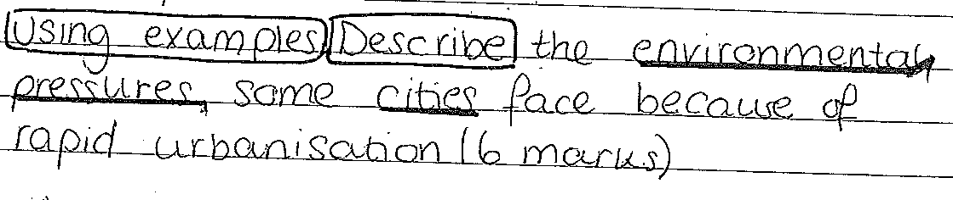
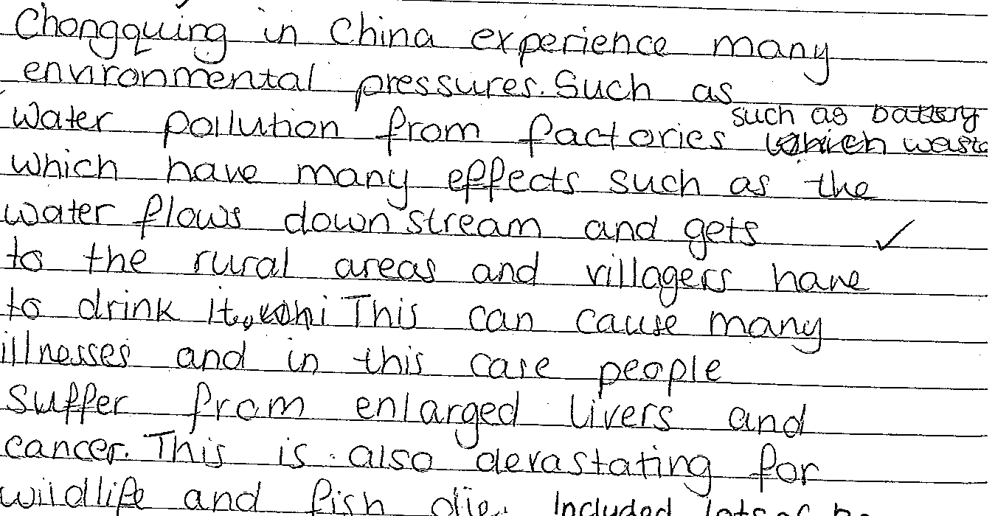
Notes:
The ‘cause and effect’ thinking of this student isn’t strong – really she’s just chaining ideas together by over-using ‘such as’.

Slide 22
‘Top and tail’ a paragraph with a one-clause sentence
Rapid urbanisation causes pressure on the environment. In Chonquing in China for example, water pollution from factories, including battery waste, affects the water supply of villagers living downstream, causing serious health problems and cancers. Wildlife is devastated and food supplies such as fish are threatened. Strict environmental controls are needed.
Notes:
Starting and ending a paragraph with summary single-clause sentences helpfully keeps the topic firmly in view. Summary sentences like these can act as important cohesive links between paragraphs, guiding the reader through a longer answer.

Slide 23

TASK in pairs: Try at least 3 different ways of joining the main clauses to the subordinate clauses. Which sentence sounds the scariest as the opening to a ghost story?
slowly decaying
the house seemed empty
its windows boarded up
covered with ivy
smiling
holding a flickering candle
a woman stood in the doorway
beckoning me to follow her
©Mornixuur.nl
Notes:
Short task to try.
Cross-curricular objective might well be:
Emphasise important information by altering the position of main and subordinate clause in a sentence. An activity like this one could be easily adapted to make it subject-specific eg in Geography
Although expanding the bauxite industry may benefit the economy in the short term, tourism is the more promising and reliable option.
Or Science
When a metal reacts with an acid, bubbles of gas are produced.

Slide 24
Subordination
Signals relationships between ideas and how one thing is dependent on another. Two useful constructions to teach are:
the use of clauses beginning with subordinating conjunctions such as: if, because, since, despite, although, while, when to support explanation and analysis:
Once the war was over, the wartime camaraderie of America and the USSR quickly deteriorated.
Adolf Hitler rose to power because he promised economic growth.
Use of relative clauses to provide additional factual detail within a sentence, using who, which, that , whose to relate information back to the noun e.g. The Yalta and Potsdam conferences, which decided Germany’s fate at the end of the war, were marked by disagreements between the Allies.

Slide 25
Sentence types and writing development
The tendency to over-use co-ordination is more typical of lower and middle ability writers. This may reflect speech patterns which are naturally more heavily co-ordinated; or it may reflect a focus upon conveying narrative action without considering the relationships between ideas that can be expressed through subordination.
Using subordination allows the relationship between clauses to be more explicit: it can represent a move from chaining ideas together (with and or but) to showing explanatory or causal links.
Using subordination results in varying the structure of the sentence, which can add to its impact on the reader e.g. by foregrounding important information.
Using subordination often invites the use of more sophisticated internal sentence punctuation.

Slide 26
Better sentence control connects ideas more securely
Chonquing in China experiences many environmental pressures such as battery waste from factories which affects villagers in downstream rural areas by polluting their water supply.
Notes:
Better sentence control avoids ambiguity and connects ideas more succinctly and securely, as in the example above which is more specific about the effects of discharged battery waste.

Slide 27
TASK: Describe the sentences used in this GCSE History answer and explain how successful they are in making the student ‘sound like an expert’.
Stalin created Comecon as a response to Marshall aid. The USSR prevented Eastern europe from taking marshall aid and so gave them funds and other materials from the USSR as well. Comecon also helped Stalin and the USSR solidify power in Europe while preventing them allying with America by taking Marshall Aid.
Can you comment on:
verb choices
how detailed information is included
how ideas are linked
how fluency and clarity might be improved
Notes:
In your own classroom, what use might you make of examples of students’ writing like this and the previous Geography one? What works well in the example above:
A clear and direct one-clause sentence that states the topic
Appropriately formal and precise verb choices eg: created, solidify, allying
Simultaneous and directly linked ideas stressed through subordination (while allying with…)
To improve:
Co-ordinated clauses (prevented…and so gave…) don’t quite make clear the sequence of events or links between them
Could benefit from final sentence that ties it together eg Thus Comecon strengthened the USSR’s security and its economy.

Slide 28
PLENARY

Slide 29
Teaching writing explicitly
In terms of your own subject knowledge, what might you need to develop in order to teach students explicitly how to improve their explanations or analyses?
What further support might you need?
Exeter’s grammar website is very useful and accessible: www.cybergrammar.com
Notes:
Literacy links in schools need to know how department staff can best be supported in developing confidence in their explicit teaching of subject vocabulary.

