Slide 1

Y7 Language Detectives
Investigating how language works: text cohesion

Slide 2
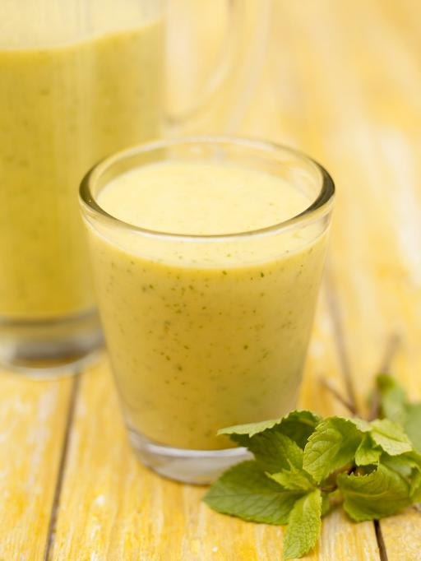
Give it all a good whizz until smooth.
Taste, and if you’ve got a sweet tooth, add a sprinkling of brown sugar or honey and give it another quick whizz.
Place the fruit in a blender or food processor, along with any juice left on the chopping board.
Chill in the fridge before serving, then garnish with a few mint leaves.
Remove the skin from 2 large, ripe mangoes and cut the juicy flesh off them.
Add 150 ml of semi-skimmed milk, the zest and juice of 1 lime and 1 handful of ice cubes.
Notes:
Show jumbled order of instructions for making mango cooler (from www.jamieoliver.com)
Pairs: Decide correct order of instructions. Note the clues you use to help you decide.
You could ask students to do this as a group of four – 2 observers to join each pair and make notes on discussion, then feedback as below:
Feedback correct order and clues used: which were the most important ones?
Order is: 5, 3, 6, 1, 2, 4
You can use the next slide to focus this feedback.

Slide 3
Jamie’s Mango Cooler
Remove the skin from 2 large, ripe
mangoes and cut the juicy flesh off them.
Place the fruit in a blender or food
processor, along with any juice left on
the chopping board. Add 150 ml of semi-
skimmed milk, the zest and juice of 1 lime
and 1 handful of ice cubes. Give it all a
good whizz until smooth. Taste, and if
you’ve got a sweet tooth, add a sprinkling
of brown sugar or honey and give it
another quick whizz. Chill in the fridge
before serving, then garnish with a few
mint leaves.
Notes:
Slide shows original presentation of instructions for making mango cooler (from www.jamieoliver.com)
Discuss with students without getting bogged down in too much detail, some main ways in which this text holds together and is sequenced clearly. Highlight:
The title for the recipe which makes it clear what the topic is.
Key topic words and how they are linked to each other: mango - ripe mangoes – the fruit – juicy flesh – any juice left – highlighted in green
Pronouns which refer back (anaphoric reference is the technical term for this) – them referring back to mangoes; it all and it referring back to the total mix of ingredients – highlighted in blue
Adverbs that signal temporal sequence: another, before, then – highlighted in brown
Logical sequence of actions in imperative verbs – remove, add, taste, chill – highlighted in red

Slide 4
Terminology check
Nouns are words for things, people, places, or states of mind or existence – so they are the most common word class or type e.g. mangoes, fruit, juice
Pronouns are words like they, we, it, these, those, which stand in for the nouns they refer to. Determiners like your, our, their are used with nouns to specify who or what is being referred to
Verbs are the words in a sentence that refer to actions or states of being e.g. remove, add, chill
The recipe uses imperative verbs which instruct you what to do
Notes:
If needed, do a quick check of understanding of key terms used so far that will also be used in the next activity. Colour coding used here is also used on next slide.

Slide 5
How can we link and sequence ideas in non-fiction writing so the reader can follow them clearly?
“Imagine a world where children were fed tasty and nutritious real food at
school from the age of 4 to 18. A world where every child was educated about
how amazing food is, where it comes from, how it affects the body and how it
can save their lives.” – Jamie Oliver
Our Food Revolution Toolkits are designed to inspire you to start a food
revolution in your school and help ensure kids get real food on their lunch trays.
These toolkits arm you with facts, empower you with ideas, and support you in
making real change on the ground. They are meant to be used, printed, shared
and passed on! Together we have an opportunity to support schools in making
sustainable change.
How are ideas linked and sequenced clearly across this text?
  by repeating and linking key nouns
  by using pronouns that refer back and determiners that specify who or what is being referred to
  by using key verbs in a logical order
Notes:
Stress that in continuous prose, the kind of cohesive language devices that you’ve just been talking about are essential for us to be able to follow ideas clearly, especially when these ideas and the vocabulary in texts are quite complex.
Show the text from Jamie Oliver’s campaign to get healthy eating into schools.
There are several ways of organising responses to the question shown on the slide, using mix of whole class, paired and individual work, according to how much support they need. E.g. Ask students to scan the text to find how often the key nouns in the text (children, food and schools) are repeated and where synonyms for these are used. They could do this in pairs, each pair given one key noun, or do as whole class.
Highlight how these are spread across the whole text and often linked in the same sentence e.g. “...to start a food revolution in your school and help ensure kids get real food on their lunch trays.”
The slide picks out examples of each kind of cohesive tie, to get them started. Ask them to find others that do the same job.
Don’t overdo the comment and analysis – aim for a few clear points and examples but stress how the cohesion works across the whole text.
Feedback examples but concentrate on explaining an answer to the bullet point question on the slide – this can be an extended oral or written response.

Slide 6
Feedback: How can we link and sequence ideas in non-fiction writing so the reader can follow them clearly?
“Imagine a world where children were fed tasty and nutritious real food at
school from the age of 4 to 18. A world where every child was educated about
how amazing food is, where it comes from, how it affects the body and how it
can save their lives.” – Jamie Oliver
Our Food Revolution Toolkits are designed to inspire you to start a food
revolution in your school and help ensure kids get real food on their lunch trays.
These toolkits arm you with facts, empower you with ideas, and support you in
making real change on the ground. They are meant to be used, printed, shared
and passed on! Together we have an opportunity to support schools in making
sustainable change.
How are ideas linked and sequenced clearly across this text?
  by repeating and linking key nouns
  by using pronouns that refer back and determiners that specify who or what is being referred to
  by using key verbs in a logical order
Notes:
Use for feedback discussion about key ways in which ideas are linked and sequenced.

Slide 7
How can we link and sequence ideas in non-fiction writing so the reader can follow them clearly?
The ideas in this text are muddled and confused. Can you improve it?
Too many people are overweight. They should serve healthy food at school.
It isn’t good for us. Fresh fruit and salads would be better than that. They serve
chips and stuff in the canteen. Our menus need to change.
Concentrate on linking and sequencing ideas clearly across the text
  by repeating and linking key nouns
  by using pronouns and determiners that refer back and specify who or what is being referred to
  by using key verbs in a logical order
Notes:
Consolidate: Ask: what is the topic? Get students first to sequence the ideas in a more logical order, then to look at how the key nouns can be strengthened for clarity. Check that pronouns refer back to the right nouns.
Extend: Ask students to write a short text of their own on the topic of healthy eating at school. This could be sent to the Headteacher to launch a ‘food revolution’ in their own school.

Slide 8
Feedback: How can we link and sequence ideas in non-fiction writing so the reader can follow them clearly?
Too many schoolchildren are overweight. At our school, the food that is served in the canteen is not healthy enough and the menus need to change. We should be served nutritious fresh fruit and salads instead of chips and burgers.
Notes:
If needed, use to model the task or to focus feedback e.g. by asking students to compare their own version with this one.

