Slide 1
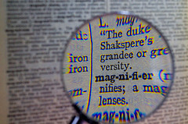
Y7 Language Detectives
Investigating how language works: varying sentence length

Slide 2
Shark attack!
The great fish swam slowly. It followed the shoreline. Now it turned.
The boy was resting. His arms dangled down. His feet and ankles dipped in and out of the water. He was not afraid. The water was calm. He wasn’t really far from shore. But he wanted to get closer. He began to kick. He paddled towards shore.
The fish saw the bubbles. It followed the boy. It was underneath the boy’s lilo.
Then it struck.
Notes:
Ask pairs to read the story aloud. Do they recognise it as a version of Jaws?
Explain that this is not the author Peter Benchley’s original version but one written by a school student who has been taught that short sentences create tension in fiction writing – but they’ve overdone it!
Ask why this writing is actually quite dull rather than exciting. You could ask students to count how many words there are in each sentence so they can see that they are mostly of similar length. Point out other problems e.g. repetition of ‘he’ and ‘his’; repetition of subject+verb patterns; monotonous rhythm and pace when read aloud as a result of these things.
Task in pairs: In order to improve this writing, the student has been told to use a better mix of short and long sentences. They are allowed to keep two of the short sentences. Suggest which two sentences they should keep and explain why.
Take brief feedback if you like but students will return to this slide in a little while so you might want to save discussion for later.

Slide 3
How can writers vary the length of sentences to create tension in fiction writing?
Read the extract from Jaws by Peter Benchley. At the seaside, a boy is floating on his lilo, unaware
that a shark is moving towards him underwater...
The boy was resting, his arms dangling down, his feet and ankles dipping in and out of the water
with each small swell. His head was turned towards shore, and he noticed that he had been carried
out beyond what his mother would consider safe. He began to kick and paddle towards shore. His
arms displaced water almost silently, but his kicking feet made erratic splashes and left swirls of
bubbles in his wake.
The fish did not hear the sound, but rather registered the sharp and jerky impulses emitted by
the kicks. They were signals, faint but true, and the fish locked on them, homing.
The boy stopped for a moment to rest. The signals ceased. The fish slowed, turning its head
from side to side, trying to recover. The boy lay perfectly still, and the fish passed beneath him,
skimming the sandy bottom. Again it turned.
The boy resumed paddling. He kicked only every third or fourth stroke; kicking was more
exertion than steady paddling. But the occasional kicks sent new signals to the fish. The fish rose.
Nearly vertical, it saw the commotion on the surface. There was no conviction that what thrashed
above was food, but food was not a concept of significance. The fish was impelled to attack: if what
it swallowed was digestible that was food; if not, it would later be regurgitated. The mouth opened,
and with a final sweep of the sickle tail, the fish struck.
Notes:
Read aloud the extract from Jaws by Peter Benchley. Ask students to listen for the way the pace and rhythm of the sentences varies; and the balance between longer sentences are shorter sentences. Take brief feedback eg by asking where the pace is slowest, and where it quickens the most.
In pairs, ask students to locate the three shortest sentences used in the extract.
Paired discussion:
Why might Benchley have chosen to make these three sentences so short?
What part do they play in the narrative structure of this incident?
How well do you think the work in creating tension for the reader?
Share ideas as a whole group.
If you like, you could ask them to locate the 2 longest sentences and repeat the questions.
Draw out the subtlety of the writing and the sparing use of very short sentences at key moments of tension in the narrative:
Shortest sentences: The signals ceased. Again it turned. The fish rose.

Slide 4
Shark attack!
The great fish swam slowly. It followed the shoreline. Now it turned.
The boy was resting. His arms dangled down. His feet and ankles dipped in and out of the water. He was not afraid. The water was calm. He wasn’t really far from shore. But he wanted to get closer. He began to kick. He paddled towards shore.
The fish saw the bubbles. It followed the boy. It was underneath the boy’s lilo.
Then it struck.
Notes:
In the light of discussion of the Jaws extract, look again at this version. How would they redraft it to create better sentence rhythms, pace and tension?
Ask students to change the text by combining some sentences into longer ones and leaving some short. Keep to the same words as far as they can (i.e. don’t add in adjectives and adverbs; just concentrate on varying length of sentences)
You can use this as a chance to model how to combine some of the sentences and which to keep short for tension.
Students can ‘speak’ their revised version or write one.
If helpful, provide a list of co-ordinating conjunctions (and, but, or) and subordinating conjunctions (e.g. while, as, since, so that, as if)
Encourage students to try two different versions of their revised text and to evaluate: which version is best at creating tension.
Consolidate: Ask students to carry on the story from this point, in their own words, writing one more paragraph where the aim is to use a mix of longer and short sentences to maintain/heighten tension. Encourage them to read their writing aloud to hear its rhythms. Get them to count the longest and shortest sentences used and to highlight these in their writing.
Extend: use photograph on next slide as stimulus for own opening paragraph to a short story in which aim is to deliberately vary sentence length to create tension. Tip - start in mid-action, writing the scene shown in the photograph rather than leading up to it.
Pairs/fours: Read each other’s paragraph and provide feedback: which one sentence is ‘best’ in terms of creating tension for the reader? Where in the paragraph is this sentence placed? Could it have been placed anywhere else to create more tension?

Slide 5
Shark attack!
The great fish had been swimming slowly, following the shoreline.
But now it turned.
The boy was resting, with his arms dangling down and his feet and ankles dipping in and out of the water. He was not afraid because the water was calm and he wasn’t really far from shore, but he wanted to get closer so he began to kick, paddling towards shore.
Seeing the bubbles, the fish followed the boy, until it was underneath the boy’s lilo.
Then it struck.
Notes:
If you like, you can use this slide to model the task or to focus feedback, e.g. by asking students to compare this version with their own, and to be specific about the nature of the changes that have been made.

Slide 6
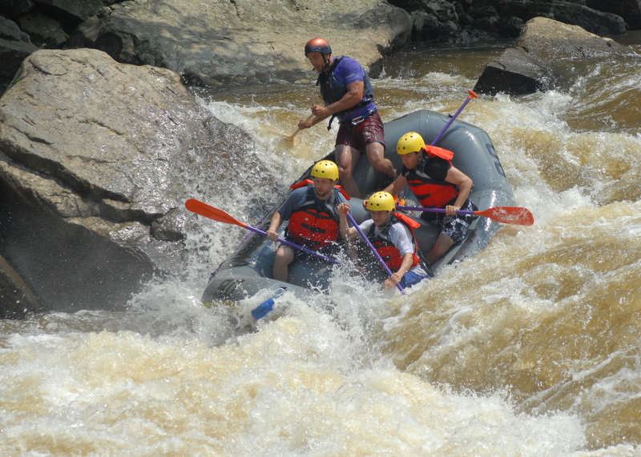
Notes:
Consolidate and Extend: Use the image to gather vocabulary and ideas for one paragraph of students’ own fiction writing in which the aim is to vary sentence length to create drama and tension. You can make this a shared writing session or independent work.
Suggest they start in ‘mid-action’ as suggested by photograph. Establish whether they will use first or third person and present or past tense.
To support further, you could provide three short sentences based on the image and ask students to include within their paragraph, deciding at which points to include them, e.g.
Then the raft flipped.
Rocks loomed up.
There was no time to shout.

