Slide 1
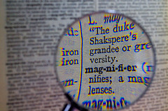
Y8 Language Detectives
Investigating how language works: using comparisons in descriptions

Slide 2
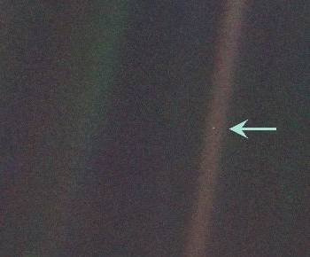
What is this?
Notes:
Think, pair, share – what might this photograph show?

Slide 3
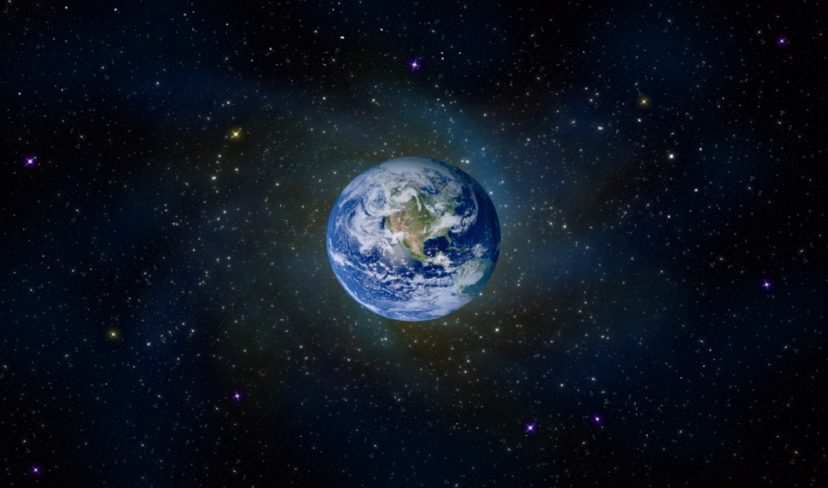
Look at the photographs of Earth as seen from space and read the astronauts’ descriptions.
Which description paints the best picture for you? Explain your choice.
A | Earth: a small, bubbly balloon hanging delicately in the nothingness of space. (Alfred Worden)
B | ...the size of a marble, the most beautiful you can imagine. That beautiful, warm, living object looked so fragile, so delicate, that if you touched it with a finger it would crumble and fall apart. (James Irwin)
C | ...a sparkling blue and white jewel, a light, delicate sky-blue sphere laced with slowly swirling veils of white, rising gradually like a small pearl in a thick sea of black mystery. (Edgar Mitchell)
Notes:
Photos of earth from space taken by Voyager 8.
Read the three astronauts’ descriptions of earth seen from space.
Pairs: discuss which of the three descriptions works best for them and why.
Feedback selectively – push for explanations of choices and why specific words or phrases work well, or not.

Slide 4
How do writers create effective descriptions using comparisons?
Earth: a small, bubbly balloon hanging delicately in the nothingness of space.
In this comparison, the earth seen from space is compared to a suspended balloon. For a comparison to ‘work’ for the reader, the two different objects being compared need:
  Something similar e.g. shape, size, texture, actions
  Something that is different enough to surprise you or make you think
What is similar between Earth and a balloon?
Both have a round shape; both seem to float or drift in space
What is different enough to surprise you or make you think?
Why ‘bubbly’? Might this suggest another comparison, between a balloon and a bubble, and how fragile both are – (bubbles and balloons easily pop)? Is the idea that the Earth is fragile and delicate too, vulnerable and easily destroyed?
Notes:
Briefly discuss as a whole class. Invite first impressions/reactions re. connotations and stress that there aren’t right/wrong answers - ‘bubbly’ might be linked to the idea of balloons for celebrations and joyfulness – a way of suggesting the beauty of the earth? Stress the non-literal nature of these suggestions – figurative language if used well should make us think of different possibilities and not necessarily be able to pin them down to one thing.

Slide 5
How do writers create effective descriptions using comparisons?
Earth...a sparkling blue and white jewel...
...a small pearl in a thick sea of black mystery...
….a light, delicate sky-blue sphere laced with slowly swirling veils of white…
In each comparison:
What is Earth compared with?
What is similar about the objects?
What is different enough to surprise you or make you think?
Notes:
Ask individuals/pairs to choose one of these comparisons and answer the questions on it. Could ask for written explanation – e.g. short analysis paragraph and offer frame for this e.g.
By saying (“quotation”) the writer is comparing the Earth to... What these objects have in common is...The comparison is surprising because...
OR Use a Venn diagram to plot points of similarity or contrast – e.g. write ‘Earth’ in left circle, write ‘pearl’ in right circle and list features of comparison in overlap e.g. a sphere, precious, glows
Consolidate: Return to students’ initial writing in response to astronaut’s description of the Earth. Invite to redraft, extend, polish for display.
Extend: Ask students to describe another object, using comparisons to bring out what is unusual and striking about it e.g. see slides 6 and 7. A possible focus for comparison is suggested in the questions asked on each slide, but students needn’t be limited to these.

Slide 6
Looking more closely: what language choices have been made?
Choosing nouns carefully:
a small bubbly balloon the size of a marble
the nothingness of space a small pearl
a sea of black mystery
Choosing adjectives carefully:
a small, bubbly balloon
that beautiful, warm, living object
so fragile, so delicate a sparkling blue and white jewel
Choosing verbs and adverbs carefully:
hanging delicately rising gradually laced with veils of white
if you touched it….it would crumble and fall apart
Notes:
Use the examples to lead a discussion of linguistic choices, showing how the comparisons are put together. Use the term noun phrase if helpful. Use the terms metaphor and simile if helpful.

Slide 7
Write your own description of earth seen from space. You can use any of the ideas or words in the descriptions below, or invent your own. Think: What am I comparing the Earth with? What is similar about the objects? What is different enough to surprise my readers or make them think? What language choices make my description work well?
A | Earth: a small, bubbly balloon hanging delicately in the nothingness of space. (Alfred Worden)
B | ...the size of a marble, the most beautiful you can imagine. That beautiful, warm, living object looked so fragile, so delicate, that if you touched it with a finger it would crumble and fall apart. (James Irwin)
C | ...a sparkling blue and white jewel, a light, delicate sky-blue sphere laced with slowly swirling veils of white, rising gradually like a small pearl in a thick sea of black mystery. (Edgar Mitchell)
Notes:
Write in pairs. You could invite them to use any of the words/phrases in the descriptions but to mix and match in a new way. You can invite students to imitate the form of description A, for example:
Earth: a fragile speckled egg, delicately placed on a black cloth, its shell patterned with swirls of blue and white.
Make this a short, timed task – one sentence or an expanded noun phrase is fine.
Share in 4s and provide feedback which answers the questions on the slide. Encourage students to be as specific as possible here, supporting comments with examples.

Slide 8
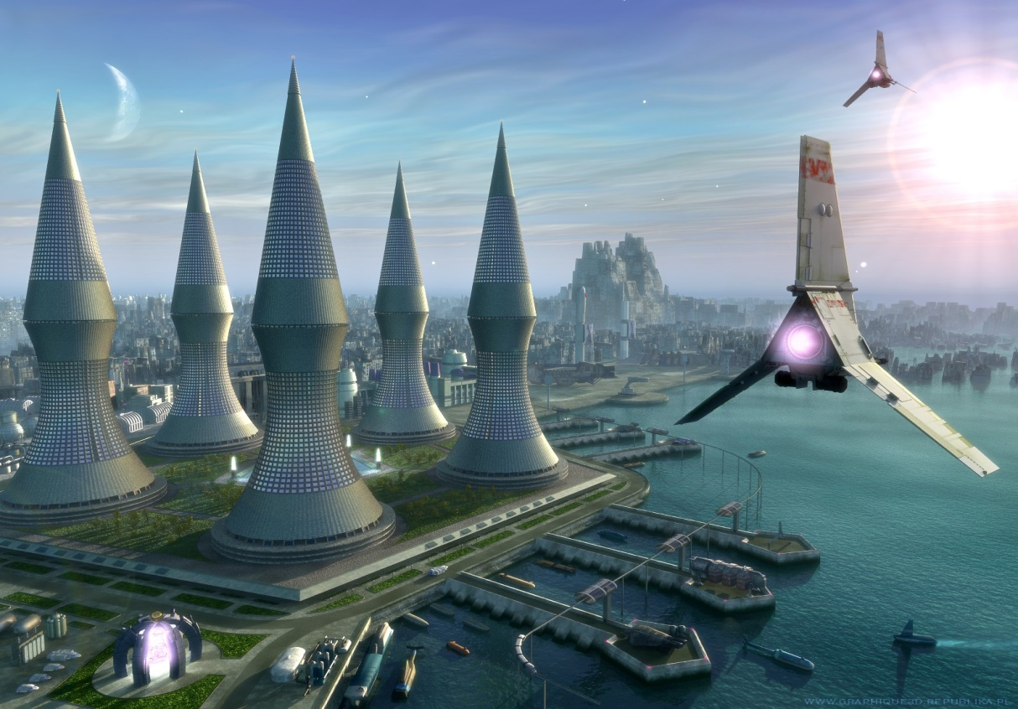
Describing a strange new world
Can you describe this strange new world by using comparisons and choosing language carefully? You can name the new world if you like.
Think: What am I comparing this new world with? What is similar about the objects? What is different enough to surprise my readers or make them think? What language choices will make my comparison work well?
Example:
Futuris: huge steel buildings, arranged like pieces on a chess board, pierce the sky, while mechanical birds hover and swoop overhead.
Notes:
Consolidation/extension: you can make this a more extended response but again the emphasis is on careful choices and evaluation of them, rather than on length. You could add to the model example or use words from it in different combinations.

